Slide 1
Can animals be nice?
Reading

Slide 2
Write ten things...
...that are blue
...that smell bad.
Irregular verbs.
...that smell good
...that are round
Adjectives.
...that are yellow.
Adverbs.

Slide 3
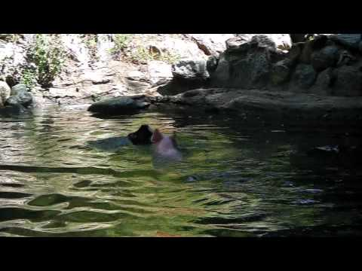
What’s happening in the video? Think of adjectives to describe the pig.

Slide 4
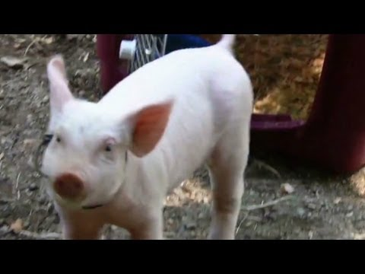
What do you think of the pig now? Were your adjectives correct?

Slide 5
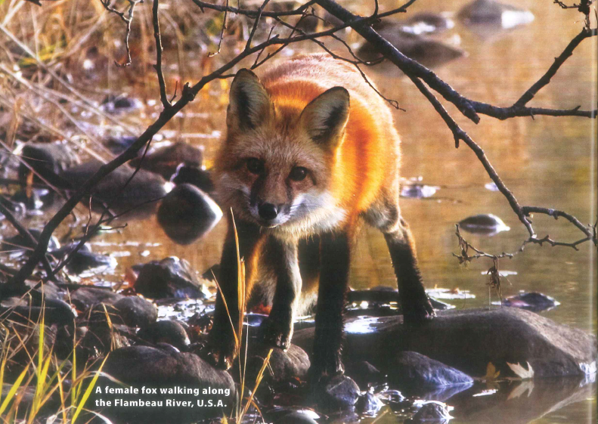
Talk to your partner:
Do you think animals can be nice? If so, give an example.

Slide 6
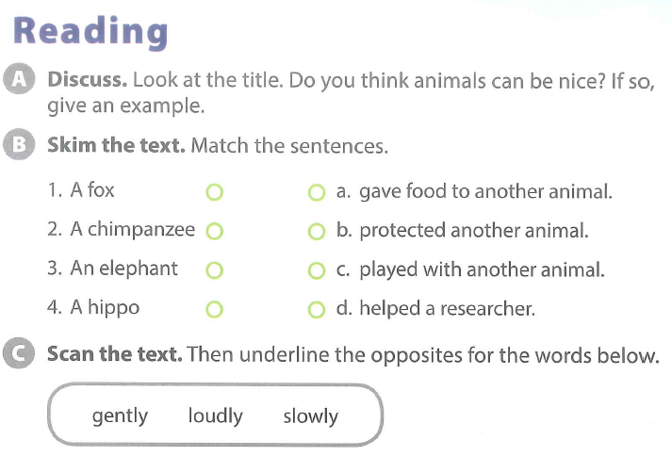

Slide 7
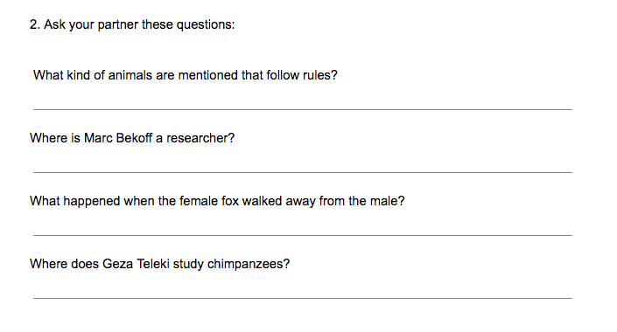

Slide 8
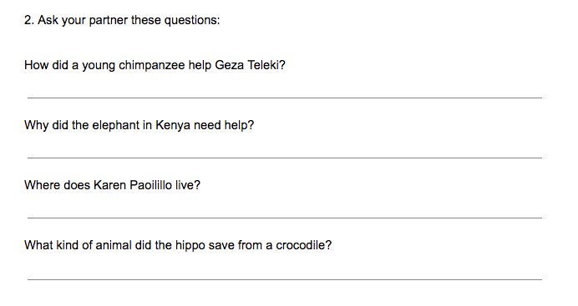

Slide 9
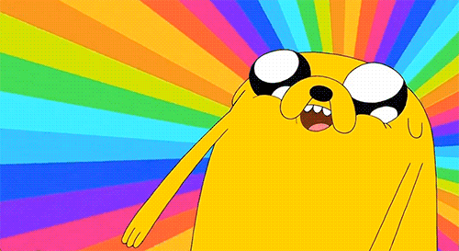
BREAK TIME

Slide 11
S3A Unit 5 Lesson 1
I’m Meeting Friends Later

Slide 12
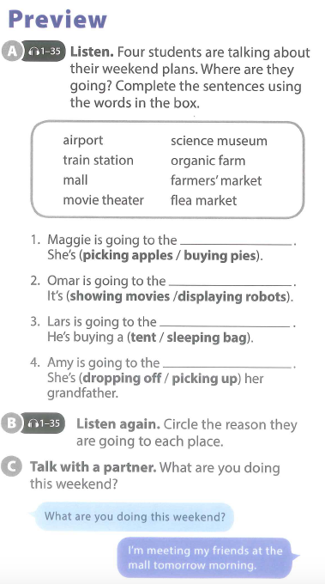

Slide 13
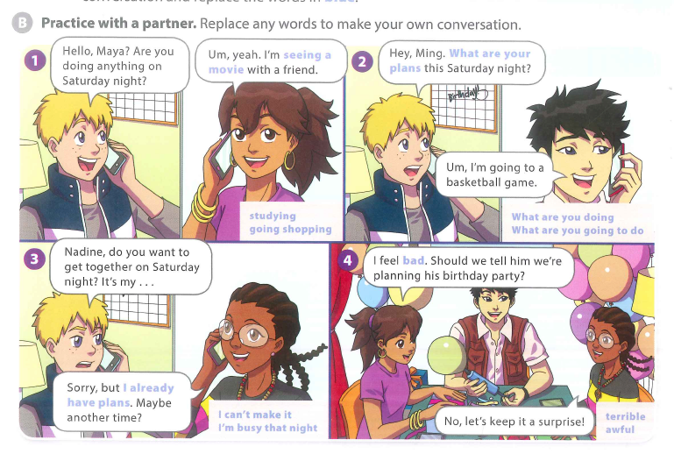

Slide 15
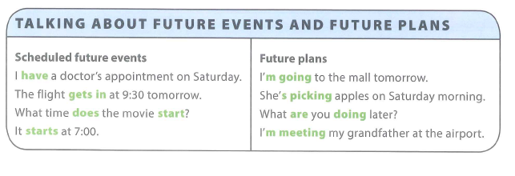
Using the present simple tense to talk about the future
Using present continuous tense to talk about the future.

Slide 16
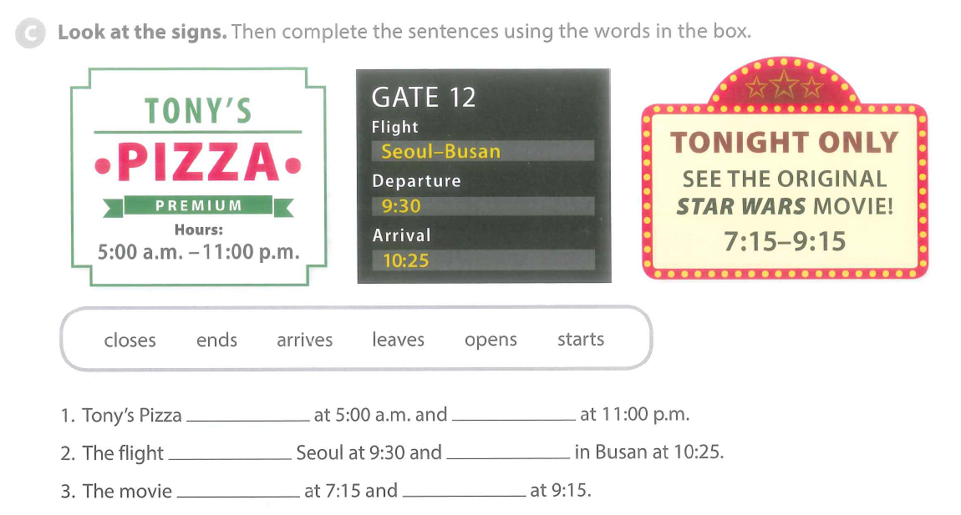

Slide 17
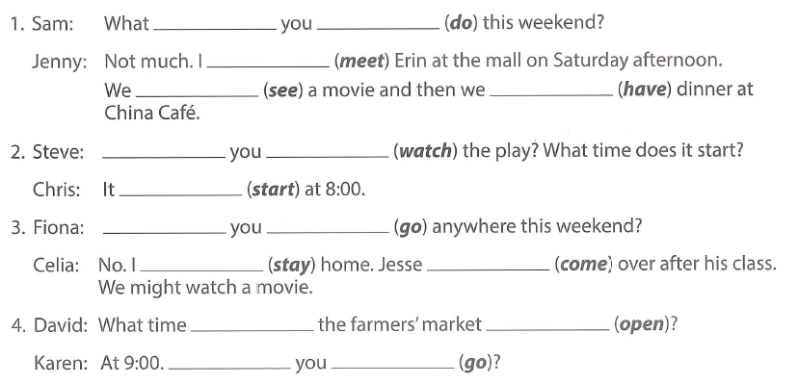

Slide 19
BREAK TIME

Slide 20
Project 3

Slide 21
SCIENCE
Reuse & Recycle
Driving Question
How can we make rubbish useful?
Project Outline
Discuss what dangers face the earth and what will happen to the earth, if we do not change.
Plan ways for you to help the earth.
Research Vietnam’s recycling habits.
Create a way to turn rubbish into something useful in Vietnam.
Present it to your class.
Tools: 3DTin / Canva

