Slide 1
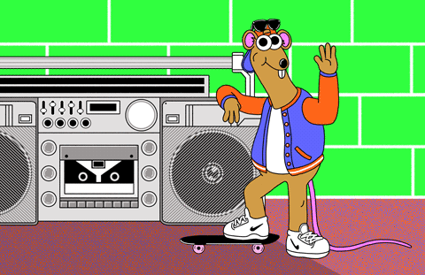
WELCOME CLASS S3A!

Slide 2
NAME 5 THINGS GAME!!!!

Slide 3
Capital Cities

Slide 4
Cartoon Characters

Slide 5
Musical Instruments

Slide 6
Mammals

Slide 7
Countries in Europe

Slide 8
Types of emotion/
feelings

Slide 9
Social Media Websites

Slide 10
Things you wear on a cold day

Slide 11
Animals that eat vegetables

Slide 12
Nationalities

Slide 13
Classroom rules!
If you set the rules, you’ll stick to them.
Rules!
Rewards! :)
Punishments :(
Notes:
Students decide class rules together.

Slide 14
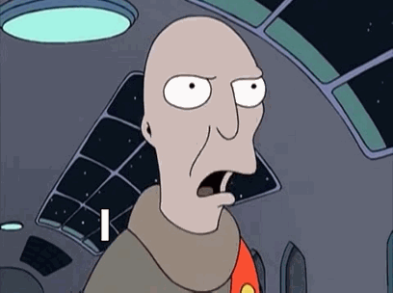
Student Survey...

Slide 15
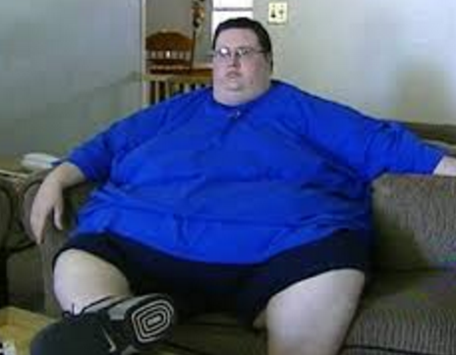

Slide 17
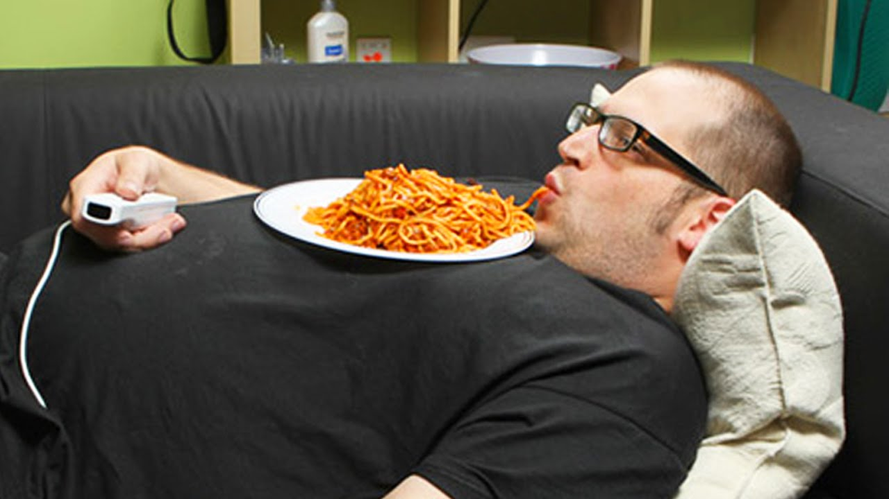

Slide 19
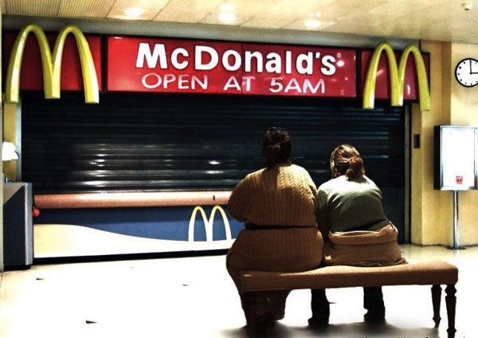

Slide 20
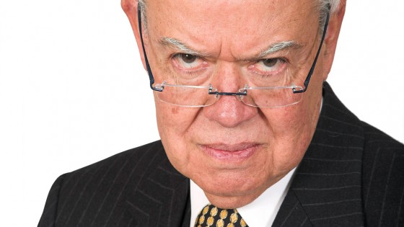

Slide 22
DICTOGLOSS!
Book Covers
1. People vary greatly in the way they look and in their personality.
2. We often think we can tell someone's personality from the way they look.
3. For example, we may expect a thin person to be quiet or shy while we may expect a fat person to be jolly and friendly.
4. We should remember, however, that we can't judge a book by its cover, and we can't judge a person by their appearance.

