Slide 1
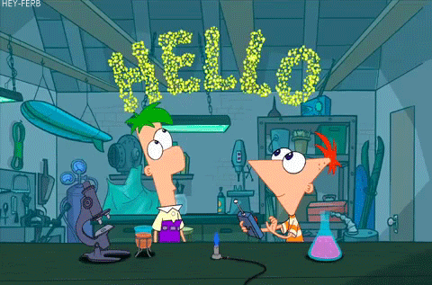

Slide 3
NAME 5 THINGS GAME!!!!

Slide 4
Capital Cities

Slide 5
Cartoon Characters

Slide 6
Musical Instruments

Slide 7
Mammals

Slide 8
Countries in Europe

Slide 9
Types of emotion/
feelings

Slide 10
Social Media Websites

Slide 11
Things you wear on a cold day

Slide 12
Animals that eat vegetables

Slide 13
Nationalities

Slide 14
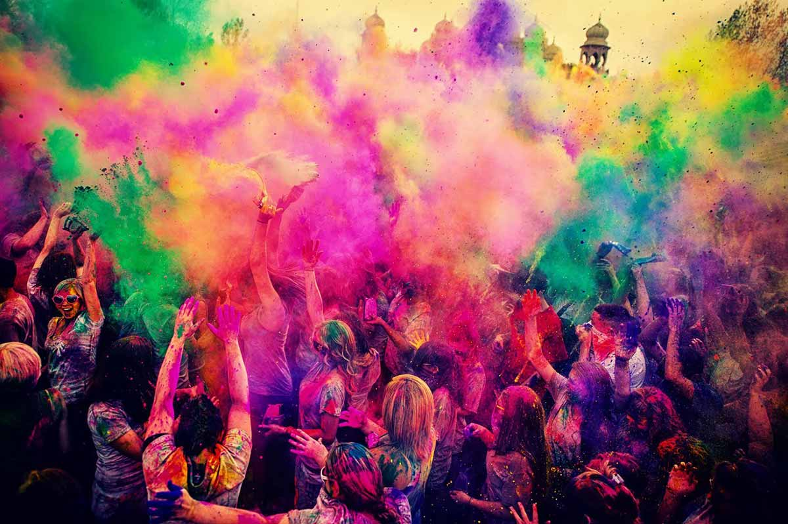
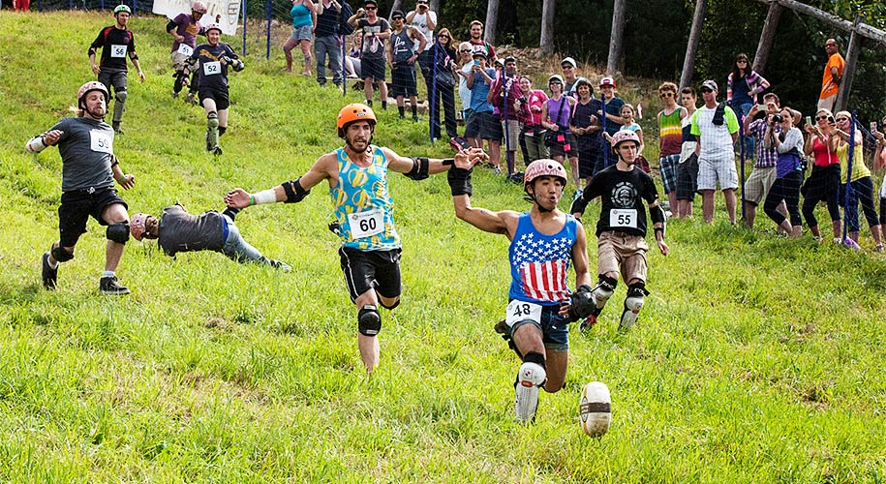
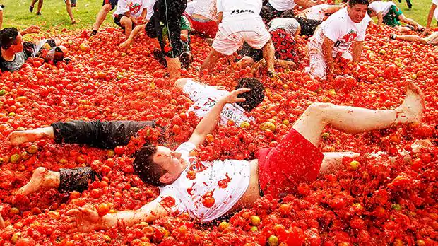
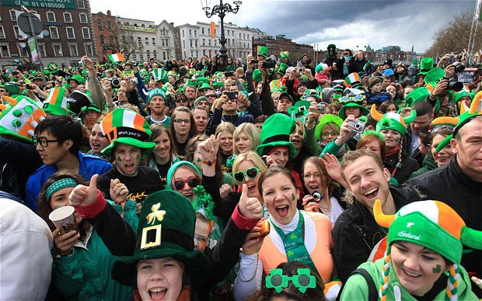
What is happening in these photos?

Slide 15
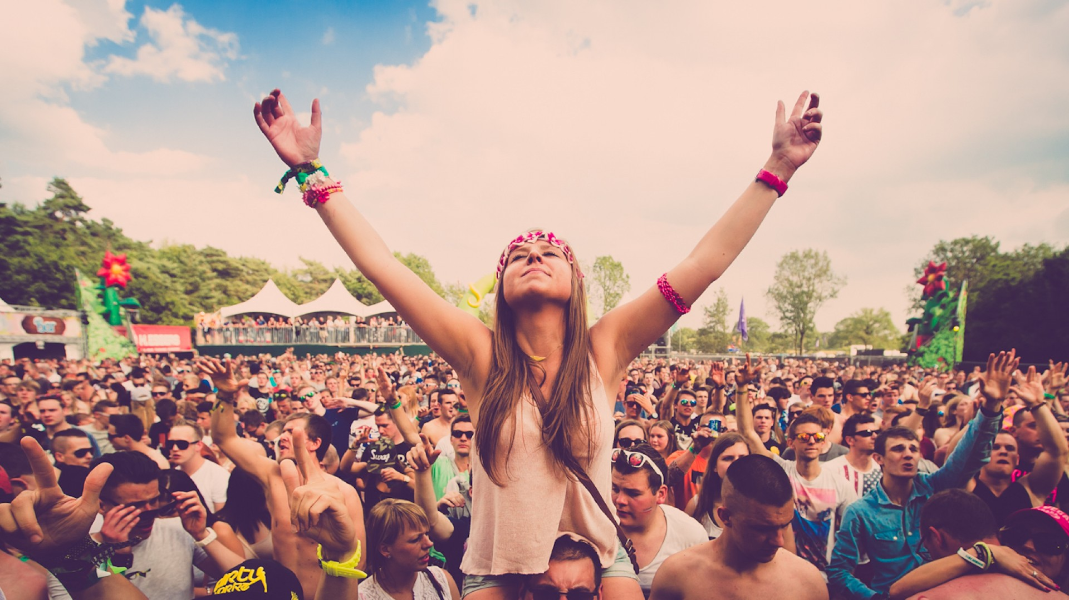
List the festivals you can think of:
Sport
Music
Religion

Slide 16
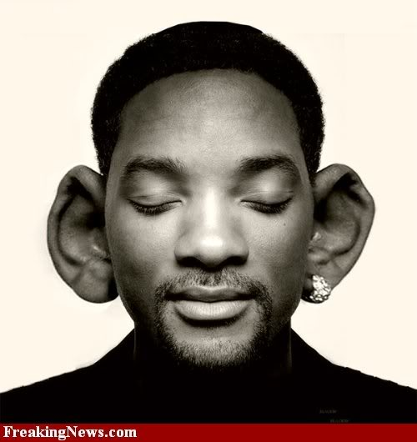
Listen and fill the gaps.
Listen again and match the gifts to the events .

Slide 17
Ask your partner
Have you ever given _________ as a gift?
Yes I have. Have you?
Perfume
Mooncake
Flowers
Cookies
A necklace

Slide 18
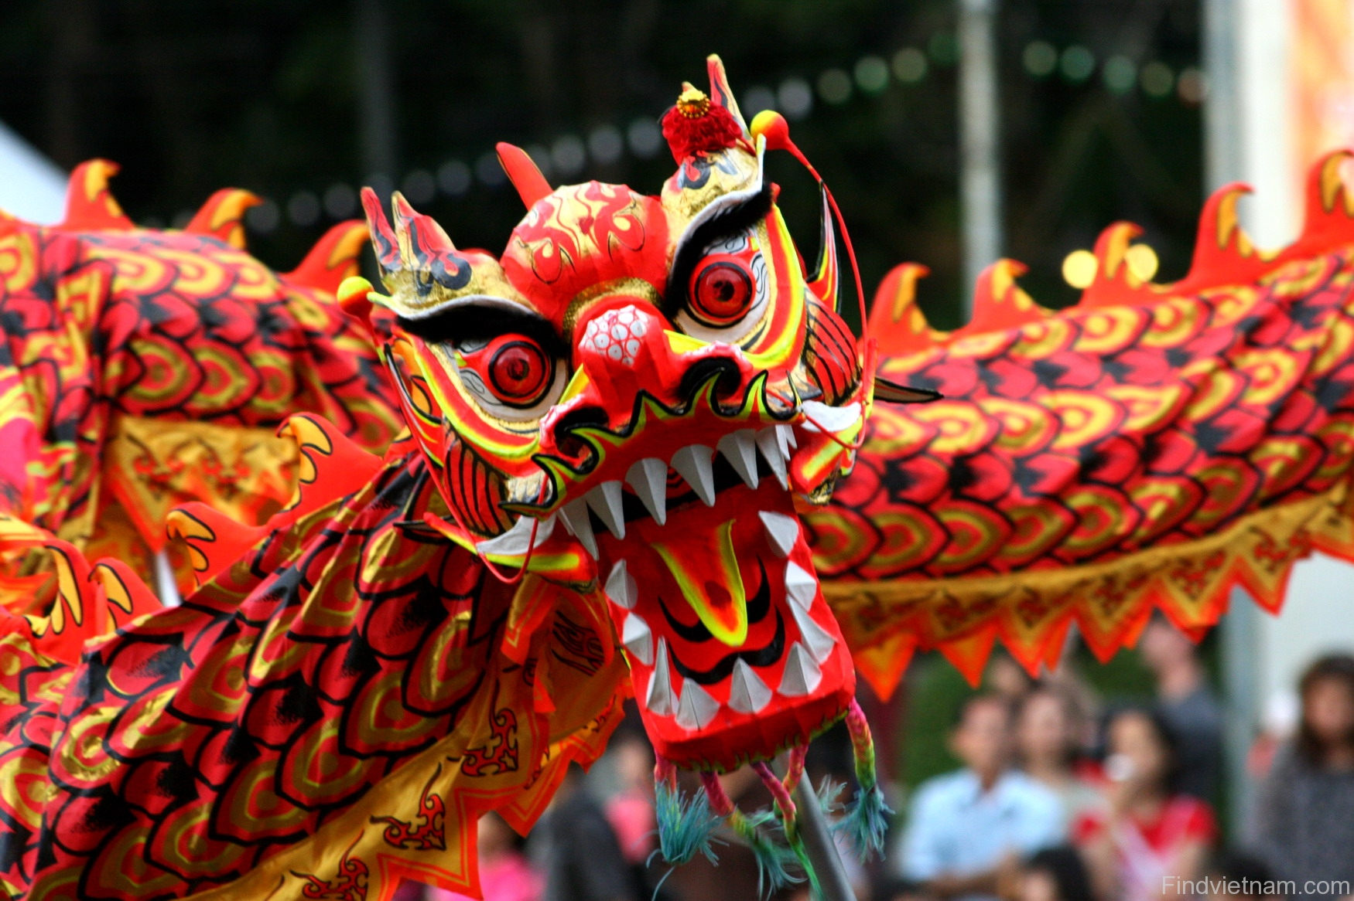
Do you celebrate any of these festivals?
What festivals does Vietnam celebrate?

Slide 19
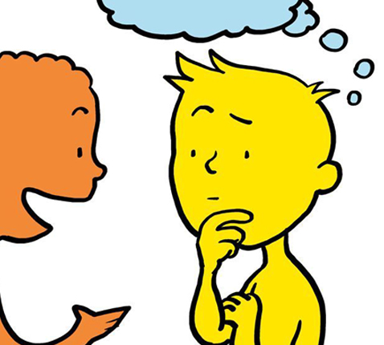
Listen to the friend talking. What are they talking about?

Slide 20
Listen and answer
1.What pet did Nadine’s parents give her as a gift?
2. Who gave her a watch?
3. When was she given chocolate?
4. What is Maya getting Nadine for her birthday?

Slide 21
What do these sentences have in common?
Have you ever gotten a pet as a gift?
Has anyone ever given you one?
Has anyone ever bought you flowers or chocolate?
What time do they refer to?
What tense is this?

Slide 22
When does the present perfect happen?
I have seen that movie twenty times.
I think I have met him once before.
There have been many earthquakes in California.
People have travelled to the Moon.

Slide 23
Draw a timeline showing the Present Perfect.
I have been to Paris.
Do we know when I went to Paris?

Slide 24
Have or Has ?
I
You
He
She
We
They
It
Ms Amber

Slide 25
Form
I’ve been to Paris three times.
Subj. + have/has + past participle…
I haven’t been to China.
Subj. + have/has + not + past participle…
Have you been to Korea?
Have/Has + subj. + past participle…

Slide 26
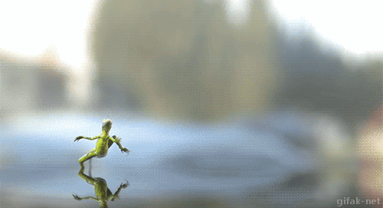
Grass skirts!
Use the present perfect to complete the sentences!
Remember-
Subj. + Have/ has + Past participle.

Slide 27
Remember these sentences?
Have you ever gotten a pet as a gift?
Has anyone ever given you one?
Has anyone ever bought you flowers or chocolate?

Slide 28
If we ask ever we are asking...
If it has happened at all - in all time.
We use ever when we ask questions. Eg. Have you ever…?
We use never when we say statements Eg. I have never….

Slide 29
JUMP THE LINE

Slide 30
1.
A -
B -
I have never drunk milk.
I have ever drunk milk.

Slide 31
2.
A -
B -
I haven't never been to Italy.
I have never been to Italy.

Slide 32
3.
A -
B -
Have you ever drive a car?
Have you ever driven a car?

Slide 33
4.
A -
B -
Have you ever been to a carnival?
Has you ever been to a carnival?

Slide 34
5.
He never tried mooncakes.
He’s never tried mooncakes.
A -
B -

Slide 35
6.
A -
B -
People have travel to the moon.
People have travelled to the moon.

Slide 36
7.
A -
B -
Has she ever met your dad?
Have she ever met your dad?

Slide 37
8.
A -
B -
Have you read your book yet?
Have you reed your book yet?

Slide 38
9.
A -
B -
I have ever been to China.
I have never been to China.

Slide 39
10.
A -
B -
Haven’t they ever been to Europe?
Haven’t they never been to Europe?

Slide 40
Match the phrases:

Slide 41
Find someone who...
Write 3 questions which start with…
‘Have you ever + past participle……?’
Walk around the classroom and ask each student your questions.
Count how many students say yes.

Slide 42
I have never...
Try and eliminate the other teams by stating something you think they have done that you haven’t. If you have done it you lose a life as well.
You have five lives.
The team who lose all lives first loses.

Slide 43
21st Century
Project 1: It’s all in the past

Slide 44
21st CENTURY LEARNING
It’s All In The Past
Driving Question
Have we learnt anything from history?
Project Outline
Choose a historical event to research.
Create a timeline to show the details of the historical event.
Discuss whether anything has changed since this historical event and if we have learnt anything from it.
Tools: Dipity / Hstry / Our story

Slide 45
Project Work!
No Social Media
Speak ONLY English!
Make sure you are all working EQUALLY!

Slide 46
Today…
Discuss in your groups:
What have we learnt from the historical event?
How have things changed?
COMPLETE YOUR GOOGLE SLIDES PRESENTATION AND PRACTISE IT
(Remember to use pictures/images… Don’t just write all the information on the slides because it’s boring!!)
Your presentation is NEXT WEEK!

