Slide 1
I want a job that
This job is....
This is a job that lets you…

Slide 2
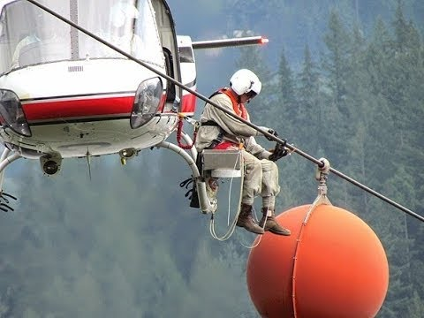

Slide 3
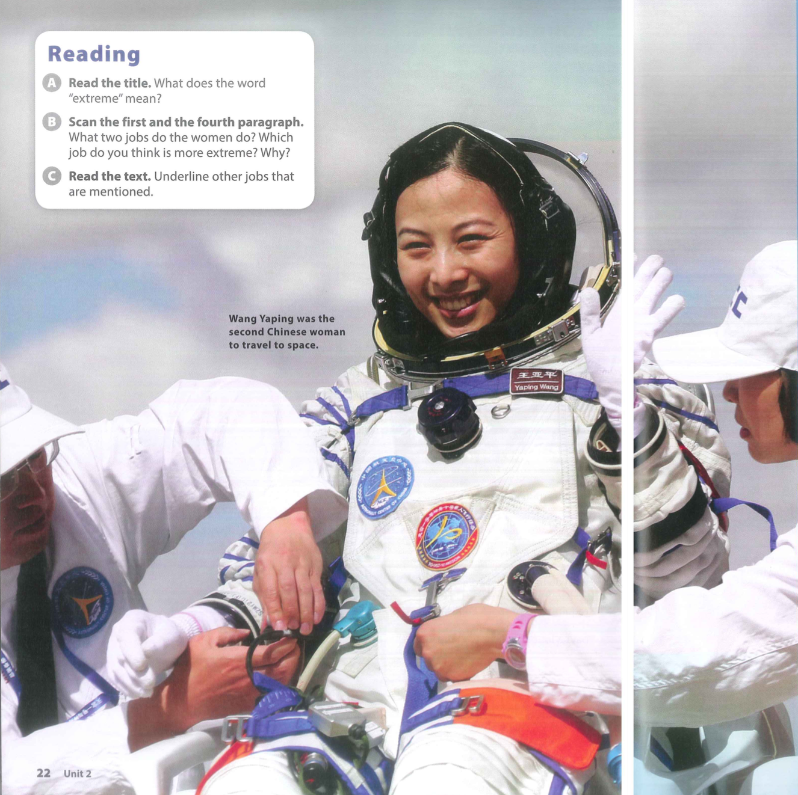
Which extreme job is this?

Slide 4
Choose the best sentence:
Bell and Wang are best friends.
Wang’s job is more extreme than Bell’s job.
Bell and Wang love going on adventures.
Bell and Wang both have extreme jobs in very different places.
Wang is more famous than Bell.

Slide 5
Extreme? Normal?

