Slide 1
My Dream Job
By the funniest, smartest, most handsome teacher ever

Slide 2
What did I Want?
A job that would let me travel all over the world
A job that lets me be creative
A job that is interesting and exciting
A job that lets me help people
A job that pays well

Slide 3
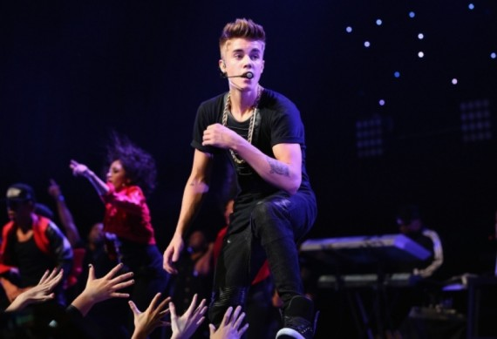
A job that would let me travel all over the world
A job that lets me be creative
A job that is interesting and exciting
A job that pays well
A job that lets me help people?
Notes:
I could be a famous singer like Justin Bieber.

Slide 4
A job that would let me travel all over the world
A job that is interesting and exciting
A job that pays well
A job that lets me help people
A job that lets me be creative?

Slide 5
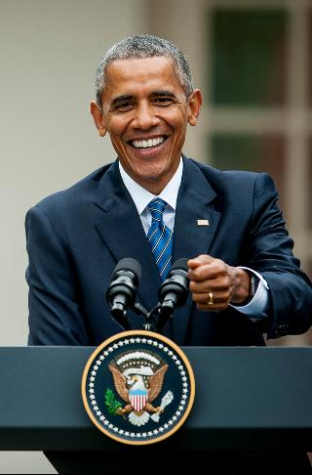
A job that would let me travel all over the world
A job that is interesting and exciting
A job that pays well
A job that lets me help people
A job that lets me be creative
TOO MUCH WORK!

Slide 6
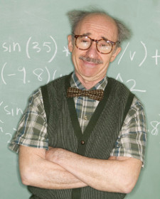

Slide 7
Notes:
Teaching is my dream job. I can help people learn and get into better schools so they can get better jobs. I can be creative with how I teach. It’s an interesting and exciting job because I can meet students and other people from different countries. And it pays me enough to buy everything I need.

Slide 8
Listening
https://drive.google.com/open?id=0B6jZ1TST9GtKTG1oaUxHdnR0Z3M
https://drive.google.com/open?id=0B6jZ1TST9GtKWkZrRTctdjJFdUU

Slide 9
