Slide 1
Project 3:
Reuse and recycle

Slide 2
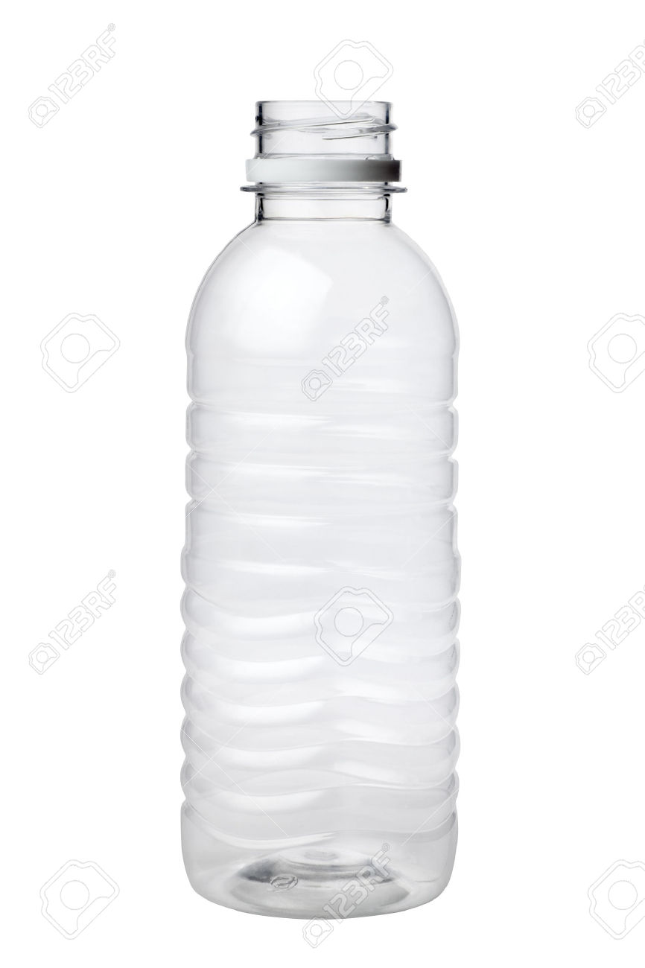
How can we use plastic bottles?

Slide 4
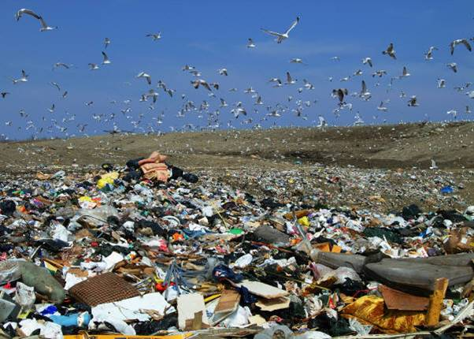
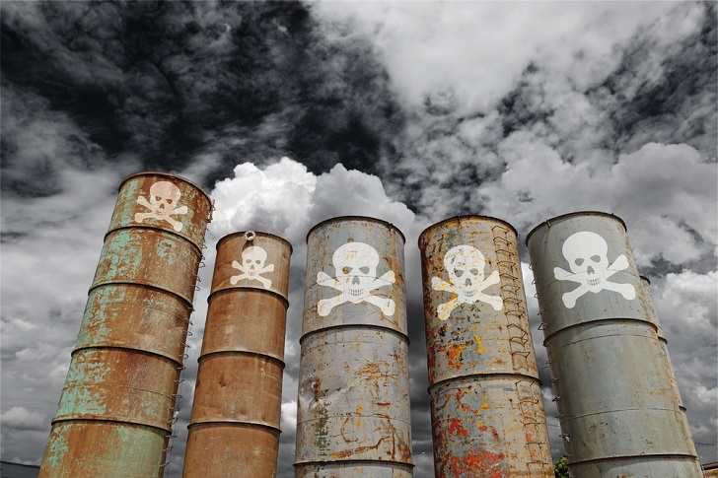
What are some environmental problems in the world?

Slide 5
Project 3: How can we make garbage useful?
Talk about problems in the environment and what will happen to the earth if they do not change.
Research Vietnam’s recycling habits.
Create a way to turn garbage into something useful in Vietnam.

Slide 6
Remember!
Your grade is based on teamwork.
Make sure you talk to your team mates.
Find a way to help your team if you are finished with your work.
When you have an idea, make sure you tell everyone on your team.
If you don’t know how to pronounce a word, ask me or Miss Linh for help! Make sure you have the correct pronunciation for your presentation.

Slide 7
Today:
Make new teams.
Research environmental problems.
Research recycling habits in Vietnam.
Think different ways to turn garbage into something useful in Vietnam.
Choose one for your project and begin planning your slides!

