Slide 1
Rules
Reading and Writing

Slide 2
Let’s Play Kahoot
//play.kahoot.it/#/?quizId=b3f9cfb7-8c87-4e63-9f48-6f071d7421b2&gameMode=ghost&startTime=1492306149640

Slide 3
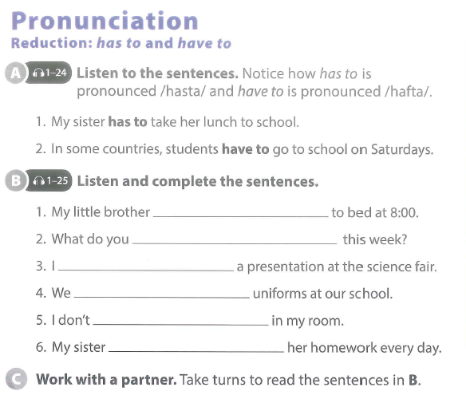

Slide 5
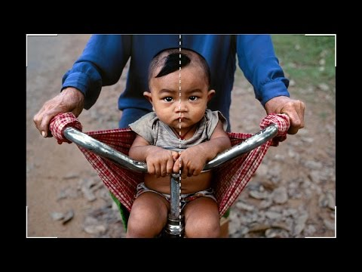
What are the nine rules for taking photographs?

Slide 7
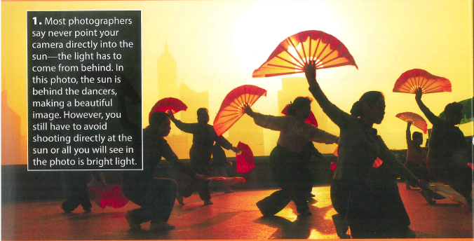
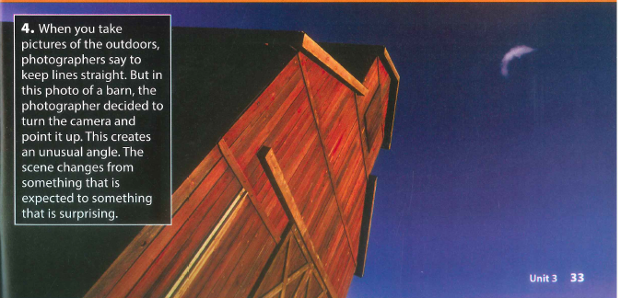
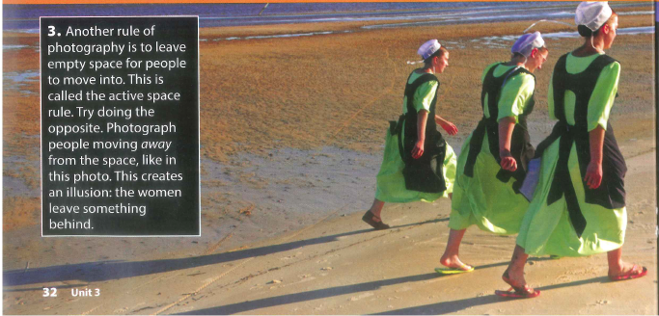
?
?
?
?

Slide 8
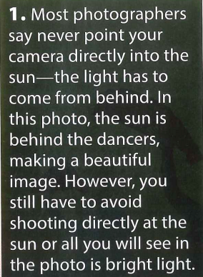
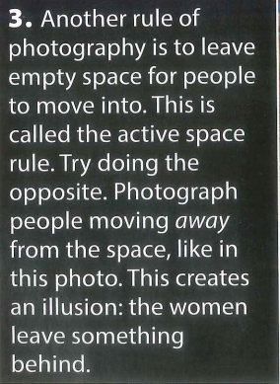
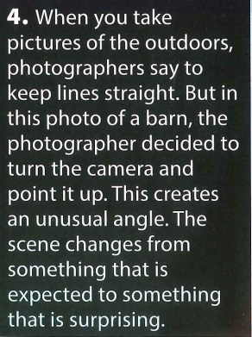

Slide 9
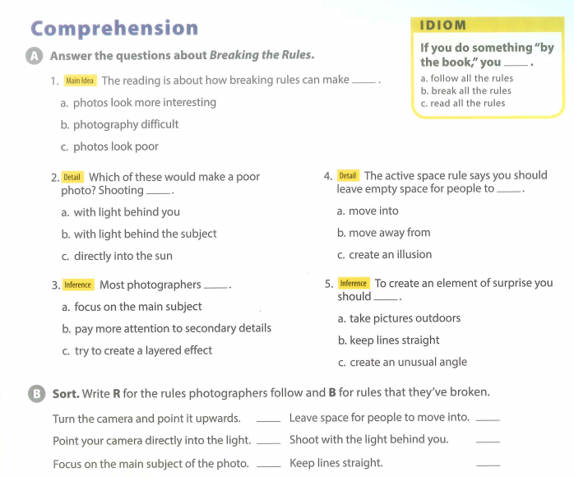

Slide 10
Personalisation

Slide 11
SOCIAL STUDIES
Cities Rule!
Driving Question
Do we need to create more rules or laws to make Vietnamese cities safer?
Project Outline
Choose a safety problem that affects Vietnam. For example, roads & transport, health, food, tourist attractions, buildings, animal treatment etc...
Research information about your topic and make rules that could help to make Vietnamese cities safer.
Find a way to raise awareness to the public about your safety topic. (video, poster, advertisement)
Tools: WIX / WeVideo / Lucidpress

Slide 12
At the end of today’s lesson...
You will share your presentation with the other groups.
We will talk about your progress so far.

Slide 13
feedback
WHat do you like about the project so far?
What do you think the group should change?
What do you think the group should add?

