Slide 1
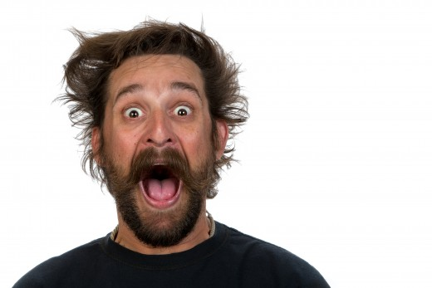
Tests

Slide 2
Notes:
Vocab review for the listening test

Slide 3
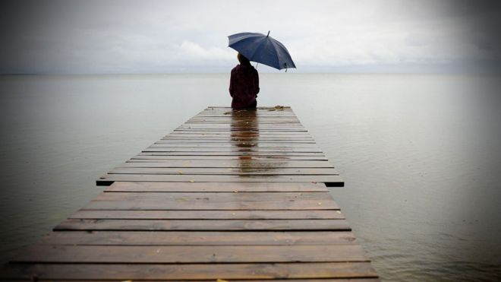
Alone
She is...

Slide 4
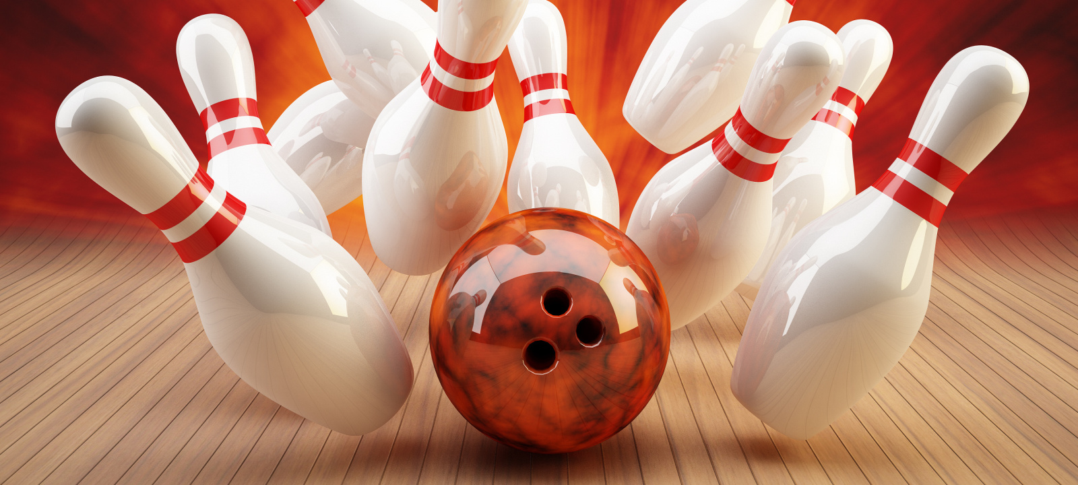
bowling

Slide 5
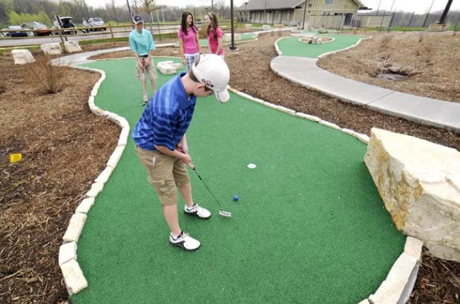
Mini golf

Slide 6
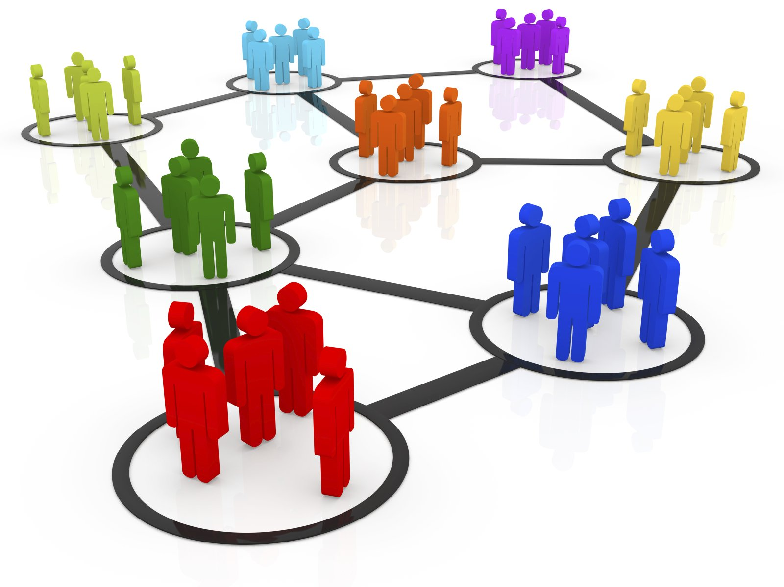
groups
They’re standing in...

Slide 7
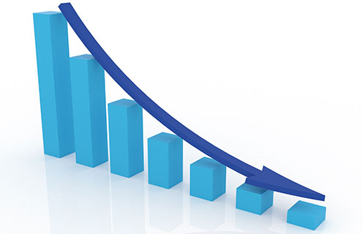
decrease

Slide 8
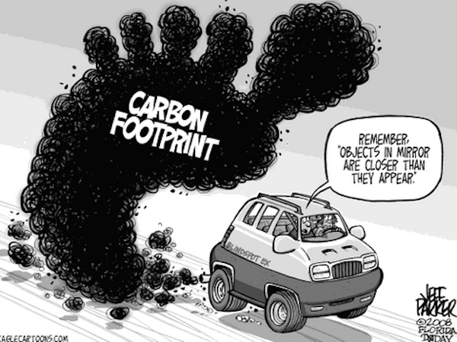
Carbon footprint
The pollution you create by driving cars or flying on planes.

Slide 9
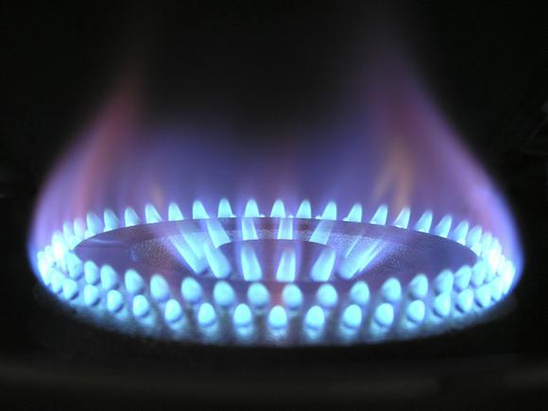
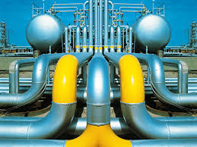
Natural gas

Slide 10
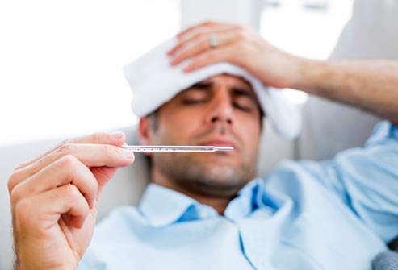
Disease
He’s sick. He has a...

Slide 11
I+will:
I’ll

Slide 12
we+will:
we’ll

Slide 13
you+will:
you’ll

Slide 14
she+will:
she’ll

Slide 15
he+will:
he’ll

Slide 16
it+will:
it’ll

Slide 17
they+will:
they’ll

Slide 18
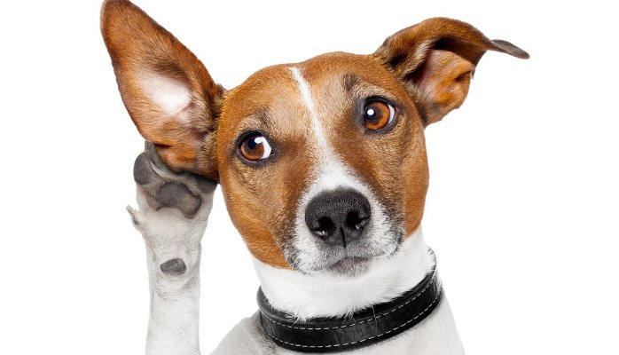
Listening test
Notes:
https://drive.google.com/drive/folders/0B89SggH_uiVSakNfYVNhOC1WRjg

Slide 19
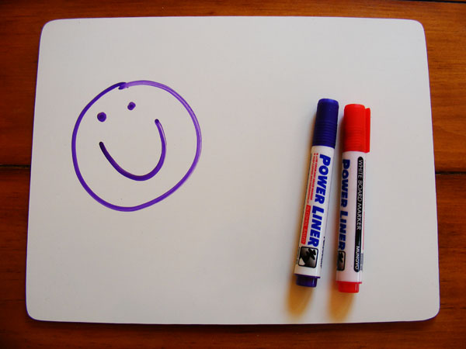
Notes:
Mini whiteboards competition

Slide 20
Write the correct words:

Slide 21
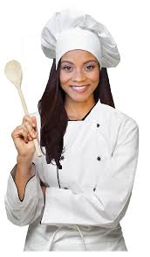
chef
She’s a...

Slide 22
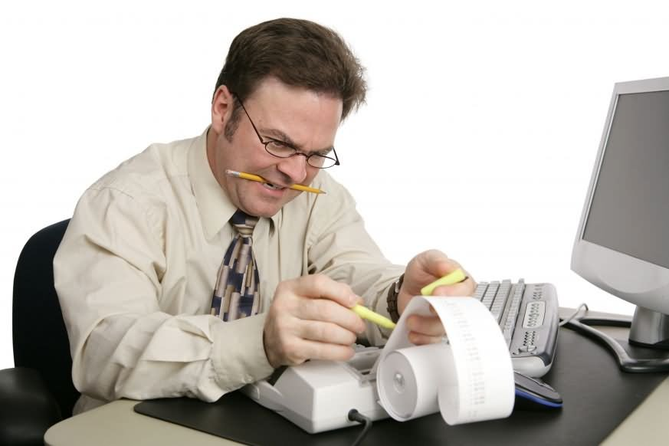
accountant
He’s an...

Slide 23
doctor
She’s a...

Slide 24
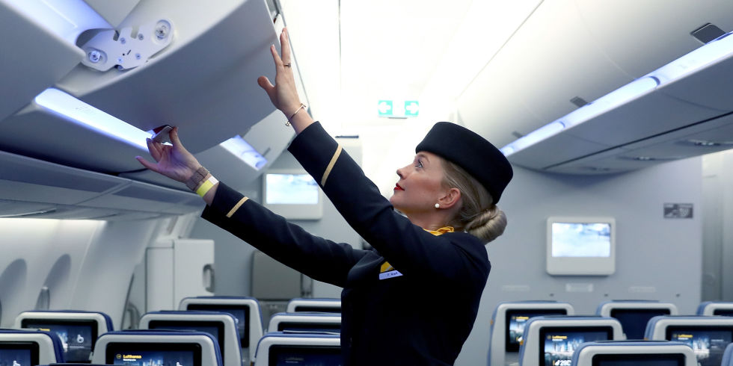
Flight attendant
She’s a...

Slide 25
I have / am having a meeting tonight.
have

Slide 26
You speak English really good/well.
well

Slide 27
Where are you go / going this weekend?
going

Slide 28
Where do you go / going on weekends?
go

Slide 29
shrink
To become smaller:

Slide 30
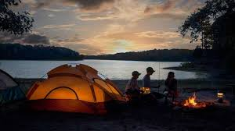
camping
Sleeping outside with a tent

Slide 31
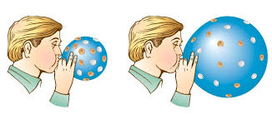
This balloon is ex…………………..
expanding

Slide 32
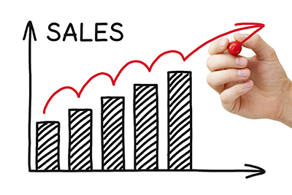
The sales are in…………….
increasing

Slide 33
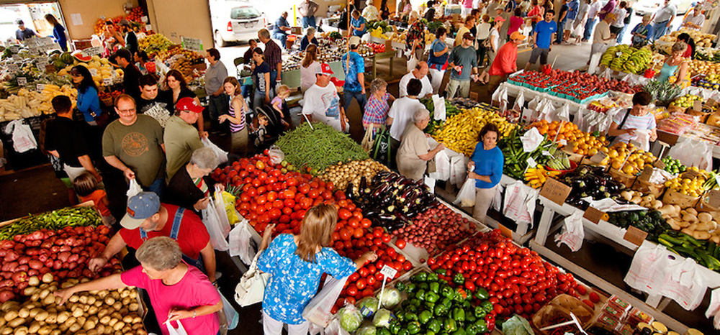
Farmer’s market
You can buy food and crafts at a(n) farmer’s market / organic farm

Slide 34
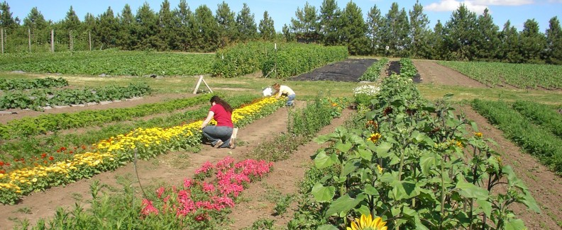
Organic farm
You can pick your own fruit and vegetables at a(n) farmer’s market / organic farm

Slide 35
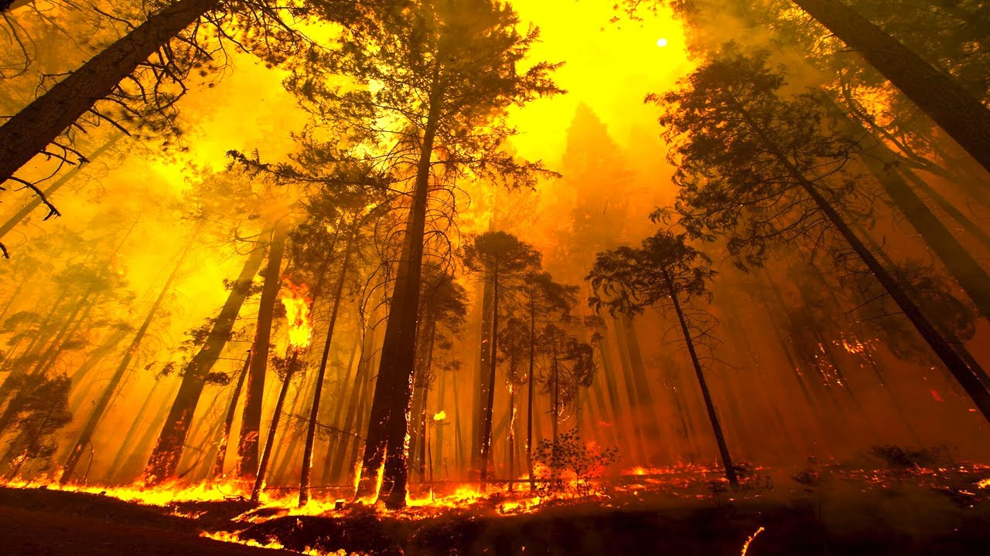
Forest fire
This is a forest fire / volcanic eruption.

Slide 36
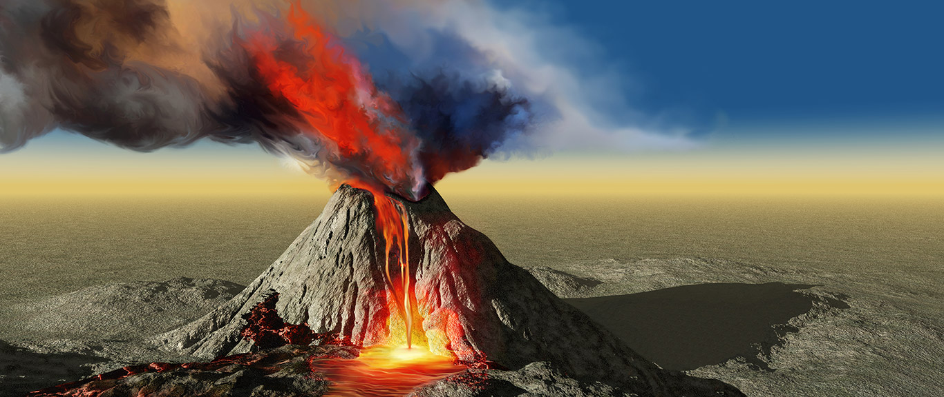
Volcanic eruption
This is a forest fire / volcanic eruption.

Slide 37
I want a job that lets you / that lets me work with people.
that lets me

Slide 38
We want jobs that are interesting / that let us.
that are interesting

Slide 39
Put the sentence in order:

Slide 40
move / Sloths / are /but /slowly
/ . / strong / they /animals
Sloths are strong animals but they move slowly.

Slide 41
books / ? / Which / your / ones / are /
Which ones are your books?

Slide 42
books / ? / Which / your / ones / are /
Which ones are your books?

Slide 43
Write the correct word:

Slide 44
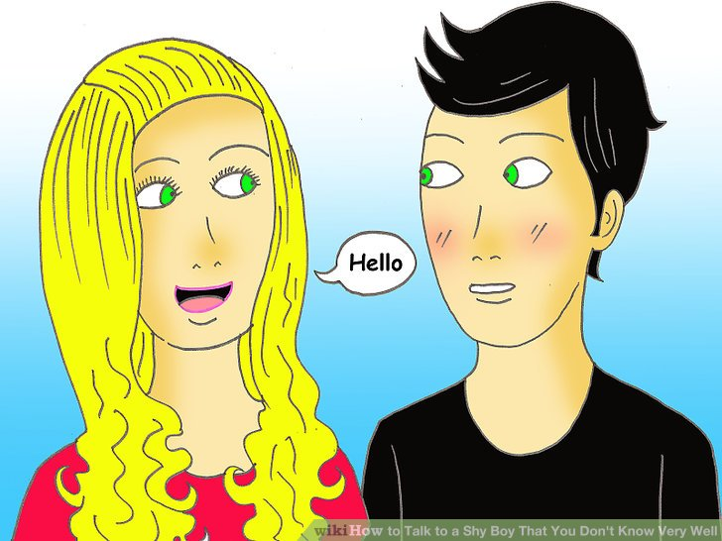
shy
He won’t talk to me, he’s a little shy / funny.

Slide 45
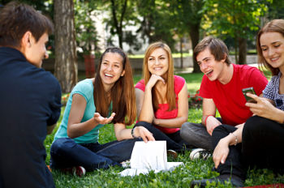
outgoing
She always speaks to everyone - she’s so hard-working / outgoing!

Slide 46
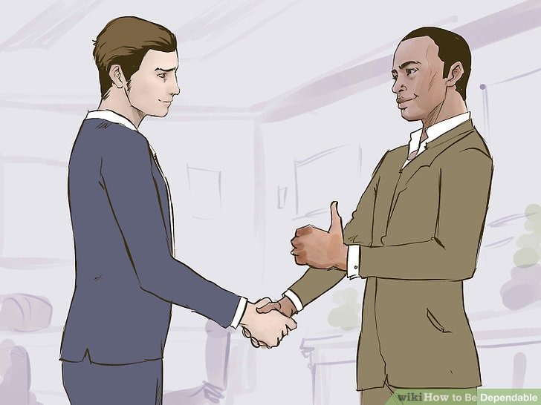
dependable
I’m sure he’ll be here on time - he’s very dependable / shy.

Slide 47
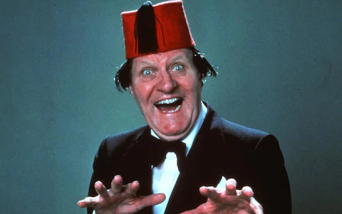
funny
People always laugh when I’m around, because I’m so funny / dependable.

Slide 48
hard-working
Ants are the most outgoing / hard-working animal in nature.

Slide 49
