Slide 1
Please don’t feed the monkeys
S3A Unit 3

Slide 2
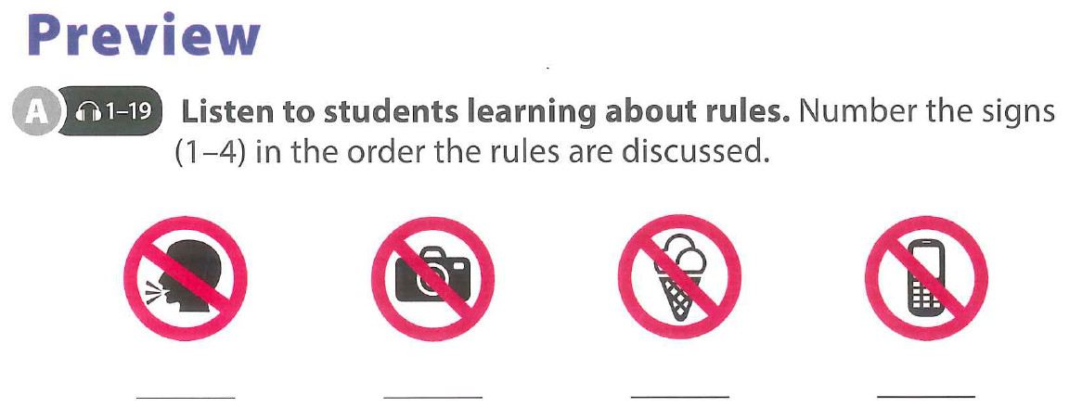

Slide 4
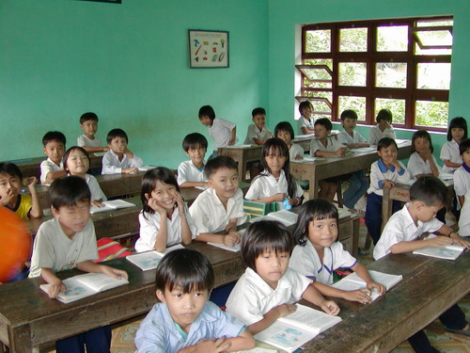
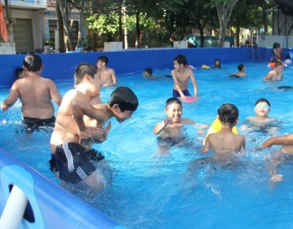
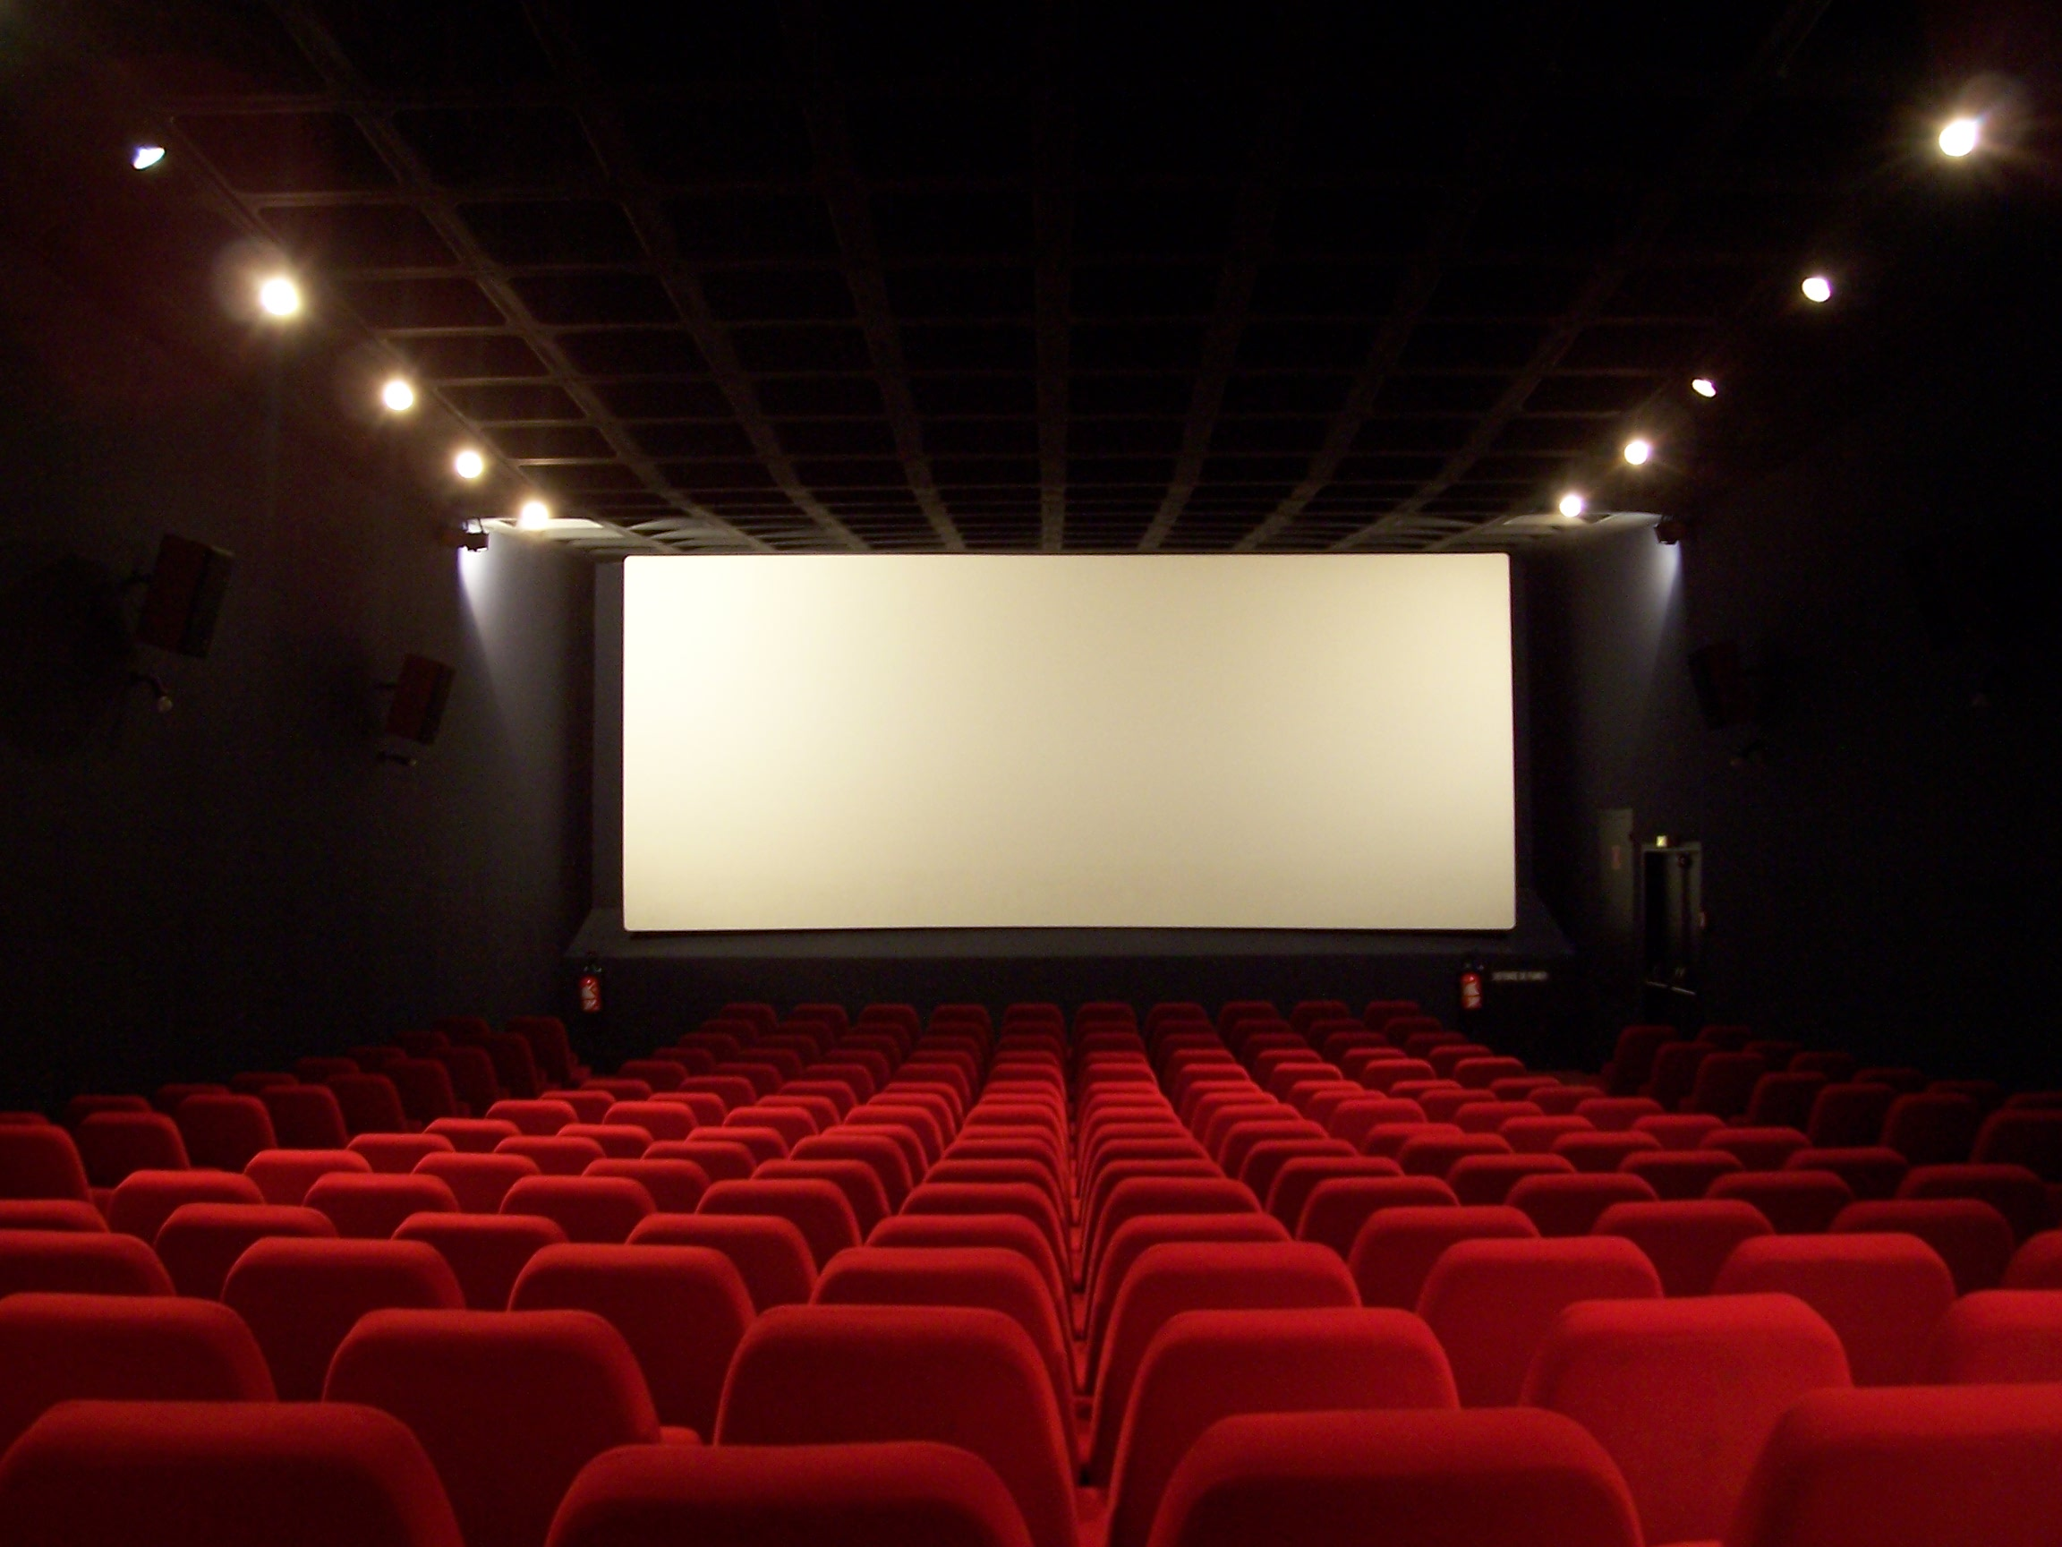
Talk to your partner: what are the rules in these places?

Slide 5
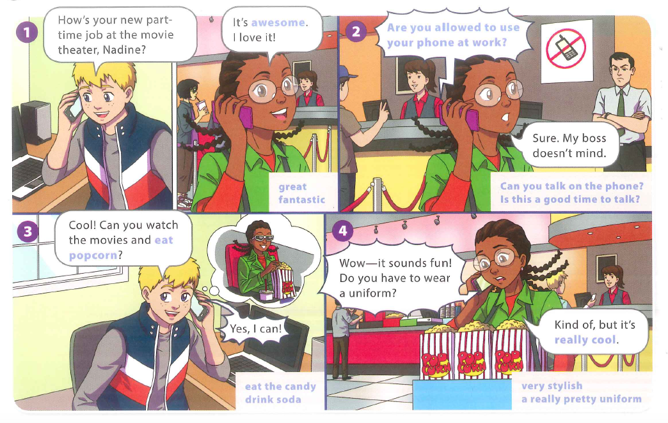
Notes:
Running dictation

Slide 7
Break Time

Slide 8
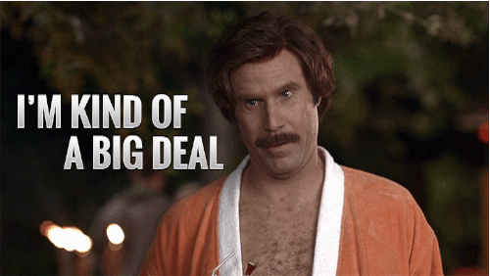
Subject + kind of + noun

Slide 11
Rewrite the rules using “can’t” or “have to”
Notes:
p29 , ex C questions (+3 more)

Slide 12
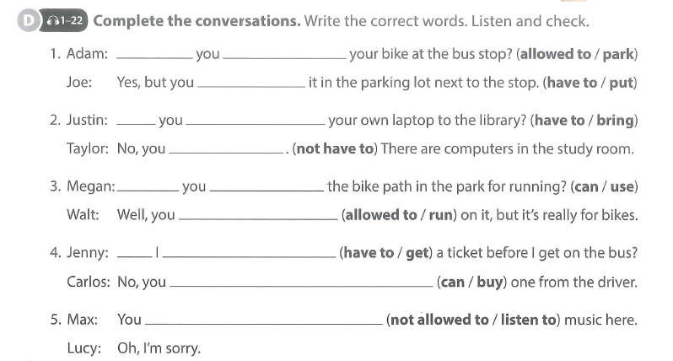

Slide 13
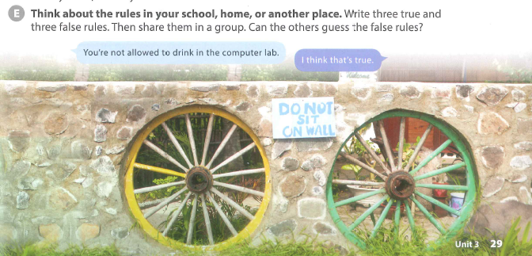

Slide 14
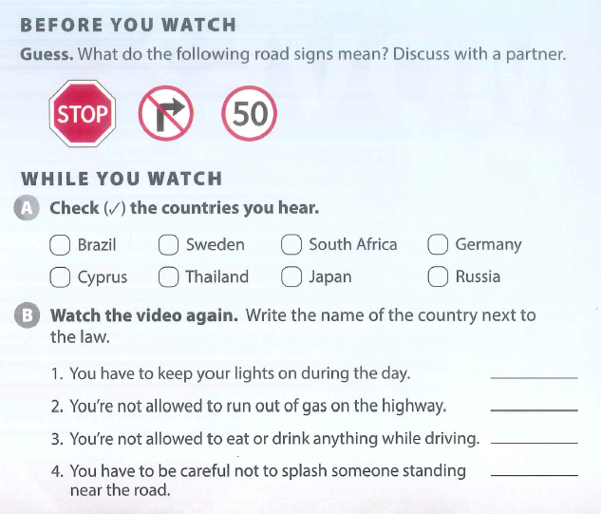
Rules of the Road

Slide 15
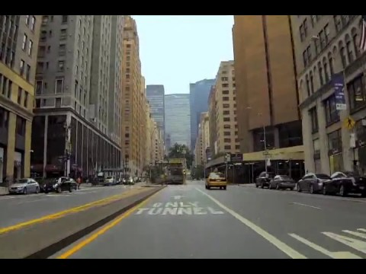
Rules of the road
Watch the video, and write down the rules of the road for different countries!

Slide 16
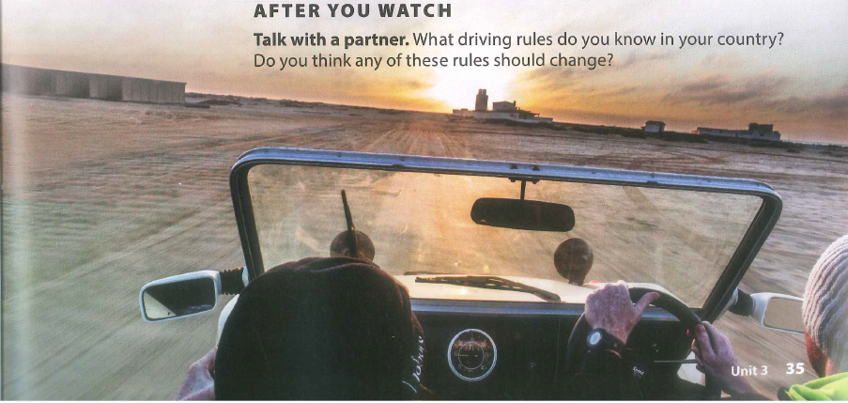

Slide 17
Break Time

Slide 18
SOCIAL STUDIES
Cities Rule!
Driving Question
Do we need to create more rules or laws to make Vietnamese cities safer?
Project Outline
Choose a safety problem that affects Vietnam. For example, roads & transport, health, food, tourist attractions, buildings, animal treatment etc...
Research information about your topic and make rules that could help to make Vietnamese cities safer.
Find a way to raise awareness to the public about your safety topic. (video, poster, advertisement)
Tools: WIX / WeVideo / Lucidpress
Notes:
Food hygiene, air pollution, animal treatment, road safety

Slide 19
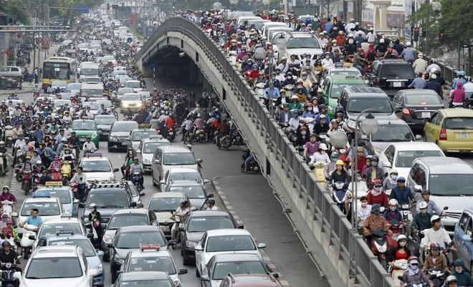
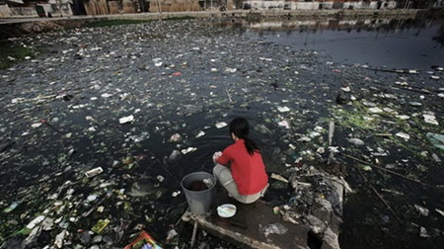
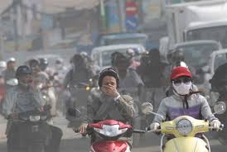
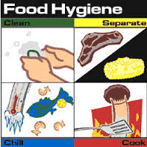
TODAY - Research...
What are the safety problems that affect Vietnam?
2) Water Pollution
4) Air Pollution
Traffic - Road Safety
3) Food Hygiene
5) Crime
Can you think of anymore?..

Slide 20
Group: __
Group Names: _________________________
Safety Problems in Vietnam!
What is the problem?
Why is it a problem?
How is it caused?
How can we make it safer?
Notes:
Brainstorm sheet - for A3 poster

