Slide 1
I’d like to be a pilot
S3A UNIT 2

Slide 2
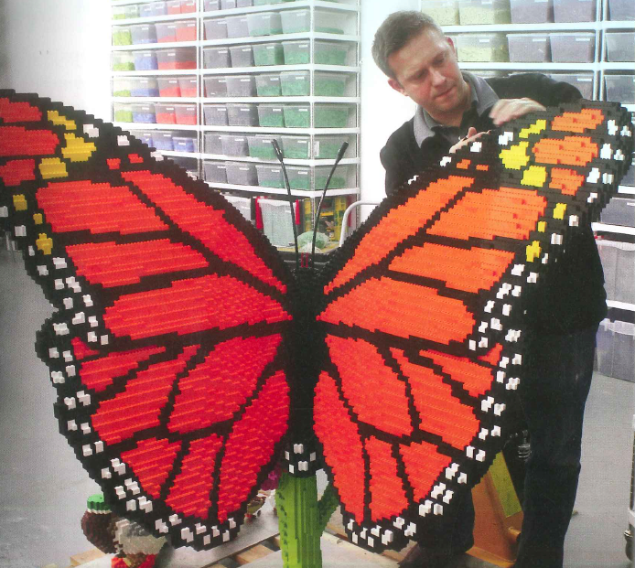
What’s his job?

Slide 3
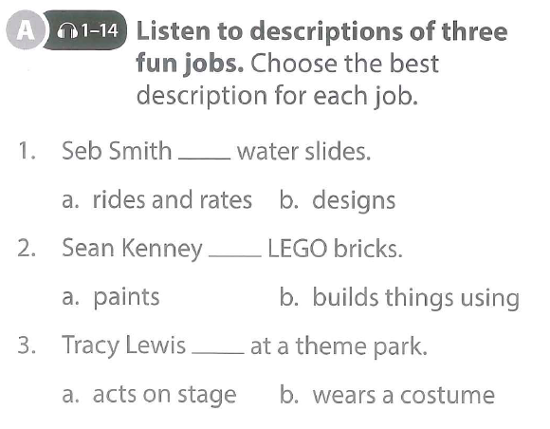
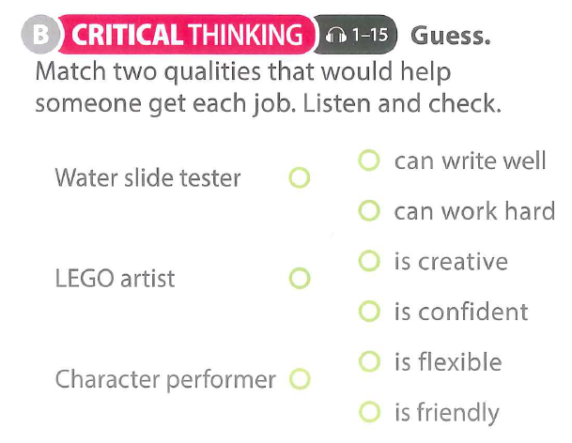
Talk to your partner: what are the five most fun jobs you can think of?

Slide 5
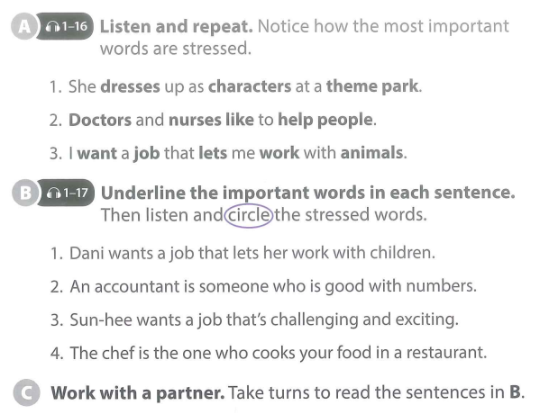
Pronunciation practice

Slide 6
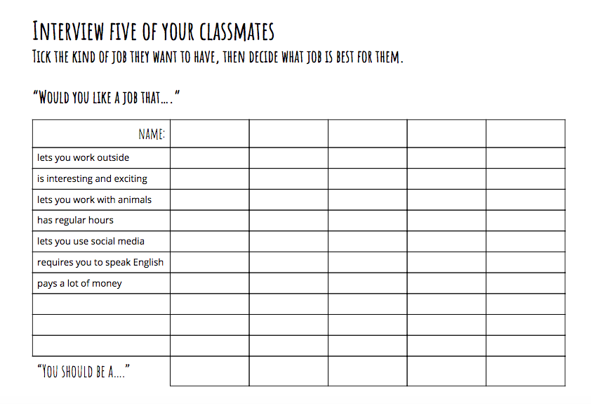

Slide 7
Across
1 across - a person who takes photographs especially as a job
2 across - someone or something that is amusing or enjoyable.
3 across - attracting your attention and making you want to learn more about something or to be involved in something
4 across - a person who takes care of the animals in a zoo

Slide 8
Down
1 down - difficult in a way that is usually interesting or enjoyable
2 down - an enjoyable experience or person
3 down - something that causes feelings of interest and enthusiasm, causes excitement
4 down - having or showing an ability to make new things or think of new ideas
5 down - someone whose job is to guide or assist people with the law
6 down - a professional cook who usually is in charge of a kitchen in a restaurant.
7 down - a person who flies an airplane, helicopter, etc.

Slide 9
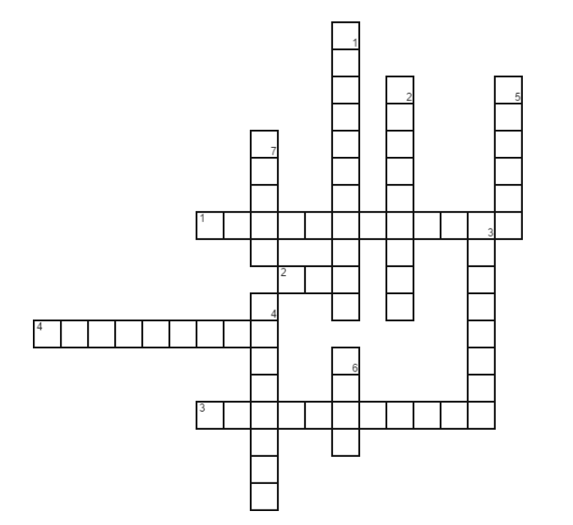

Slide 10
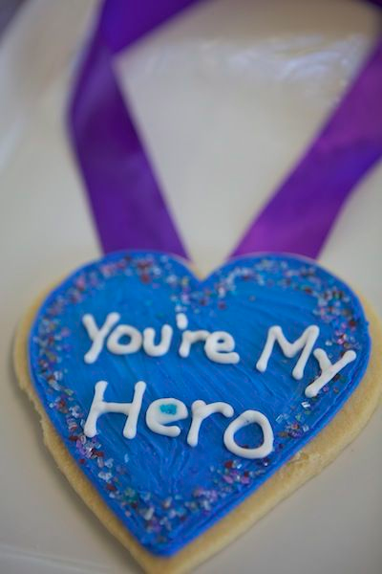
21st CENTURY LEARNING
You're A Hero
Driving Question
What makes a hero?
Project Outline
Discuss with your group what you think makes a hero and what jobs and duties they have?
Who is your hero and why?
Create a national holiday for a hero. It can be for an individual hero or for all heroes. Think about: where it will be, date(s), activities, special guests, music, food, prizes, etc.
Tools: Canva / Poster my wall

Slide 11
What makes a hero? - week 5
What makes a hero? Who are your heroes?
National holidays
Start work on your presentation
Continue to work on your presentation & Feedback
Feedback, finish your Google Slides document, plan what you’re going to say
Presentation Day

Slide 12
feedback
WHat do you like about the project so far?
What do you think the group should change?
What do you think the group should add?

Slide 13
21st CENTURY LEARNING
You're A Hero
Driving Question
What makes a hero?
Project Outline
Discuss with your group what you think makes a hero and what jobs and duties they have?
Who is your hero and why?
Create a national holiday for a hero. It can be for an individual hero or for all heroes. Think about: where it will be, date(s), activities, special guests, music, food, prizes, etc.
Tools: Canva / Poster my wall

Slide 14
by the end of today’s lesson...
Finish your slideshow
Plan: what are you going to say?
Start practicing

