Slide 1
Talking about the future.

Slide 2
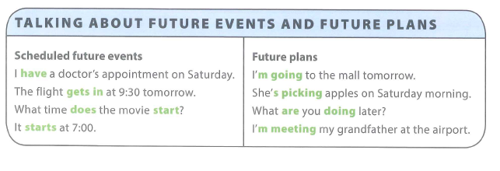
Talk to your partner: What’s the difference between “scheduled future events” and “future plans”?
Using the present simple tense to talk about the future
Using present continuous tense to talk about the future.

Slide 3
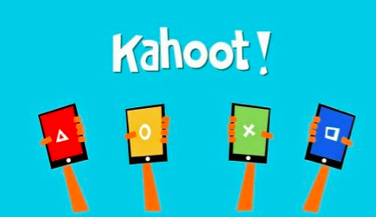
https://create.kahoot.it/#quiz/13ccc209-1498-404d-bbbf-a93bd0dea67a

Slide 7
Pronunciation

Slide 8
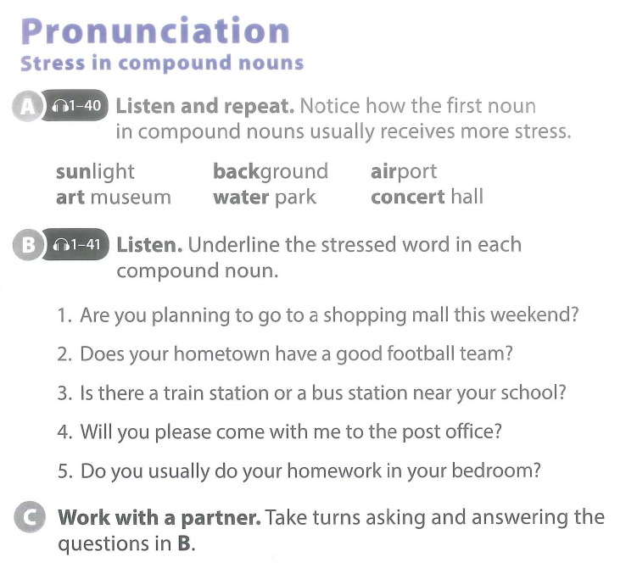

Slide 9
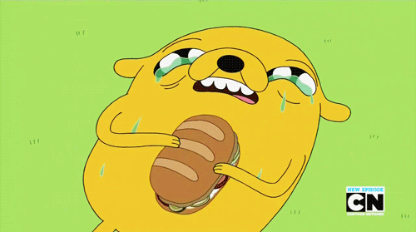
BREAK TIME

Slide 10
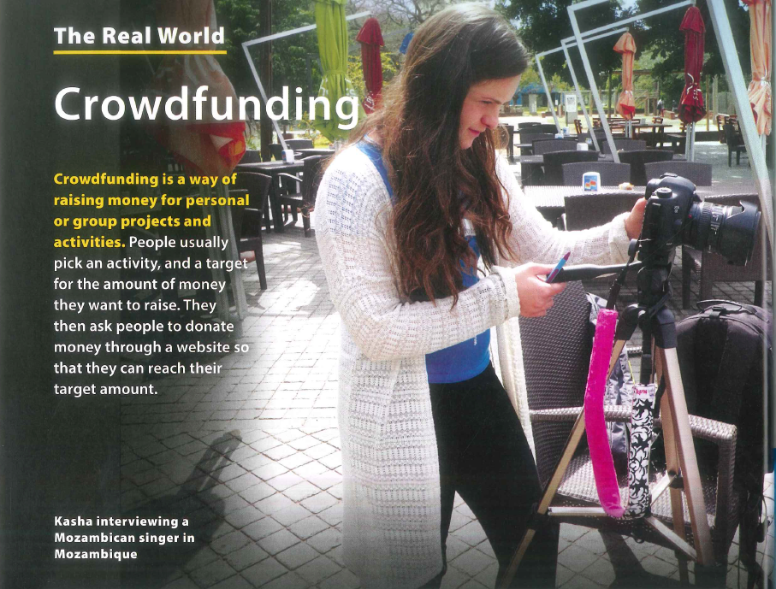

Slide 11
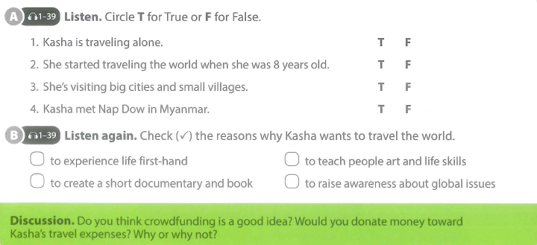

Slide 12
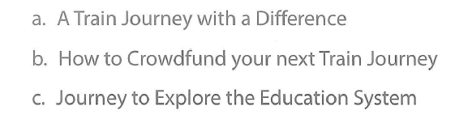
Read the article. Pick the best title.
You have 45 seconds.

Slide 13
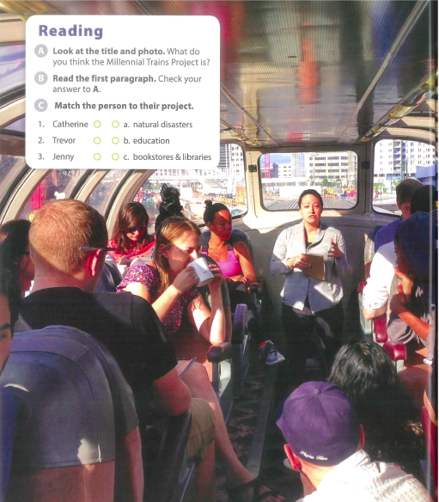

Slide 19
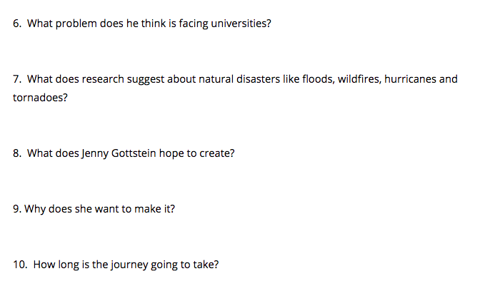

Slide 20
Productive Tasks

Slide 21
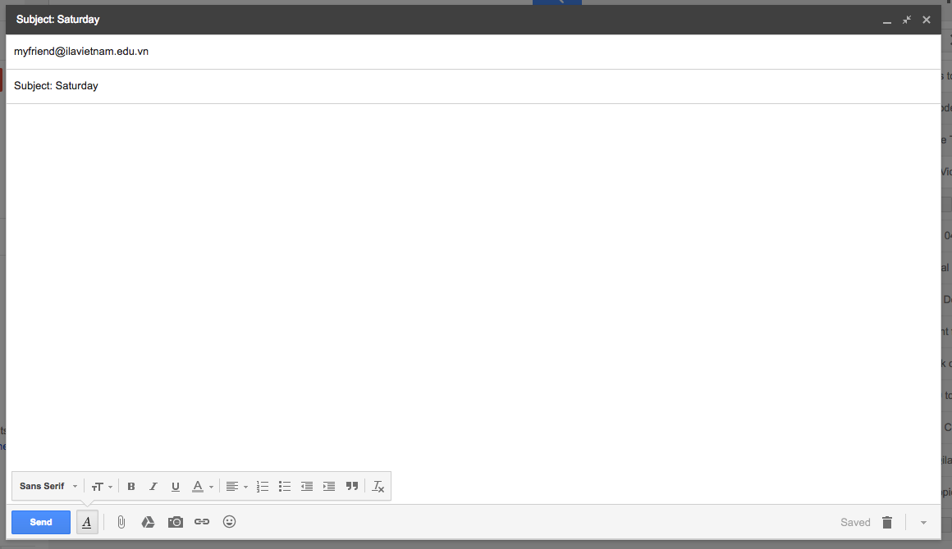
____________________,
____________________________________________________________________________________________________________________________________________________________________________________________________________________________________________________________________________________________________________________________________________________
_________________________________________________________________________________________________________________________________________________________________________________________________________________________________________________________________________________________________________________________________________________________________________________________________________________________________________________________________________________________________________________________________________________________

Slide 22
BREAK TIME

Slide 23
SCIENCE
Reuse & Recycle
Driving Question
How can we make rubbish useful?
Project Outline
Discuss what dangers face the earth and what will happen to the earth, if we do not change.
Plan ways for you to help the earth.
Research Vietnam’s recycling habits.
Create a way to turn rubbish into something useful in Vietnam.
Present it to your class.
Tools: 3DTin / Canva

