Slide 1
To be doing
Grammar Review

Slide 2
Name that Celebrity
https://www.sporcle.com/games/hdasks/name-the-celebrity

Slide 3
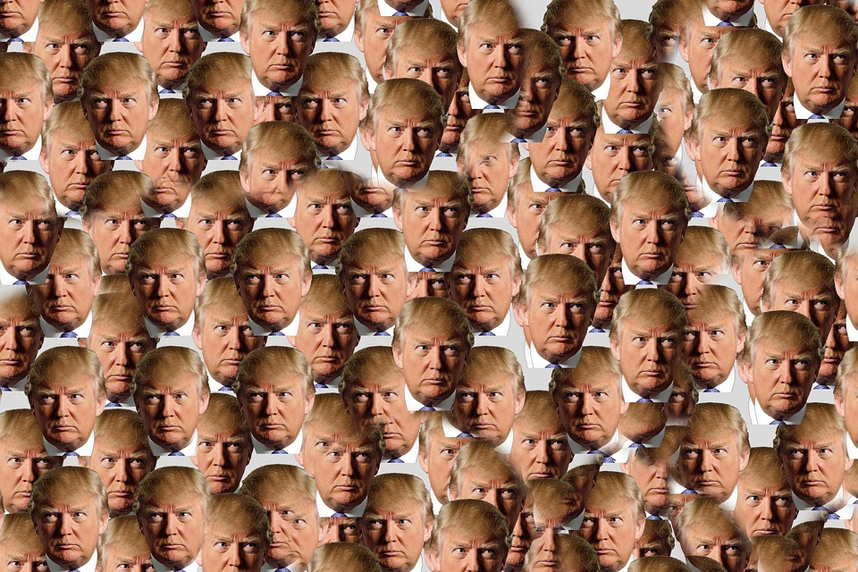
TRUMP!!

Slide 4
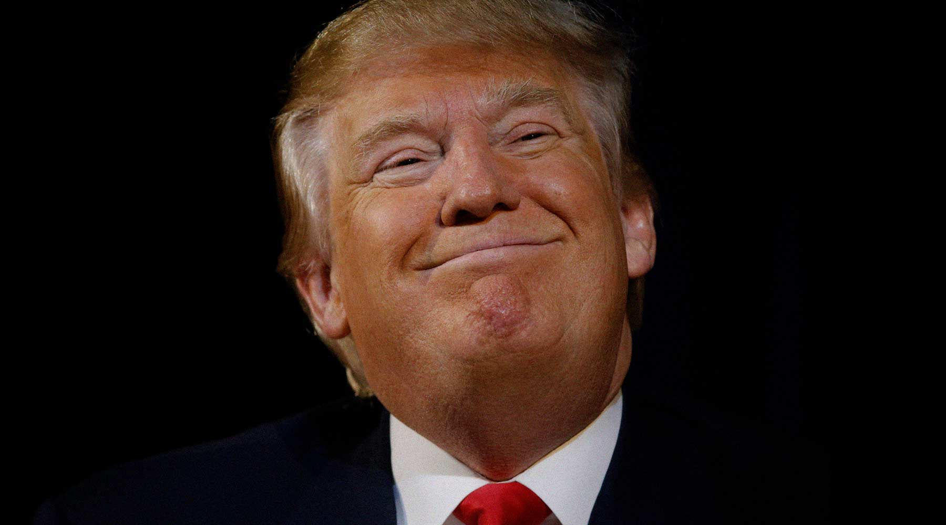
What is he doing this week?

Slide 5
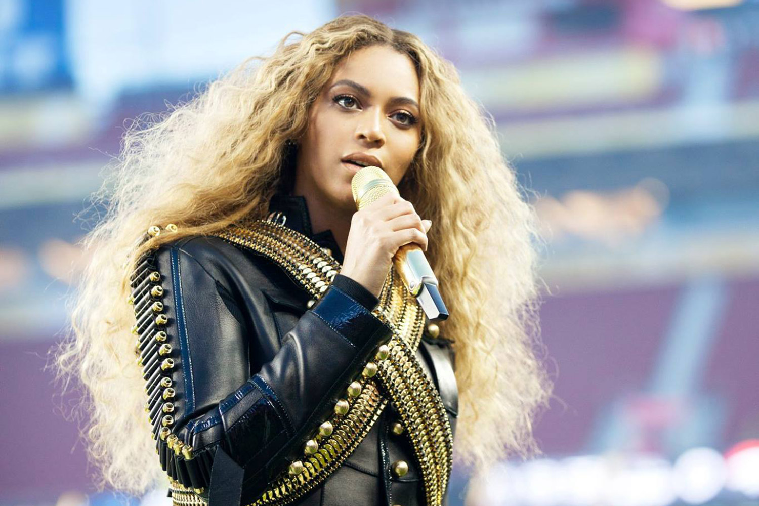
What is she doing this week?

Slide 6
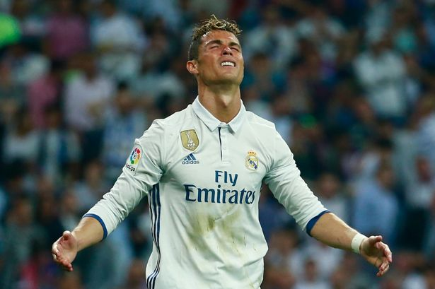
What is he doing this week?

Slide 7
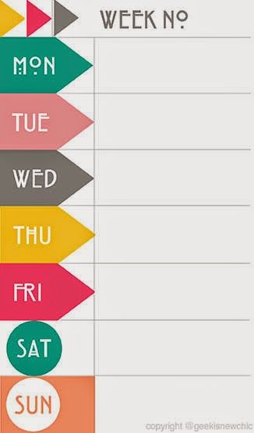
Pick one famous person.
What is he/she doing this week? Add four things to his/her weekly planner.

Slide 8
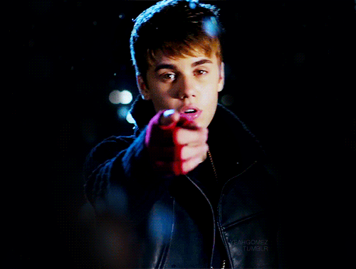
You are a big, important, famous person
Walk around the room and talk to other big, important famous people
Make plans for next week and add them to your planner.
Include times and who you will be with.
Oh, hi there Justin Bieber.
Oh, hey Trump. What’s up?
Nothing man. Im going bowling on Thursday. Do you want to come?
Oh baby. What time are you going? I’m busy on Thursday morning. I do love bowling though...

Slide 9
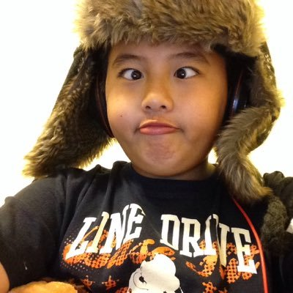
Read this email.
It’s from your biggest fan. A nice young man named Khang..

Slide 10
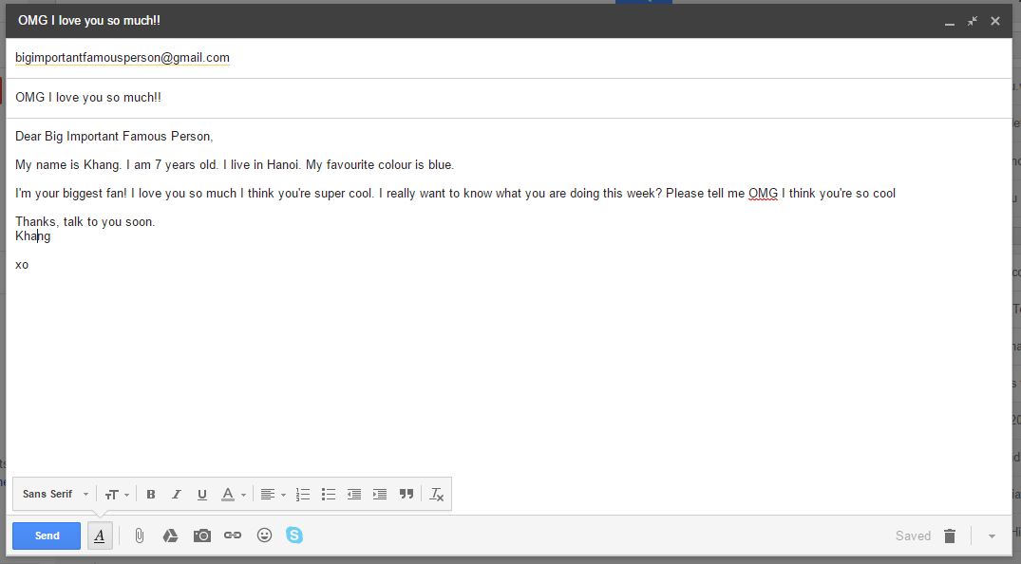

Slide 11
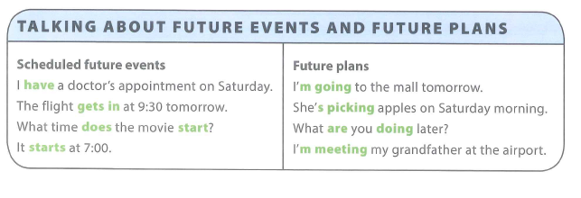
Now write a reply.
Let him know what you’re doing next week.
Remember!

Slide 12
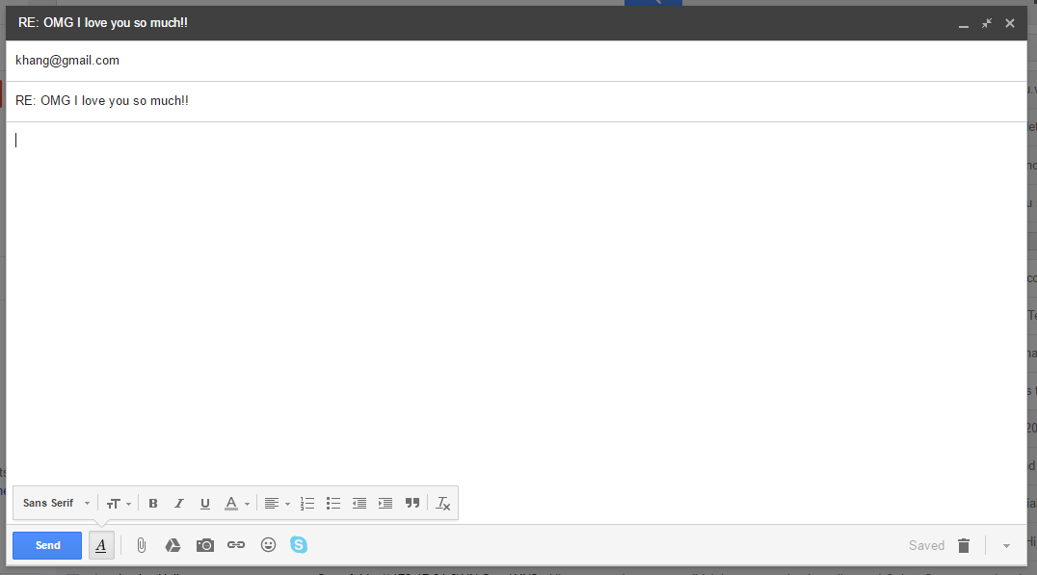
____________________,
____________________________________________________________________________________________________________________________________________________________________________________________________________________________________________________________________________________________________________________________________________________
_________________________________________________________________________________________________________________________________________________________________________________________________________________________________________________________________________________________________________________________________________________________________________________________________________________________________________________________________________________________________________________________________________________________

Slide 13
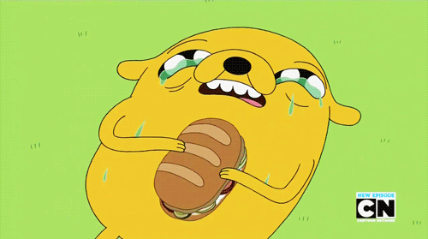
BREAK TIME

Slide 14
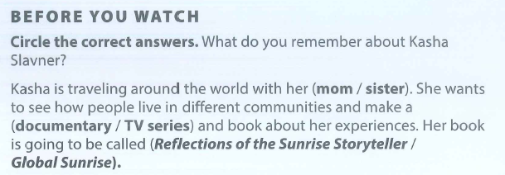

Slide 15
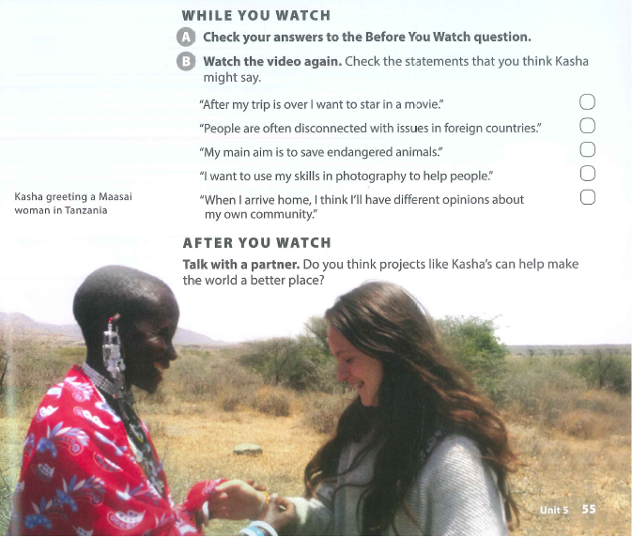

Slide 16
Pronunciation

Slide 17
What are compound nouns?
E.g. toothpaste
A compound noun is a noun made up of two or more words.
Can you think of more?

Slide 18
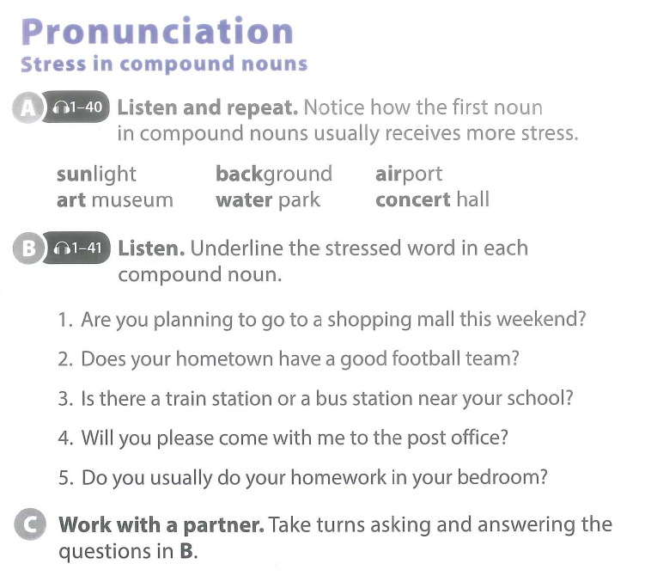

Slide 20
BREAK TIME

Slide 21
SCIENCE
Reuse & Recycle
Driving Question
How can we make rubbish useful?
Project Outline
Discuss what dangers face the earth and what will happen to the earth, if we do not change.
Plan ways for you to help the earth.
Research Vietnam’s recycling habits.
Create a way to turn rubbish into something useful in Vietnam.
Present it to your class.
Tools: 3DTin / Canva

Slide 22
Continue working on your project.
You will all do great. I believe in you!!
Look at these links if you need ideas:
http://www.viralnova.com/cool-trash-ideas/
http://www.mnn.com/lifestyle/recycling/blogs/10-beautifully-useful-things-made-from-useless-trash
http://tuoitrenews.vn/features/27206/ho-chi-minh-city-grows-unsightly-because-of-garbagetopped-bridges

