Slide 1
What Earth be like in the future
Grammar

Slide 2
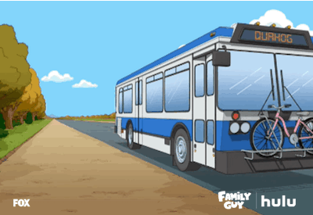
Stop the bus

Slide 3
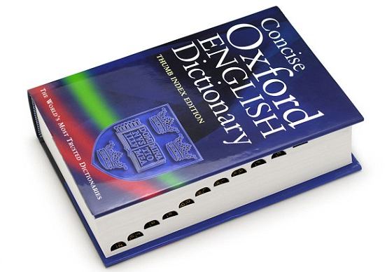
Dictionary Race

Slide 4
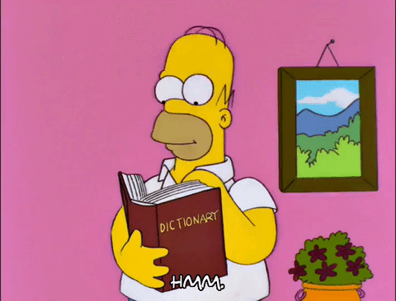
Dictionary Race
Work with a partner.
Look up each word.
Write the definition on the floor
The fastest two teams will get one point.
OMG SO EXCITING!! :O

Slide 5
Optimist
Noun. A person who thinks that good things will happen

Slide 6
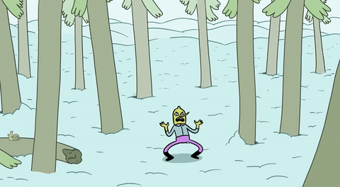
Expand
Verb. To become bigger or make something bigger.

Slide 7
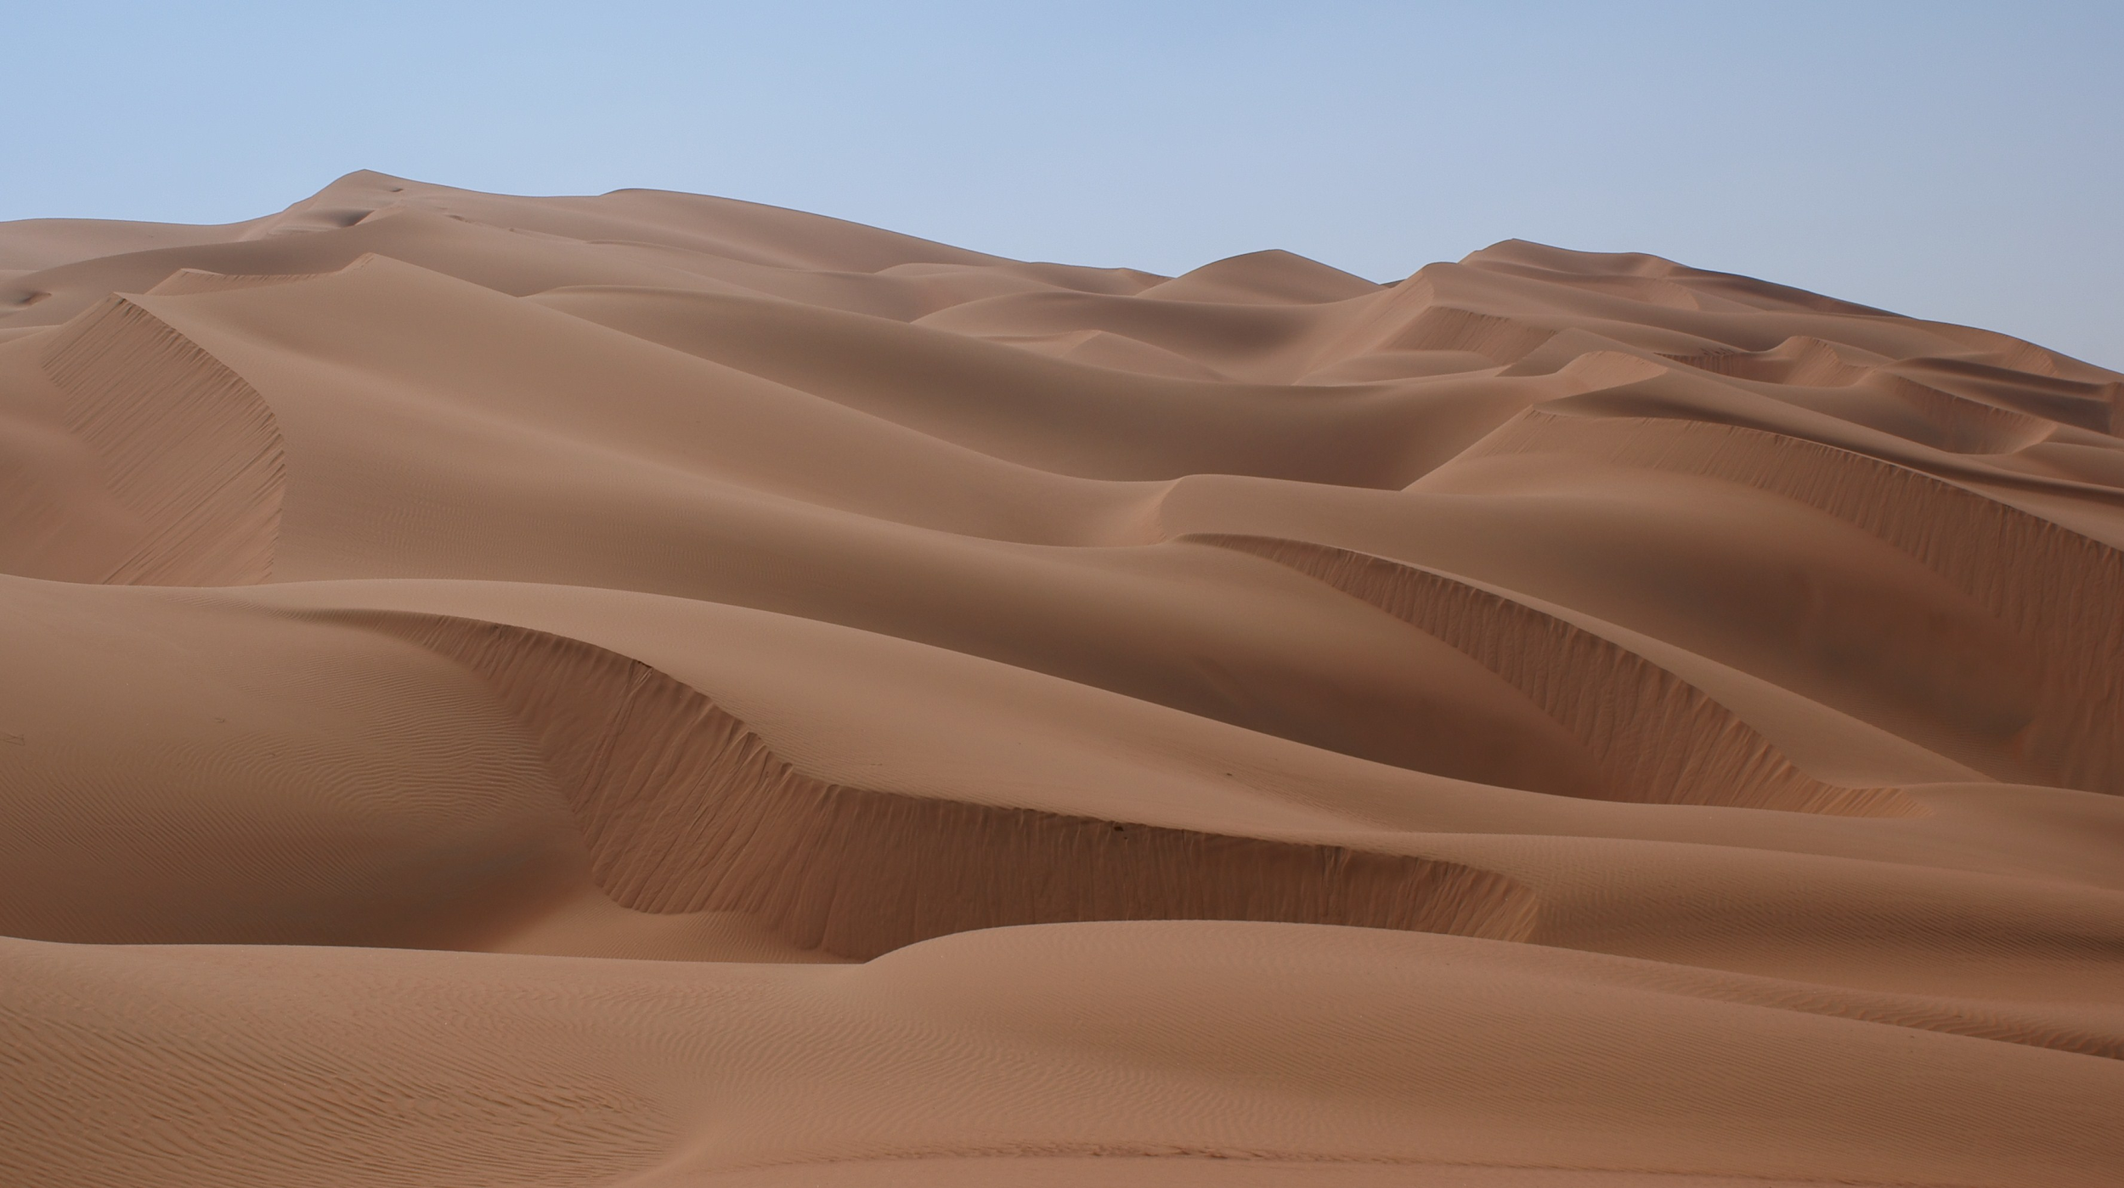
Desert
Noun. A large dry area of land with very few plants

Slide 8
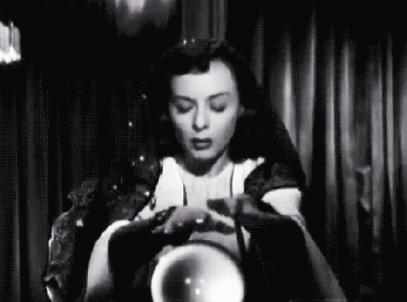
Predict
Verb. To say what you think will happen.

Slide 9
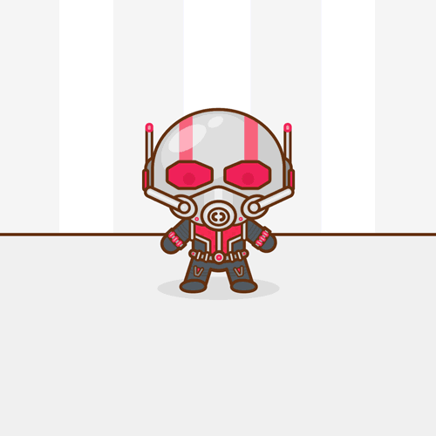
Shrink
Verb. To become smaller or make something smaller

Slide 10
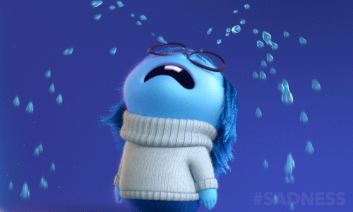
Pessimist
Noun. A person who thinks bad things will happen

Slide 11
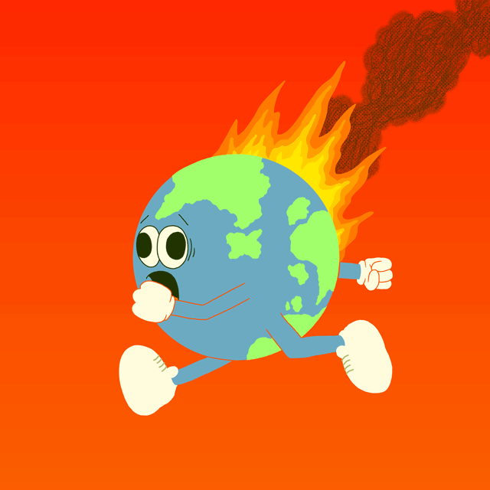
Global Warming
Noun. The fact that earth’s atmosphere is getting hotter because of increases in certain gases.

Slide 12
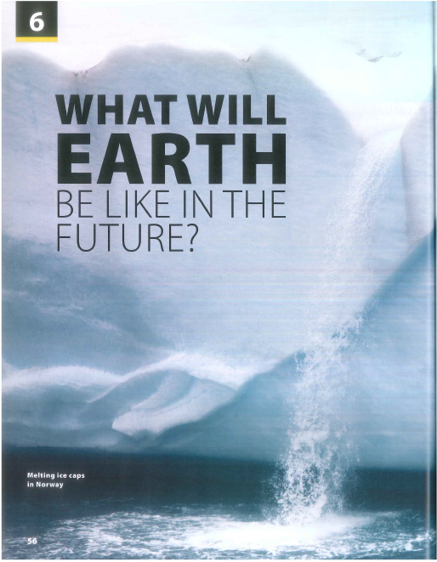

Slide 13
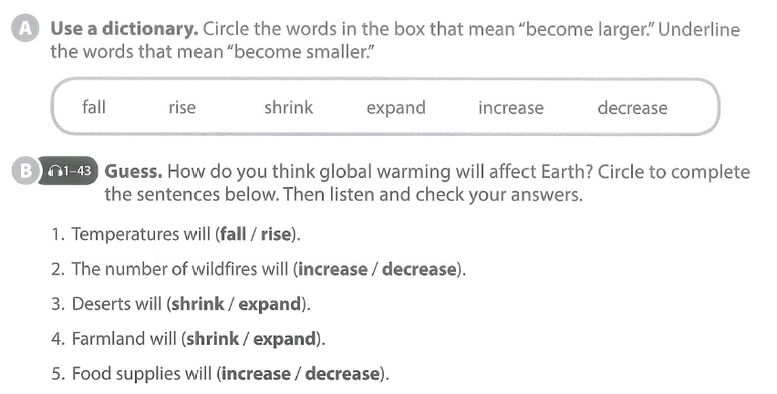

Slide 14
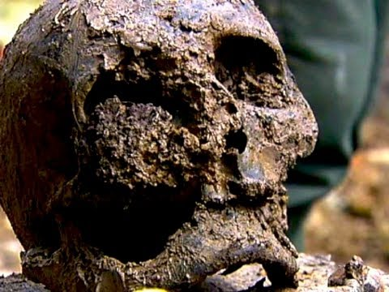
What are you some other effects of global warming?

Slide 15
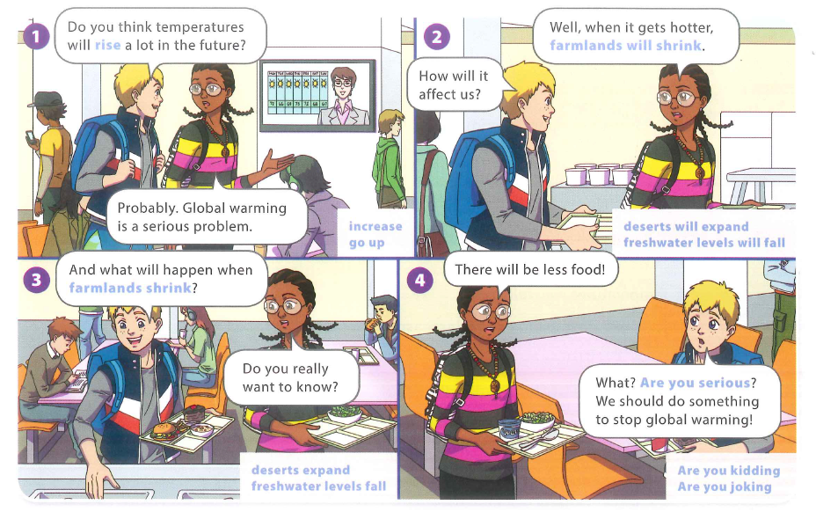

Slide 19
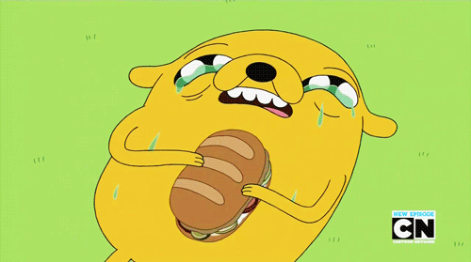
BREAK TIME

Slide 20
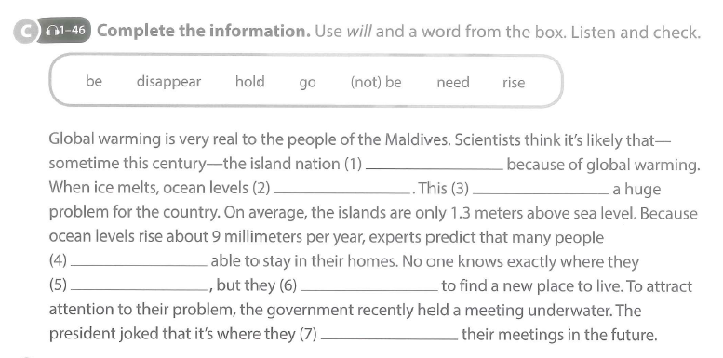

Slide 21
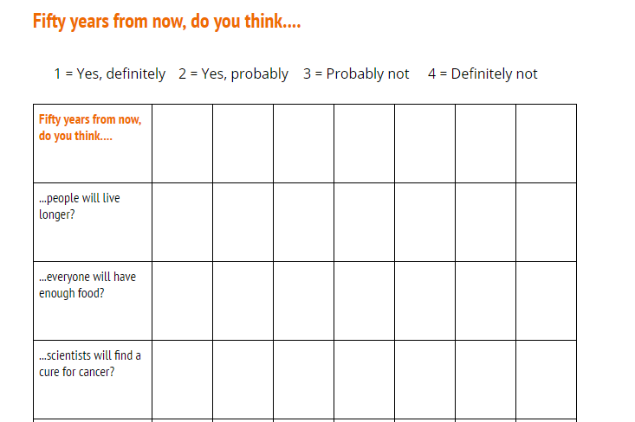

Slide 22
Making predictions about the future.
Definitely
Probably
Probably not
Definitely not

Slide 23
SCIENCE
Reuse & Recycle
Driving Question
How can we make rubbish useful?
Project Outline
Discuss what dangers face the earth and what will happen to the earth, if we do not change.
Plan ways for you to help the earth.
Research Vietnam’s recycling habits.
Create a way to turn rubbish into something useful in Vietnam.
Present it to your class.
Tools: 3DTin / Canva

Slide 24
Your presentation is next week
By the end of today’s lesson...
Finish your Slides.
Plan what each person in your group is going to say.
Practice speaking.

