Slide 1
An ancient murder

Slide 3
Pronunciation battleships

Slide 4
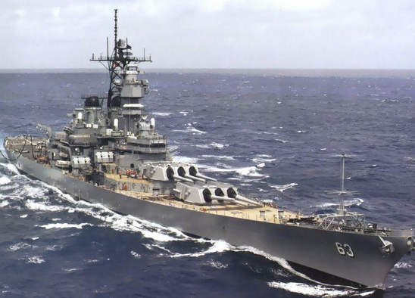
Rules:
2 players: place 3 words anywhere on your grid.
Say vocabulary words from your grid.
If your partner has a ship on that word, they say: HIT! You sink the ship!
If your partner doesn’t have a ship on that word, they say: MISS! Now it’s your partner’s turn.
The aim: to sink* your partner’s ships!
*sink: when something goes under water

Slide 5
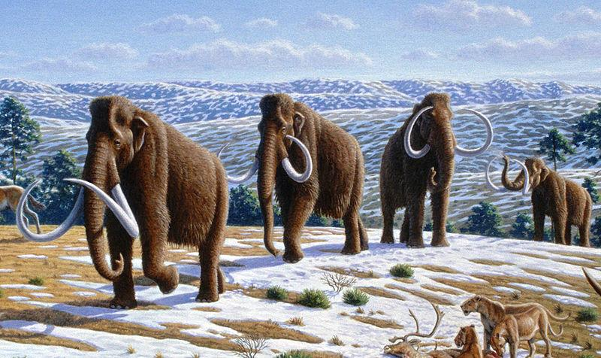
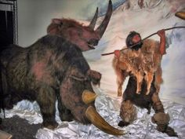
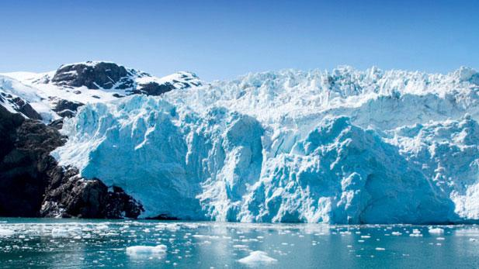
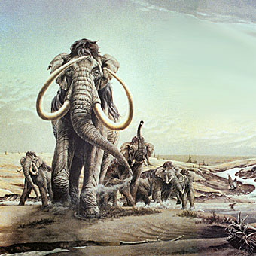
How long ago do you think these pictures were taken? What would be the good things about living at this time? What would be the bad things?

Slide 7
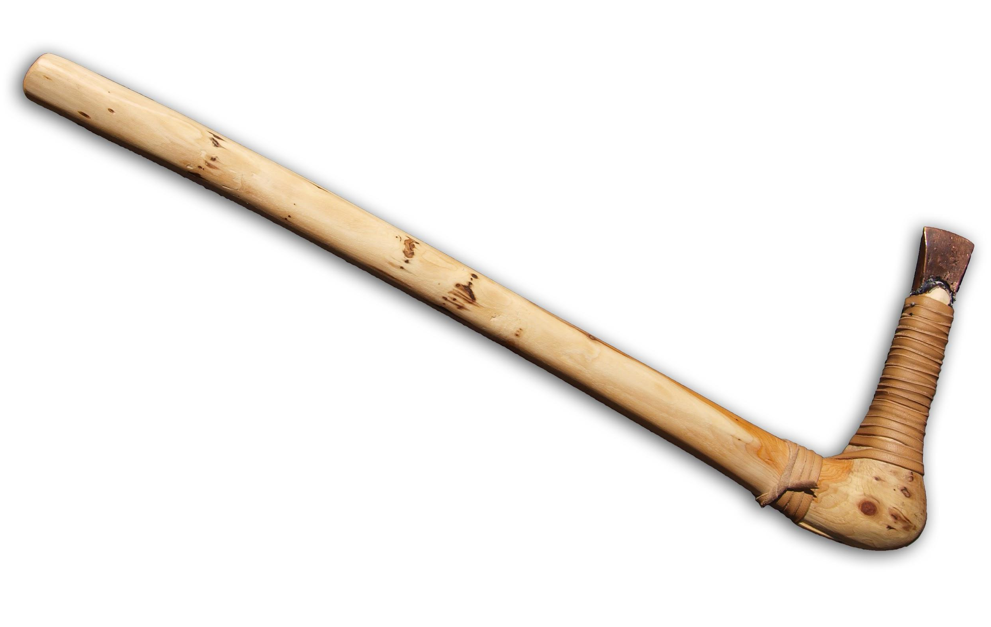
axe (noun)

Slide 8
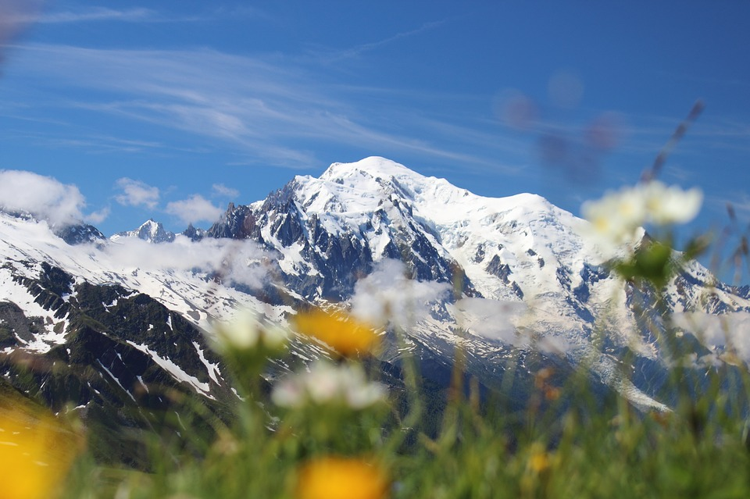
Alps (noun)

Slide 9
mystery (noun)

Slide 10
hiker (noun)

Slide 11
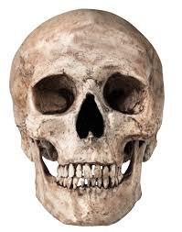
skull

Slide 12
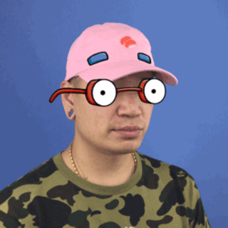
violent (adjective)

Slide 13
valuable (adjective)

Slide 14
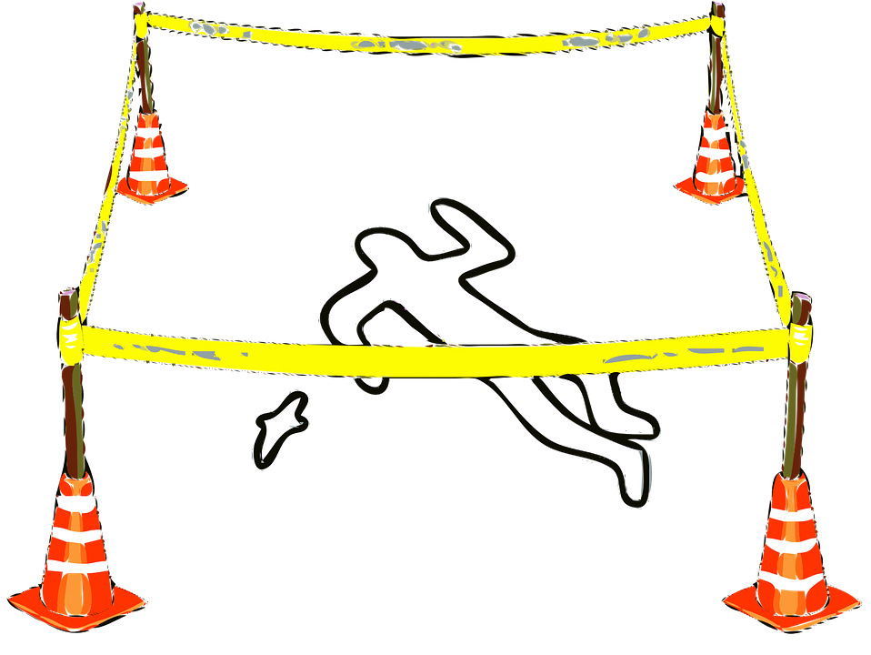
Murder (verb)

Slide 15
theory (noun)

Slide 16
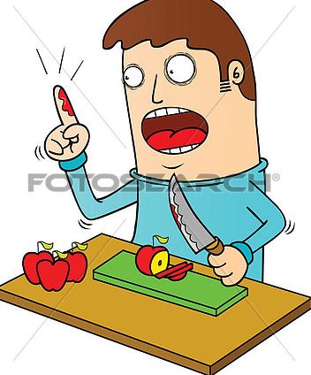
wound (noun)

Slide 17
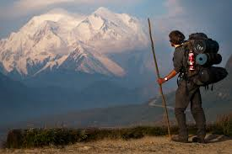
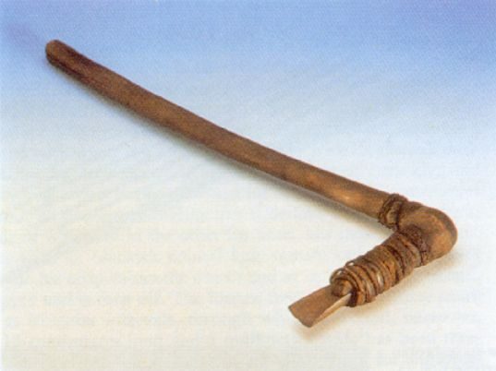
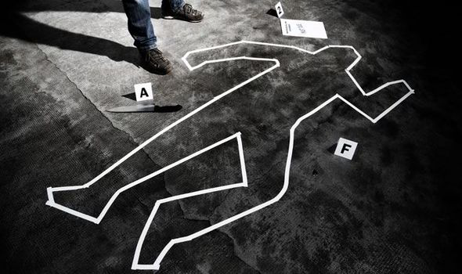
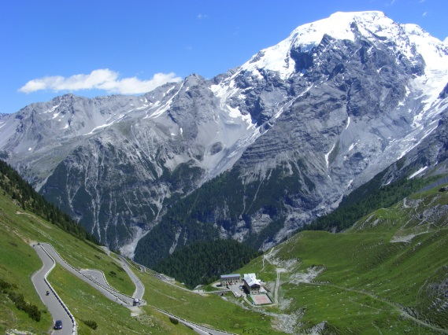
Running dictation
A
C
B
E
D

Slide 23
Write the word and it’s definition next to the correct letter
A________________________________
B________________________________
C________________________________
D________________________________
E________________________________

Slide 24
Match the words on your sheets to their definitions
When someone has been killed.
A problem someone is trying to find the answer to but doesn’t know it.
A group of mountains found in Europe.
Someone who is walking up a mountain.
A tool which can be used to cut things like meat, wood or even stones.

Slide 25
alps
hiker
copper axe
mystery
murder

Slide 26
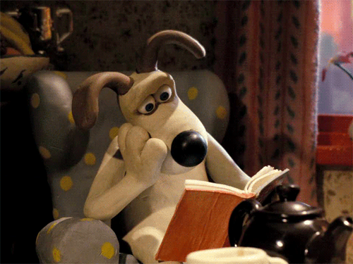
Reading

Slide 27
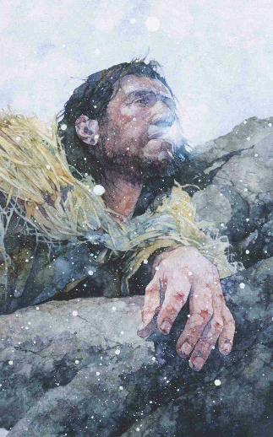

Slide 28
Turn to your books and do exercise A on page 72!
Read quickly! You have 2 minutes
Now turn to page 74 and do exercises A + B

Slide 29
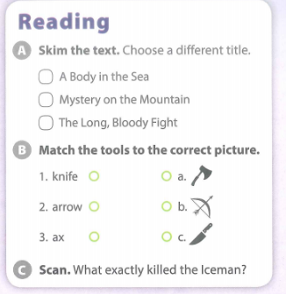
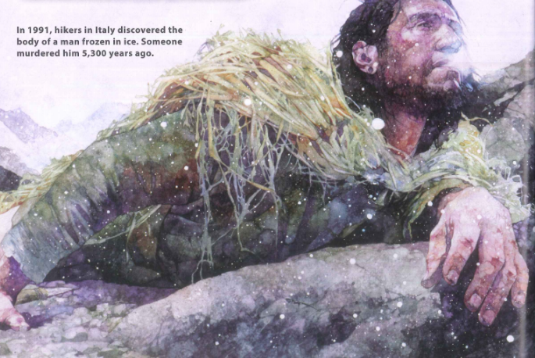

Slide 31
When did the Iceman die?

Slide 32
What were the Iceman’s shoes made of?

Slide 33
How old was the Iceman?

Slide 34
What killed the Iceman?

Slide 35
What did the Iceman have in his stomach?

Slide 36
Video

Slide 37
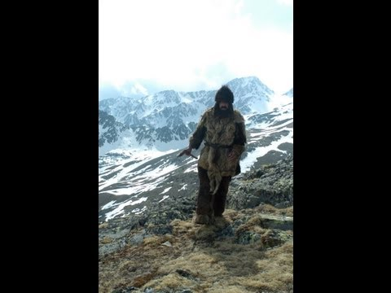
Watch the video.
Write down any words you don’t know!

Slide 38
Why do you think the iceman was killed?
Discuss with your partner
Write down 4 reasons you think he was killed!

Slide 39
Questions around the Room

Slide 43
21st Century
Project 1: It’s all in the past

Slide 44
21st CENTURY LEARNING
It’s All In The Past
Driving Question
Have we learnt anything from history?
Project Outline
Choose a historical event to research.
Create a timeline to show the details of the historical event.
Discuss whether anything has changed since this historical event and if we have learnt anything from it.
Tools: Dipity / Hstry / Our story

Slide 45
Class Rules!
SPEAK ENGLISH!

Slide 46
Class Rules!
Don’t forget your devices!

Slide 47
Class Rules!
No texting, social media, games, etc.!

Slide 48
Class Rules!
Make sure you are all contributing EQUALLY to your group project!

Slide 49
Functional English
In ……..
…….Years ago
For ………………………………...
From……………….. to…………..

Slide 50
Today:
1) Planning:
*What? Happened
*When? Did it happen
*Where ? Did it happen
*Who were involved?
2) Draw a timeline for your event
3) Present what your project is about to group. Explain who will do what.

Slide 51
Discussion questions

Slide 52
Discussion questions:
What historical event have you chosen?
Why are you interested in that historical event?
Has the world changed since the historical event?
What can you learn from the historical event?

