Slide 1
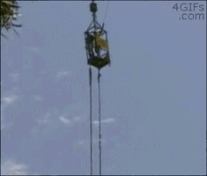
Bucket Lists

Slide 2
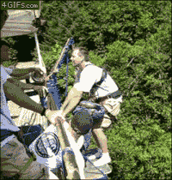

Slide 3
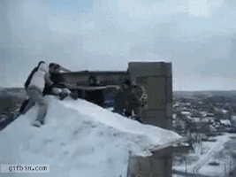

Slide 4
We are going to watch a video - try and answer these questions
What percent of people want to know when they will die?
What is a ‘bucket list’?
What does ‘kick the bucket’ (idiom) mean?
What countries do they visit in the video?

Slide 6
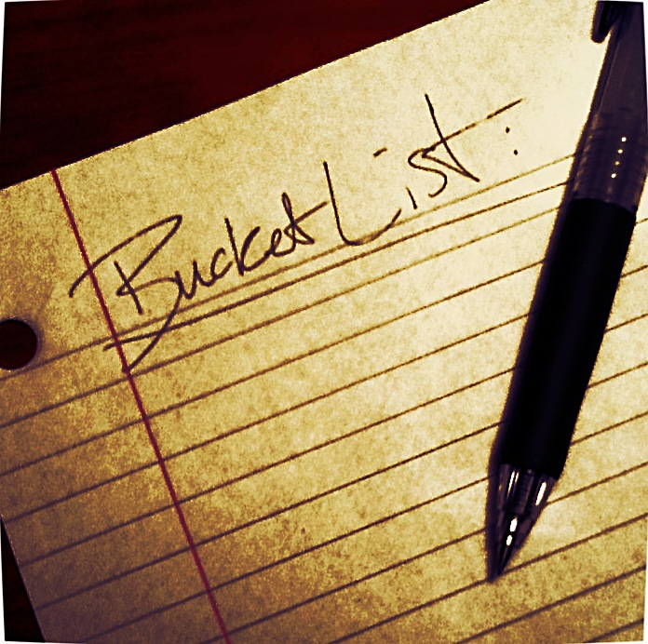
Bucket list quiz!

Slide 7
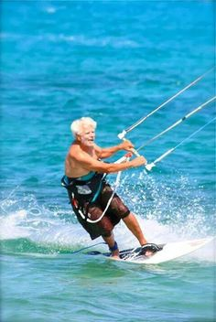
Bucket list idea number 1:
mismwing thiw hodplins
Notes:
Swimming with dolphins

Slide 8
Bucket list idea number 2:
givanh drichlen
Notes:
Having children

Slide 9
Bucket list idea number 3:
sabe munpjgi
Notes:
Base jumping

Slide 10
Bucket list idea number 4:
tooshing a nug
Notes:
Shooting a gun

Slide 11
Bucket list idea number 5:
givinl ni a friedfent trouncy
Notes:
Living in a different country

Slide 12
Bucket list idea number 6:
vellarting noti paces
Notes:
Travelling into space

Slide 13
Bucket list idea number 7:
gace viding thiw krahss
Notes:
Cage diving with sharks

Slide 14
Bucket list idea number 8:
geinb no VT
Notes:
Being on TV

Slide 15
Bucket list idea number 8:
blimc tonum stevere
Notes:
Climb mount everest

Slide 16
Tablet time!
A search for popular places to visit on lots of people’s bucket lists.

Slide 17
Tablet time!
In which country are Victoria falls?

Slide 18
Tablet time!
Draw ‘stonehenge’ on the board.

Slide 19
Tablet time!
In which country is ‘the Grand Canyon’?.

Slide 20
Tablet time!
In which country is Angkor?.

Slide 21
Tablet time!
In which country is ‘the great wall of China?’.

Slide 22
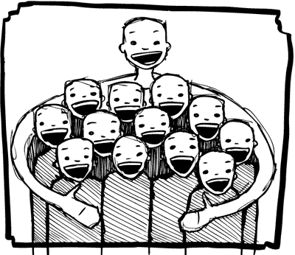
include

Slide 23
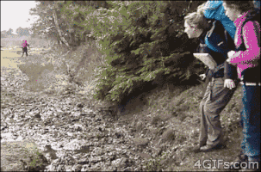
to backpack (v)
To travel with only one bag

Slide 24
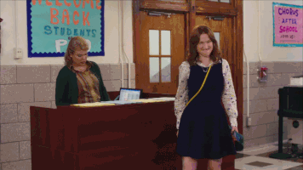
to achieve (v)
To succeed in doing something

Slide 25
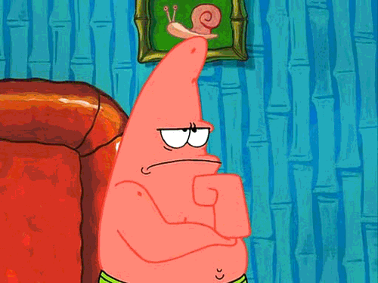
to give thought to (v)
To think about something

Slide 26
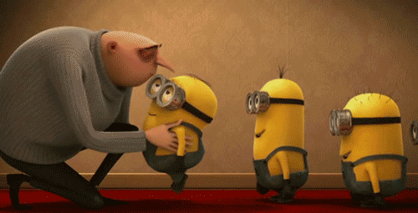
to attend (v)
To join

Slide 27
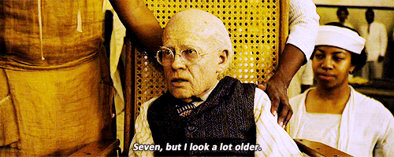
A lifetime (n)
The time between someone’s birth and death

Slide 28
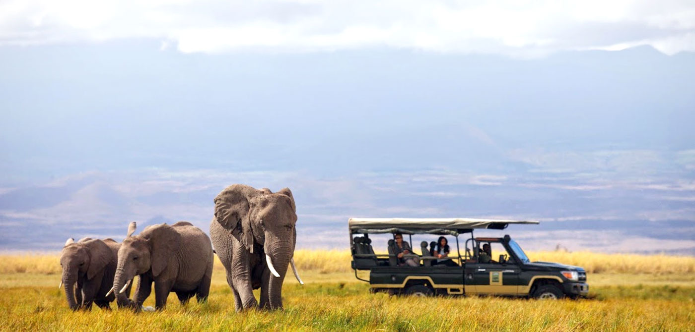
safari

Slide 29
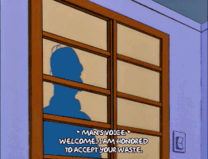
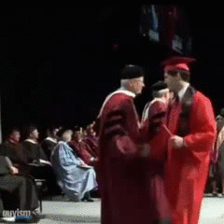
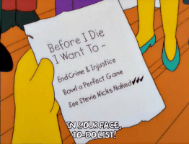
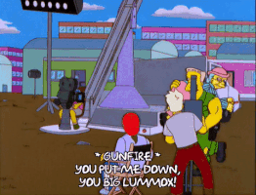
Notes:
Sticky ball?

Slide 30
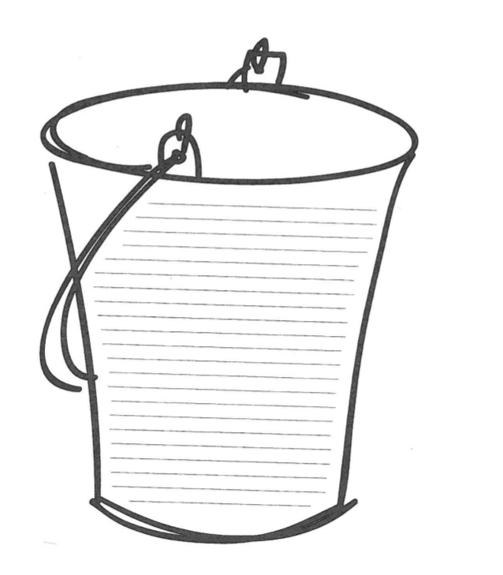
My bucket list
This is a list of all the things I want to do before I’m old! At number one is to visit 50 countries. I love travelling and meeting people from foreign countries. So far I have visited 12 - I have a long way to go! There are other things I want to do someday too. I want to ride an elephant, hug an orangutan, see the Northern Lights and go skydiving! Another thing I’d really like to do is...
Notes:
Homework is to write their own bucket list!

