Slide 1
Can you guess the holiday?

Slide 2
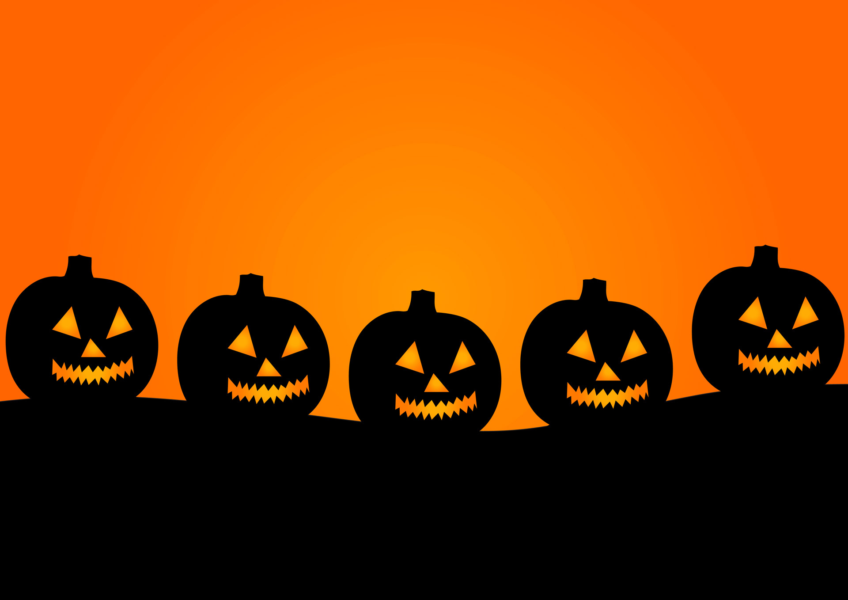

Slide 3
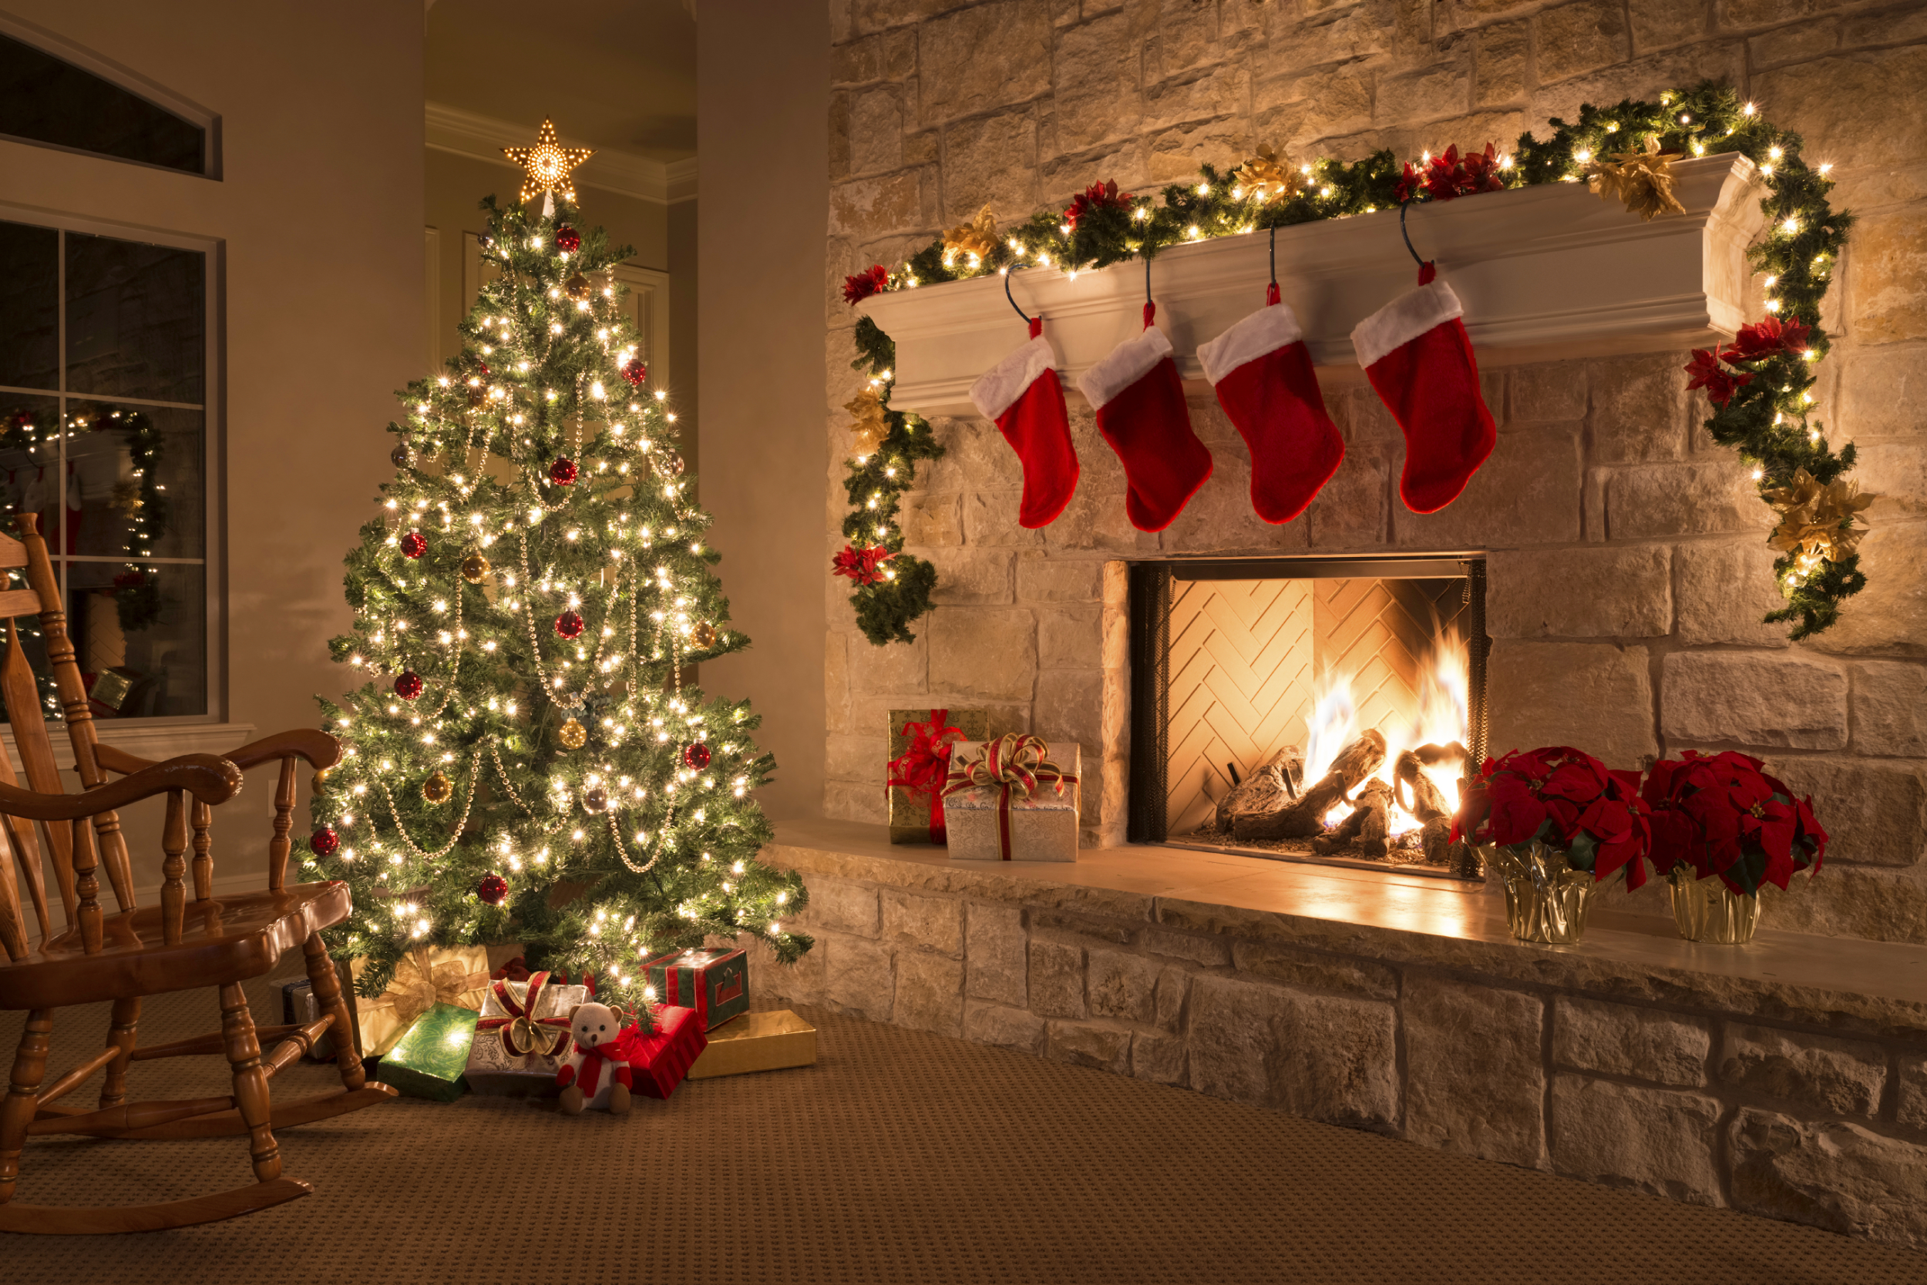

Slide 4
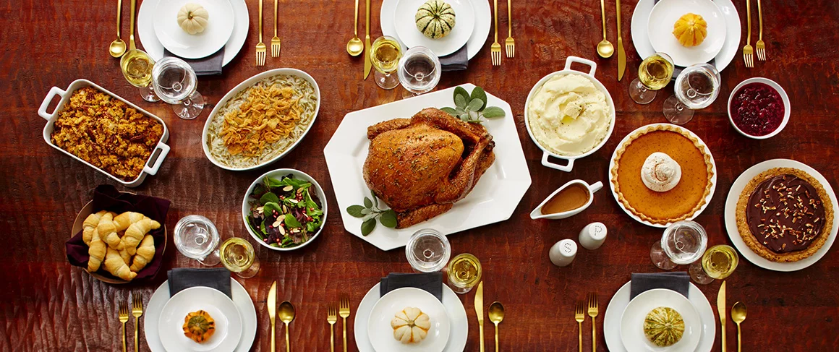

Slide 5
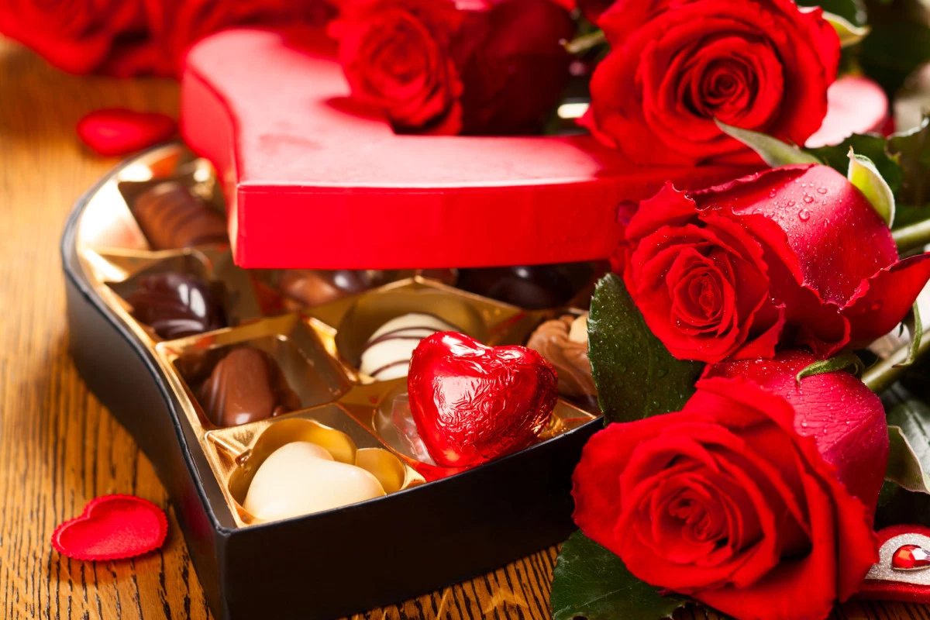

Slide 6
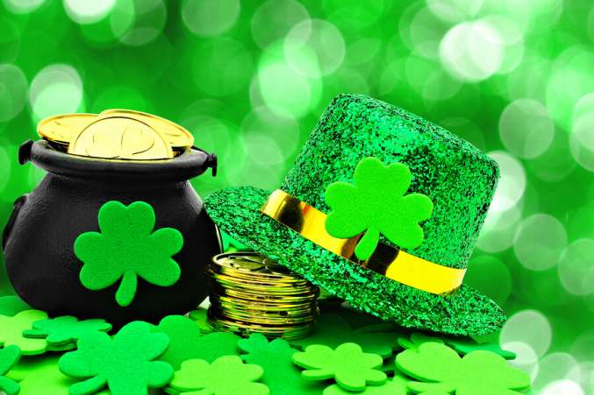

Slide 7
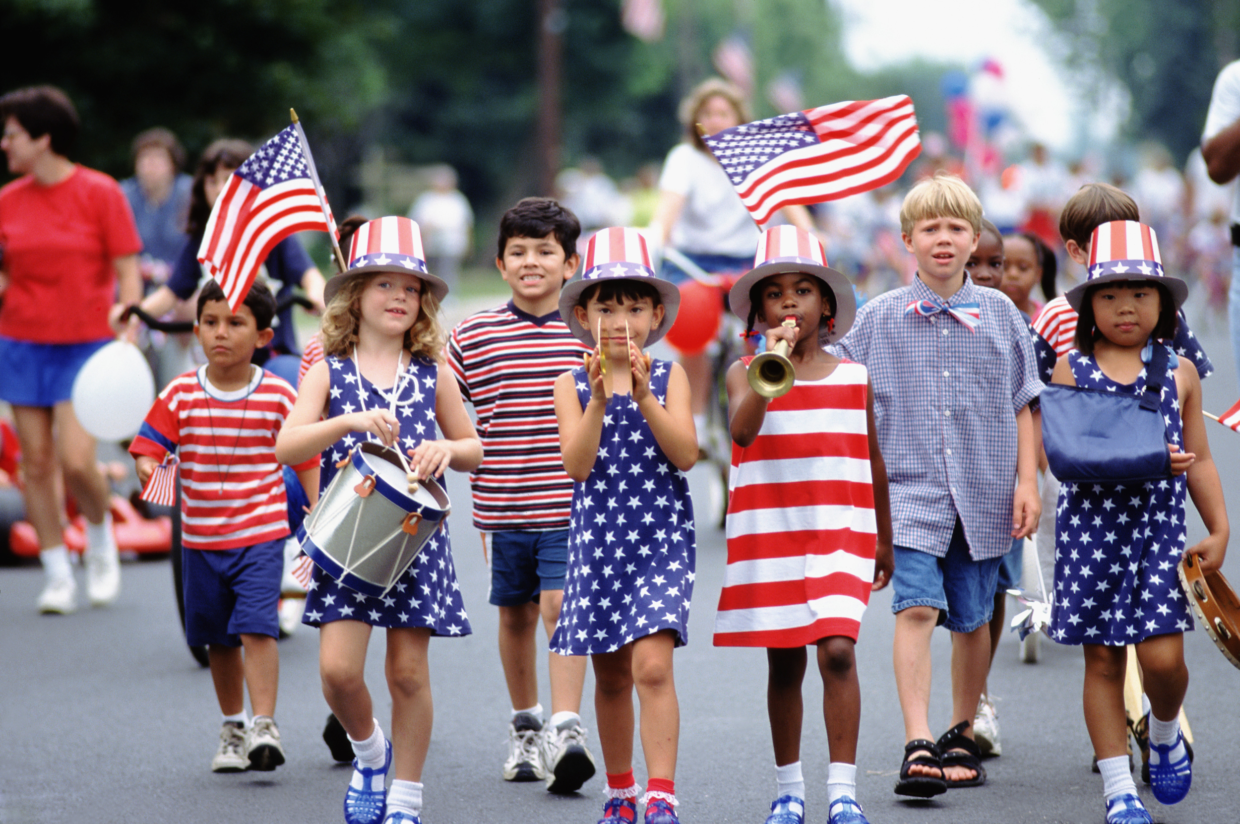

Slide 8
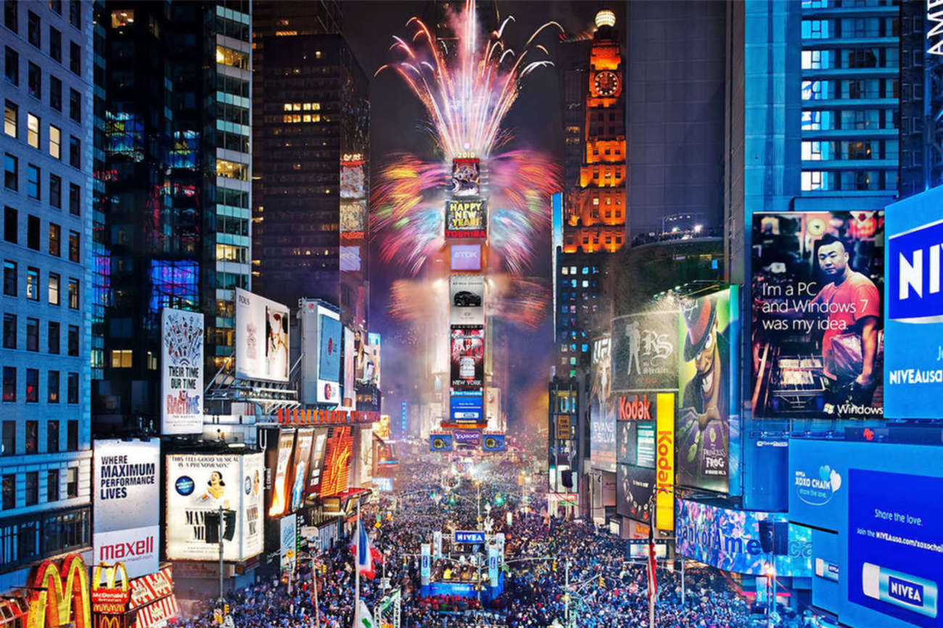

Slide 9
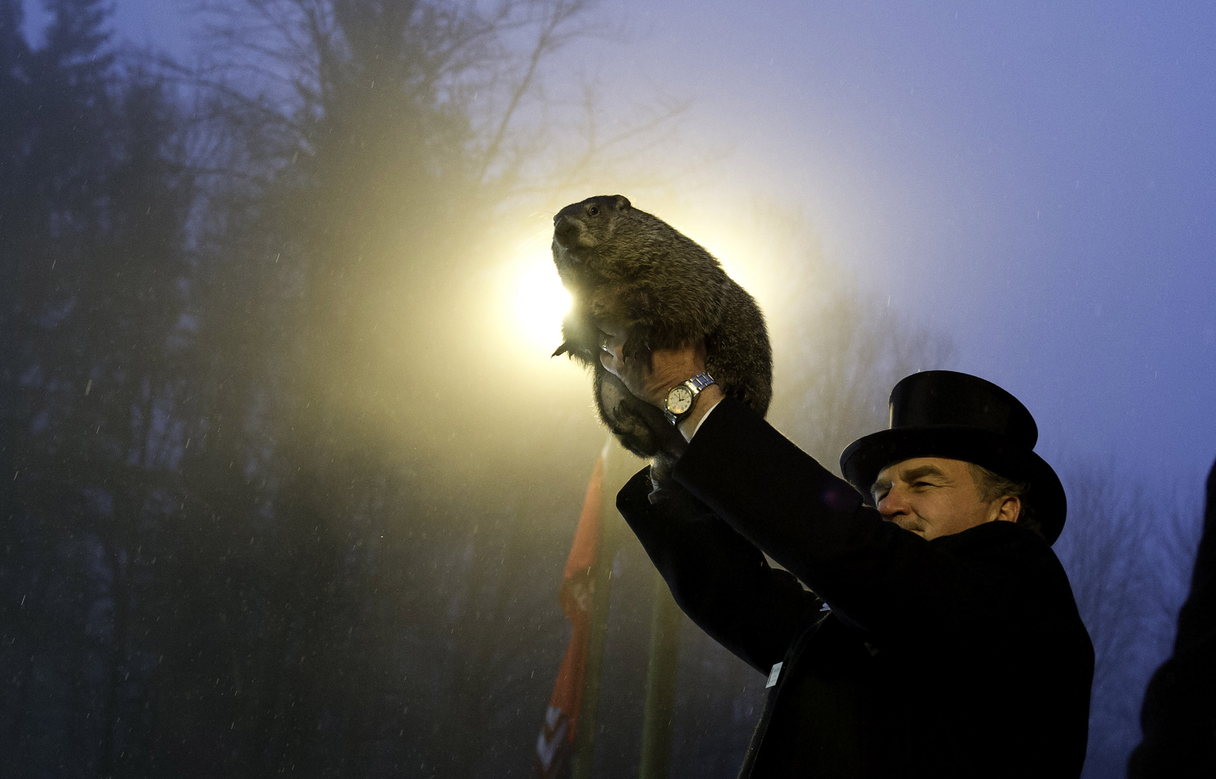

Slide 11
Halloween

Slide 12
Christmas

Slide 13
Thanksgiving

Slide 14
Valentine’s Day

Slide 15
St Patrick’s Day

Slide 16
Fourth of July

Slide 17
New Year’s Eve

Slide 18
Groundhog Day

Slide 19
Earth Day

