Slide 1
Global Warming
What will happen?

Slide 2
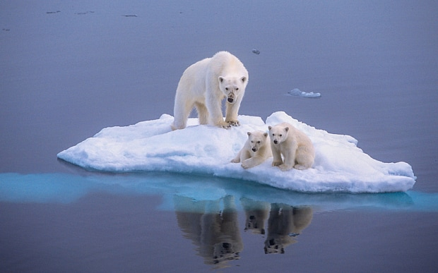
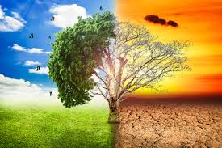
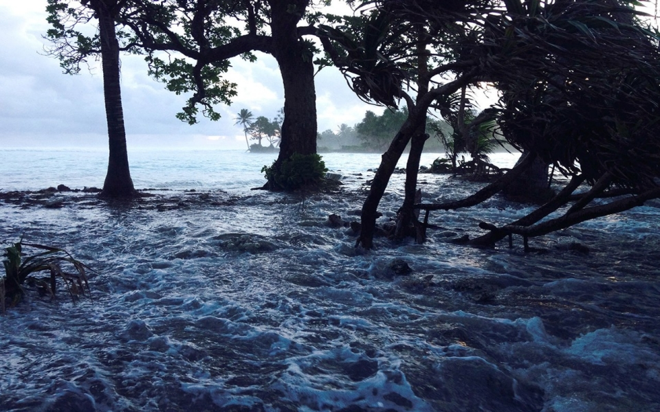
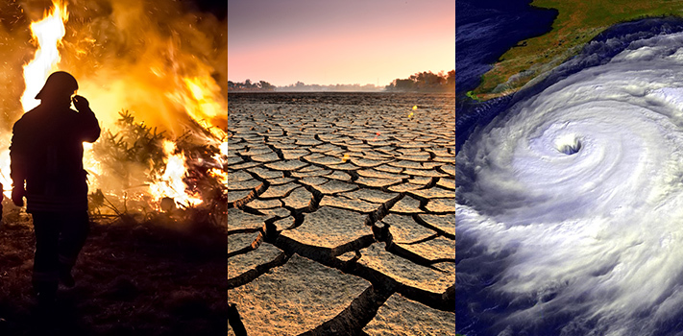

Slide 3
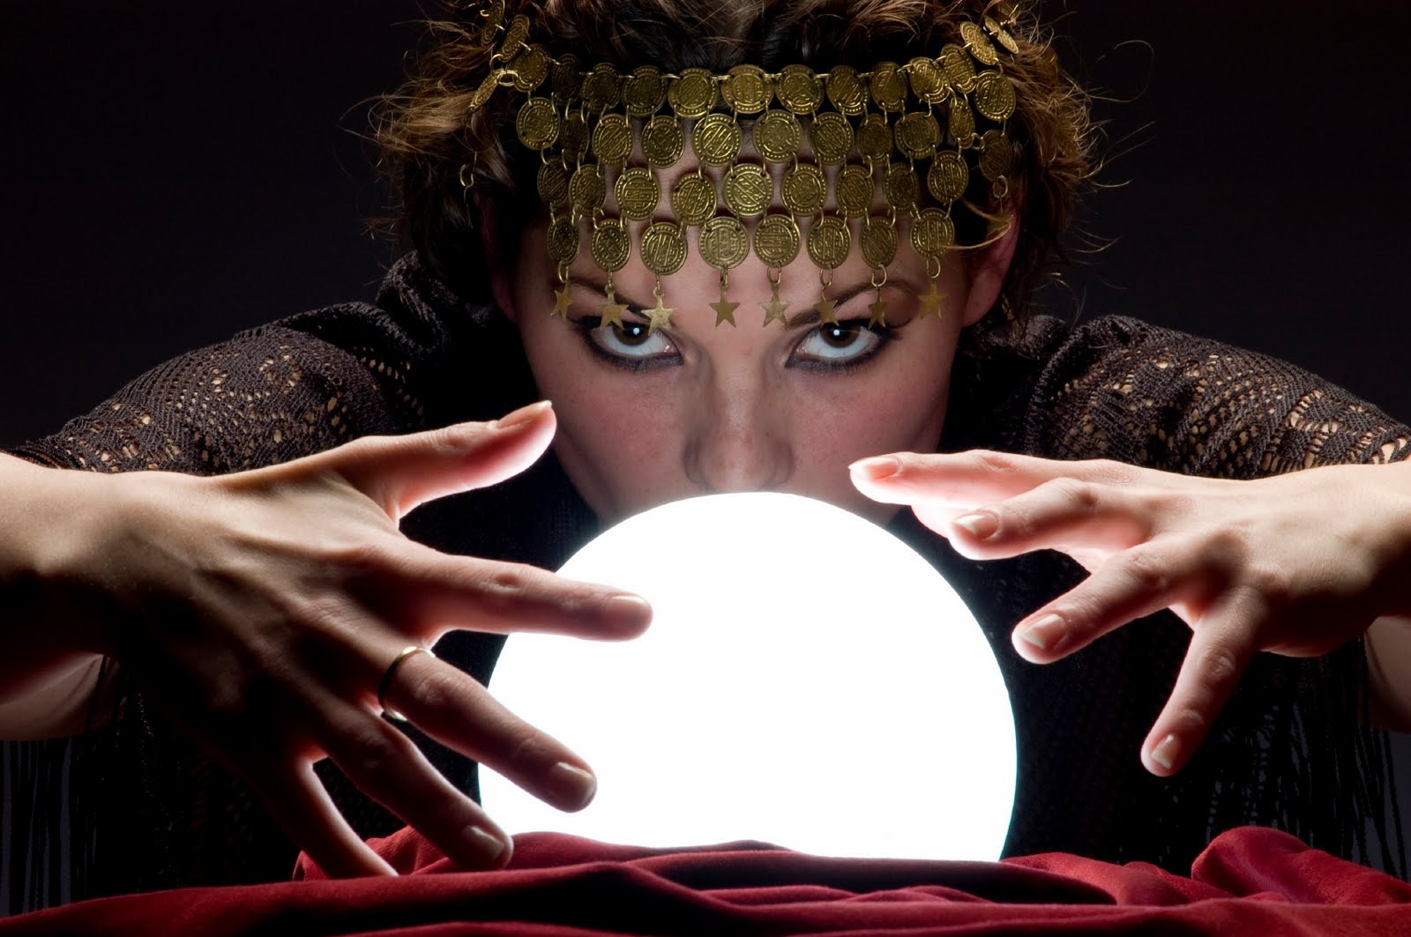
Grammar: Predicting the future
What will the future be like?
It will be hotter and drier.
Will there be a lot more people?
Yes, there will be a lot more people.
Do you think food prices will increase?
Yes, I do. I think they’ll increase.

Slide 4
___________ find ways to reduce pollution.
___________ try to reduce my carbon footprint.
___________ find a way to stop global warming.
I believe ___________ run out of oil and gas in the next 100 years.
There will be more drinking water in the future.
In 20 years, I think there will be less food for people to eat.

