Slide 1
Backs to the board!

Slide 2
dependable
Someone who you can _________.
Someone who h___lps you.
Someone who is always on

Slide 3
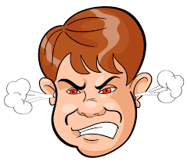
patient
Someone who is good at ________ing.
Someone who doesn’t get __________.

Slide 4
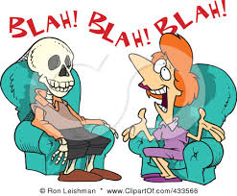
Chatty, talkative
Someone who ______ a lot. (blah blah blah)
Someone who is NOT _______. (shhhhh!)

Slide 5
Shy, introvert
Someone who doesn’t like to (go out/stay in)
Someone who doesn’t like (talking a lot/being quiet).
The opposite of ex________rt.

Slide 6
easygoing
Someone who is (difficult/not difficult) to get along with.
Someone who (always/never) wants to do what you want to do.
Someone who is very (smart/relaxed).

Slide 7
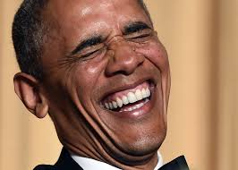
funny
Someone who makes you __________. (hahaha!)
Someone who has a good sense of __________.
Someone who likes to tell j_____s.

Slide 8
Extrovert, outgoing
Someone who likes to go _______.
Someone who likes to make new __________s.
Someone who is not (friendly/shy).
Someone who is very (friendly/shy).

Slide 9
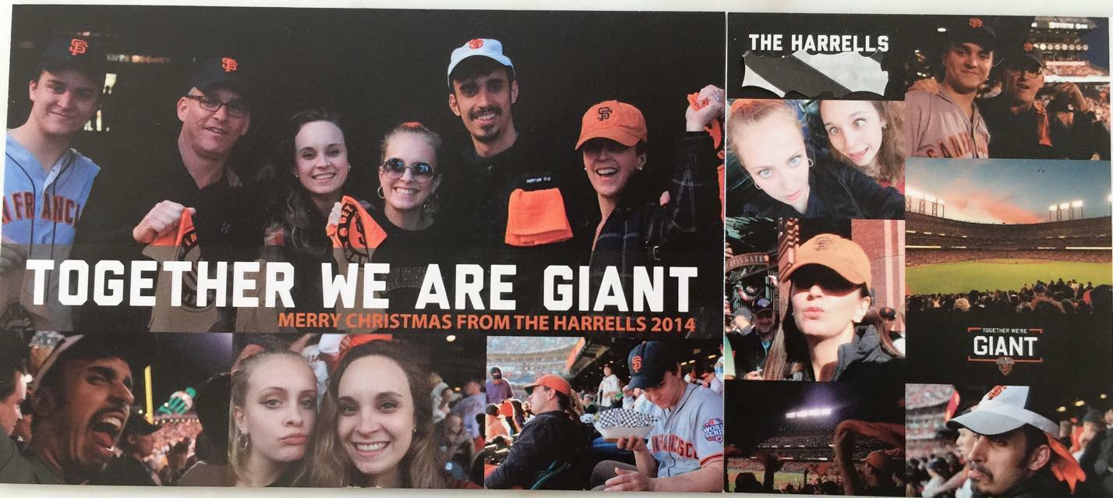

Slide 10
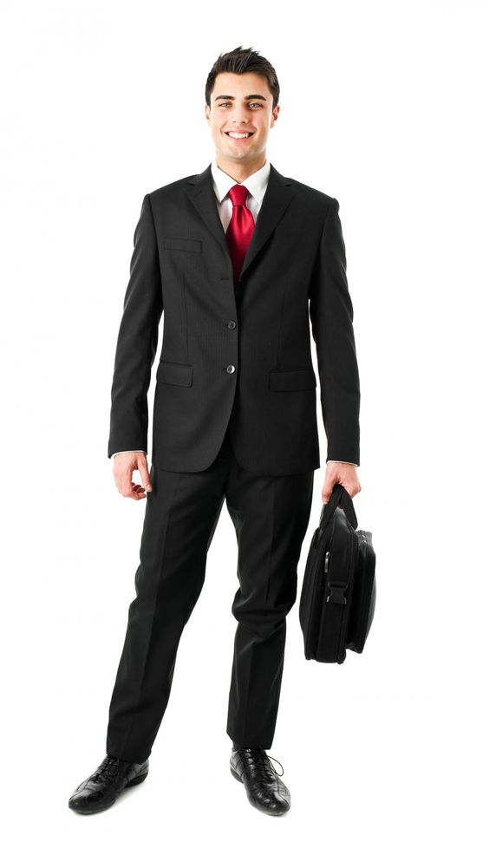
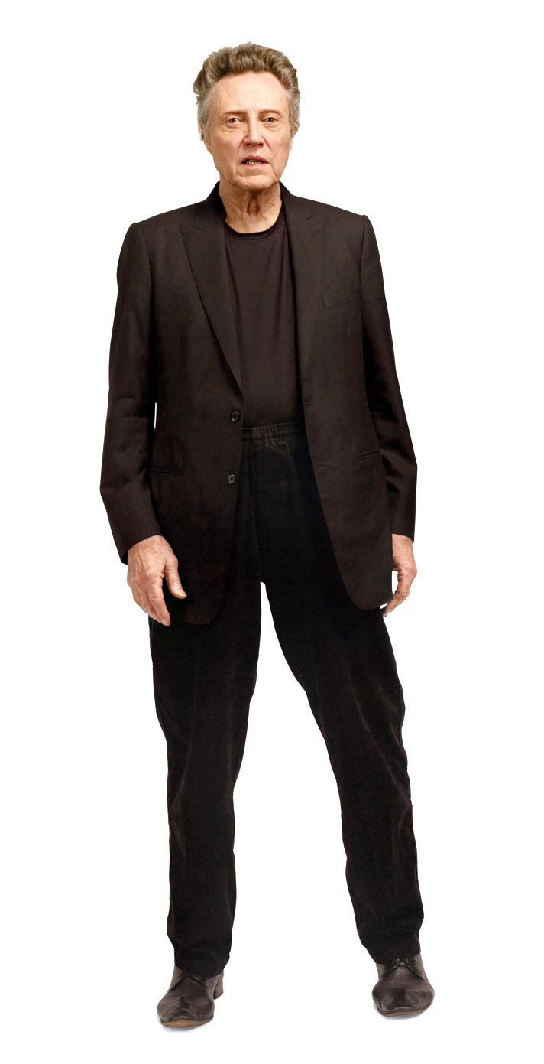
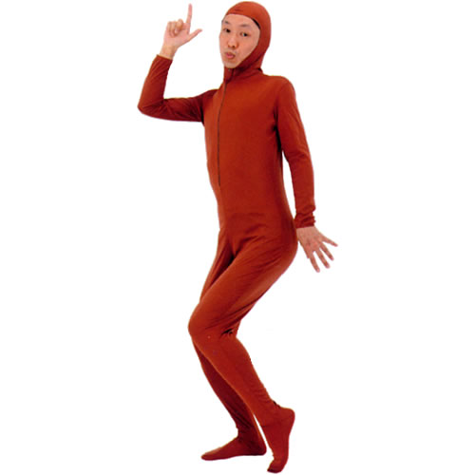
Chris Julie Steve Mr. PPAP Cindy

