Slide 1
Rules

Slide 2
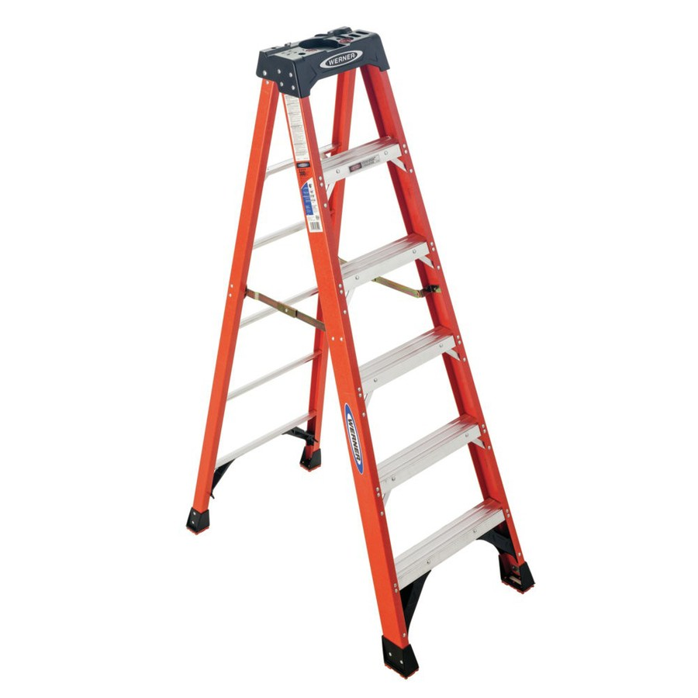
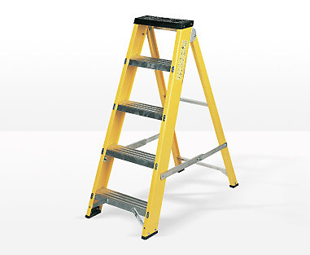
Ladders Game
Notes:
Other warmers: word train

Slide 3
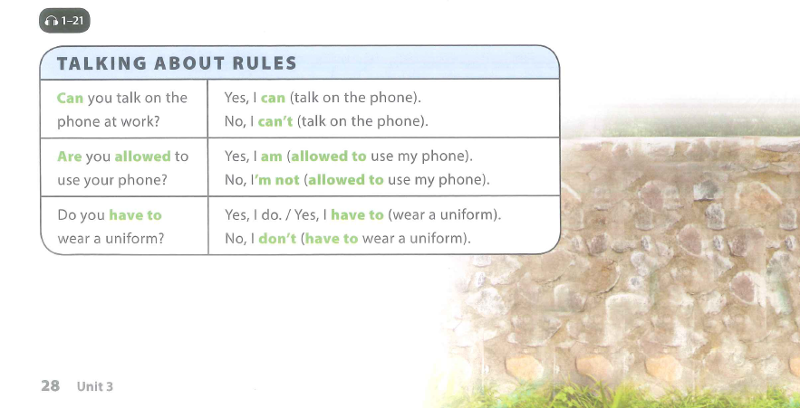

Slide 4
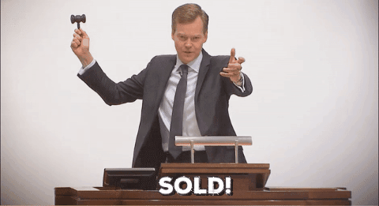
Grammar AUction

Slide 5
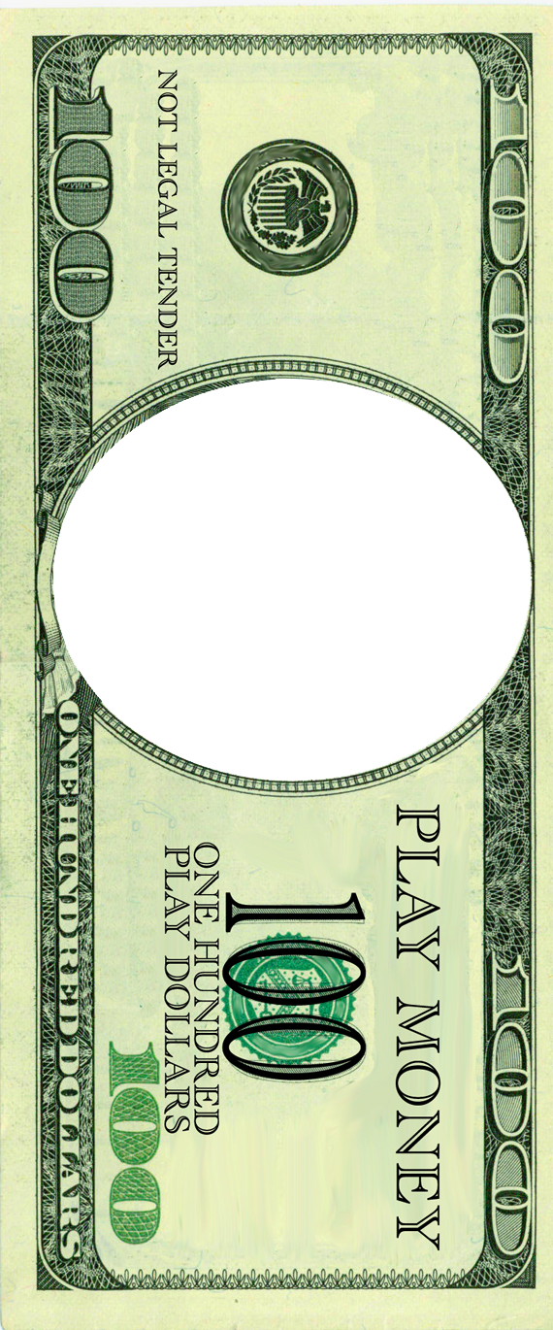

Slide 6
Are you allowed talk in class?

Slide 7
Do you allowed to use your phone?
2. No, I am have to wear a uniform.
3. No, I can’t talk on my phone.
4. Do you have wear uniform?
5. Can you talking on the phone at work?
6. Can you watch movies and eat popcorn?
7. Are you allowed park your bike at the bus stop?
8. Are you have to bring your own laptop to the library?
9. You are not allowed to listen to music here.

Slide 8
RULES AROUND THE WORLD!!!
Do you know any funny laws from different countries?

Slide 9
Where in the world…?
You have to be a qualified electrician to change a lightbulb.
1

Slide 10
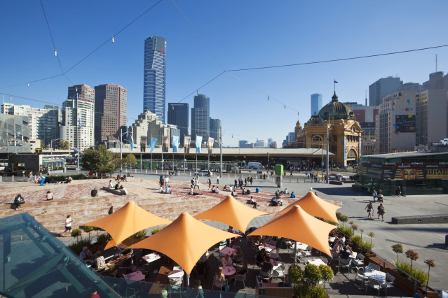
VICTORIA, AUSTRALIA!
A law in Australia’s second-most populated state decrees that it’s illegal to change a light bulb unless you’re a licensed electrician.
Rebels who defy this law could receive a fine of up to AU$10.

Slide 11
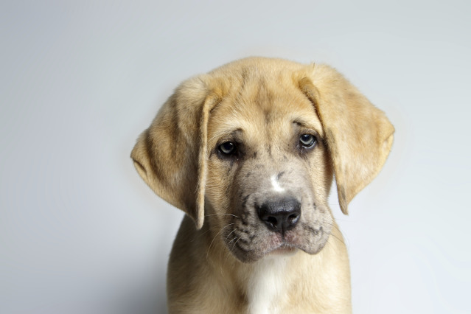
Where in the world…?
It is illegal to look miserable!
2

Slide 12
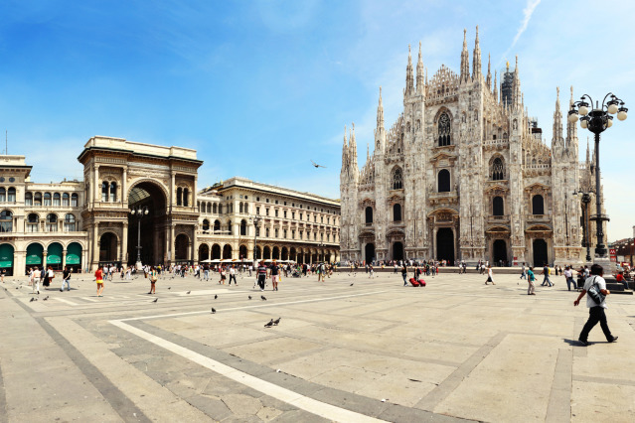
Milan, italy!
A law here states that it is a legal requirement to smile at all times, except during funerals or hospital visits.
Frowners could face a hefty fine.

Slide 13
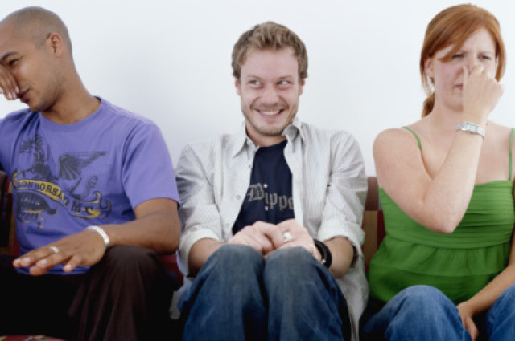
Where in the world…?
You aren’t allowed to fart after 6pm on a Thursday.
3

Slide 14
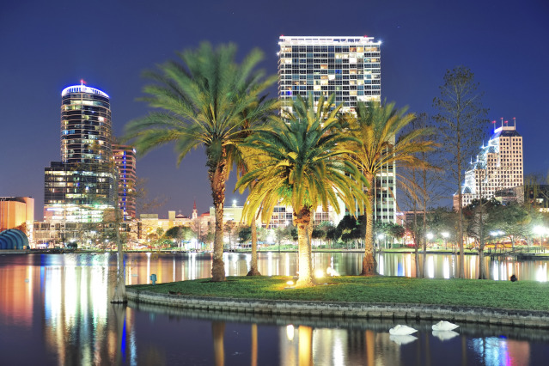
Florida, USA!
Yes, it is It is illegal to fart in a public place after 6pm on Thursday. 5.59pm is fine.

Slide 15
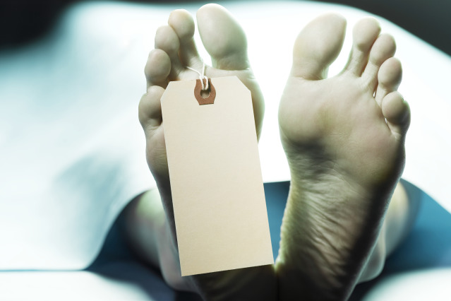
Where in the world…?
It is illegal to die in the Houses of Parliament.
4

Slide 16
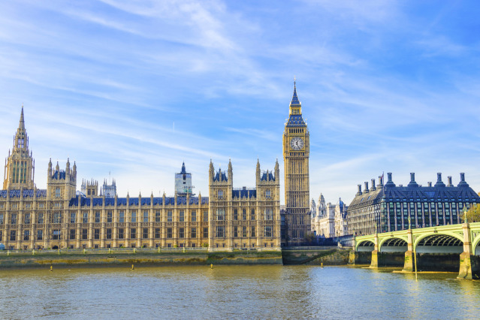
England
This was voted the most ludicrous law in the UK in 2007.

Slide 17
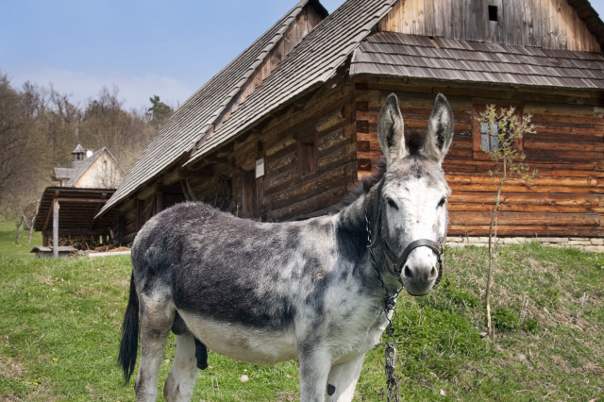
Where in the world...
It is against the law to have a sleeping donkey in your bathtub after 7pm!!
5

Slide 18
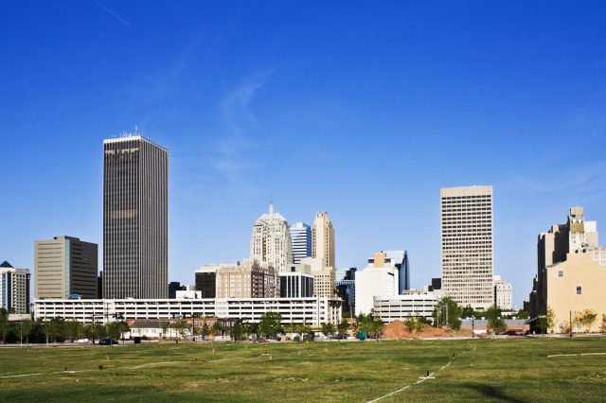
Oklahoma, USA!

Slide 19
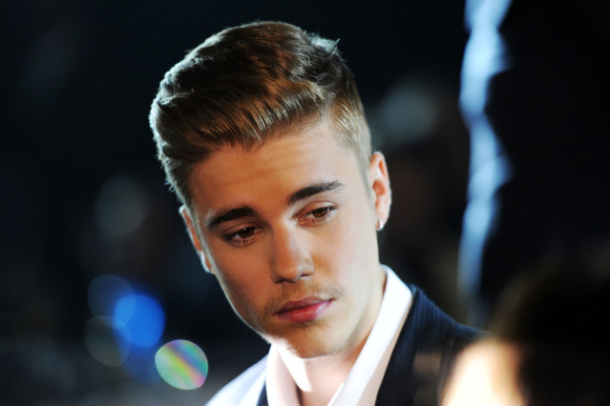
Where in the world…?
1 in every 5 songs played on the radio MUST be sung by a native singer.
6

Slide 20
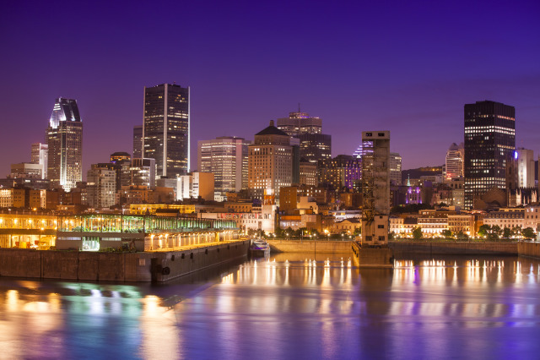
CANADA!
Great for Justin Bieber fans, not so great for the rest of the human population.

Slide 21
Where in the world…?
It is illegal to be fat.
7

Slide 22
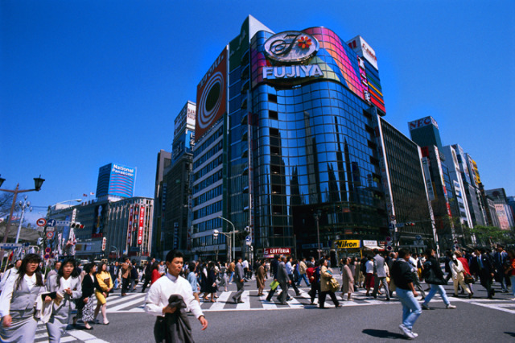
JAPAN!
In the country that brought us sumo wrestling, it is illegal to be fat.
In 2009, lawmakers set a maximum waistline, meaning every man aged over 40 must not have a waistline measuring over 80cm, and every woman cannot measure over 90cm.

Slide 23
Where in the world…?
8
You can’t flush the toilet after 10pm.

Slide 24
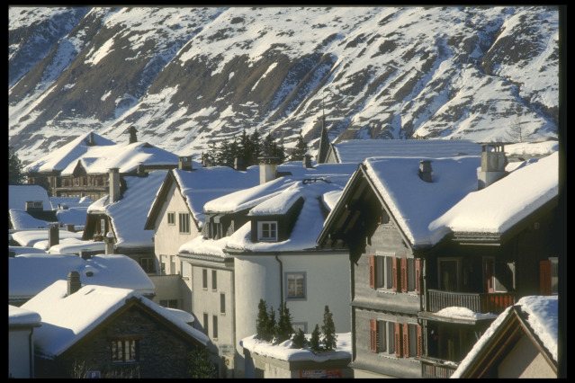
Switzerland!
Flushing the loo after 10pm in an apartment building is illegal in Switzerland.
The government considers it noise pollution!

Slide 25
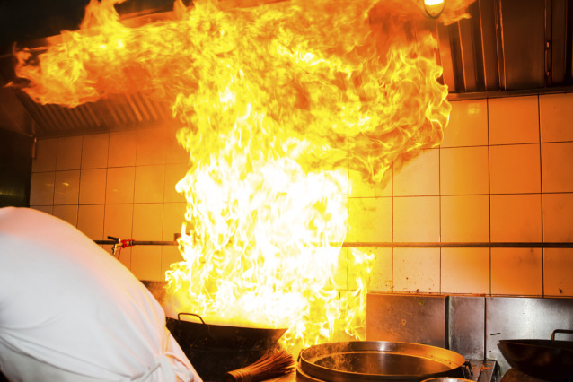
Where in the world...
You can’t eat in a restaurant if it is on fire.
9

Slide 26
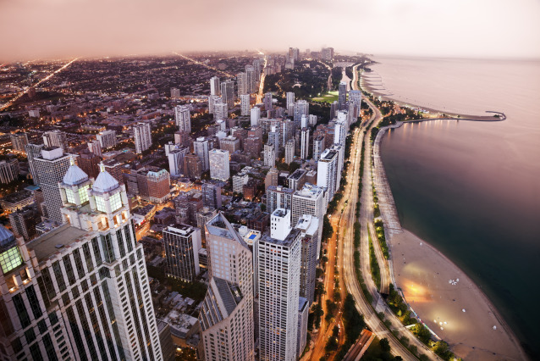
Chicago, USA
No matter how good the pizza tastes, if the restaurant sets on fire – you can’t stick around!

Slide 27
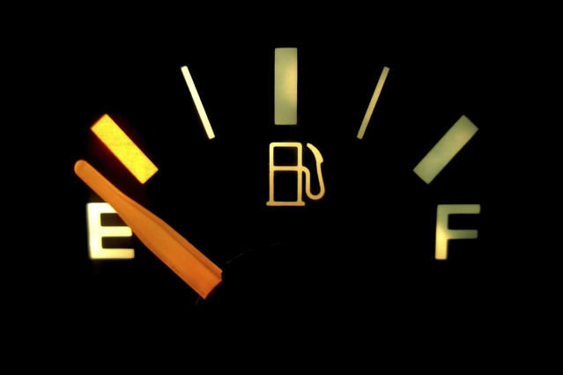
Where in the world…?
You aren’t allowed to run out of petrol on the motorway.
10

Slide 28
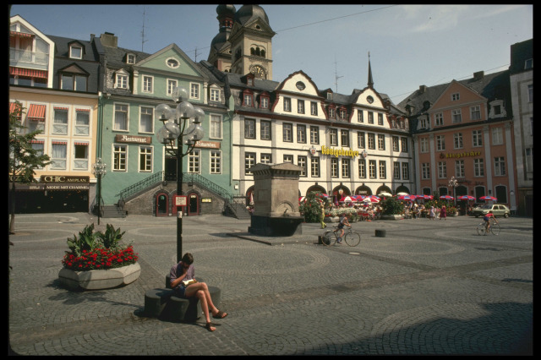
GERMANY
On Germany’s legendary highway, running out of petrol is illegal, and so is walking along the autobahn.
So those who do break down must pull over and use their horn to attraction attention. The penalty is €80 for endangering other drivers.

Slide 29
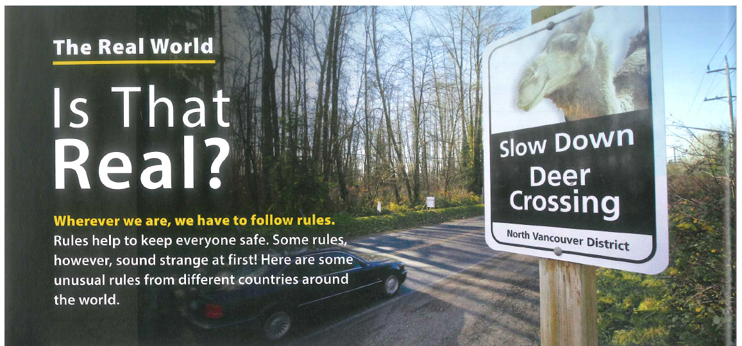

Slide 30
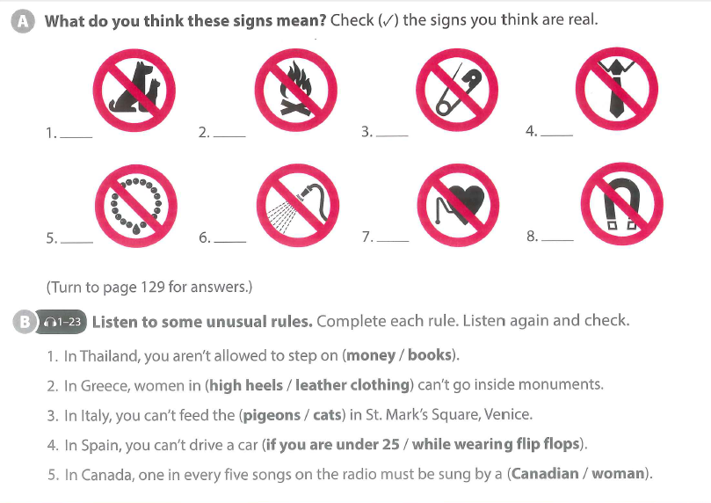

Slide 31
Are there any unusual rules in vietnam?

Slide 32
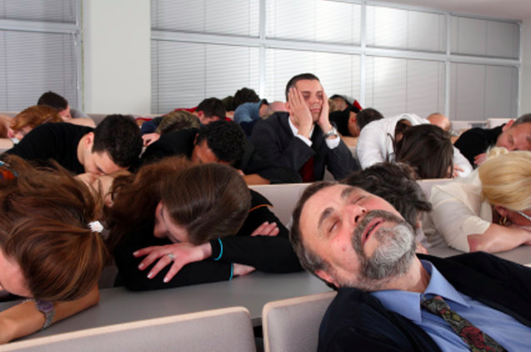
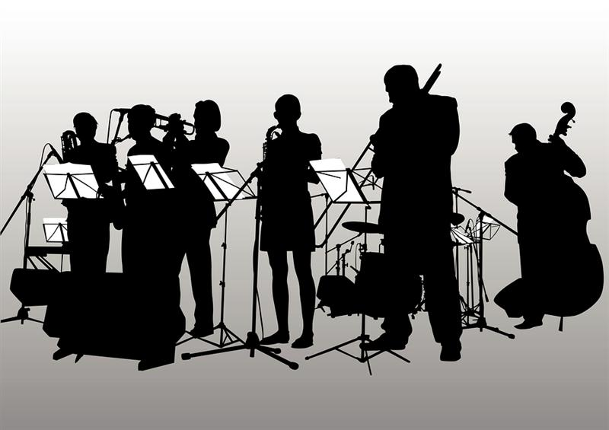
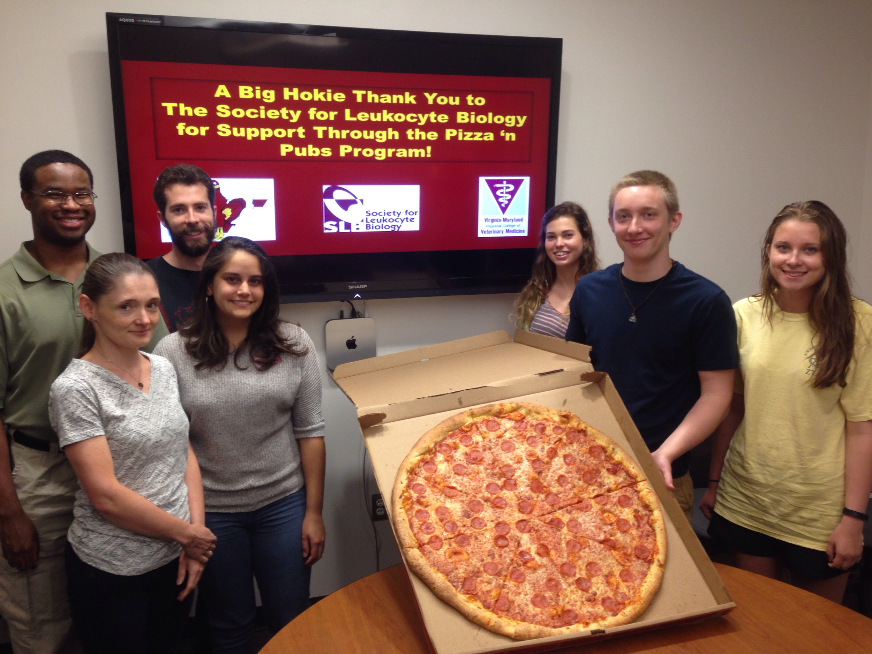
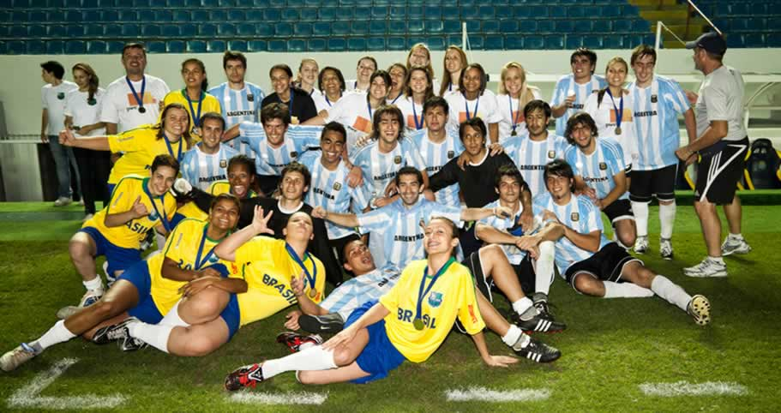
Notes:
What clubs are these?

Slide 33
Communication: GET INTO GROUPS OF 3!
Choose a club you want to start!
What is your club name?
Think about 4/5 rules for your club.
Draw signs for them.
Show the other groups your signs. Can they guess the rules?
Notes:
Extension idea: Make a poster for your club with the signs written on it. Present your poster to class.

Slide 34
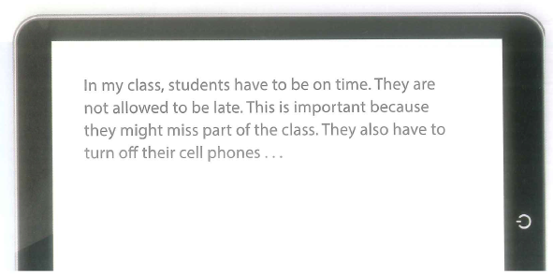
Homework:
Write a paragraph for your club
Explain the rules and the reasons for them!

Slide 35
Open your books to page 30

Slide 37
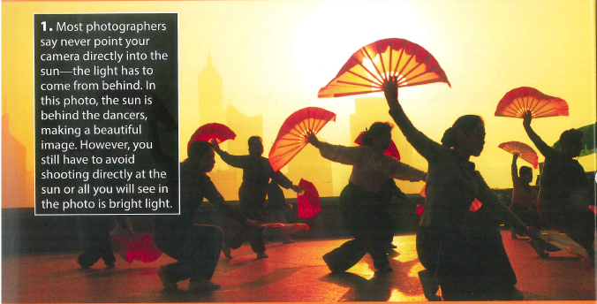

Slide 39
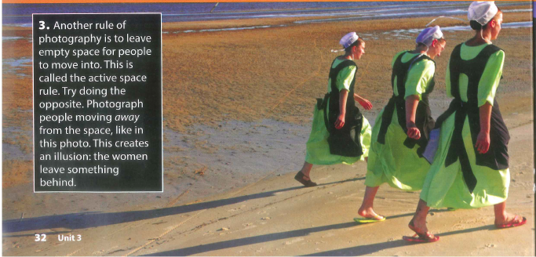

Slide 40
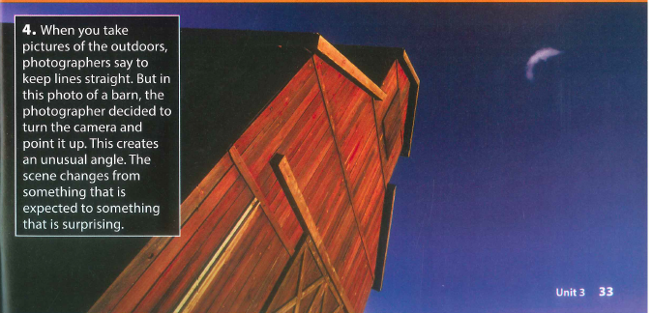

Slide 42
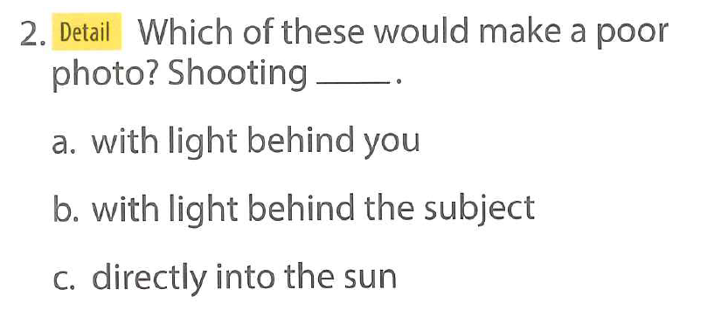

Slide 44
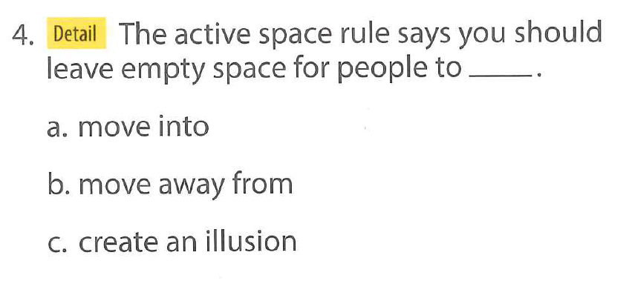

Slide 45
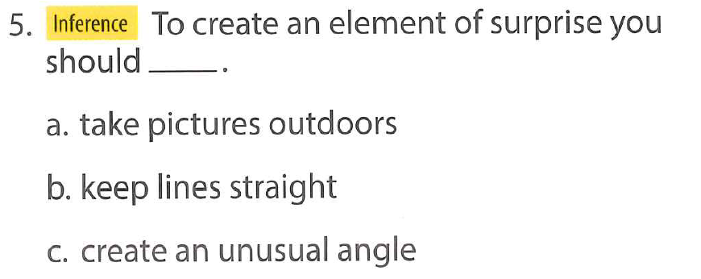

Slide 46
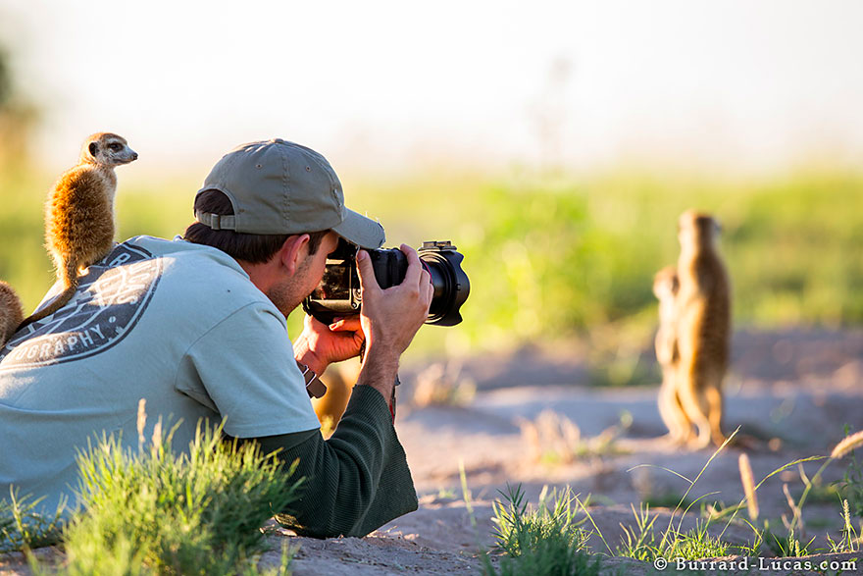

Slide 47
Use your tablets/phone:
Find a photograph you like
(5minutes)
Explain to your group why you like it!

Slide 48
SOCIAL STUDIES
Cities Rule!
Driving Question
Do we need to create more rules or laws to make Vietnamese cities safer?
Project Outline
Choose a safety problem that affects Vietnam. For example, roads & transport, health, food, tourist attractions, buildings, animal treatment etc...
Research information about your topic and make rules that could help to make Vietnamese cities safer.
Find a way to raise awareness to the public about your safety topic. (video, poster, advertisement)
Tools: WIX / WeVideo / Lucidpress

Slide 49
Group: __
Group Names: _________________________
…………………………
What is the problem?
Why is it a problem?
How is it caused?
How can we make it safer?
Notes:
Brainstorm sheet - for A3 poster

Slide 50
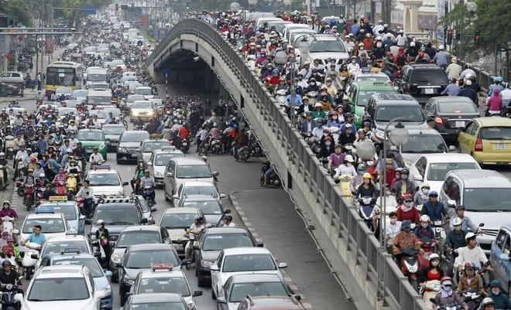
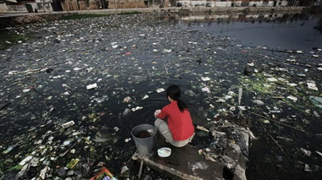
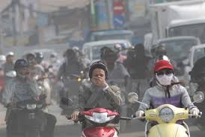
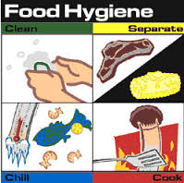
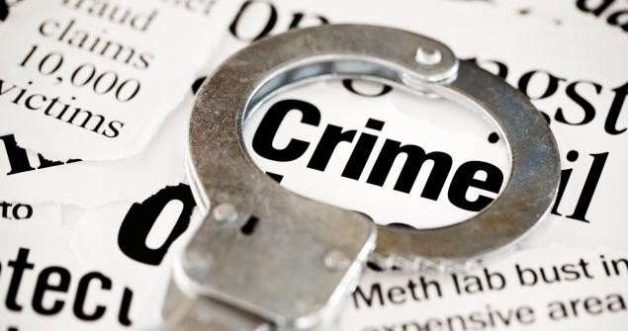
TODAY
In your groups,
1) Pick a topic to research…
2) Find your project plan. Fill it in!
3) Research your topic!
4) Fill in your presentation plan
2) Water Pollution
4) Air Pollution
Traffic - Road Safety
3) Food Hygiene
5) Crime

Slide 51
What rules are there in cities in Vietnam?
Do people listen to rules in cities in Vietnam?
What bad things happen in cities in Vietnam?
How could new rules or laws help to make cities in Vietnam safer?

