Slide 1
A VERY ENGLISH CHRISTMAS!
How often do you think we do things at Christmas?

Slide 2
PLAY THIS IF YOU LIKE!

Slide 3
CHRISTMAS WORDS!
How many words do you know about Christmas? Think of as many as you can in groups…

Slide 4
CHRISTMAS HANGMAN!
Break into 4 teams.
One person come and get the word/phrase from teacher.
That student will go back and play hangman with their team.
First team to guess correctly wins!
Notes:
Your students should know plenty of vocabulary about Christmas already, so the following are either picked for their importance to the rest of the lesson or as a more detailed understanding of specifics. The words are: Christmas pudding, carol singers, Turkey (or Christmas dinner), mince pies, Queen Elizabeth II (they only need to know it’s the Queen of England), speech, stockings, sherry, advent calendar and Christmas decorations. For the hangman, break the class into about 4 teams of 3-5. Show the picture on the WB, and one person from each team comes and gets the phrase from you. That student will then go back to their team and run the hangman. If the team fails they are out, and it’s first team to guess the word correctly.

Slide 5
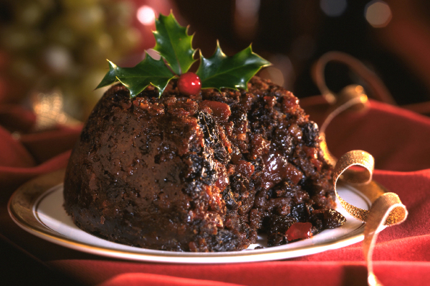
CHRISTMAS PUDDING

Slide 6
CAROL SINGERS

Slide 7
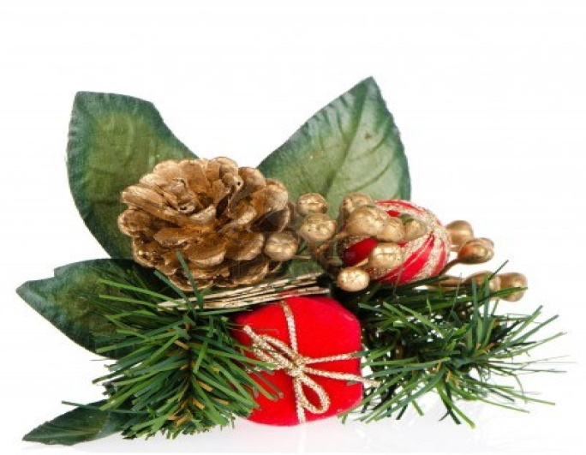
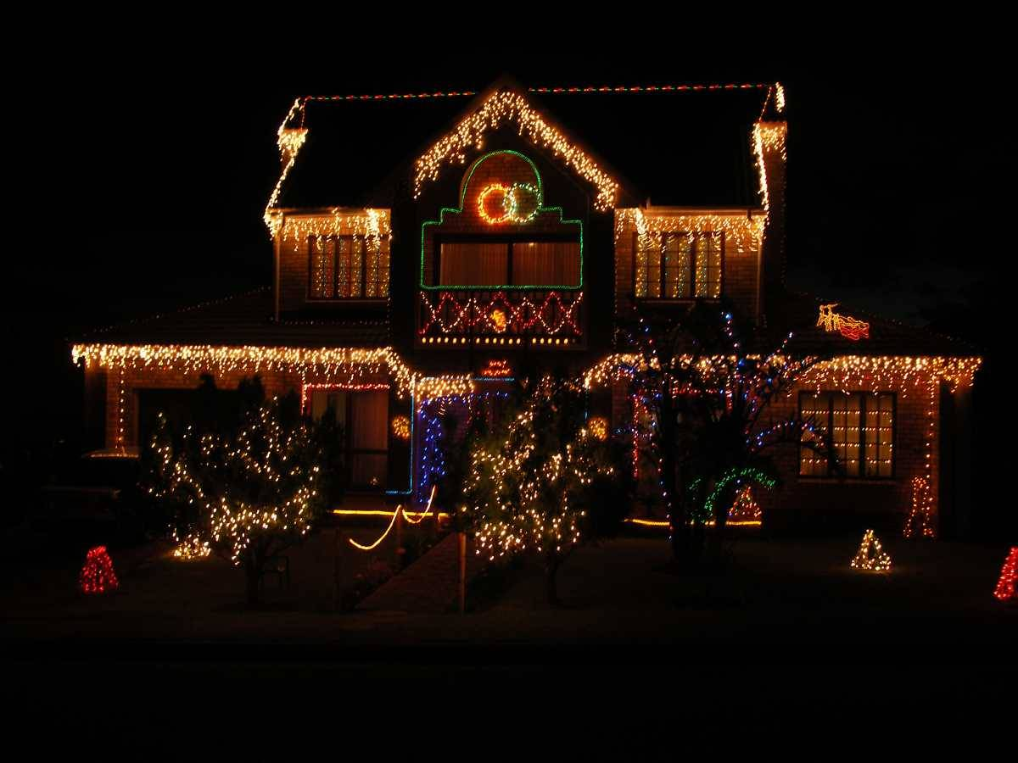
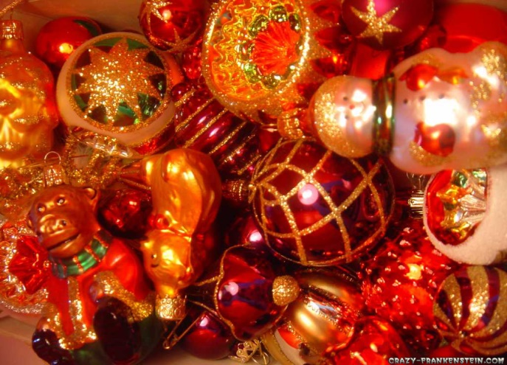
CHRISTMAS DECORATIONS

Slide 8
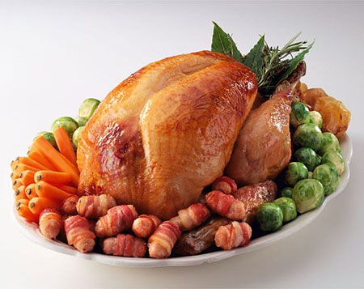
CHRISTMAS TURKEY

Slide 9
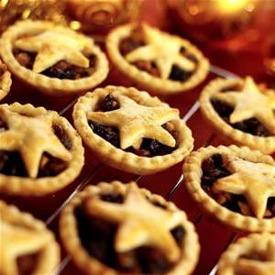
MINCE PIES

Slide 10
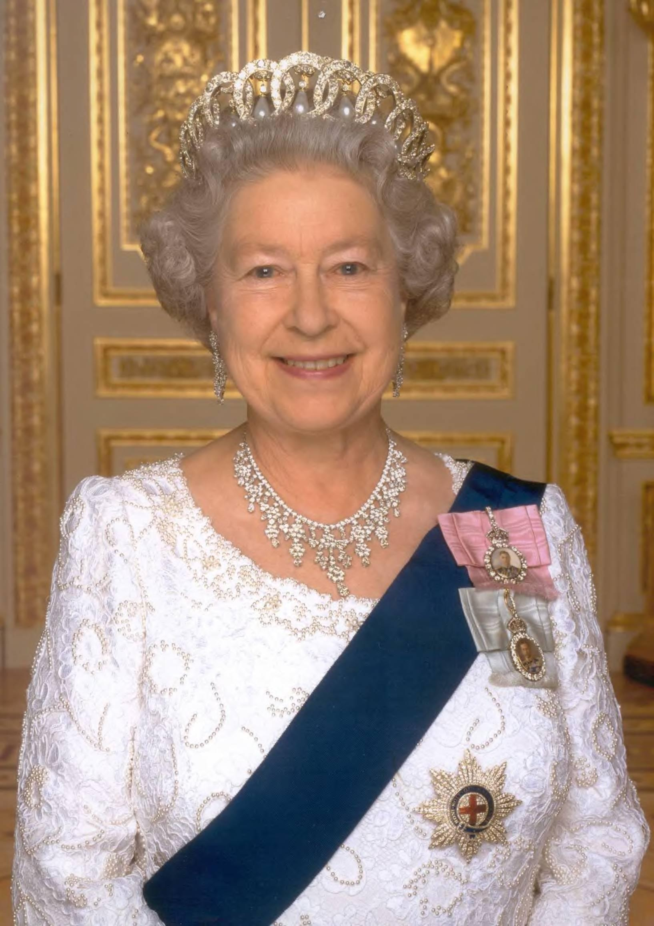
QUEEN ELIZABETH II

Slide 11
A SPEECH

Slide 12
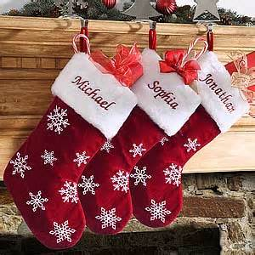
stockings

Slide 13
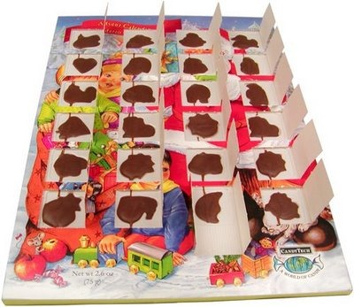
Advent calendar

Slide 14
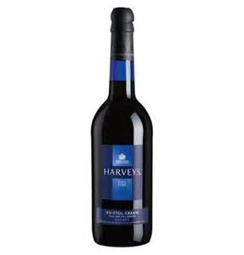
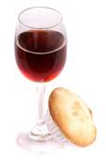
sherry

Slide 15
READING – AN ENGLISH CHRISTMAS
Get into pairs.
You each have a reading about Christmas in England.
Look at the following statements. Does it happen before, during, or after Christmas day?
Read quickly and write on your paper – throw at teacher first!
Notes:
Show them the following simple sentences (only a few, it’s just gist) and have them find and decide in small teams of 2 or 3. I like to do this as a simple paper throw, pieces of paper per team (coloured if you can) and they write the answer and throw at teacher. You have to catch it and they love chucking stuff at you. CCQ ‘during’ to be sure they know what it means in class.

Slide 16
WHEN DOES IT HAPPEN?
People go shopping in the sales on Boxing Day.
after

Slide 17
WHEN DOES IT HAPPEN?
We eat turkey and hot Christmas pudding.
during

Slide 18
WHEN DOES IT HAPPEN?
We watch the Queen’s speech.
during

Slide 19
WHEN DOES IT HAPPEN?
We take down the decorations for Christmas.
after

Slide 20
WHEN DOES IT HAPPEN?
Children open their advent calendars.
before

Slide 21
WHEN DOES IT HAPPEN?
People go out with the children and carol sing
before

Slide 22
WHEN DOES IT HAPPEN?
Some people go to church.
during

Slide 23
WHEN DOES IT HAPPEN?
Children leave a mince pie and sherry out for Father Christmas.
before

Slide 24
CHRISTMAS TRUE OR FALSE!
Look at the following statements.
Look through your reading and decide if they are True or False.
Notes:
This is a speed reading exercise that sets up the later adverbs exercise. Don’t have them read it straight away, instead hand out face down in pairs and run the questions as a speed race. For the answers you can have them just use mini WB’s or play one of the following:
Football into the correct circle on the floor at one end.
Curling: Draw T and F on the floor in circles and have groups decide and slide a board rubber into correct answer, closest to centre wins.
Group race: go through questions first and get them to write answers. Put circle in middle of floor and t and f at either end of the room, and then go back through questions. Class runs as a whole to correct answer and last person into the correct answer sits down till there is one left.

Slide 25
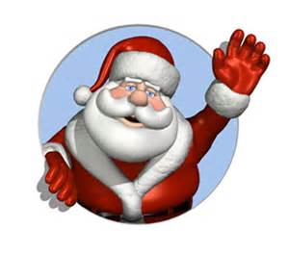
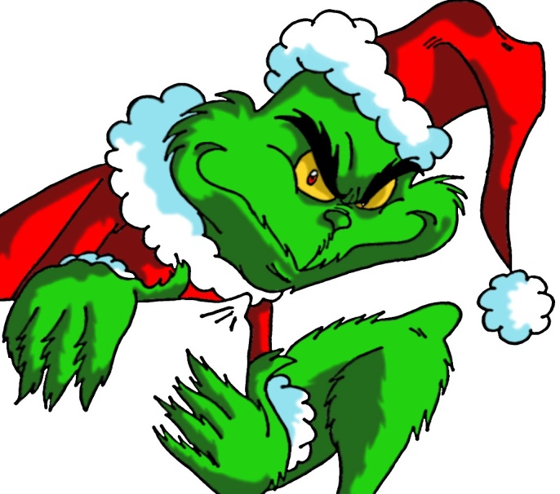
CHRISTMAS TRUE OR FALSE!
Santa means true!
The Grinch means false!

Slide 26
IS IT TRUE OR FALSE…?
It always snows at Christmas time in London.

Slide 27
IS IT TRUE OR FALSE…?
Advent calendars have 25 doors to open on them.

Slide 28
IS IT TRUE OR FALSE…?
Some people think it’s too dangerous for children to go carol singing these days.

Slide 29
IS IT TRUE OR FALSE…?
Children leave milk and mince pies out for Father Christmas.

Slide 30
IS IT TRUE OR FALSE…?
Only good children get presents from Father Christmas.

Slide 31
IS IT TRUE OR FALSE…?
Everyone likes to go out on Christmas day to celebrate.

Slide 32
IS IT TRUE OR FALSE…?
If you get the penny in the Christmas pudding you will get bad luck.

Slide 33
IS IT TRUE OR FALSE…?
Christmas is to celebrate the birth of Jesus Christ 2000 years ago.

Slide 34
GRAMMAR – ADVERBS OF FREQUENCY
Find the sentences in the text that talk about how often things happen…
‘Some children call him Santa Claus, but in England he is still most often referred to as Father Christmas.’
‘Christmas is always pictured as snowy, but in England, and especially in the south in places like London, it almost never snows at that time of year.’

Slide 35
GRAMMAR – ADVERBS OF FREQUENCY
Most often and almost never are two adverbs we use to talk about how often we do things. Can you think of any others…?
Notes:
Ask them to think of further adverbs, at this level they should be able to come back with a few so give them 1-2 minutes and just feedback onto the whiteboard.

Slide 36
How often do you…?
In pairs you will have a list of adverbs.
Look at the following timeline and decide where each goes.

Slide 37
GRAMMAR – ADVERBS OF FREQUENCY
NEVER
ALWAYS
ALMOST NEVER
ALMOST ALWAYS
HARDLY EVER
OFTEN
NOT OFTEN
USUALLY
SOMETIMES
Notes:
Treat this like a quiz – have them fill the timeline themselves in pairs on mini WB’s, then reveal the answers and reward any group that got them all in the right order.

Slide 38
ADVERBS BETTING GAME
Look at the following sentences about Christmas in England.
Think about what you have heard, and decide/guess which adverb phrase goes in the gap.
Bet as much money as you feel confident betting.
Notes:
For this it is important that they understand the gist of the reading, so if it says nothing in the text, they should be able to guess it would be never, but it tests both their reading and grammar comprehension – CCQ the answers as you go to be sure.
Give them $100 in 2 $50 notes (you may need a lot for this game!). Let them bet, but make it clear they can change the amount according to how certain they are. Teams of 3-4 is good for this one, though you could use less if you want some students to be more involved. If a team ends up with no money because of too many wrong answers, then allow them to carry on betting with only $50, if they get it right they get some money back, but if they get it wrong, every other team gets 50 because they had no money. This helps keep the losing team involved and not just give up.

Slide 39
It _______ snow in London on Christmas day.
Hardly ever / almost never

Slide 40
English people ______ eat out on Christmas day.
Hardly ever

Slide 41
English people ______ decorate the outside of their houses with Christmas decorations.
sometimes

Slide 42
English people _____ have fireworks on Christmas day.
never

Slide 43
English people _____ leave their decorations up until the 12th January.
almost never

Slide 44
Trains _____ run on Christmas day.
never

Slide 45
In England, Christmas pudding is ____ served hot.
almost always

Slide 46
English children ____ put out a glass of sherry and a mince pie for Santa on Christmas Eve.
often

Slide 47
English people _____ go to church on Christmas day.
sometimes

Slide 48
English people _____ listen to the Queen’s speech on Christmas day.
often

Slide 49
English people ______ use the expression Santa or Santa Claus.
sometimes

Slide 50
English people _____ put presents in stockings.
often

Slide 51
English kids _____ go carol singing outside peoples houses.
don’t often

Slide 52
English people _____ invite friends around for Christmas dinner.
hardly ever

Slide 53
CHRISTMAS BOARD GAME
Get into 4 groups.
On the board is a board game, take it in turns to role the dice.
Use the adverbs to talk about what you do at Christmas – best answers win!
Notes:
For this you can run it how you like, either print out the game in groups or run it straight off the board in teams but as a class. I like to run as a class and get everyone talking together, and it also makes on the spot error corrections much easier, but the kids might enjoy doing it in smaller groups. If so obviously monitor for corrections and keep the focus on using adverbs to talk about the routines they may or may not follow. Take into account you may need to have them use their imaginations a little and elicit answers as some of them may not do anything for Christmas at all.

