Slide 1
Cognitive Biases
Choice supportive Bias

Slide 2
What are cognitive biases?
Cognitive biases are unconscious errors in thinking that arise from problems related to memory, attention, and other mental mistakes.
These biases result from our brain’s efforts to simplify the incredibly complex world in which we live.
Confirmation bias, hindsight bias, self-serving bias, anchoring bias, availability bias, the framing effect, and inattentional blindness are some of the most common examples of cognitive bias.
Cognitive biases have direct implications on our safety, our interactions with others, and the way we make judgments and decisions in our daily lives.
Although these biases are unconscious, there are small steps we can take to train our minds to adopt a new pattern of thinking and mitigate the effects of these biases.

Slide 3
Choice-supportive bias or post-purchase rationalization is the tendency to retroactively ascribe positive attributes to an option one has selected and/or to demote the forgone options. It is part of cognitive science, and is a distinct cognitive bias that occurs once a decision is made.

Slide 4
What was the last thing you bought and why?

Slide 5
In cognitive science, choice-supportive bias is the tendency to remember our choices as better than they actually were, because we tend to over attribute positive features to options we chose and negative features to options not chosen. Individuals tend to think that "they chose this option so it must have been the better option". As a result, we feel good about ourselves and our choices and have less regret for bad decisions.

Slide 6
For example, Henkel and Mather (2007) found that giving people false reminders about which option they chose in a previous experiment session led them to remember the option they had chosen as being better than the other option. In the first experiment session, participants had to decide between two used cars. In the second experiment session, Henkel and Mather gave them a list of the features of the two options but with some new positive and negative features mixed in with the old features. Next, participants were asked to indicate whether each option was new, had been associated with the option they chose, or had been associated with the option they rejected. Participants attributed the most positive features to the option they had originally chosen, even those that were completely new and hadn’t been attributed to either car in the first session.

Slide 7
Choice-supportive bias has applications in web-marketing, for example to get your customers to attribute positive features to your brand and products, and even negative ones to others. For example, a strategy can be to show previously visited pages and bought items to your visitors (in other words remind them that they have already “chosen” you). Another good practice can be reassuring customers on the choices they make to enhance their own choice-supportive bias and result in greater post-purchase satisfaction.

Slide 9
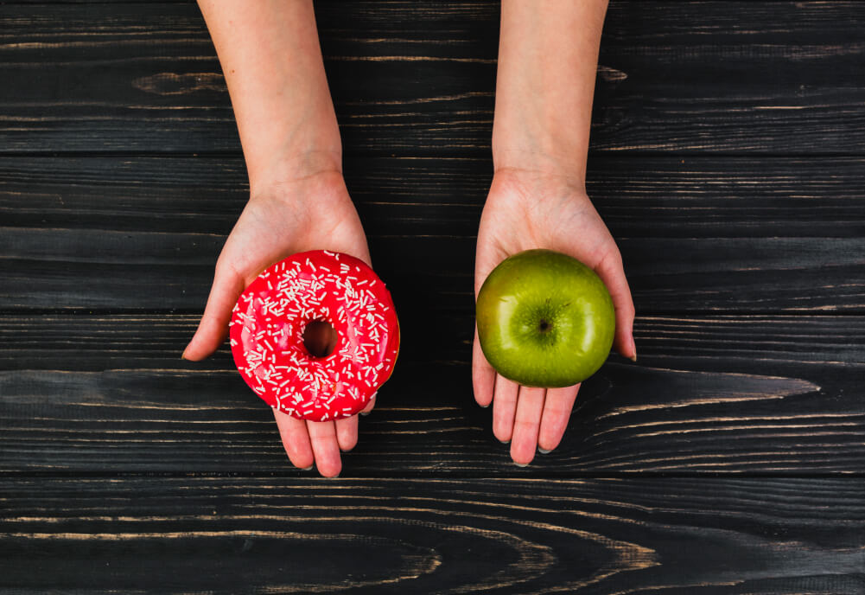
Which one would you use?

Slide 11
How to avoid the choice supportive bias
We all suffer from choice-supportive bias as we don’t have full access to many of the underlying motivations that drive behaviour. As a result people post-rationalise reasons to support their decisions and seek to justify their choices.

Slide 12
How to avoid the choice supportive bias
Do not fall for ‘brand loyalty’. Assess the merits of everything rationally, and make informed decisions from there. Companies are aware of choice-supportive bias, and will expect you to continue to buy their products, even if they’re inferior.

Slide 14
Now try the quiz…
https://play.kahoot.it/v2/?quizId=df4125a8-8736-4137-8411-5fcef1a194b6

