Slide 1
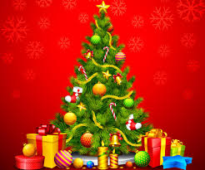
Christmas Special Lesson

Slide 2
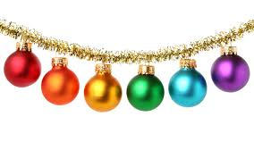
Christmas Spelling Ball

Slide 3
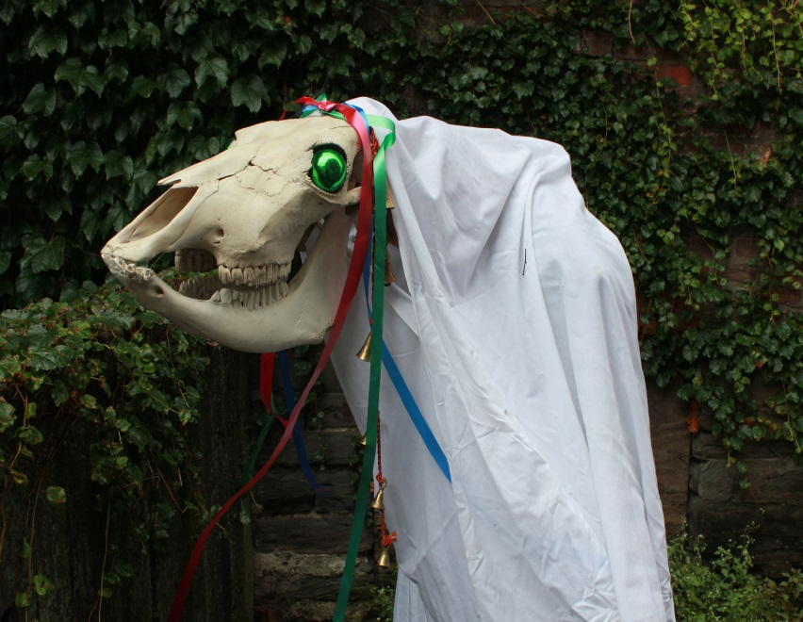
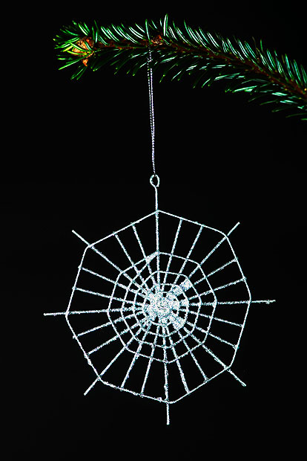
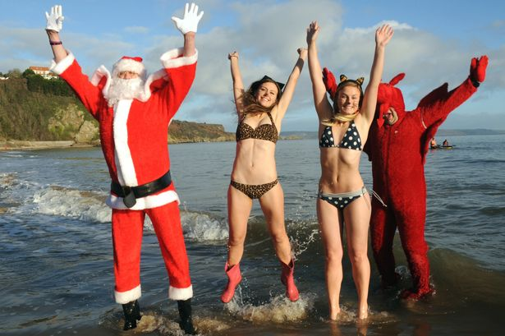
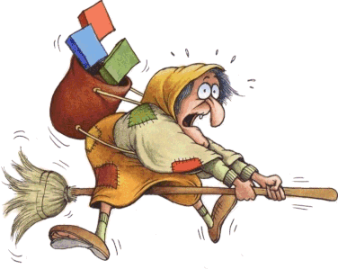
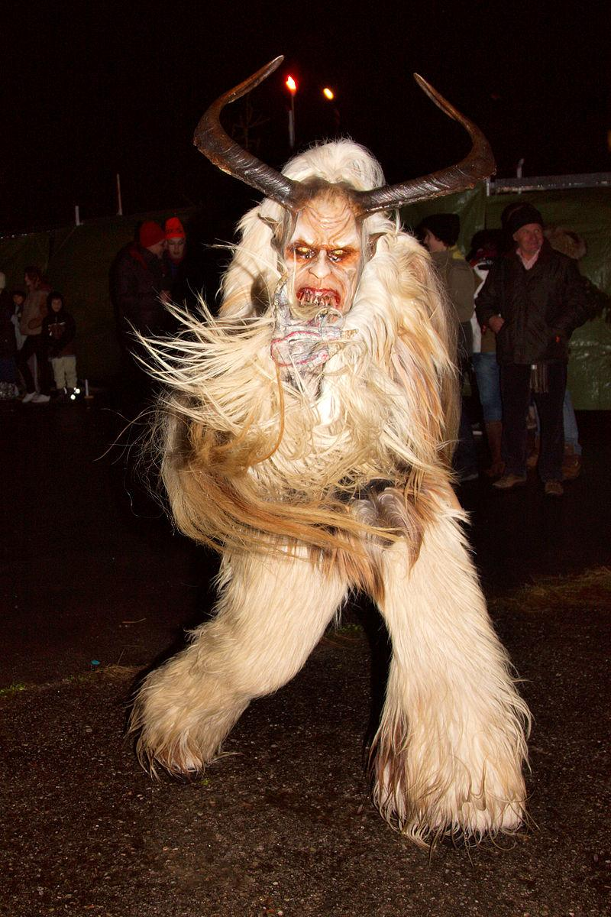

Slide 5
Oh, I won't ask for much this Christmas I won't even wish for snow And I'm just going to keep on waiting Underneath the _____
I won't make a list and send it To the North Pole for Saint Nick I won't even stay awake to Hear those magic reindeer _____ Because I just want you here tonight Holding on to me so _____ What more can I _____? Baby, all I want for Christmas is you Oh, all the lights are shining So brightly everywhere And the sound of children's Laughter fills the _____ And everyone is singing I hear those sleigh bells _____ Santa, won't you bring me the one I really need? Won't you please bring my baby to _____?
I don't want a lot for Christmas There is just one thing I need I don't care about the presents Underneath the Christmas tree I just want you for my own More than you could ever _____ Make my wish come true All I want for Christmas is _____ I don't want a lot for Christmas There is just one thing I need And I don't care about the presents Underneath the Christmas tree I don't need to hang my _____ There upon the fireplace Santa Claus won't make me happy With a toy on Christmas Day I just want you for my own More than you could ever _____ Make my wish come true All I want for _____ is you
Oh, I don't want a lot for Xmas This is all I'm asking for I just want to see my baby Standing right outside my _____ Oh, I just want you for my own More than you could ever _____ Make my wish come true Baby, all I want for Xmas is you
All I want for Xmas is you, baby All I want for Xmas is you, baby All I want for Xmas is you, baby All I want for Xmas is you, baby

Slide 6
Oh, I won't ask for much this Christmas I won't even wish for snow And I'm just going to keep on waiting Underneath the mistletoe
I won't make a list and send it To the North Pole for Saint Nick I won't even stay awake to Hear those magic reindeer click Because I just want you here tonight Holding on to me so tight What more can I do? Baby, all I want for Christmas is you Oh, all the lights are shining So brightly everywhere And the sound of children's Laughter fills the air And everyone is singing I hear those sleigh bells ringing Santa, won't you bring me the one I really need? Won't you please bring my baby to me?
I don't want a lot for Christmas There is just one thing I need I don't care about the presents Underneath the Christmas tree I just want you for my own More than you could ever know Make my wish come true All I want for Christmas is you I don't want a lot for Christmas There is just one thing I need And I don't care about the presents Underneath the Christmas tree I don't need to hang my stocking There upon the fireplace Santa Claus won't make me happy With a toy on Christmas Day I just want you for my own More than you could ever know Make my wish come true All I want for Christmas is you
Oh, I don't want a lot for Xmas This is all I'm asking for I just want to see my baby Standing right outside my door Oh, I just want you for my own More than you could ever know Make my wish come true Baby, all I want for Xmas is you
All I want for Xmas is you, baby All I want for Xmas is you, baby All I want for Xmas is you, baby All I want for Xmas is you, baby

Slide 7
Christmas Quiz!- Question 1
What day is Christmas on this year?
Monday
Friday
Thursday
Sunday

Slide 8
Question 2
What do people in America and Europe usually eat on Christmas Day?
Lamb
Turkey
Chicken
Beef steak

Slide 9
Question 3
What do people in North America hang over the fire place at Christmas?
Lights
Start
Stockings
Socks

Slide 10
Question 4
What was the original reason for Christmas?
The birth of Mary
The birth of Jesus
Celebrate the children
Go to Church

Slide 11
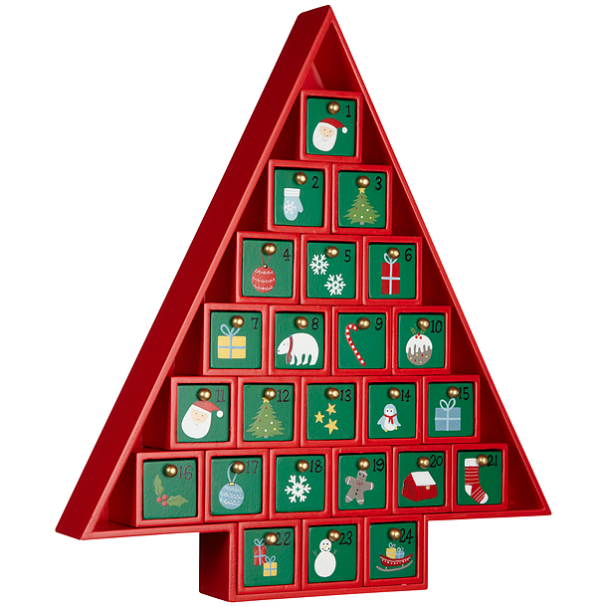
Question 5- What is inside this calendar?
Cookies
Chocolates
Candies
Money

Slide 12
Question 6
Where does Santa Claus live?
South Pole
America
North Pole
Canada

Slide 13
Question 7
Who helps Santa?
Reindeers
Elves
Santa’s wife
Children

Slide 14
Question 8
Where do Turkey’s originally come from?
Europe
Asia
America
Africa?

Slide 15
Question 9
Which town was Jesus born in?
New York
Bethlehem
Istanbul
Los Angeles

Slide 16
Question 10
What do people say when they see each other at Christmas time?
Write your answer on your board.

Slide 17
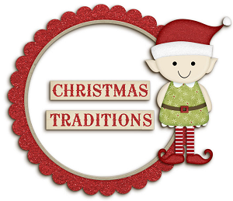
ILA Christmas XXX

Slide 18
What Christmas traditions do you know?
In groups of 3-4 students, talk about any Christmas traditions that you celebrate with your family.
If you don’t celebrate Christmas, what traditions do you know about?

Slide 19
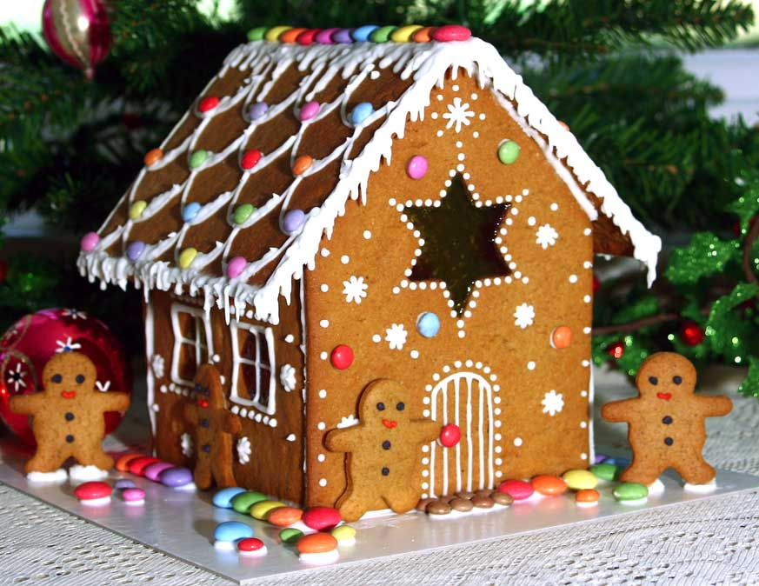
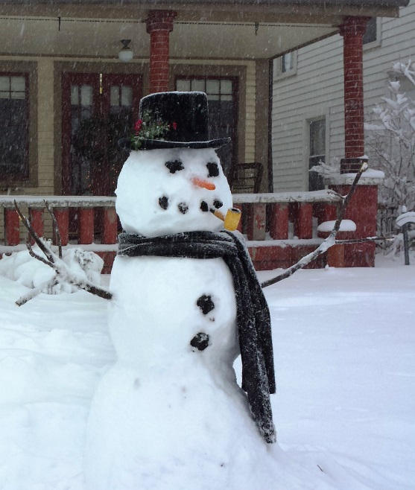
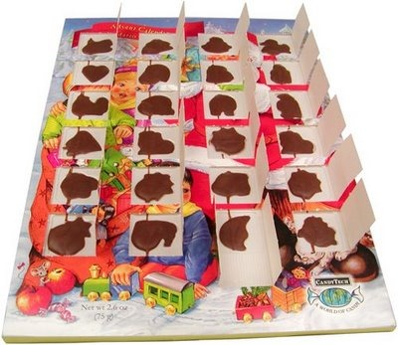
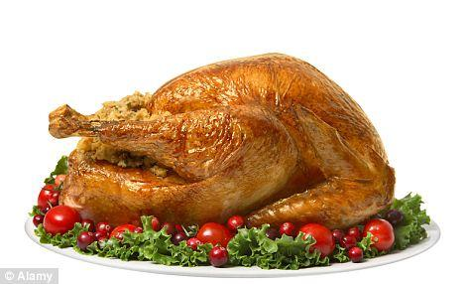

Slide 20
Christmas BINGO
North Pole Snow Carols Winter
Santa Claus Elves Cookies Advent
Reindeer December Cakes
Rudolph Church Parcels
Star Traditions Bows
Angel Crimbo Stocking
Turkey Gifts Chimney
Ginger Bread Decorations Bells
Songs Family Snowflake

Slide 21
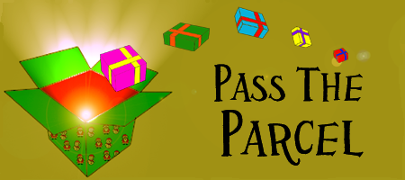
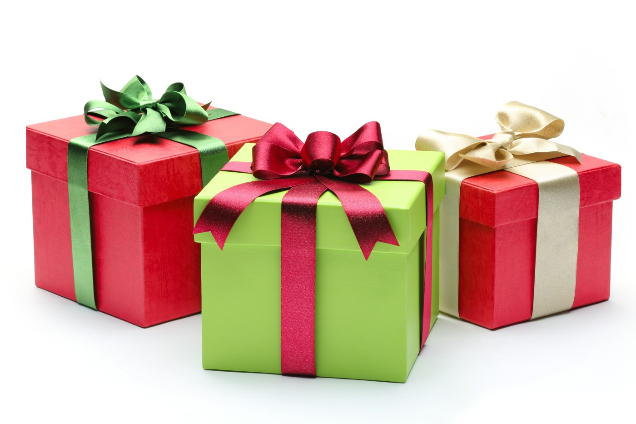
Pass the parcel

