Slide 1
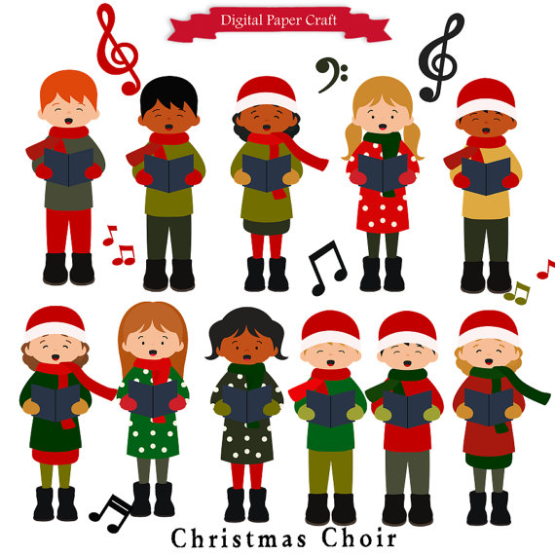
Carols

Slide 2
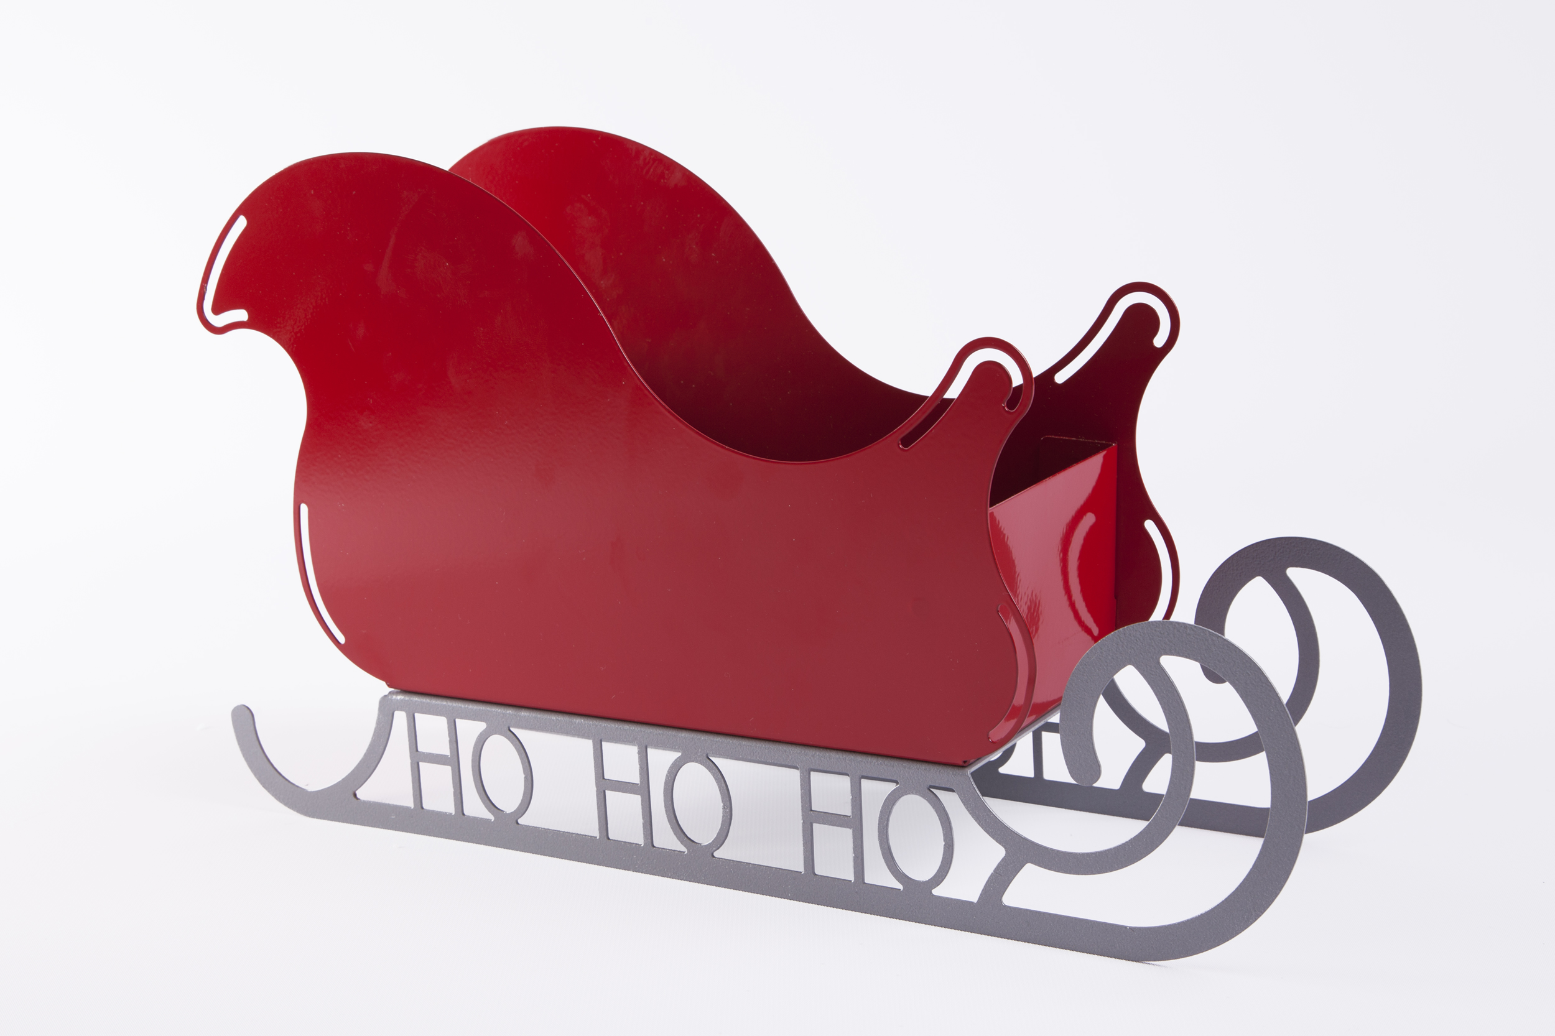
Sleigh

Slide 3
Holly

Slide 4
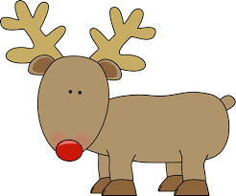
Reindeer

Slide 5
Wreath

Slide 6
