Slide 1
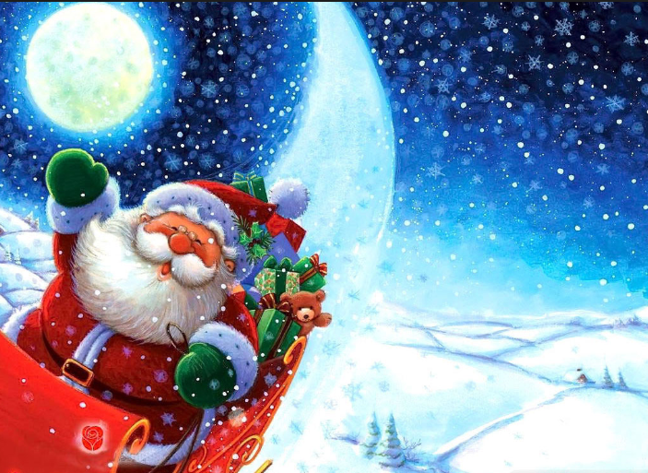
It’s going to be a very Merry Christmas!!! HO HO HO!!!

Slide 2
Santa Claus

Slide 3
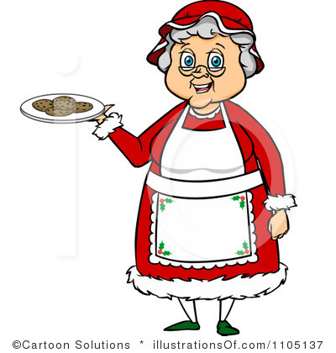
Mrs Claus

Slide 4
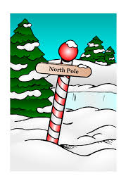
The North Pole

Slide 5
beard

Slide 6
sleigh

Slide 7
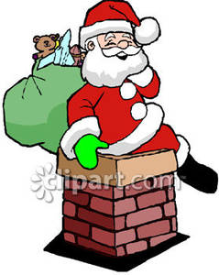
chimney

Slide 8
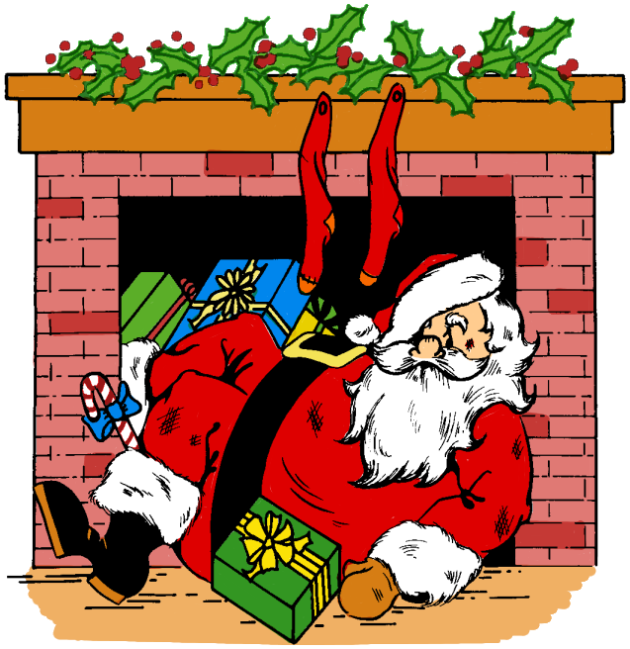
fireplace

Slide 9
reindeer

Slide 10
Rudolph

Slide 11
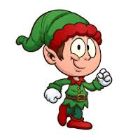
Elf

Slide 12
Grinch

Slide 13
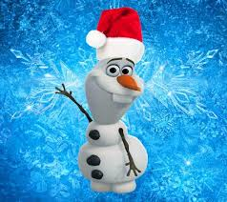
Snowman

Slide 14
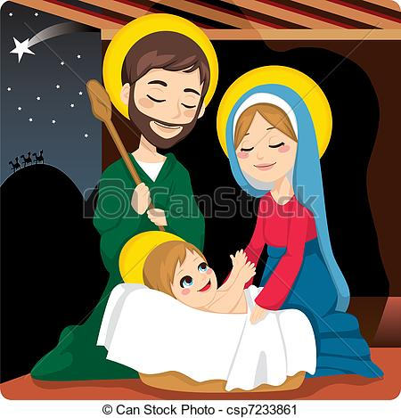
Mary, Joseph and the baby Jesus

Slide 15
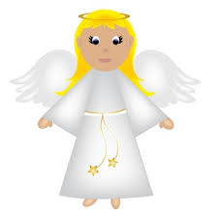
Angel

Slide 16
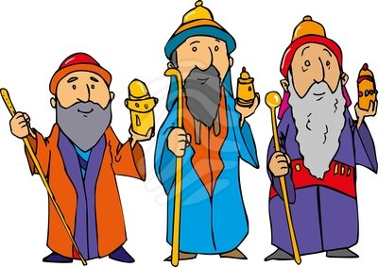
Three Wise Men

Slide 17
Christmas tree

Slide 18
gifts // presents

Slide 19
wrapping paper

Slide 20
bow

Slide 21
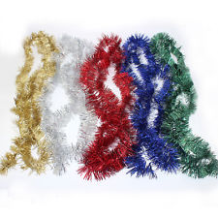
Tinsel

Slide 22
fruitcake

Slide 23
decorations

Slide 24
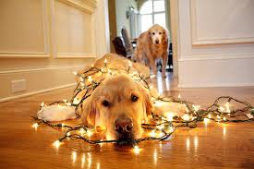
Fairy lights

Slide 25
stockings

Slide 26
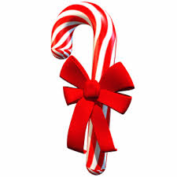
Candy Cane

Slide 27
caroling

Slide 28
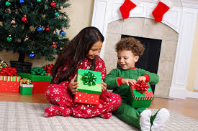
Give gifts / Open gifts

Slide 29
bells

Slide 30
mistletoe

Slide 31
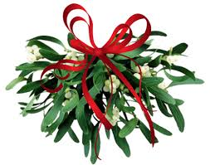
Holly

Slide 32
Christmas Wreath

Slide 33
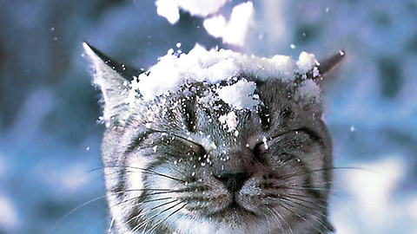
Snow

Slide 34
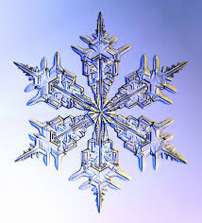
Snowflake

Slide 35
What do you know about Christmas?
Discuss with your partner…
Do you celebrate Christmas?
What do you know about Christmas?
What is the story of Christmas?

Slide 36
What do you remember??
Memory Game!

Slide 37
Elf Grinch

Slide 38
Decorations Tinsel

Slide 39
Stockings Bow

Slide 40
Fairy Lights Angel

Slide 41
Bells Bow

Slide 42
Mary, Joseph and Three the baby Jesus Wise Men

Slide 43
Reindeer Rudolph

Slide 44
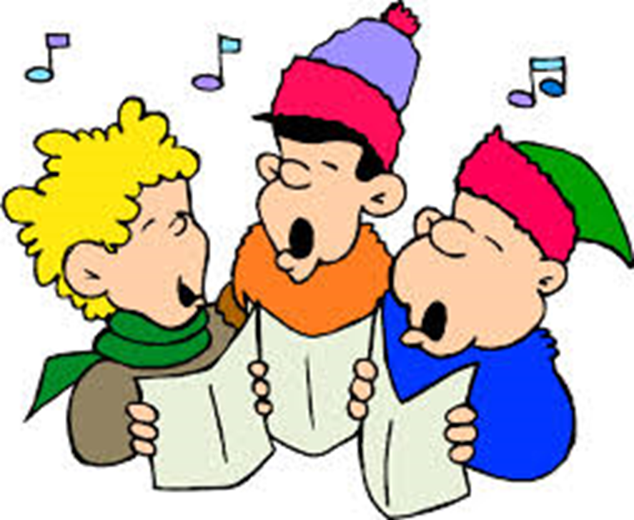
Caroling Singing

Slide 45
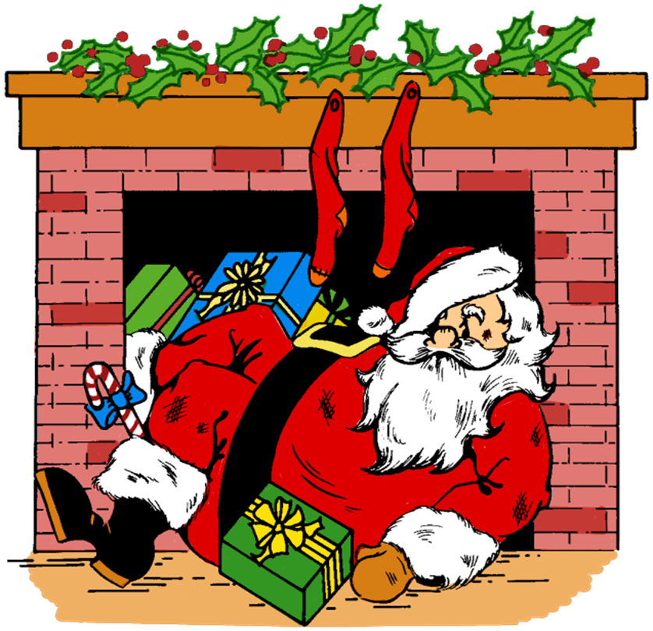
chimney fireplace

Slide 46
Snow Snowflake

Slide 47
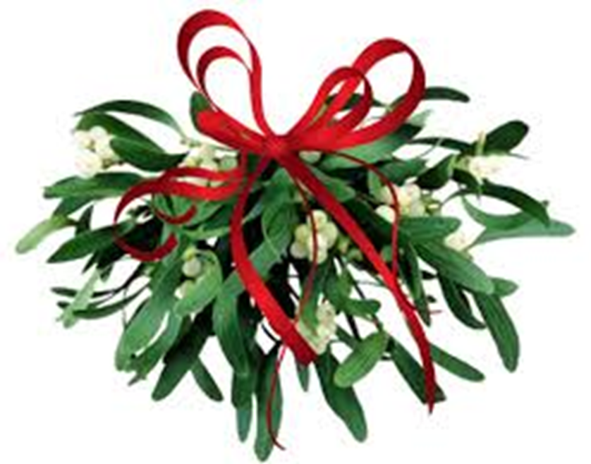
Holly Mistletoe

