Slide 1
Cognitive Biases
The bandwagon effect

Slide 2
What are cognitive biases?
Cognitive biases are unconscious errors in thinking that arise from problems related to memory, attention, and other mental mistakes.
These biases result from our brain’s efforts to simplify the incredibly complex world in which we live.
Confirmation bias, hindsight bias, self-serving bias, anchoring bias, availability bias, the framing effect, and inattentional blindness are some of the most common examples of cognitive bias.
Cognitive biases have direct implications on our safety, our interactions with others, and the way we make judgments and decisions in our daily lives.
Although these biases are unconscious, there are small steps we can take to train our minds to adopt a new pattern of thinking and mitigate the effects of these biases.

Slide 3
Dunning-Kruger effect
The Dunning Kruger effect is when people of below average ability believe that they are experts in the field.

Slide 4
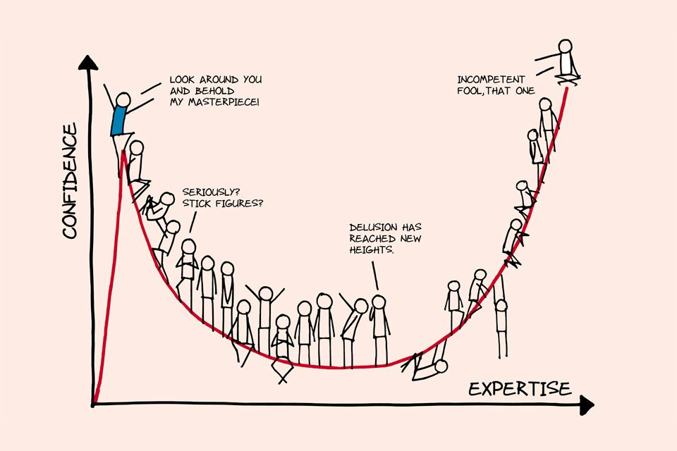

Slide 5
Why do the bottom 10% believe they are in the top 10%?
Why do the top 10% always underestimate their abilities?

Slide 6
What is it?
The Dunning-Kruger effect is a type of cognitive bias in which people believe that they are smarter and more capable than they really are. Essentially, low ability people do not possess the skills needed to recognize their own incompetence. The combination of poor self-awareness and low cognitive ability leads them to overestimate their own capabilities.

Slide 7
The term lends a scientific name and explanation to a problem that many people immediately recognize—that fools are blind to their own foolishness. As Charles Darwin wrote in his book The Descent of Man, "Ignorance more frequently begets confidence than does knowledge."

Slide 8
An Overview of the Dunning-Kruger Effect
This phenomenon is something you have likely experienced in real life, perhaps around the dinner table at a holiday family gathering. Throughout the course of the meal, a member of your extended family begins spouting off on a topic at length, boldly proclaiming that he is correct and that everyone else's opinion is stupid, uninformed, and just plain wrong. It may be plainly evident to everyone in the room that this person has no idea what they are talking about, yet they prattle on, blithely oblivious to their own ignorance.

Slide 9
The effect is named after researchers David Dunning and Justin Kruger, the two social psychologists who first described it. In their original study on this psychological phenomenon, they performed a series of four investigations

Slide 10
People who scored in the lowest percentiles on tests of grammar, humor, and logic also tended to dramatically overestimate how well they had performed (their actual test scores placed them in the 12th percentile, but they estimated that their performance placed them in the 62nd percentile)

Slide 11
In one experiment, for example, Dunning and Kruger asked their 65 participants to rate how funny different jokes were. Some of the participants were exceptionally poor at determining what other people would find funny—yet these same subjects described themselves as excellent judges of humor.

Slide 12
Incompetent people, the researchers found, are not only poor performers, they are also unable to accurately assess and recognize the quality of their own work. This is the reason why students who earn failing scores on exams sometimes feel that they deserved a much higher score. They overestimate their own knowledge and ability and are incapable of seeing the poorness of their performance.

Slide 13
Low performers are unable to recognize the skill and competence levels of other people, which is part of the reason why they consistently view themselves as better, more capable, and more knowledgeable than others.

Slide 14
"In many cases, incompetence does not leave people disoriented, perplexed, or cautious," wrote David Dunning in an article for Pacific Standard. "Instead, the incompetent are often blessed with an inappropriate confidence, buoyed by something that feels to them like knowledge."

Slide 15
This effect can have a profound impact on what people believe, the decisions they make, and the actions they take. In one study, Dunning and Ehrlinger found that women performed equally to men on a science quiz, and yet women underestimated their performance because they believed they had less scientific reasoning ability than men. The researchers also found that as a result of this belief, these women were more likely to refuse to enter a science competition.

Slide 16
Dunning and his colleagues have also performed experiments in which they ask respondents if they are familiar with a variety of terms related to subjects including politics, biology, physics, and geography. Along with genuine subject-relevant concepts, they interjected completely made-up terms.

Slide 17
In one such study, approximately 90 percent of respondents claimed that they had at least some knowledge of the made-up terms. Consistent with other findings related to the Dunning-Kruger effect, the more familiar participants claimed that they were with a topic, the more likely they were to also claim they were familiar with the meaningless terms. As Dunning has suggested, the very trouble with ignorance is that it can feel just like expertise.

Slide 18
Causes of the Dunning-Kruger Effect
So what explains this psychological effect? Are some people simply too dense, to be blunt, to know how dim-witted they are? Dunning and Kruger suggest that this phenomenon stems from what they refer to as a "dual burden." People are not only incompetent; their incompetence robs them of the mental ability to realize just how inept they are.

Slide 19
Causes of the Dunning-Kruger Effect
Incompetent people tend to:
Overestimate their own skill levels
Fail to recognize the genuine skill and expertise of other people
Fail to recognize their own mistakes and lack of skill
Dunning has pointed out that the very knowledge and skills necessary to be good at a task are the exact same qualities that a person needs to recognize that they are not good at that task. So if a person lacks those abilities, they remain not only bad at that task but ignorant to their own inability.

Slide 20
Causes of the Dunning-Kruger Effect
Incompetent people tend to:
Overestimate their own skill levels
Fail to recognize the genuine skill and expertise of other people
Fail to recognize their own mistakes and lack of skill
Dunning has pointed out that the very knowledge and skills necessary to be good at a task are the exact same qualities that a person needs to recognize that they are not good at that task. So if a person lacks those abilities, they remain not only bad at that task but ignorant to their own inability.

Slide 21
An Inability to Recognize Lack of Skill and Mistakes
Dunning suggests that deficits in skill and expertise create a two-pronged problem. First, these deficits cause people to perform poorly in the domain in which they are incompetent. Secondly, their erroneous and deficient knowledge makes them unable to recognize their mistakes.⁶
A Lack of Metacognition
The Dunning-Kruger effect is also related to difficulties with metacognition, or the ability to step back and look at one's own behavior and abilities from outside of oneself. People are often only able to evaluate themselves from their own limited and highly subjective point of view. From this limited perspective, they seem highly skilled, knowledgeable, and superior to others. Because of this, people sometimes struggle to have a more realistic view of their own abilities.¹
A Little Knowledge Can Lead to Overconfidence
Another contributing factor is that sometimes a tiny bit of knowledge on a subject can lead people to mistakenly believe that they know all there is to know about it. As the old saying goes, a little bit of knowledge can be a dangerous thing. A person might have the slimmest bit of awareness about a subject, yet thanks to the Dunning-Kruger effect, believe that he or she is an expert.
Other factors that can contribute to the effect include our use of heuristics, or mental shortcuts that allow us to make decisions quickly, and our tendency to seek out patterns even where none exist. Our minds are primed to try to make sense of the disparate array of information we deal with on a daily basis. As we try to cut through the confusion and interpret our own abilities and performance within our individual worlds, it is perhaps not surprising that we sometimes fail so completely to accurately judge how well we do.

Slide 22
Who Is Affected by the Dunning-Kruger Effect?
So who is affected by the Dunning-Kruger effect? Unfortunately, we all are. This is because no matter how informed or experienced we are, everyone has areas in which they are uninformed and incompetent. You might be smart and skilled in many areas, but no one is an expert at everything.
The reality is that everyone is susceptible to this phenomenon, and in fact, most of us probably experience it with surprising regularity. People who are genuine experts in one area may mistakenly believe that their intelligence and knowledge carry over into other areas in which they are less familiar. A brilliant scientist, for example, might be a very poor writer. In order for the scientist to recognize their own lack of skill, they need to possess a good working knowledge of things such as grammar and composition. Because those are lacking, the scientist in this example also lacks the ability to recognize their own poor performance.

Slide 23
The Dunning-Kruger effect is not synonymous with low IQ. As awareness of the term has increased, its misapplication as a synonym for "stupid" has also grown. It is, after all, easy to judge others and believe that such things simply do not apply to you.

Slide 24
So if the incompetent tend to think they are experts, what do genuine experts think of their own abilities? Dunning and Kruger found that those at the high end of the competence spectrum did hold more realistic views of their own knowledge and capabilities. However, these experts actually tended to underestimate their own abilities relative to how others did.²
Essentially, these top-scoring individuals know that they are better than the average, but they are not convinced of just how superior their performance is compared to others. The problem, in this case, is not that experts don't know how well-informed they are; it's that they tend to believe that everyone else is knowledgeable as well.

Slide 25
Is There Any Way to Overcome the Dunning-Kruger Effect?
So is there anything that can minimize this phenomenon? Is there a point at which the incompetent actually recognize their own ineptitude? "We are all engines of misbelief," Dunning has suggested. While we are all prone to experiencing the Dunning-Kruger effect, learning more about how the mind works and the mistakes we are all susceptible to might be one step toward correcting such patterns.
Dunning and Kruger suggest that as experience with a subject increases, confidence typically declines to more realistic levels. As people learn more about the topic of interest, they begin to recognize their own lack of knowledge and ability. Then as people gain more information and actually become experts on a topic, their confidence levels begin to improve once again.
So what can you do to gain a more realistic assessment of your own abilities in a particular area if you are not sure you can trust your own self-assessment?

Slide 26
Keep learning and practicing. Instead of assuming you know all there is to know about a subject, keep digging deeper. Once you gain greater knowledge of a topic, the more likely you are to recognize how much there is still to learn. This can combat the tendency to assume you’re an expert, even if you're not.
Ask other people how you're doing. Another effective strategy involves asking others for constructive criticism. While it can sometimes be difficult to hear, such feedback can provide valuable insights into how others perceive your abilities.
Question what you know. Even as you learn more and get feedback, it can be easy to only pay attention to things that confirm what you think you already know. This is an example of another type of psychological bias known as the confirmation bias. In order to minimize this tendency, keep challenging your beliefs and expectations. Seek out information that challenges your ideas.⁷

Slide 28
Now try the quiz…
https://play.kahoot.it/v2/?quizId=f24ea907-888d-468e-9daf-f08e46c89c69

