Slide 1
Logical fallacies

Slide 2


Slide 3
What are logical fallacies?
Logical fallacies are like landmines; easy to overlook until you find them the hard way.
One of the most important components of learning in college is academic discourse, which requires argumentation and debate. Argumentation and debate inevitably lend themselves to flawed reasoning and rhetorical errors. Many of these errors are considered logical fallacies. Logical fallacies are commonplace in the classroom, in formal televised debates, and perhaps most rampantly, on any number of internet forums.

Slide 4
What are logical fallacies?
But what is a logical fallacy? And just as important, how can you avoid making logical fallacies yourself? Whether you’re in college, or preparing to go to college; whether you’re on campus or in an online bachelor’s degree program, it pays to know your logical fallacies. This article lays out some of the most common logical fallacies you might encounter, and that you should be aware of in your own discourse and debate.

Slide 5
What are logical fallacies?
A logical fallacy is an error in reasoning common enough to warrant a fancy name. Knowing how to spot and identify fallacies is a priceless skill. It can save you time, money, and personal dignity. There are two major categories of logical fallacies, which in turn break down into a wide range of types of fallacies, each with their own unique ways of trying to trick you into agreement.

Slide 6
A Formal Fallacy
a breakdown in how you say something. The ideas are somehow sequenced incorrectly. Their form is wrong, rendering the argument as noise and nonsense.

Slide 7
An Informal Fallacy
denotes an error in what you are saying, that is, the content of your argument. The ideas might be arranged correctly, but something you said isn’t quite right. The content is wrong or off-kilter.

Slide 8
Ad Hominem Fallacy
When people think of “arguments,” often their first thought is of shouting matches riddled with personal attacks. Ironically, personal attacks run contrary to rational arguments. In logic and rhetoric, a personal attack is called an ad hominem. Ad hominem is Latin for “against the man.” Instead of advancing good sound reasoning, an ad hominem replaces logical argumentation with attack-language unrelated to the truth of the matter.

Slide 9
Ad Hominem Fallacy
More specifically, the ad hominem is a fallacy of relevance where someone rejects or criticizes another person’s view on the basis of personal characteristics, background, physical appearance, or other features irrelevant to the argument at issue.

Slide 10
Ad Hominem Fallacy
An ad hominem is more than just an insult. It’s an insult used as if it were an argument or evidence in support of a conclusion. Verbally attacking people proves nothing about the truth or falsity of their claims. Use of an ad hominem is commonly known in politics as “mudslinging.”

Slide 11
Ad Hominem Fallacy
Instead of addressing the candidate’s stance on the issues, or addressing his or her effectiveness as a statesman or stateswoman, an ad hominem focuses on personality issues, speech patterns, wardrobe, style, and other things that affect popularity but have no bearing on their competence. In this way, an ad hominem can be unethical, seeking to manipulate voters by appealing to irrelevant foibles and name-calling instead of addressing core issues. In this last election cycle, personal attacks were volleyed freely from all sides of the political aisle, with both Clinton and Trump facing their fair share of ad hominem fallacies.

Slide 12
Ad Hominem Fallacy
Ad hominem is an insult used as if it were an argument or evidence in support of a conclusion.
A thread on Quora lists the following doozies against Hillary Clinton: “Killary Clinton,” “Crooked Hillary,” “Hilla the Hun,” “Shillary,” “Hitlery,” “Klinton,” “Hildebeest,” “Mr. President,” “Heil Hillary,” “Wicked Witch of the West Wing,” “Robberty Hillham Clinton,” and the decidedly unsubtle, “The Devil.”

Slide 13
Ad Hominem Fallacy
The NY Daily News offers an amusing list of insults against Donald Trump: “Short fingered Vulgarian,” “Angry Creamsicle,” “Fascist Carnival Barker,” “F*ckface von Clownstick,” “Decomposing Jack-O-Lantern,” “Chairman of the Saddam Hussein Fanclub,” “Racist Clementine,” “Sentient Caps Lock Button,” “Cheeto Jesus,” “Tangerine Tornado,” and perhaps the most creative/literary reference, “Rome Burning in Man Form.”

Slide 14
Ad Hominem Fallacy
The use of ad hominem often signals the point at which a civil disagreement has descended into a “fight.” Whether it’s siblings or friends, most everyone has had a verbal disagreement crumble into a disjointed shouting match of angry insults and accusations aimed at discrediting the other person. When these insults crowd out a substantial argument, they become ad hominems.

Slide 15


Slide 16
Your turn...
See if you can tell which of these is an ad hominem argument, and which is just an insult...
Example 1
“MacDougal roots for a British football team. Clearly he’s unfit to be a police chief in Ireland.”
Example 2
“All people from Crete are liars”

Slide 17
Strawman Argument
It’s much easier to defeat your opponent’s argument when it’s made of straw. The Strawman argument is aptly named after a harmless, lifeless, scarecrow. In the strawman argument, someone attacks a position the opponent doesn’t really hold. Instead of contending with the actual argument, he or she attacks the equivalent of a lifeless bundle of straw, an easily defeated effigy, which the opponent never intended upon defending anyway.

Slide 18


Slide 19
Strawman argument
The strawman argument is a cheap and easy way to make one’s position look stronger than it is. Using this fallacy, opposing views are characterized as “non-starters,” lifeless, truthless, and wholly unreliable. By comparison, one’s own position will look better for it. You can imagine how strawman arguments and ad hominem fallacies can occur together, demonizing opponents and discrediting their views.
With the strawman argument, someone attacks a position the opponent doesn’t really hold.

Slide 20
Strawman argument
This fallacy can be unethical if it’s done on purpose, deliberately mischaracterizing the opponent’s position for the sake of deceiving others. But often the strawman argument is accidental, because the offender doesn’t realize the are oversimplifying a nuanced position, or misrepresenting a narrow, cautious claim as if it were broad and foolhardy.

Slide 21


Slide 22
Your turn...
See if you can detect how both of the following responses could qualify as a strawman argument.
Senator: “Driving a car with low emissions, such as a Prius, could help to reduce our impact on the environment.”
Response A Response B
“The Senator thinks we can solve all our ecological problems by driving a Prius.”
“Quite the contrary, the Senator thinks the environment is such a wreck that no one’s car choice or driving habits would make the slightest difference.”

Slide 23
Appeal to Ignorance (argumentum ad ignorantiam)
Any time ignorance is used as a major premise in support of an argument, it’s liable to be a fallacious appeal to ignorance. Naturally, we are all ignorant of many things, but it is cheap and manipulative to allow this unfortunate aspect of the human condition to do most of our heavy lifting in an argument.
An appeal to ignorance isn’t proof of anything except that you don’t know something.

Slide 24
Appeal to ignorance
Interestingly, appeal to ignorance is often used to bolster multiple contradictory conclusions at once. Consider the following two claims:
•“No one has ever been able to prove definitively that extra-terrestrials exist, so they must not be real.”
•“No one has ever been able to prove definitively that extra-terrestrials do not exist, so they must be real.”
If the same argument strategy can support mutually exclusive claims, then it’s not a good argument strategy.

Slide 25
Appeal to ignorance
An appeal to ignorance isn’t proof of anything except that you don’t know something. If no one has proven the non-existence of ghosts or flying saucers, that’s hardly proof that those things either exist or don’t exist. If we don’t know whether they exist, then we don’t know that they do exist or that they don’t exist. Appeal to ignorance doesn’t prove any claim to knowledge.

Slide 26
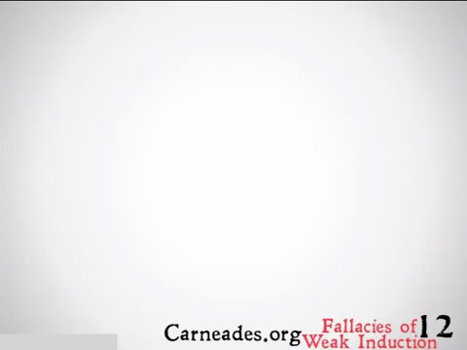

Slide 27
Your turn...
Consider the following examples. Can you spot the appeal to ignorance?
Example 1
“We have no evidence that the Illuminati ever existed. They must have been so clever they destroyed all the evidence.”
Example 2
“I know nothing about Tank Johnson except that he has a criminal record as long as your leg, but I’ll bet he’s really just misunderstood.”

Slide 28
False Dilemma/False Dichotomy
This fallacy has a few other names: “black-and-white fallacy,” “either/or fallacy,” “false dichotomy,” and “bifurcation fallacy.” This line of reasoning fails by limiting the options to two when there are in fact more options to choose from. Sometimes the choices are between one thing, the other thing, or both things together (they don’t exclude each other). Sometimes there is a whole range of options, three, four, five, or a hundred and forty-five. However it may happen, the false dichotomy fallacy errs by oversimplifying the range of options.

Slide 29
False Dilemma/False Dichotomy
Dilemma-based arguments are only fallacious when, in fact, there are more than the stated options. It’s not a fallacy however if there really are only two options. For example, “either Led Zeppelin is the greatest band of all time, or they are not.” That’s a true dilemma, since there really are only two options there: A or non-A. It would be fallacious however to say, “There are only two kinds of people in the world: people who love Led Zeppelin, and people who hate music.” Some people are indifferent about that music. Some sort of like it, or sort of dislike it, but don’t have strong feelings either way.

Slide 30
False Dilemma/False Dichotomy
Dilemma-based arguments are only fallacious when, in fact, there are more than the stated options.
The false dilemma fallacy is often a manipulative tool designed to polarize the audience, heroicizing one side and demonizing the other. It’s common in political discourse as a way of strong-arming the public into supporting controversial legislation or policies.

Slide 31
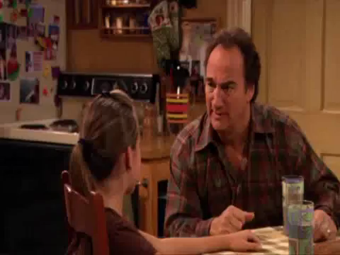

Slide 32
Your turn...
See if you can identify a third option these politicians failed to mention.
Example 1
“Either we go to war, or we appear weak.”
Example 2
“Either you love me, or you hate me.”

Slide 33
Slippery slope fallacy...
You may have used this fallacy on your parents as a teenager: “But, you have to let me go to the party! If I don’t go to the party, I’ll be a loser with no friends. Next thing you know I’ll end up alone and jobless living in your basement when I’m 30!” The slippery slope fallacy works by moving from a seemingly benign premise or starting point and working through a number of small steps to an improbable extreme.

Slide 34
Slippery slope fallacy...
This fallacy is not just a long series of causes. Some causal chains are perfectly reasonable. There could be a complicated series of causes that are all related, and we have good reason for expecting the first cause to generate the last outcome. The slippery slope fallacy, however, suggests that unlikely or ridiculous outcomes are likely when there is just not enough evidence to think so.

Slide 35
Slippery slope fallacy...
The slippery slope fallacy suggests that unlikely or ridiculous outcomes are likely when there’s just not enough evidence to think so.
It’s hard enough to prove one thing is happening or has happened; it’s even harder to prove a whole series of events will happen. That’s a claim about the future, and we haven’t arrived there yet. We, generally, don’t know the future with that kind of certainty. The slippery slope fallacy slides right over that difficulty by assuming that chain of future events without really proving their likelihood.

Slide 36
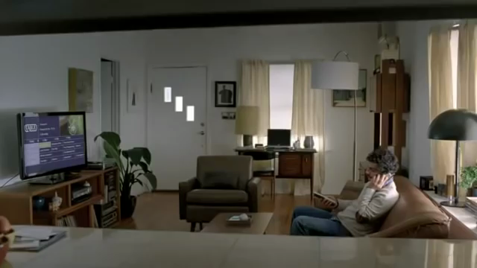

Slide 37
Your turn...
Which of these examples is a slippery slope fallacy and which is not?
Example 1
“Your coach’s policy is that no one can be a starter on game day if they miss practice. So, if you miss basketball practice today, you won’t be a starter in Friday’s game. Then you won’t be the first freshman to start on the Varsity basketball team at our school.”
Example 2
“If America doesn’t send weapons to the Syrian rebels, they won’t be able to defend themselves against their warring dictator. They’ll lose their civil war, and that dictator will oppress them, and the Soviets will consequently carve out a sphere of influence that spreads across the entire Middle East.”

Slide 38
Circular reasoning (petitio principii)
When a person’s argument is just repeating what they already assumed beforehand, it’s not arriving at any new conclusion. We call this a circular argument or circular reasoning. If someone says, “The Bible is true; it says so in the Bible”—that’s a circular argument. They are assuming that the Bible only speaks truth, and so they trust it to truthfully report that it speaks the truth, because it says that it does. It is a claim using its own conclusion as its premise, and vice versa, in the form of “If A is true because B is true; B is true because A is true”. Another example of circular reasoning is, “According to my brain, my brain is reliable.” Well, yes, of course we would think our brains are in fact reliable if our brains are the one’s telling us that our brains are reliable.

Slide 39
Circular reasoning (petitio principii)
Circular arguments are also called Petitio principii, meaning “Assuming the initial [thing]” (commonly mistranslated as “begging the question”). This fallacy is a kind of presumptuous argument where it only appears to be an argument. It’s really just restating one’s assumptions in a way that looks like an argument. You can recognize a circular argument when the conclusion also appears as one of the premises in the argument.

Slide 40


Slide 41
Your turn...
Another way to explain circular arguments is that they start where they finish, and finish where they started. See if you can identify which of these is a circular argument.
Example 1
“Smoking pot is against the law because it’s wrong; I know it’s wrong because it is against the law.”
Example 2
“Because smoking pot is against the law, this leads many to believe it is wrong.”

Slide 42
Hasty generalisation...
A hasty generalization is a general statement without sufficient evidence to support it. A hasty generalization is made out of a rush to have a conclusion, leading the arguer to commit some sort of illicit assumption, stereotyping, unwarranted conclusion, overstatement, or exaggeration.

Slide 43
Hasty generalisation...
Normally we generalize without any problem; it is a necessary, regular part of language. We make general statements all the time: “I like going to the park,” "Democrats disagree with Republicans,” "It’s faster to drive to work than to walk," or "Everyone mourned the loss of Harambe, the Gorilla.”

Slide 44
Hasty generalisation...
Hasty generalization may be the most common logical fallacy because there’s no single agreed-upon measure for “sufficient” evidence.
Indeed, the above phrase “all the time” is a generalization — we aren’t literally making these statements all the time. We take breaks to do other things like eat, sleep, and inhale. These general statements aren’t addressing every case every time. They are speaking generally, and, generally speaking, they are true. Sometimes you don’t enjoy going to the park. Sometimes Democrats and Republicans agree. Sometimes driving to work can be slower than walking if the roads are all shut down for a Harambe procession.

Slide 45
Hasty generalisation...
Hasty generalization may be the most common logical fallacy because there’s no single agreed-upon measure for “sufficient” evidence. Is one example enough to prove the claim that, "Apple computers are the most expensive computer brand?" What about 12 examples? What about if 37 out of 50 apple computers were more expensive than comparable models from other brands?

Slide 46
Hasty generalisation...
Hasty generalization may be the most common logical fallacy because there’s no single agreed-upon measure for “sufficient” evidence. Is one example enough to prove the claim that, "Apple computers are the most expensive computer brand?" What about 12 examples? What about if 37 out of 50 apple computers were more expensive than comparable models from other brands?

Slide 47
Hasty generalisation...
There’s no set rule for what constitutes “enough” evidence. In this case, it might be possible to find reasonable comparison and prove that claim is true or false. But in other cases, there’s no clear way to support the claim without resorting to guesswork. The means of measuring evidence can change according to the kind of claim you are making, whether it’s in philosophy, or in the sciences, or in a political debate, or in discussing house rules for using the kitchen. A much safer claim is that "Apple computers are more expensive than many other computer brands.”

Slide 48
Hasty generalisation...
Meanwhile, we do well to avoid treating general statements like they are anything more than simple, standard generalizations, instead of true across the board. Even if it is true that many Apple computers are more expensive than other computers, there are plenty of cases in which Apple computers are more affordable than other computers. This is implied in the above generalization, but glossed over in the first hasty generalization.

Slide 49
Hasty generalisation...
A simple way to avoid hasty generalizations is to add qualifiers like “sometimes,” "maybe," "often," or "it seems to be the case that . . . ". When we don’t guard against hasty generalization, we risk stereotyping, sexism, racism, or simple incorrectness. But with the right qualifiers, we can often make a hasty generalization into a responsible and credible claim.

Slide 50
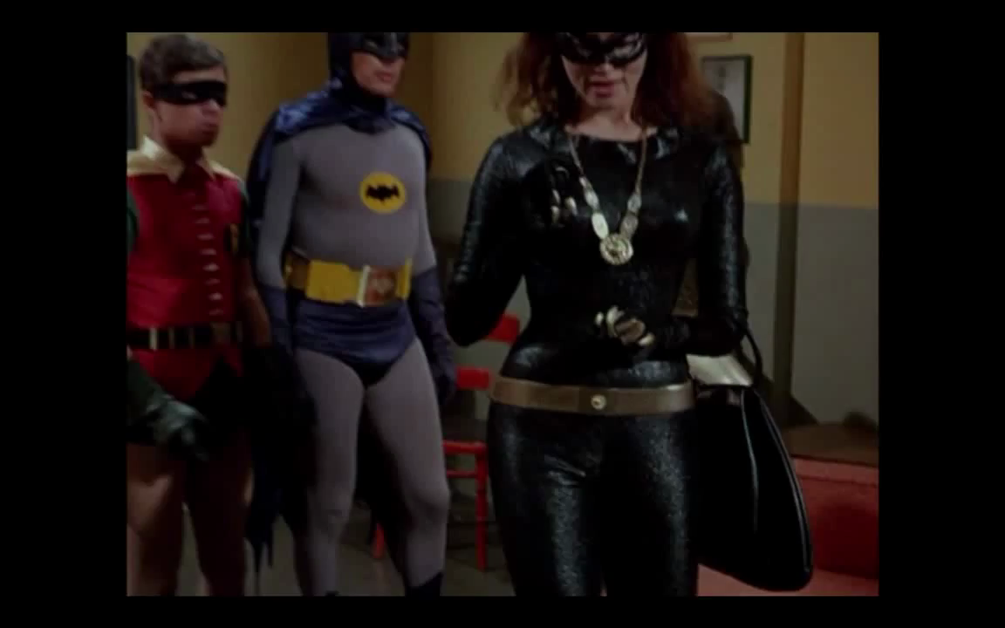

Slide 51
Your turn...
Which of the following is a hasty generalization?
Example 1
“Some people vote without seriously weighing the merits of the candidate.”
Example 2
“People nowadays only vote with their emotions instead of their brains.”

Slide 52
Red Herring Fallacy (ignoratio elenchi)
A “red herring fallacy” is a distraction from the argument typically with some sentiment that seems to be relevant but isn’t really on-topic. This tactic is common when someone doesn’t like the current topic and wants to detour into something else instead, something easier or safer to address. A red herring fallacy is typically related to the issue in question but isn’t quite relevant enough to be helpful. Instead of clarifying and focusing, it confuses and distracts.

Slide 53
Red Herring Fallacy (ignoratio elenchi)
A red herring fallacy can be difficult to identify because it’s not always clear how different topics relate.
The phrase “red herring” refers to a kippered herring (salted herring-fish) which was reddish brown in color and quite pungent. According to legend, this aroma was so strong and delectable to dogs that it served as a good training device for testing how well a hunting dog could track a scent without getting distracted. Dogs aren’t generally used for hunting fish so a red herring is a distraction from what he is supposed to be hunting.

Slide 54
Red Herring Fallacy (ignoratio elenchi)
A red herring fallacy can be difficult to identify because it’s not always clear how different topics relate. A “side” topic may be used in a relevant way, or in an irrelevant way. In the big meaty disagreements of our day, there are usually a lot of layers involved, with different subtopics weaving into them. We can guard against the red herring fallacy by clarifying how our part of the conversation is relevant to the core topic.

Slide 55


Slide 56
Your turn...
Which of the following examples is a red herring fallacy?
Example 1
“My wife wants to talk about cleaning out the garage, so I asked her what she wants to do with our patio furniture. Now she’s shopping for new patio furniture and not asking me about the garage.”
Example 2
“My wife wants to talk about cleaning out the garage, so I asked her what she wants to do with the patio furniture, because it’s just sitting in the garage taking up space.”

Slide 57
Tu Quoque/Appeal to hypocrisy
The “tu quoque,” Latin for “you too,” is also called the “appeal to hypocrisy” because it distracts from the argument by pointing out hypocrisy in the opponent. This tactic doesn’t solve the problem, or prove one’s point, because even hypocrites can tell the truth. Focusing on the other person’s hypocrisy is a diversionary tactic. In this way, using the tu quoque typically deflects criticism away from yourself by accusing the other person of the same problem or something comparable. If Jack says, “Maybe I committed a little adultery, but so did you Jason!” Jack is trying to diminish his responsibility or defend his actions by distributing blame to other people. But no one else’s guilt excuses his own guilt. No matter who else is guilty, Jack is still an adulterer.

Slide 58
Tu Quoque/Appeal to hypocrisy
The tu quoque fallacy is an attempt to divert blame, but it really only distracts from the initial problem. To be clear, however, it isn’t a fallacy to simply point out hypocrisy where it occurs. For example, Jack may say, “yes, I committed adultery. Jill committed adultery. Lots of us did, but I’m still responsible for my mistakes.” In this example, Jack isn’t defending himself or excusing his behavior. He’s admitting his part within a larger problem. The hypocrisy claim becomes a tu quoque fallacy only when the arguer uses some (apparent) hypocrisy to neutralize criticism and distract from the issue.

Slide 60
Your turn...
Which of the following is a tu quoque fallacy?
Example 1
“But, Dad, I know you smoked when you were my age, so how can you tell me not to do it?”
Example 2
“Son, yes, I smoked when I was your age, it was dumb then. And it’s dumb now. That’s why I forbid you to smoke, chew, or vape, or use nicotine gum, or whatever you kids do with tobacco these days.”

Slide 61
Causal fallacy
The causal fallacy is any logical breakdown when identifying a cause. You can think of the causal fallacy as a parent category for several different fallacies about unproven causes.
One causal fallacy is the false cause or non causa pro causa ("not the-cause for a cause") fallacy, which is when you conclude about a cause without enough evidence to do so. Consider, for example, “Since your parents named you ‘Harvest,’ they must be farmers.” It’s possible that the parents are farmers, but that name alone is not enough evidence to draw that conclusion. That name doesn’t tell us much of anything about the parents. This claim commits the false cause fallacy.

Slide 62
Causal fallacy
Another causal fallacy is the post hoc fallacy. Post hoc is short for post hoc ergo propter hoc ("after this, therefore because of this"). This fallacy happens when you mistake something for the cause just because it came first. The key words here are “post” and “propter” meaning “after” and “because of.” Just because this came before that doesn’t mean this caused that. Post doesn’t prove propter. A lot of superstitions are susceptible to this fallacy. For example:
“Yesterday, I walked under a ladder with an open umbrella indoors while spilling salt in front of a black cat. And I forgot to knock on wood with my lucky dice. That must be why I’m having such a bad day today. It’s bad luck.”

Slide 63
Causal fallacy
Now, it’s theoretically possible that those things cause bad luck. But since those superstitions have no known or demonstrated causal power, and “luck” isn’t exactly the most scientifically reliable category, it’s more reasonable to assume that those events, by themselves, didn’t cause bad luck. Perhaps that person’s "bad luck" is just their own interpretation because they were expecting to have bad luck. They might be having a genuinely bad day, but we cannot assume some non-natural relation between those events caused today to go bad. That’s a Post Hoc fallacy. Now, if you fell off a ladder onto an angry black cat and got tangled in an umbrella, that will guarantee you one bad day.

Slide 64
Causal fallacy
Another kind of causal fallacy is the correlational fallacy also known as cum hoc ergo propter hoc (Lat., “with this therefore because of this"). This fallacy happens when you mistakenly interpret two things found together as being causally related. Two things may correlate without a causal relation, or they may have some third factor causing both of them to occur. Or perhaps both things just, coincidentally, happened together. Correlation doesn’t prove causation.
Consider for example, “Every time Joe goes swimming he is wearing his Speedos. Something about wearing that Speedo must make him want to go swimming.” That statement is a correlational fallacy. Sure it’s theoretically possible that he spontaneously sports his euro-style swim trunks, with no thought of where that may lead, and surprisingly he’s now motivated to dive and swim in cold, wet nature. That’s possible. But it makes more sense that he put on his trunks because he already planned to go swimming.

Slide 65
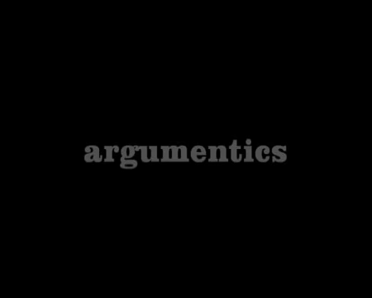

Slide 66
Your turn...
Which kind of causal fallacy is at work in these examples?
Example 1
“Jimmy isn’t at school today. He must be on a family trip.”
Example 2
“Jimmy has a fever, sinus congestion, a cough, and can’t come to school, so he probably has a test later today.”
Example 3
“Someone really should move this ‘deer crossing’ sign. This is a dangerous stretch of highway and the deer really should be crossing somewhere else.”

Slide 67
Fallacy of sunk costs...
Sometimes we invest ourselves so thoroughly in a project that we’re reluctant to ever abandon it, even when it turns out to be fruitless and futile. It’s natural and usually not a fallacy to want to carry on with something we find important, not least because of all the resources we’ve put into it. However, this kind of thinking becomes a fallacy when we start to think that we should continue with a task or project because of all that we’ve put into it, without considering the future costs we’re likely to incur by doing so. There may be a sense of accomplishment when finishing, and the project might have other values, but it’s not enough to justify the cost invested in it.

Slide 68
Fallacy of sunk costs...
We are susceptible to this errant behavior when we crave that sense of completion or a sense of accomplishment
“Sunk cost” is an economic term for any past expenses that can no longer be recovered. For example, after watching the first six episodes of Battlestar Galactica, you decide the show isn’t for you. Those six episodes are your “sunk cost.” But, because you’ve already invested roughly six hours of your life in it, you rationalize that you might as well finish it. All apologies to Edward James Olmos, but this isn’t "good economics" so to speak. It’s more cost than benefit.

Slide 69
Fallacy of sunk costs...
Psychologically, we are susceptible to this errant behavior when we crave that sense of completion or a sense of accomplishment, or we are too comfortable or too familiar with this unwieldy project. Sometimes, we become too emotionally committed to an “investment,” burning money, wasting time, and mismanaging resources to do it.

Slide 70


Slide 71
Your turn...
Consider the following examples. Which of these is a sunk cost fallacy and which is not?
Example 1
“I know this relationship isn’t working anymore and that we’re both miserable. No marriage. No kids. No steady job. But I’ve been with him for seven years, so I’d better stay with him.”
Example 2
“I’m halfway done with college. This is so tough, and it’s not nearly as fun as I thought it would be, but I don’t know. I guess I’ll finish it and get my degree.”

Slide 72
Appeal to Authority (argumentum ad verecundiam)
This fallacy happens when we misuse an authority. This misuse of authority can occur in a number of ways. We can cite only authorities — steering conveniently away from other testable and concrete evidence as if expert opinion is always correct. Or we can cite irrelevant authorities, poor authorities, or false authorities.
Like many of the other fallacies in this list, the argumentum ad verecundiam (“argument from respect”) can be hard to spot. It’s tough to see, sometimes, because it is normally a good, responsible move to cite relevant authorities supporting your claim. It can’t hurt. But if all you have are authorities, and everyone just has to “take their word for it” without any other evidence to show that those authorities are correct, then you have a problem.

Slide 73
Appeal to Authority (argumentum ad verecundiam)
Often this fallacy refers to irrelevant authorities — like citing a foot doctor when trying to prove something about psychiatry; their expertise is in an irrelevant field. When citing authorities to make your case, you need to cite relevant authorities, but you also need to represent them correctly, and make sure their authority is legitimate.
Suppose someone says, “I buy Hanes™ underwear because Michael Jordan says it’s the best.” Michael Jordan may be a spokesperson, but that doesn’t make him a relevant authority when it comes to underwear. This is a fallacy of irrelevant authority.

Slide 74
Appeal to Authority (argumentum ad verecundiam)
Now consider this logical leap: “four out of five dentists agree that brushing your teeth makes your life meaningful.” Dentists generally have expert knowledge about dental hygiene, but they aren’t qualified to draw far-reaching conclusions about its existential meaningfulness. This is a fallacy of misused authority. For all we know, their beliefs about the “meaning of life” are just opinions, not expert advice.

Slide 75
Appeal to Authority (argumentum ad verecundiam)
Or take the assumption that, “I’m the most handsome man in the world because my mommy says so.” Now, while I might be stunningly handsome, my mom’s opinion doesn’t prove it. She’s biased. She’s practically required to tell me I’m handsome because it’s her job as a mother to see the best in me and to encourage me to be the best I can be. She’s also liable to see me through “rose-colored glasses.” And, in this case, she’s not an expert in fashion, modeling, or anything dealing in refined judgments of human beauty. She’s in no position to judge whether I’m the most handsome man in the world. Her authority there is illusory (sorry mom).

Slide 76
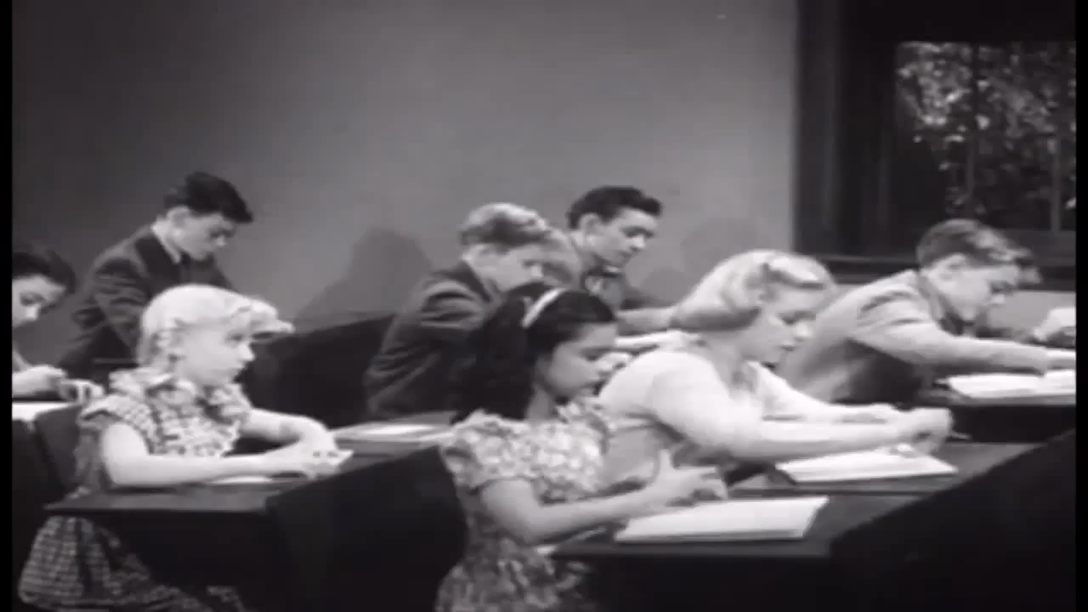

Slide 77
Your turn...
Consider the following examples. How do these statements mishandle authorities?
Example 1
“Because Martin Sheen played the president on television, he’d probably make a great president in real life.”
Example 2
“One day robots will enslave us all. It’s true. My computer science teacher says so.”
Example 3
“This internet news site said that the candidate punches babies. We know that’s true because it’s on the internet.”

Slide 78
Equivocation (ambiguity)
Equivocation happens when a word, phrase, or sentence is used deliberately to confuse, deceive, or mislead by sounding like it’s saying one thing but actually saying something else. Equivocation comes from the roots “equal” and “voice” and refers to two-voices; a single word can “say” two different things. Another word for this is ambiguity.

Slide 79
Equivocation (ambiguity)
When it’s poetic or comical, we call it a “play on words.” But when it’s done in a political speech, an ethics debate, or in an economics report, for example, and it’s done to make the audience think you’re saying something you’re not, that’s when it becomes a fallacy. Sometimes, this is not a “fallacy” per se, but just a miscommunication. The equivocation fallacy, however, has a tone of deception instead of just a simple misunderstanding. Often this deception shows up in the form of euphemisms, replacing unpleasant words with “nicer” terminology. For example, a euphemism might be replacing “lying” with the phrase “ creative license, ” or replacing my “criminal background” with my “youthful indiscretions,” or replacing “fired from my job” with “taking early retirement.” When these replacement words are used to mislead people they become an equivocation fallacy.

Slide 80
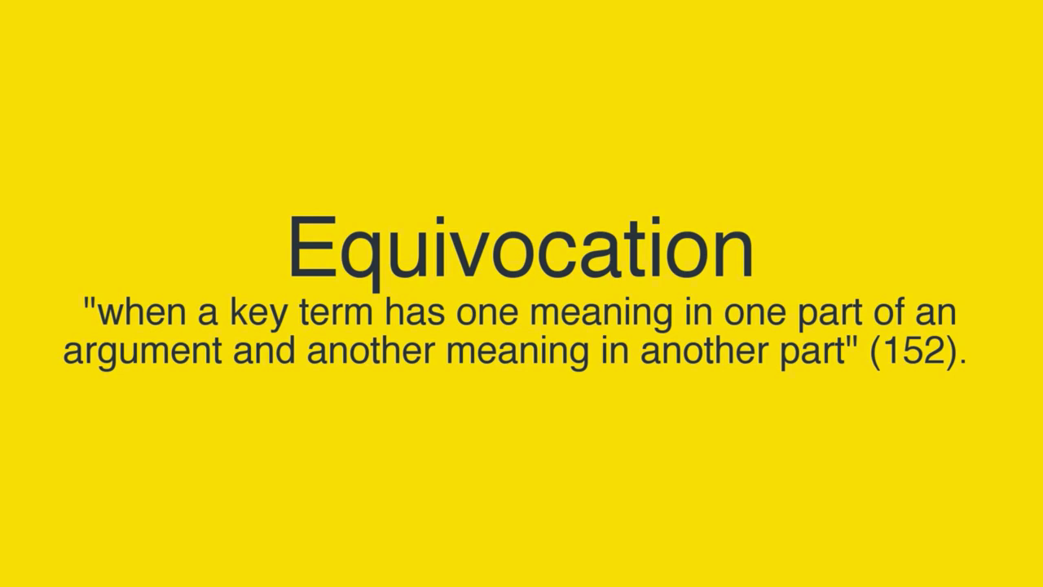

Slide 81
Your turn...
How do each of these examples commit an equivocation fallacy?
Example 1
“His political party wants to spend your precious tax dollars on big government. But my political party is planning strategic federal investment in critical programs.”
Example 2
“I don’t understand why you’re saying I broke a promise. I said I’d never speak again to my ex-girlfriend. And I didn’t. I just sent her some pictures and text messages.”

Slide 82
Appeal to Pity/Emotion (argumentum ad misericordiam)
Argumentum ad misericordiam is Latin for “argument to compassion.” Like the ad hominem fallacy above, it is a fallacy of relevance. Personal attacks, and emotional appeals, aren’t strictly relevant to whether something is true or false. In this case, the fallacy appeals to the compassion and emotional sensitivity of others when these factors are not strictly relevant to the argument. Appeals to pity often appear as emotional manipulation.

Slide 83
Appeal to Pity/Emotion (argumentum ad misericordiam)
“How can you eat that innocent little carrot? He was plucked from his home in the ground at a young age and violently skinned, chemically treated, and packaged, and shipped to your local grocer, and now you are going to eat him into oblivion when he did nothing to you. You really should reconsider what you put into your body.”

Slide 84
Appeal to Pity/Emotion (argumentum ad misericordiam)
Obviously, this characterization of carrot-eating is plying the emotions by personifying a baby carrot like it’s a conscious animal, or, well, a baby. By the time the conclusion appears, it’s not well-supported. If you are to be logically persuaded to agree that “you should reconsider what you put into your body,” then it would have been better evidence to hear about unethical farming practices or unfair trading practices such as slave labor, toxic runoffs from fields, and so on.

Slide 85
Appeal to Pity/Emotion (argumentum ad misericordiam)
Truth and falsity aren’t emotional categories, they are factual categories. They deal in what is and is not, regardless of how one feels about the matter. Another way to say it is that this fallacy happens when we mistake feelings for facts. Our feelings aren’t disciplined truth-detectors unless we’ve trained them that way. So, as a general rule, it’s problematic to treat emotions as if they were (by themselves) infallible proof that something is true or false. Children may be scared of the dark for fear there are monsters under their bed, but that’s hardly proof of monsters.

Slide 86
Appeal to Pity/Emotion (argumentum ad misericordiam)
To be fair, emotions can sometimes be relevant. Often, the emotional aspect is a key insight into whether something is morally repugnant or praiseworthy, or whether a governmental policy will be winsome or repulsive. People’s feelings about something can be critically important data when planning a campaign, advertising a product, or rallying a group together for a charitable cause. It becomes a fallacious appeal to pity when the emotions are used in substitution for facts or as a distraction from the facts of the matter.

Slide 87
Appeal to Pity/Emotion (argumentum ad misericordiam)
It’s not a fallacy for jewelry and car companies to appeal to your emotions to persuade you into purchasing their product. That’s an action, not a claim, so it can’t be true or false. It would however be a fallacy if they used emotional appeals to prove that you need this car, or that this diamond bracelet will reclaim your youth, beauty, and social status from the cold clammy clutches of Father Time. The fact of the matter is, you probably don’t need those things, and they won’t rescue your fleeting youth.

Slide 88


Slide 89
Your turn...
Which of these is a fallacious appeal to emotion, and which one is not?
Example 1
“Professor, you have to give me an A on this paper. I know I only turned in a sentence and some clip art, but you have to understand, my grandmother suddenly died while traveling in the Northern Yukon, and her funeral was there so I had to travel, and my parents got divorced in the middle of the ceremony, and all the stress caused me to become catatonic for two weeks. Have some pity, my grandmother’s last wish was that I’d get an A in this class.”
Example 2
“Professor, I know this work was subpar, and I feel pretty bad about it. I’d like to schedule a meeting with you to discuss how I can do better on our next assignment.”

Slide 90
Bandwagon fallacy
The bandwagon fallacy assumes something is true (or right, or good) because other people agree with it. A couple different fallacies can be included under this label, since they are often indistinguishable in practice. The ad populum fallacy (Lat., “to the populous/popularity”) is when something is accepted because it’s popular. The concensus gentium (Lat., “consensus of the people”) is when something is accepted because the relevant authorities or people all agree on it. The status appeal fallacy is when something is considered true, right, or good because it has the reputation of lending status, making you look “popular,” “important,” or “successful.”

Slide 91
Bandwagon fallacy
For our purposes, we’ll treat all of these fallacies together as the bandwagon fallacy. According to legend, politicians would parade through the streets of their district trying to draw a crowd and gain attention so people would vote for them. Whoever supported that candidate was invited to literally jump on board the bandwagon. Hence the nickname “bandwagon fallacy.”

Slide 92
Bandwagon fallacy
This tactic is common among advertisers. “If you want to be like Mike (Jordan), you’d better eat your Wheaties.” “Drink Gatorade because that’s what all the professional athletes do to stay hydrated.” “McDonald’s has served over 99 billion, so you should let them serve you too.” The form of this argument often looks like this: “Many people do or think X, so you ought to do or think X too.”

Slide 93
Bandwagon fallacy
One problem with this kind of reasoning is that the broad acceptance of some claim or action is not always a good indication that the acceptance is justified. People can be mistaken, confused, deceived, or even willfully irrational. And when people act together, sometimes they become even more foolish — i.e., “mob mentality.” People can be quite gullible, and this fact doesn’t suddenly change when applied to large groups.

Slide 95
Your turn...
Which of these is a bandwagon fallacy?
Example 1
“Almost everyone at my school will be at the party Friday night. It must be a popular thing to do.”
Example 2
“Almost everyone at my school will be at the party Friday night. It must be the right thing to do.”

Slide 96
Kahoot!
https://play.kahoot.it/v2/?quizId=e1f9eecd-b23e-4240-9ea9-6dac58377a6e

