Slide 1
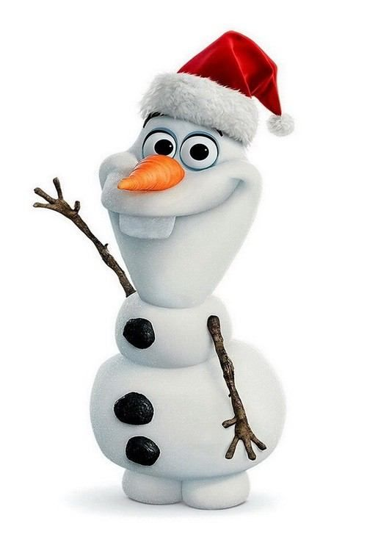
Merry Christmas!
Are you ready for a Christmas lesson?
Today we are going to: Learn new words about elves and snowmen, play games and make presents!

Slide 2
Let’s learn the new words!
Ready?

Slide 3
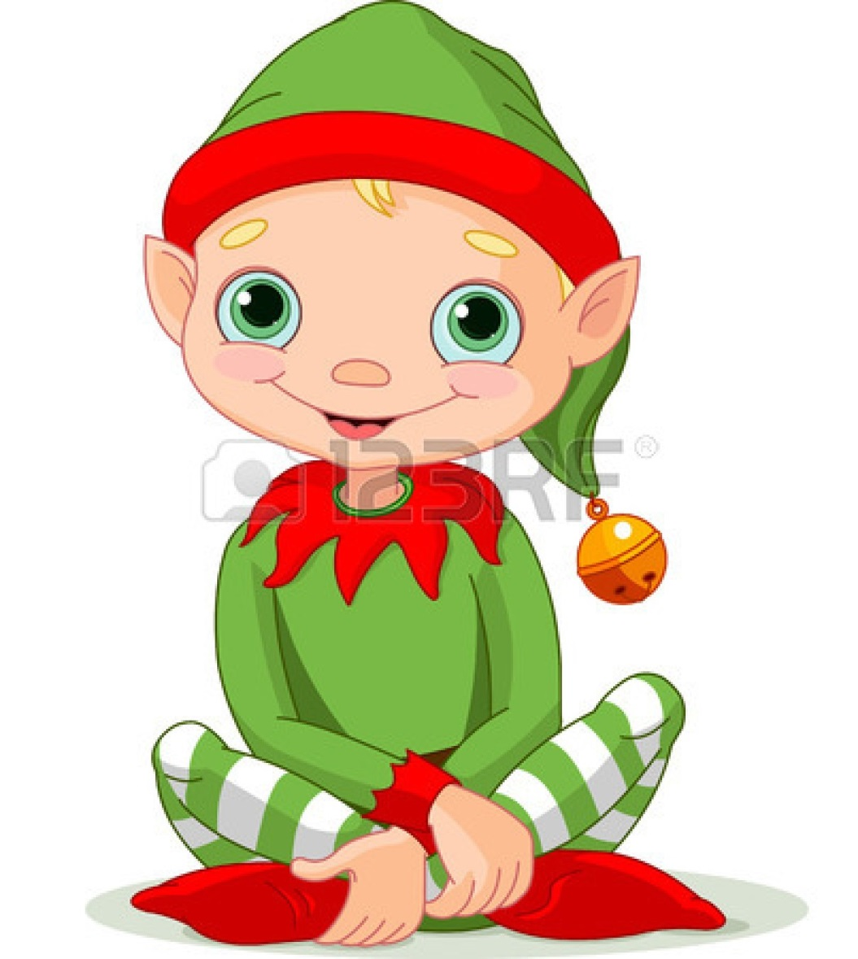
elf

Slide 4
bell

Slide 5
pointy ears

Slide 6
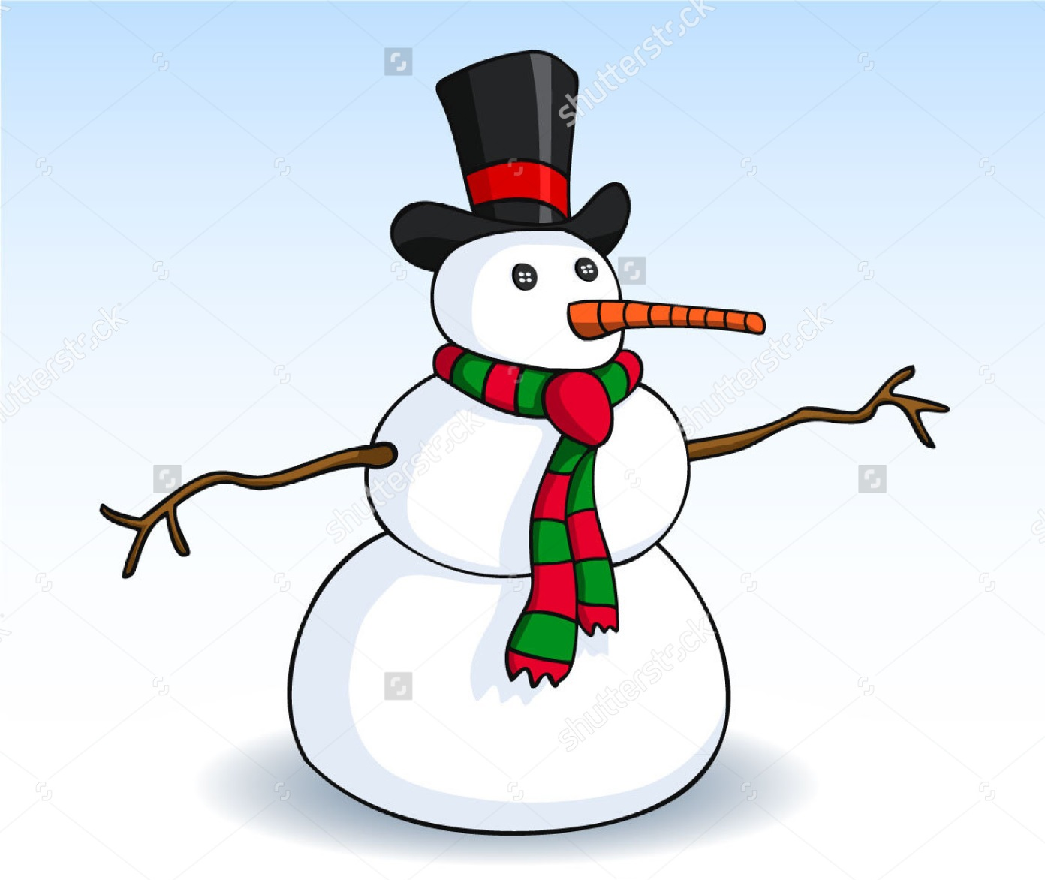
snowman

Slide 7
button eyes

Slide 8
carrot nose

Slide 9
hat

Slide 11
