Slide 1
Cognitive Biases
Overconfidence bias

Slide 2
What are cognitive biases?
Cognitive biases are unconscious errors in thinking that arise from problems related to memory, attention, and other mental mistakes.
These biases result from our brain’s efforts to simplify the incredibly complex world in which we live.
Confirmation bias, hindsight bias, self-serving bias, anchoring bias, availability bias, the framing effect, and inattentional blindness are some of the most common examples of cognitive bias.
Cognitive biases have direct implications on our safety, our interactions with others, and the way we make judgments and decisions in our daily lives.
Although these biases are unconscious, there are small steps we can take to train our minds to adopt a new pattern of thinking and mitigate the effects of these biases.

Slide 3
Overconfidence Bias
The overconfidence bias is the tendency people have to be more confident in their own abilities, such as driving, teaching, or spelling, than is objectively reasonable. This overconfidence also involves matters of character.
Generally, people believe that they are more ethical than their competitors, co-workers, and peers. For example, a recent study showed that 50% of business people polled believed that they were in the top 10% ethically.
Because of the overconfidence bias, people will often take ethical issues lightly. They simply assume that they have good character and will therefore do the right thing when they encounter ethical challenges. In fact, studies show that the overconfidence bias causes people to overestimate how much, and how often, they will donate money or volunteer their time to charities.
So, overconfidence in our own moral character can cause us to act without proper reflection. And that is when we are most likely to act unethically.

Slide 4
If you roll a dice 99 times, and it lands on 6 99 times in a row, what are the chances of getting a 6 on the 100th roll?

Slide 5
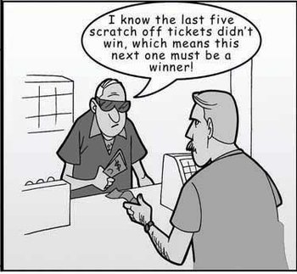
Overconfidence bias relates to the ‘Gambler’s fallacy’
(the belief that the probability for an outcome after a series of outcomes is not the same as the probability for a single outcome.
The gambler's fallacy is real and true in cases where the events in question are independent and identically distributed.
Some believes that the next dice roll is like to be a 6, as it has been before.
Others would say that any other number is massively overdue to come up.
The truth is, each time, each number is likely to be 1/6.
(although if this really did happen, you wouldn’t be considered a fool for questioning whether the game is rigged!)

Slide 6
The overconfidence effect is a well-established bias in which a person's subjective confidence in his or her judgments is reliably greater than the objective accuracy of those judgments, especially when confidence is relatively high.^{[1][2]} Overconfidence is one example of a miscalibration of subjective probabilities. Throughout the research literature, overconfidence has been defined in three distinct ways: (1) overestimation of one's actual performance; (2) overplacement of one's performance relative to others; and (3) overprecision in expressing unwarranted certainty in the accuracy of one's beliefs.^{[3][4]}

Slide 7
The most common way in which overconfidence has been studied is by asking people how confident they are of specific beliefs they hold or answers they provide. The data show that confidence systematically exceeds accuracy, implying people are more sure that they are correct than they deserve to be. If human confidence had perfect calibration, judgments with 100% confidence would be correct 100% of the time, 90% confidence correct 90% of the time, and so on for the other levels of confidence. By contrast, the key finding is that confidence exceeds accuracy so long as the subject is answering hard questions about an unfamiliar topic. For example, in a spelling task, subjects were correct about 80% of the time, whereas they claimed to be 100% certain.^{[5]} Put another way, the error rate was 20% when subjects expected it to be 0%. In a series where subjects made true-or-false responses to general knowledge statements, they were overconfident at all levels. When they were 100% certain of their answer to a question, they were wrong 20% of the time.^{[6]}

Slide 8
Overestimation
One manifestation of the overconfidence effect is the tendency to overestimate one's standing on a dimension of judgment or performance. This subsection of overconfidence focuses on the certainty one feels in their own ability, performance, level of control, or chance of success. This phenomenon is most likely to occur on hard tasks, hard items, when failure is likely or when the individual making the estimate is not especially skilled. Overestimation has been seen to occur across domains other than those pertaining to one's own performance. This includes the illusion of control, planning fallacy.^{[3]}
Illusion of control
Illusion of control describes the tendency for people to behave as if they might have some control when in fact they have none.^{[7]} However, evidence does not support the notion that people systematically overestimate how much control they have; when they have a great deal of control, people tend to underestimate how much control they have.^{[8]}
Planning fallacy
The planning fallacy describes the tendency for people to overestimate their rate of work or to underestimate how long it will take them to get things done.^{[9]} It is strongest for long and complicated tasks, and disappears or reverses for simple tasks that are quick to complete.
Contrary evidence
Wishful-thinking effects, in which people overestimate the likelihood of an event because of its desirability, are relatively rare.^{[10]} This may be in part because people engage in more defensive pessimism in advance of important outcomes,^{[11]} in an attempt to reduce the disappointment that follows overly optimistic predictions.^{[12]}

Slide 9
Overprecision
Overprecision is the excessive confidence that one knows the truth. For reviews, see Harvey (1997) or Hoffrage (2004). Much of the evidence for overprecision comes from studies in which participants are asked about their confidence that individual items are correct. This paradigm, while useful, cannot distinguish overestimation from overprecision; they are one and the same in these item-confidence judgments. After making a series of item-confidence judgments, if people try to estimate the number of items they got right, they do not tend to systematically overestimate their scores. The average of their item-confidence judgments exceeds the count of items they claim to have gotten right.[ One possible explanation for this is that item-confidence judgments were inflated by overprecision, and that their judgments do not demonstrate systematic overestimation.
Confidence intervals
The strongest evidence of overprecision comes from studies in which participants are asked to indicate how precise their knowledge is by specifying a 90% confidence interval around estimates of specific quantities. If people were perfectly calibrated, their 90% confidence intervals would include the correct answer 90% of the time.^{[16]} In fact, hit rates are often as low as 50%, suggesting people have drawn their confidence intervals too narrowly, implying that they think their knowledge is more accurate than it actually is.

Slide 10
Overplacement
Overplacement is the most prominent manifestation of the overconfidence effect which is a belief that erroneously rates someone as better than others.^{[17]} This subsection of overconfidence occurs when people believe themselves to be better than others, or "better-than-average".^{[3]} It is the act of placing yourself or rating yourself above others (superior to others). Overplacement more often occurs on simple tasks, ones we believe are easy to accomplish successfully.
Manifestations
Better-than-average effects
Perhaps the most celebrated better-than-average finding is Svenson's (1981) finding that 93% of American drivers rate themselves as better than the median.^{[18]} The frequency with which school systems claim their students outperform national averages has been dubbed the "Lake Wobegon" effect, after Garrison Keillor's apocryphal town in which "all the children are above average."^{[19]} Overplacement has likewise been documented in a wide variety of other circumstances.^{[20]} Kruger (1999), however, showed that this effect is limited to "easy" tasks in which success is common or in which people feel competent. For difficult tasks, the effect reverses itself and people believe they are worse than others.^{[21]}
Comparative-optimism effect
Some researchers have claimed that people think good things are more likely to happen to them than to others, whereas bad events were less likely to happen to them than to others.^{[22]} But others have pointed out that prior work tended to examine good outcomes that happened to be common (such as owning one's own home) and bad outcomes that happened to be rare (such as being struck by lightning).^{[23][24][25]} Event frequency accounts for a proportion of prior findings of comparative optimism. People think common events (such as living past 70) are more likely to happen to them than to others, and rare events (such as living past 100) are less likely to happen to them than to others.
Positive illusions
Taylor and Brown (1988) have argued that people cling to overly positive beliefs about themselves, illusions of control, and beliefs in false superiority, because it helps them cope and thrive.^{[26]} Although there is some evidence that optimistic beliefs are correlated with better life outcomes, most of the research documenting such links is vulnerable to the alternative explanation that their forecasts are accurate.
Social knowledge
People tend to overestimate what they personally know, unconsciously assuming they know facts they would actually need to access by asking someone else or consulting a written work. Asking people to explain how something works (like a bicycle, helicopter, or international policy) exposes knowledge gaps and reduces the overestimation of knowledge on that topic.^{[27]}

Slide 11
How to avoid ‘Overconfidence bias’
Consider the element of luck in your success. Sometimes you’ve had success because you just happened to be in the right place at the right time.
Consider the work you put in for past success. If you have put in lots of research and effort, it is likely your hard work which has paid off, rather than some natural talent you possess (and if you put in no effort at all, it is likely due to luck).
Consider other people and their input carefully, they may be aware of something which you have accidentally blinded yourself to.
Always be aware that failure can and does occur, and this can be unexpected and out of your control.

Slide 12
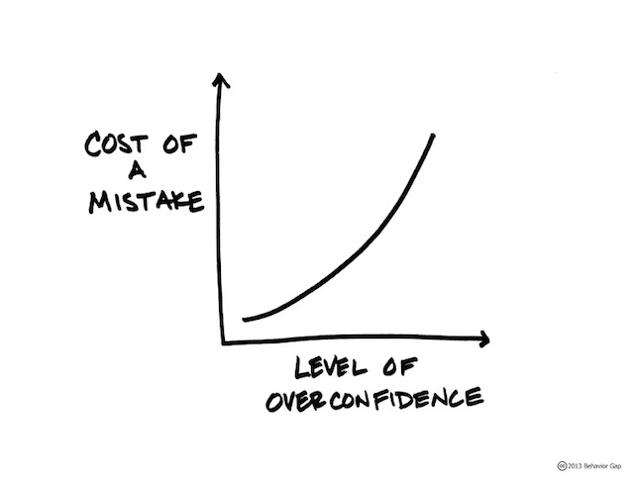

Slide 15
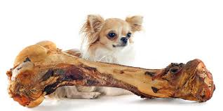

Slide 17
Now try the quiz…
https://play.kahoot.it/v2/?quizId=42c4de5c-2eb6-4106-b559-52a54d907bfc

