Slide 1
Cognitive Biases
Placebo Bias

Slide 2
What are cognitive biases?
Cognitive biases are unconscious errors in thinking that arise from problems related to memory, attention, and other mental mistakes.
These biases result from our brain’s efforts to simplify the incredibly complex world in which we live.
Confirmation bias, hindsight bias, self-serving bias, anchoring bias, availability bias, the framing effect, and inattentional blindness are some of the most common examples of cognitive bias.
Cognitive biases have direct implications on our safety, our interactions with others, and the way we make judgments and decisions in our daily lives.
Although these biases are unconscious, there are small steps we can take to train our minds to adopt a new pattern of thinking and mitigate the effects of these biases.

Slide 3
A placebo is any treatment that has no active properties, such as a sugar pill.
There are many clinical trials where a person who has taken the placebo instead of the active treatment has reported an improvement in symptoms.
Belief in a treatment may be enough to change the course of a person's physical illness.

Slide 4
  Why do things work just because we believe they will work?

Slide 5
The placebo effect is defined as a phenomenon in which some people experience a benefit after the administration of an inactive "look-alike" substance or treatment. This substance, or placebo, has no known medical effect. Sometimes the placebo is in the form of a pill (sugar pill), but it can also be an injection (saline solution) or consumable liquid.

Slide 6
In most cases, the person does not know that the treatment they are receiving is actually a placebo. Instead, they believe that they are the recipient of the real treatment. The placebo is designed to seem exactly like the real treatment, yet the substance has no actual effect on the condition it purports to treat.

Slide 7
Placebo vs. Placebo Effect
It is important to note that a "placebo" and the "placebo effect" are different things. The term placebo refers to the inactive substance itself, while the term placebo effect refers to any effects of taking a medicine that cannot be attributed to the treatment itself.

Slide 8
Causes
Why do people experience real changes as a result of fake treatments? While researchers know that the placebo effect is a real effect, they do not yet fully understand how and why this effect occurs. Research is ongoing as to why some people experience changes even when they are only receiving a placebo. A number of different factors may contribute to this phenomenon.

Slide 9
Hormone Response
One possible explanation is that taking the placebo triggered a release of endorphins. Endorphins have a structure similar to morphine and other opiate painkillers and act as the brain's own natural painkillers.
Researchers have been able to demonstrate the placebo effect in action using brain scans, showing that areas that contain many opiate receptors were activated in both the placebo and treatment groups.¹ Naloxone is an opioid antagonist that blocks both natural endorphins and opioid drugs. After people received naloxone, placebo pain relief was reduced.

Slide 10
Conditioning
Other possible explanations include classical conditioning, or when you form an association between two stimuli resulting in a learned response. In some cases, a placebo can be paired with an actual treatment until it evokes the desired effect.²﻿﻿
For example, if you're regularly given the same arthritis pill to relieve stiff, sore joints, you may begin to associate that pill with pain relief. If you're given a placebo that looks similar to your arthritis pill, you may still believe it provides pain relief because you've been conditioned to do so.
Expectation
Expectations, or what we believe we will experience, have been found to play a significant role in the placebo effect.³ People who are highly motivated and expect the treatment to work may be more likely to experience a placebo effect.
A prescribing physician's enthusiasm for treatment can even impact how a patient responds. If a doctor seems very positive that a treatment will have a desirable effect, a patient may be more likely to see benefits from taking the drug. This demonstrates that the placebo effect can even take place when a patient is taking real medications to treat an illness.
Verbal, behavioral, and social cues can contribute to a person's expectations of whether the medication will have an effect.
Behavioral: The act of taking a pill or receiving an injection to improve your condition
Social: Reassuring body language, eye contact, and speech from a doctor or nurse
Verbal: Listing to a health care provider talk positively about treatment

Slide 11
Genetics
Genes may also influence how people respond to placebo treatments. Some people are genetically predisposed to respond more to placebos. One study found that people with a gene variant that codes for higher levels of the brain chemical dopamine are more prone to the placebo effect than those with the low-dopamine version. People with the high-dopamine version of this gene also tend to have higher levels of pain perception and reward-seeking.⁴
The Nocebo Effect
Conversely, individuals can experience more symptoms or side effects as a response to a placebo, a response that is sometimes referred to as the "nocebo effect." For example, a patient might report having headaches, nausea, or dizziness in response to a placebo.

Slide 12
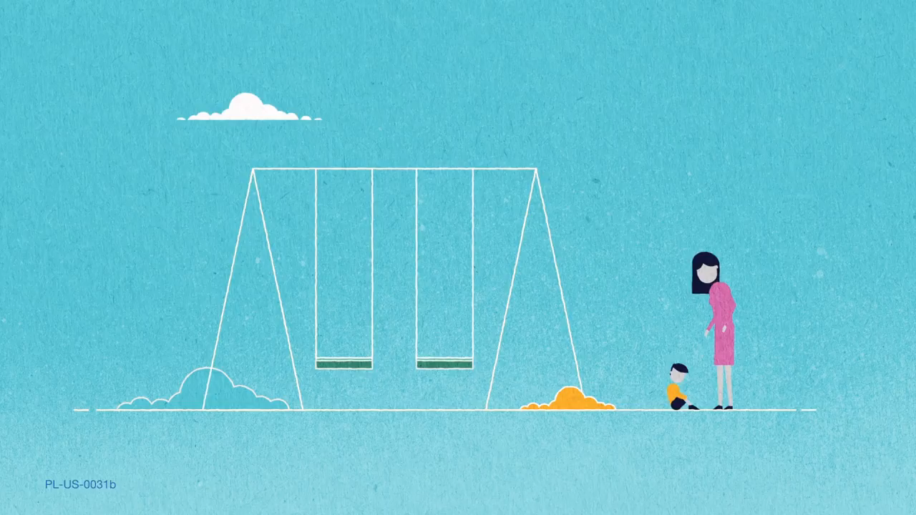

Slide 13
Now try the quiz…
https://play.kahoot.it/v2/?quizId=0fbfa41a-6016-44d6-a5cf-16ab5f41b285

