Slide 1
Cognitive Biases
Survivorship bias

Slide 2
What are cognitive biases?
Cognitive biases are unconscious errors in thinking that arise from problems related to memory, attention, and other mental mistakes.
These biases result from our brain’s efforts to simplify the incredibly complex world in which we live.
Confirmation bias, hindsight bias, self-serving bias, anchoring bias, availability bias, the framing effect, and inattentional blindness are some of the most common examples of cognitive bias.
Cognitive biases have direct implications on our safety, our interactions with others, and the way we make judgments and decisions in our daily lives.
Although these biases are unconscious, there are small steps we can take to train our minds to adopt a new pattern of thinking and mitigate the effects of these biases.

Slide 3
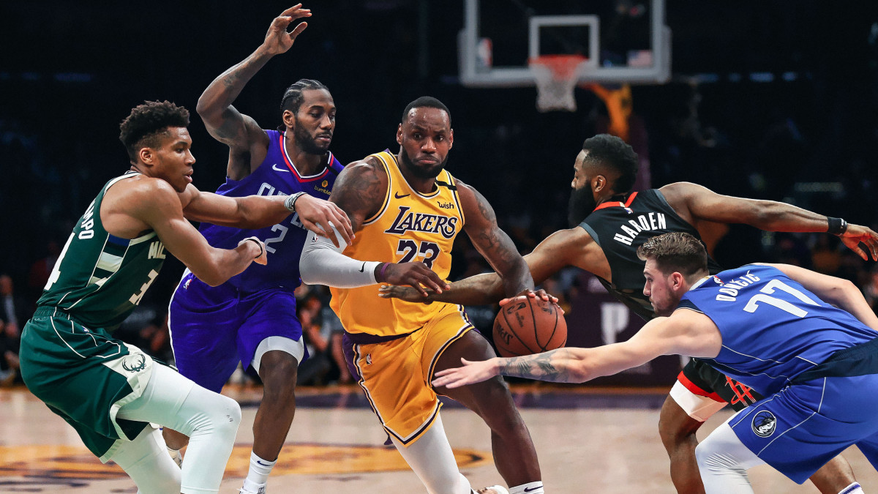
Does playing basketball make you taller?

Slide 4
Survivorship bias or survival bias is the logical error of concentrating on the people or things that made it past some selection process and overlooking those that did not, typically because of their lack of visibility. This can lead to some false conclusions in several different ways. It is a form of selection bias.
Survivorship bias can lead to overly optimistic beliefs because failures are ignored, such as when companies that no longer exist are excluded from analyses of financial performance. It can also lead to the false belief that the successes in a group have some special property, rather than just coincidence (correlation "proves" causality). For example, if three of the five students with the best college grades went to the same high school, that can lead one to believe that the high school must offer an excellent education when, in fact, it may be just a much larger school instead. This can be better understood by looking at the grades of all the other students from that high school, not just the ones who made the top-five selection process.
Another example of a distinct mode of survivorship bias would be thinking that an incident was not as dangerous as it was because everyone communicated with afterwards survived. Even if one knew that some people are dead, they would not have their voice to add to the conversation, leading to bias in the conversation.

Slide 6
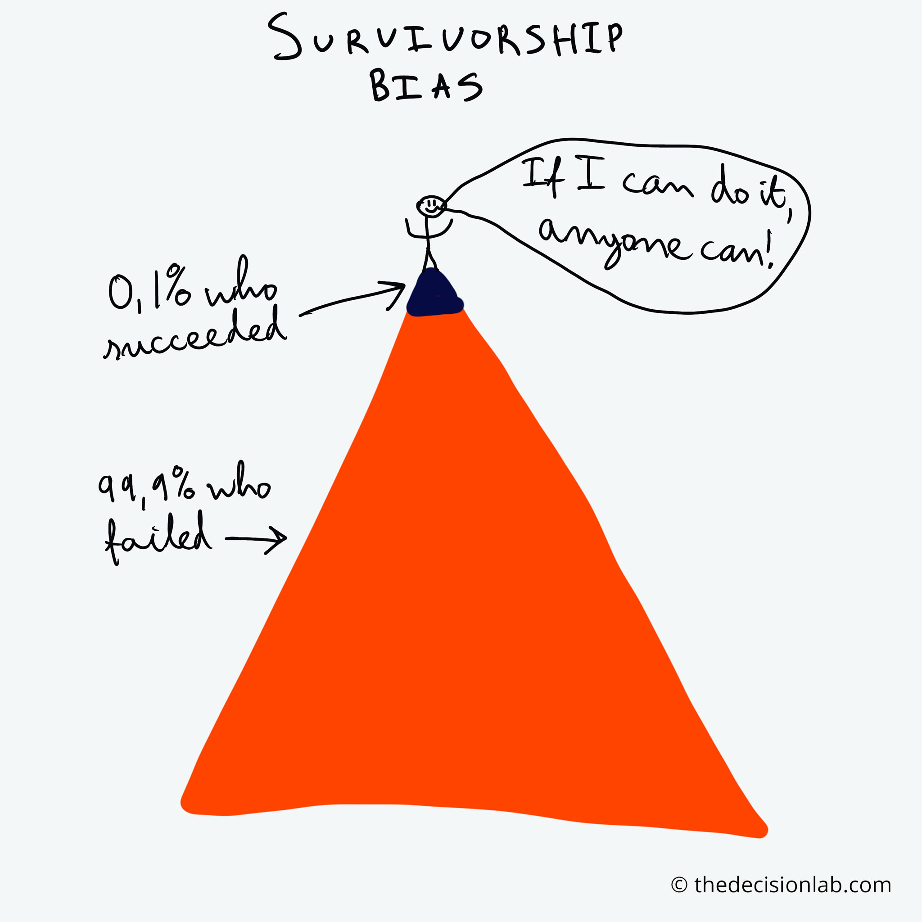

Slide 8
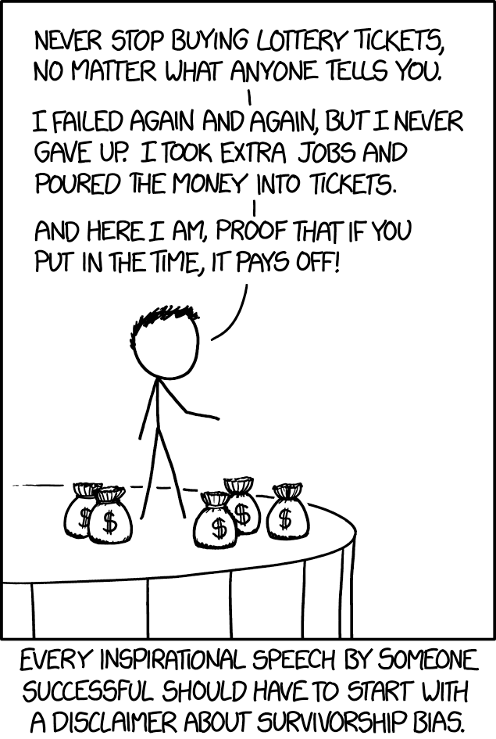

Slide 9
Why do we listen to success stories but ignore stories of failure?

Slide 10
Skim read this article:
https://www.gobankingrates.com/money/wealth/8-smart-habits-billionaires/?utm_campaign=1127317&utm_source=yahoo.com&utm_content=13&utm_medium=rss

Slide 11
Whilst many of these traits are admirable, there are also many people who are not billionaires that have these traits.
Many people are curious, frugal, and smart, and are not billionaires.
The aim of the article is to drive traffic to the site. It is not based in anything factual.
The website itself is an investment website. They want your money. People who aspire to be rich will likely read this article and then start investing, using their website.
It cites no sources and provides examples or evidence that these ‘facts’ are true.
Even if it is true, the survivorship bias indicates that having these traits will not make you more or less likely to become a billionaire.

Slide 12
How to Prevent Survivorship Bias
In order to prevent survivorship bias, researchers must be very selective with their data sources. Researchers must ensure that the data sources that they have selected do not omit observations that are no longer in existence in order to reduce the risk of survivorship bias.

Slide 13
A hospital claims that 100% of its patients have survived.
A school claims that 100% of its students get top marks
A police officer claims that he catches 100% of the criminals he chases.

Slide 14
The hospital does not take in very sick people, or it kicks them out just before they die.
The school expels all of the underachieving students right before exam time.
The police officer says that the people he could not catch were innocent, because he wasn’t able to arrest them and prove their guilt.

Slide 15
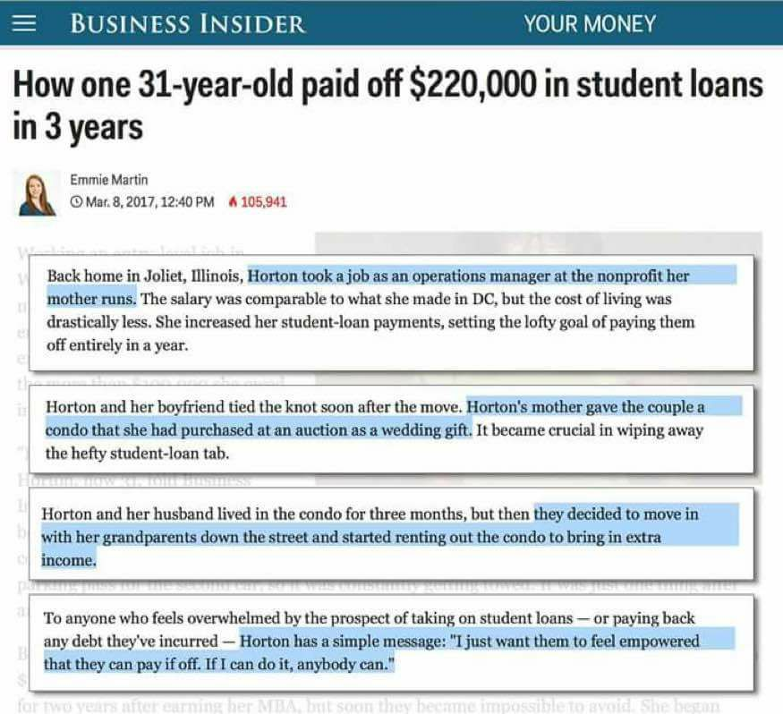

Slide 17
Now try the quiz…
https://play.kahoot.it/v2/?quizId=cd6c4452-af9a-413f-a322-4ecf5f7fd995

