Slide 1
Cognitive Biases
The bandwagon effect

Slide 2
What are cognitive biases?
Cognitive biases are unconscious errors in thinking that arise from problems related to memory, attention, and other mental mistakes.
These biases result from our brain’s efforts to simplify the incredibly complex world in which we live.
Confirmation bias, hindsight bias, self-serving bias, anchoring bias, availability bias, the framing effect, and inattentional blindness are some of the most common examples of cognitive bias.
Cognitive biases have direct implications on our safety, our interactions with others, and the way we make judgments and decisions in our daily lives.
Although these biases are unconscious, there are small steps we can take to train our minds to adopt a new pattern of thinking and mitigate the effects of these biases.

Slide 3
The bandwagon effect
The bandwagon effect is a psychological phenomenon whereby people do something primarily because other people are doing it, regardless of their own beliefs, which they may ignore or override.
The origin of the phrase comes from the use of a bandwagon, which is a float in a parade that encourages people to jump aboard and enjoy the music that is being played. The contagious effect of music and celebration ensures that large numbers of people will be jumping on. This principle was used from the 19th century in political campaigns to link candidates with the notion of having fun and to point out those who are not on the bandwagon as missing out.

Slide 4
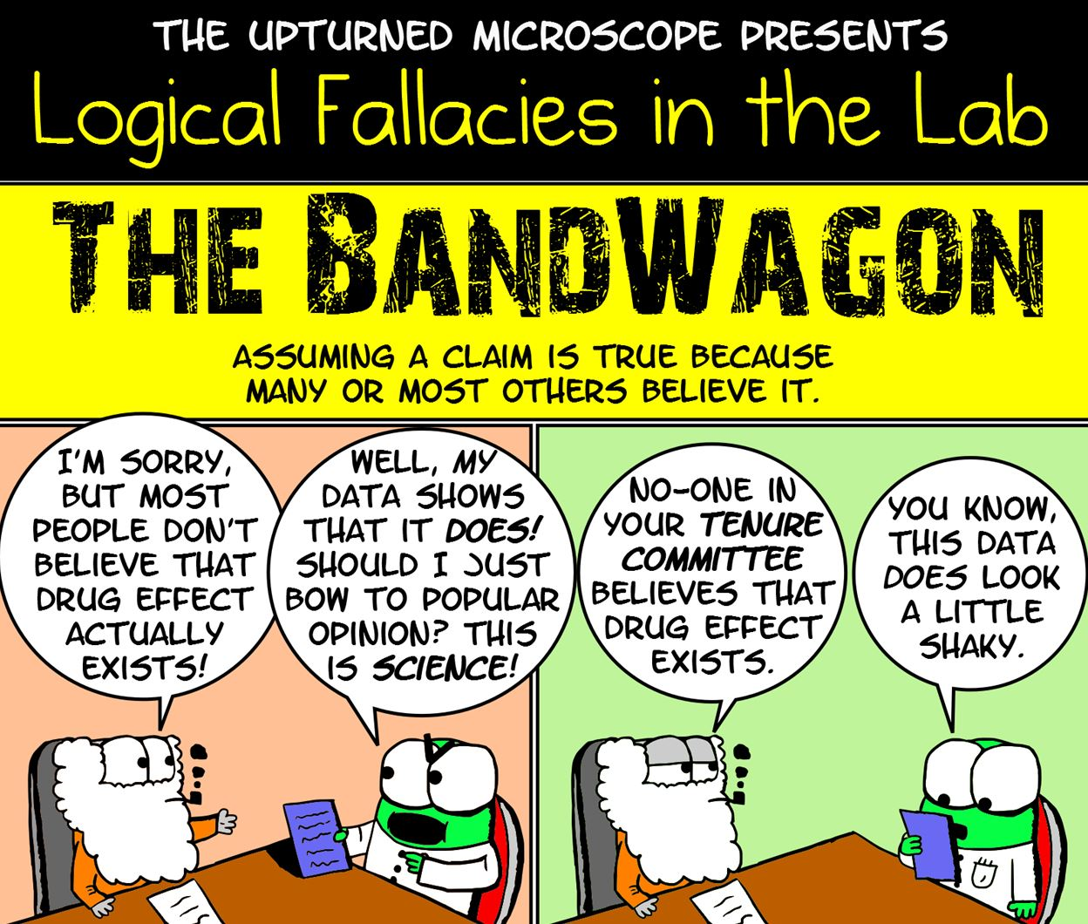

Slide 6
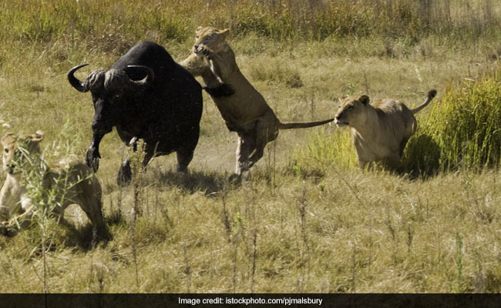

Slide 7
What happens when the buffalo is separated from the herd?

Slide 9
What happens when the buffalo stays with the herd?

Slide 10
Over time, it has come to be understood as a form of manipulation to influence people to join with a trend in politics or consumer behavior. The implication is that since so many other people are doing it, it must be good, or at least acceptable. This phenomenon does not allow for each individual to examine their particular values and beliefs to see if the prevailing trend is something with which they choose to take part.
The bandwagon effect has wider implications outside of politics and buying behaviors. In social psychology, this tendency of people to align their beliefs and behaviors with those of a group is also called "herd mentality" or “groupthink.”

Slide 11
For those of us who want to be free of manipulation of those around us so that we are free to make choices that will enhance our well being, becoming aware of the subtle influences that may be stealing our happiness is worthy of our time and attention.
We are all so dramatically affected by the people around us. If we are around people who read a lot, it stimulates us to read more. If we are around people who are politically aware, it urges us to pay more attention to political events and trends. If we are around people who eat a balanced diet and exercise regularly, we are more apt to live a healthy lifestyle.

Slide 12
Watch the video to 2:37 – Why does Nadia turn around?
https://www.youtube.com/watch?v=dDAbdMv14Is
Watch the video to 2:35 – Why do they all start standing? https://www.youtube.com/watch?v=o8BkzvP19v4

Slide 13
Why is the bandwagon effect dangerous?
Remember when we talked about the ‘Dunning-Kruger effect’?
Often people who do not know what they’re talking about have a lot of confidence, and can often appear to be well-informed.
To others, this may lead them to believe them purely based on their confidence. This –in turn- can lead to many people believing something that is false.

Slide 14
Critical thinking vs Denialsim
The subject of critical thinking is important. It’s important enough that it drives all of science and discovery and has given our modern culture great power and ability. Everything we have that makes our life easier and better: our technology, our system of government, our entire way of life, is founded on good critical thinking that was and is done by very smart people. It’s important that we have a clear understanding of what critical thinking is, but it’s also important that we show what it’s not. Just because someone says they are a critical thinker doesn’t mean they are. This is a label that actually means something. So let’s talk about this.
What do all of these things have in common:
Global conspiracy theories
Creationism
Anti-vaccination movement
Climate change denial
Holocaust denial
Flat Earth theory
All of these groups, and unfortunately many others, all believe that they are being enlightened and intelligent critical thinkers. Unfortunately, the truth is the exact opposite. To call anyone who goes in for this kind of nonsense as a critical thinker is a misnomer.

Slide 15
Critical thinking vs Denialsim
Critical thinking is using rational thought and logic to analyze information and make reasonable decisions or conclusions based on facts and evidence. Being critical is also sometimes described as discerning, analytical, diagnostic, exacting, particular, open minded, informed by evidence and disciplined.

Slide 16
Critical thinking vs Denialsim
Denialism is a refusal to accept well-established theory, law or evidence. It is not critical thinking, but people who do this tell themselves and anyone else who will listen that they are just being critical thinkers by questioning the accepted party line. They often describe solid scientific consensus and evidence-based conclusions as a conspiracy they are fighting against, having discovered in their internet research that there is some shadowy cabal working very hard to fool the general public for some nefarious reason.

Slide 18
Now try the quiz…
https://play.kahoot.it/v2/?quizId=660510ae-ed04-4510-ad6e-9d25d3fd665c

