Slide 1
Cognitive Biases
The framing effect

Slide 2
At the time of writing, the Covid-19 pandemic has killed 0.02% of the population of Vietnam

Slide 3
At the time of writing, the Covid-19 pandemic has killed over 20,000 people in Vietnam.

Slide 4
CHEAP CAR OR EXPENSIVE BUGATTI?
Which would you prefer?

Slide 5
THE BUGATTI
Which would you prefer?

Slide 6
CHEAP CAR + 102,354,930,000 vnd
Which would you prefer?

Slide 7
What are cognitive biases?
Cognitive biases are unconscious errors in thinking that arise from problems related to memory, attention, and other mental mistakes.
These biases result from our brain’s efforts to simplify the incredibly complex world in which we live.
Confirmation bias, hindsight bias, self-serving bias, anchoring bias, availability bias, the framing effect, and inattentional blindness are some of the most common examples of cognitive bias.
Cognitive biases have direct implications on our safety, our interactions with others, and the way we make judgments and decisions in our daily lives.
Although these biases are unconscious, there are small steps we can take to train our minds to adopt a new pattern of thinking and mitigate the effects of these biases.

Slide 8
The framing effect
The framing effect is the cognitive bias wherein an individual’s choice from a set of options is influenced more by how the information is worded than by the information itself.
The prospect theory is crucial to understanding the framing effect; it describes how individuals evaluate their losses and acquire insight in an asymmetric fashion.
The two Israeli psychologists, Daniel Kahneman and Amos Tversky are responsible for introducing both the framing effect and the prospect theory.
The framing effect increases with age, and has been observed in a variety of contexts ranging from plea-bargaining to choosing cancer treatments.
Thorough investigation, a critical and analytical approach to information, and the consideration of a diversity of opinions may help avoid the framing effect.

Slide 9
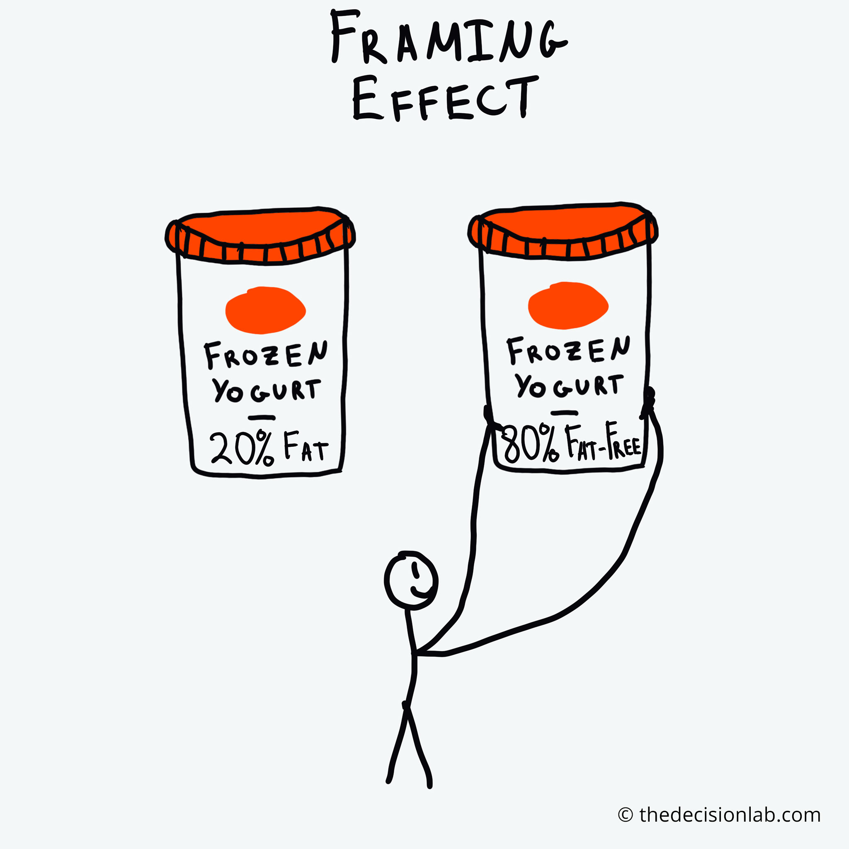

Slide 10
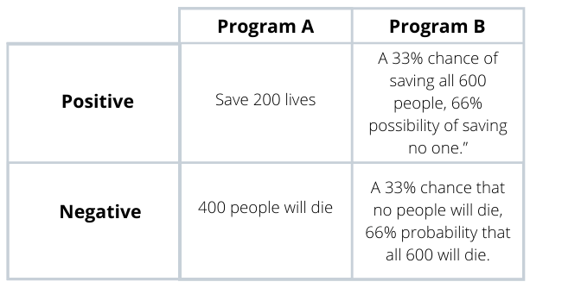

Slide 12
How and why is the framing effect used?
What effect can it have on people, politics, and society?

Slide 13
The framing effect can be described as a cognitive bias wherein an individual’s choice from a set of options is influenced more by the presentation than the substance of the pertinent information (Plous, 1993).
The salience of certain features over others, as well as the positive or negative connotations pertaining to the information, is more likely than the actual information itself to determine the recipient’s response.
Moreover, individuals are more likely to desire risks when the information is framed negatively, but seek to avoid risks when the information is framed positively (Tversky & Kahneman, 1981).

Slide 14
While looking for a disinfectant, you choose a product which claims to kill 95% of all the germs, over one which claims that 5% of the germs will survive.
You’re concerned about your blood sugar level, and you choose a chocolate that is ‘90% sugar-free’ over one that is ‘10% sugar.’
You are required to decide between two elective courses for your final semester in college. You are determined to maintain your high GPA, and you talk with the professor of each class. One tells you that 20% of the students procure A’s while the other tells you that 80% of the students fail to get an A. You choose the former over the latter.

Slide 16
Now try the quiz…
INSERT LINK

