Slide 1
Xmas Lesson for J1 – J2
Aims:
1) To introduce some Xmas vocab and give students the opportunity to practise using it in written and oral activities
2) To review basic prepositions of place within the context of a Christmas song (Where’s Santa?)
Target Vocab: Santa, Reindeer, Sleigh, Presents, Christmas Tree, Bauble, Star, Stockings Target Grammar: Santa is on the rooftop, Santa is putting presents under the tree, Santa is in his sleigh
Procedure:
Circle time / TPR routine
Play the song “Where’s Santa? ” (link in slide 3) without the audio. Students watch and complete the worksheet. They must tick the images they see on the video. Answer key: the elf and xmas pudding are not in the video. (Set context).
Feedback and elicit what images they know already. Play video again to check answers. (Identify gaps)
Then present the FCs to reinforce (slides 3 – 10). (Present target language)
First present the pics. Students listen.
Play two receptive games to check their comprehension. Play the whole class receptive game ‘Jump the line’ followed by an individual receptive game ‘ slap the board’ or ‘go fish’ or ‘pass the parcel’. (Check STs comprehension receptively).
Then play two activities where students match the word cards to the pics. (Introduce written form of TL and check comprehension receptively).
Pelmanism (turn over; match the cards).
Chopstick pick up (teacher calls out a word and they race to pick up corresponding word card)
Now give them the playing cards handout. First do a listening dictation where you tell the students to colour the items specific colours. Then, get the students to write the names of the items underneath. To scaffold, lay the word cards out on the floor so that they can look at them if needed. (Receptive comprehension check followed by checking students 'written accuracy of TL).

Slide 2
Then get the students to stick the handout onto a piece of A4 card. Then get them to cut out the pics to make playing cards.
Before playing snap with the cards, drill the words with the students. (Give STs practice forming TL orally)
Play snap. Put the students into groups of 3 or 4. Each group must merge their packs of cards together (i.e there should be 3-4 duplicates of each word). Higher levels can say full sentences such as ‘It’s Santa or they are stockings’. (Give STs practice forming TL orally / test recognition of TL)
As an extension activity, play ‘snatch the card’. Make one pile of cards. Groups of 3-4. One student turns over a card and the first person to say the word gets to keep it. The person with the most cards at the end is the winner. (Give STs practice forming TL orally / test recognition of TL)
Now play the “Where’s Santa?” song again, again without audio. Now the students should be able to identify more items in the video. (Check students comprehension of TL)
Now play it with audio. Get the students to sing along. After, freeze the video at different points and ask comprehension questions like “where’s Santa?”He’s on the rooftop. ‘Or what are these?’ These are stockings. (STs answer comprehension questions that require an oral response)
Finally play a game to reinforce the language in the song and revise basic prepositions. Play a game of ‘Santa where are you?’. Take the 3 situation flashcards that show Santa in different places (slides 11-13). Choose a game based around asking and answering questions about where Santa is. For example, question and answer in a circle with two balls. Or Telephone, where the teacher says a sentence with a prepositional phrase in it (there are 3 in the song) and then the students whisper it down the line and the student at the front has to hit the correct flashcard and say the sentence. (Controlled oral practice of target vocab and grammar).
For higher ability classes, you could finish by giving them the song lyrics (available on the YouTube page) and making a gapfill out of it. Remove key vocab items, students complete and then listen and check. (Controlled written practice of target vocab and grammar).
For higher ability classes, you could finish by getting them to write down three presents they would like. And three items to put in three stockings. You then collect the writing and use the info to play a guessing game. (Freer written practice)

Slide 3
https://youtu.be/3PcmHSPVlKY

Slide 4
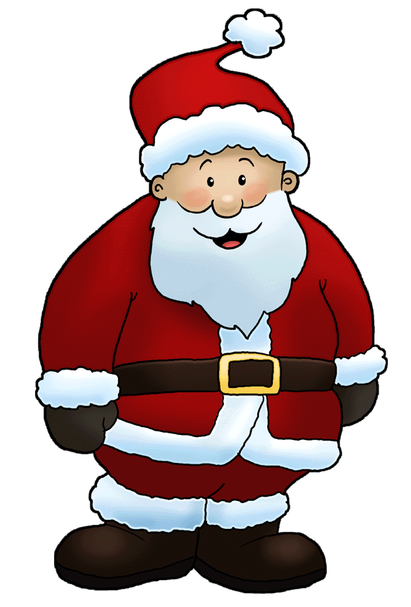

Slide 5
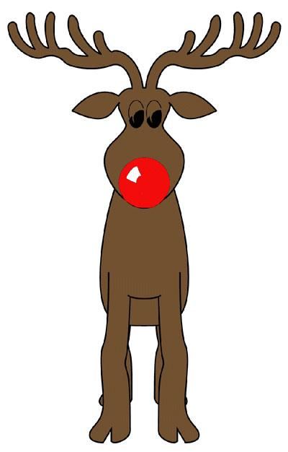

Slide 13
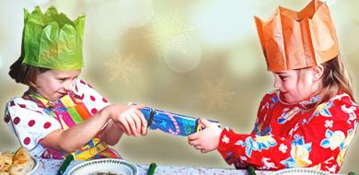
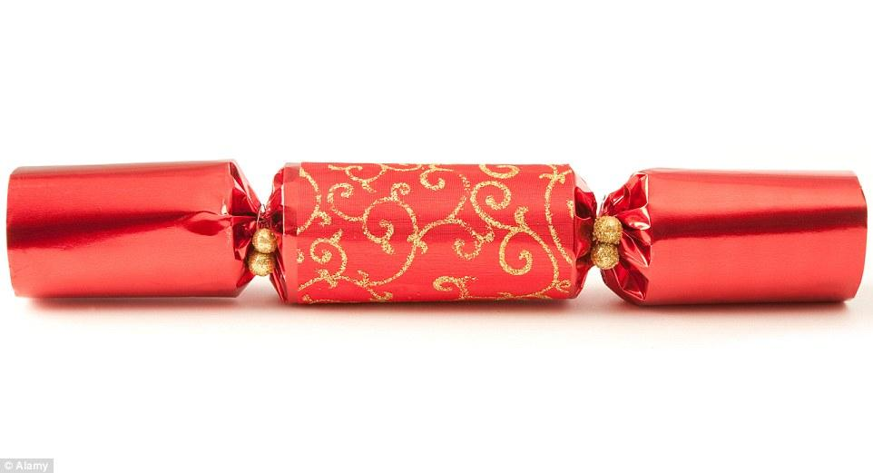

Slide 14
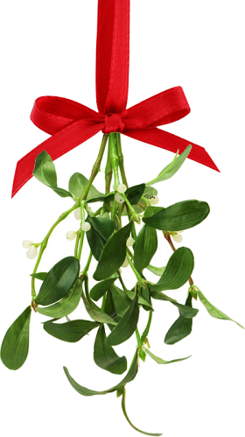
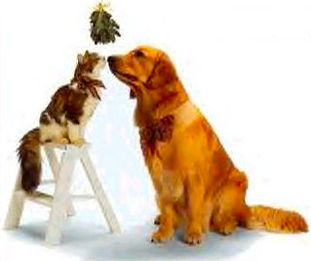

Slide 15
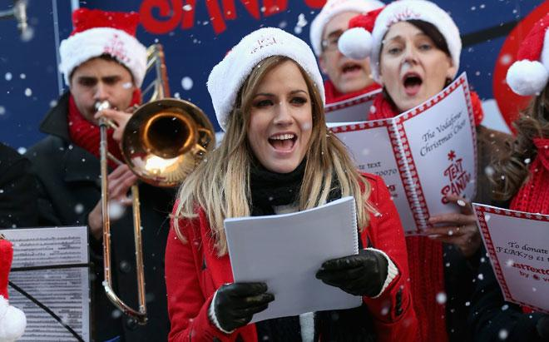
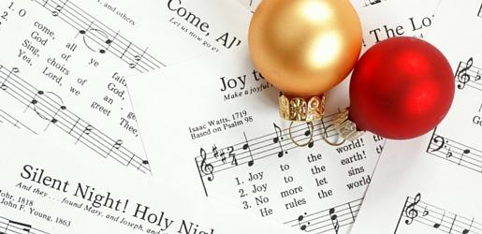

Slide 16
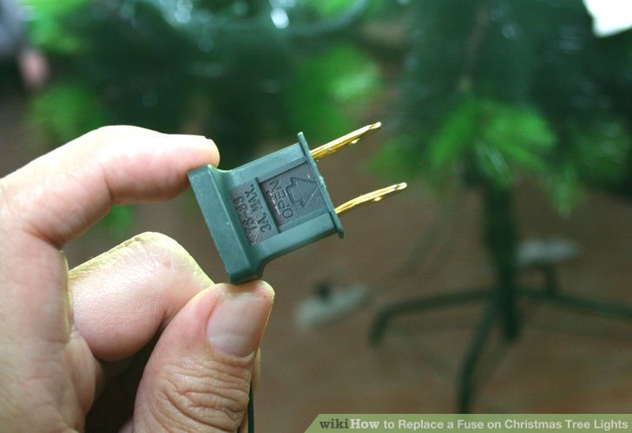

Slide 17
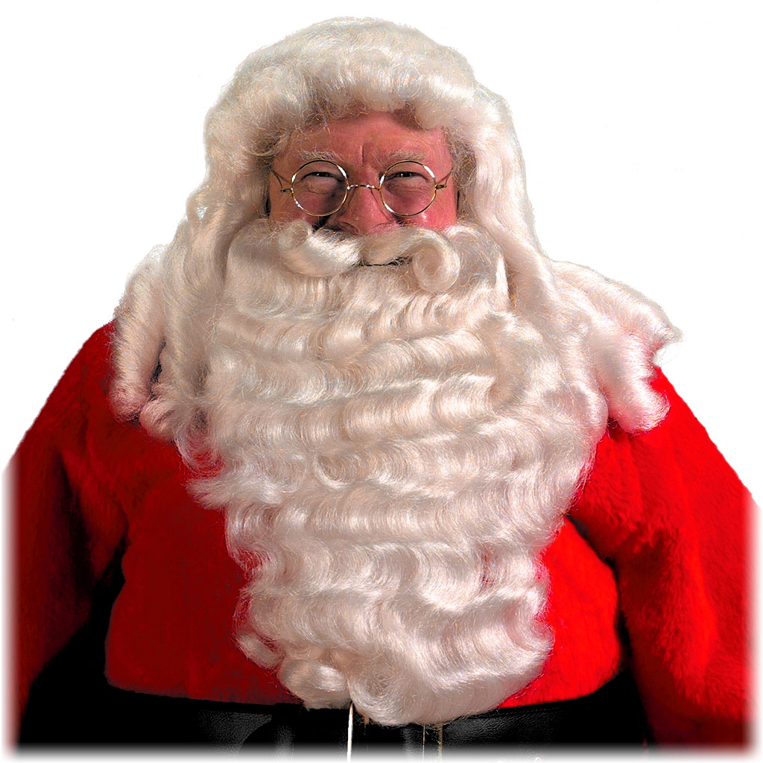

Slide 18
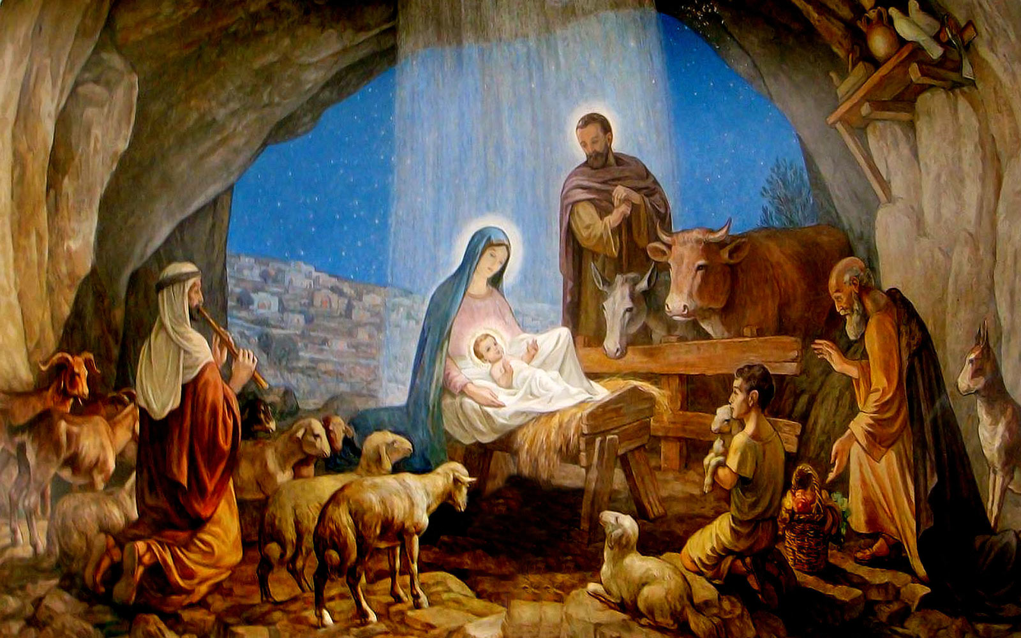

Slide 19
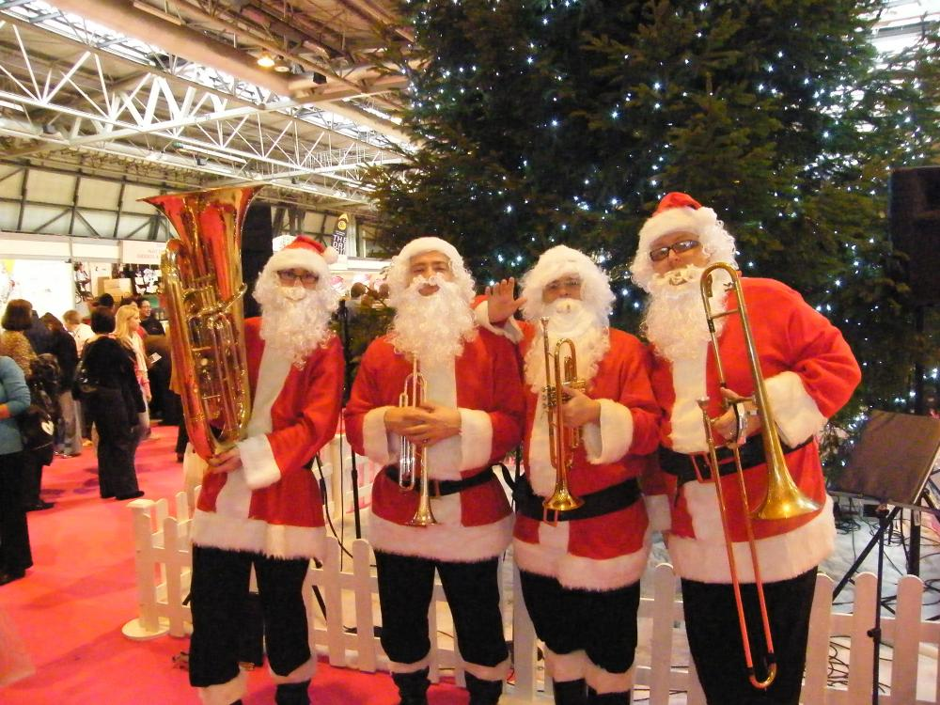

Slide 21
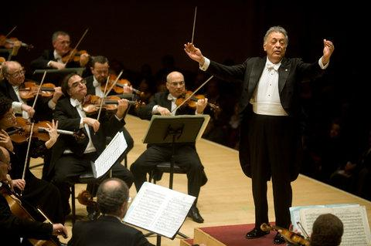

Slide 23
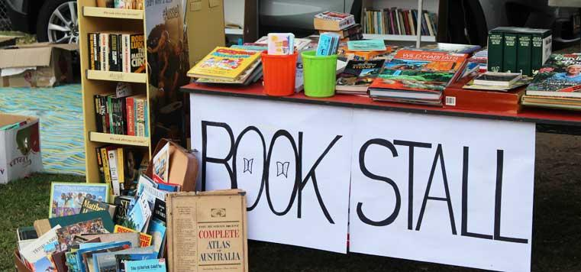

Slide 25
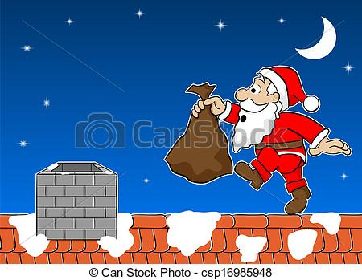

Slide 26
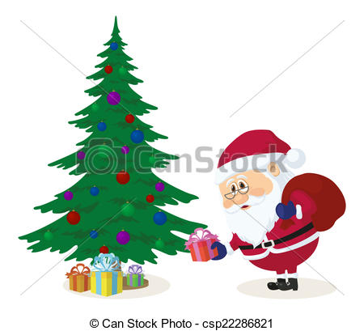

Slide 27
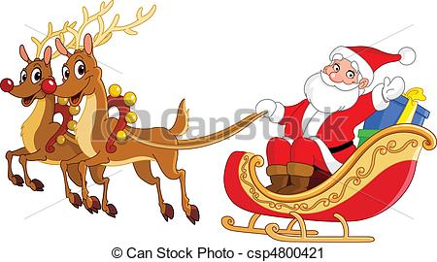

Slide 29
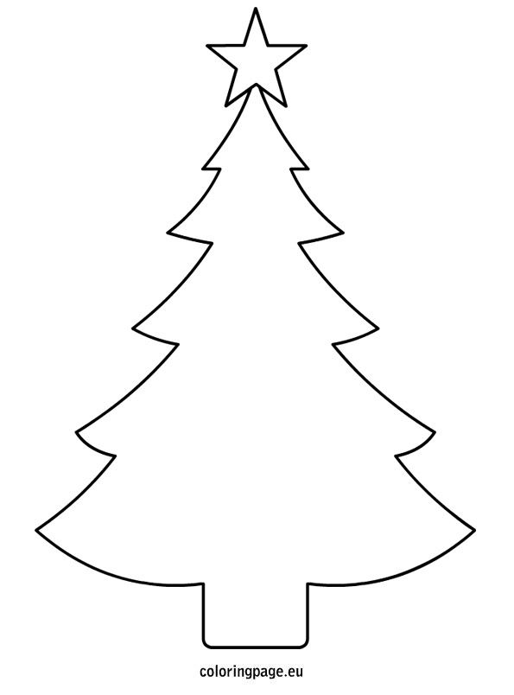
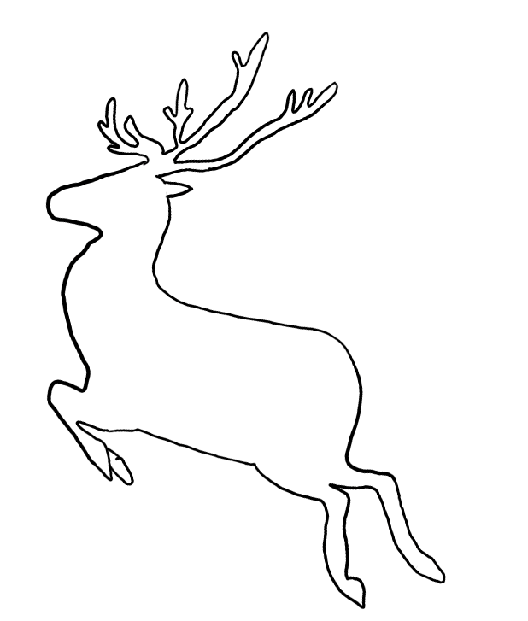
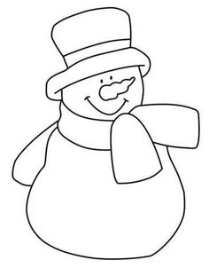
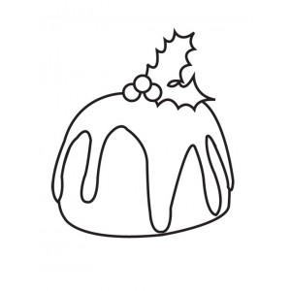
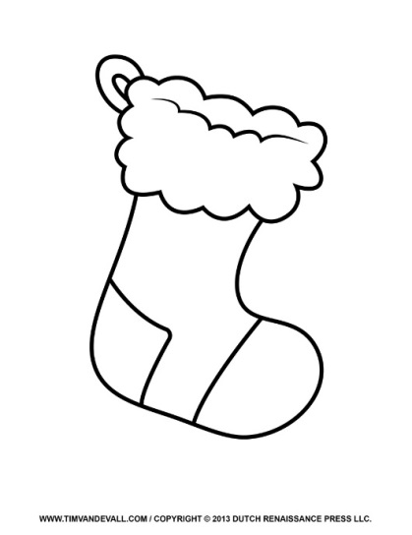
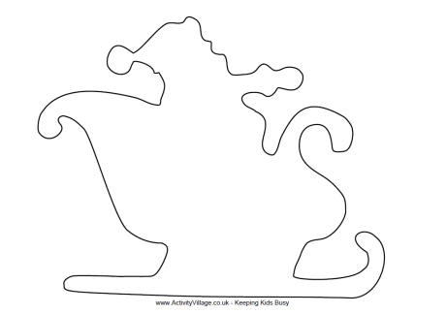

Slide 30
Santa | Reindeer | Sleigh | Present
Christmas Tree | Bauble | Star | Stocking

Slide 31

      
      

