Slide 1
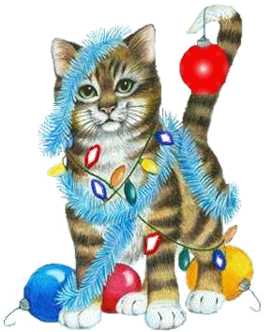
Christmas!

Slide 2
+1 point
+2 points
+3 points
1
2
2
?
1

Slide 3
If you see a star, congratulations! You can steal 2 points from another team!

Slide 4
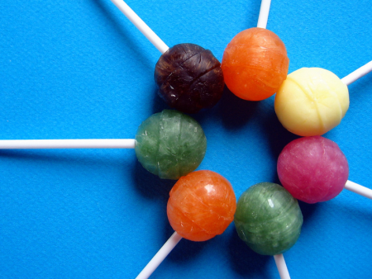
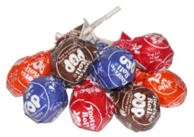
The team with the most points at the end wins!

Slide 5
1
2
3
4
5
6
7
8
X
X
X
X
X
X
X
X
9
10
11
12
13
14
15
16
X
X
X
X
X
X
X
X
17
18
19
20
21
22
23
24
X
X
X
X
X
X
X
X
25
26
27
28
29
30
31
32
X
X
X
X
X
X
X
X
34
35
36
37
38
39
40
33
X
X
X
X
X
X
X
X
41
42
43
44
45
46
47
48
X
X
X
X
X
X
X
X
49
50
51
52
53
54
X
X
X
X
X
X
X
Pick a Number!

Slide 6
Team 1
Team 2
Team 3
Team 4
Team 5
Team 6
Team 7
Team 8

Slide 7
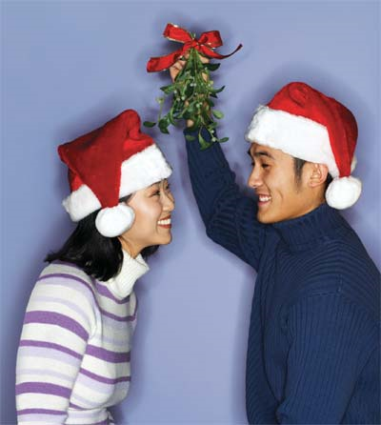
1.
What happens underneath the mistletoe?
?
1
C. People make a Christmas wish.
A. People sings songs
B. People kiss

Slide 8
Another name for Santa is...
2.
A. Old fat man
C. Mister Christmas
B. Saint Nick
?
2

Slide 9
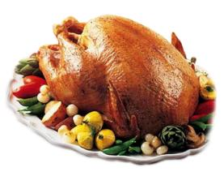
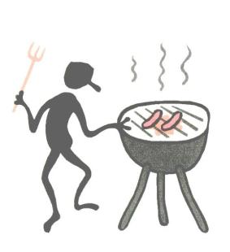
3.
In New Zealand, people celebrate by...
A. Eating a turkey
B. Having a barbecue
C. Visiting cemeteries
?
1

Slide 10
4.
43

Slide 11
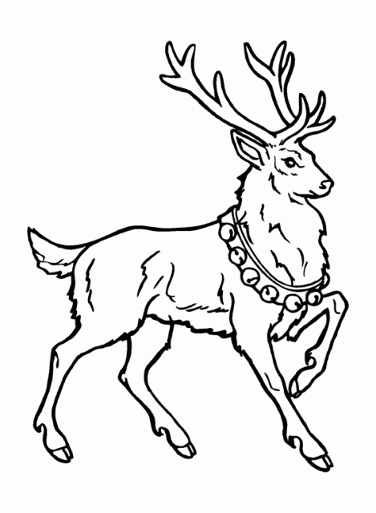
5.
What kind of an animal is Rudolph?
reindeer
?
2

Slide 12
What kind of a tree are Christmas trees?
Korean: “소나무”
6.
A. Oak
B. Willow
C. Pine
?
2

Slide 13
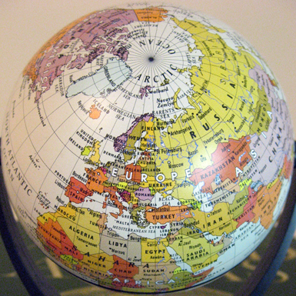
7.
Where does Santa live?
A. The South Pole
B. The North Pole
?
1

Slide 14
8.
What does “merry” mean?
happy
?
1

Slide 15
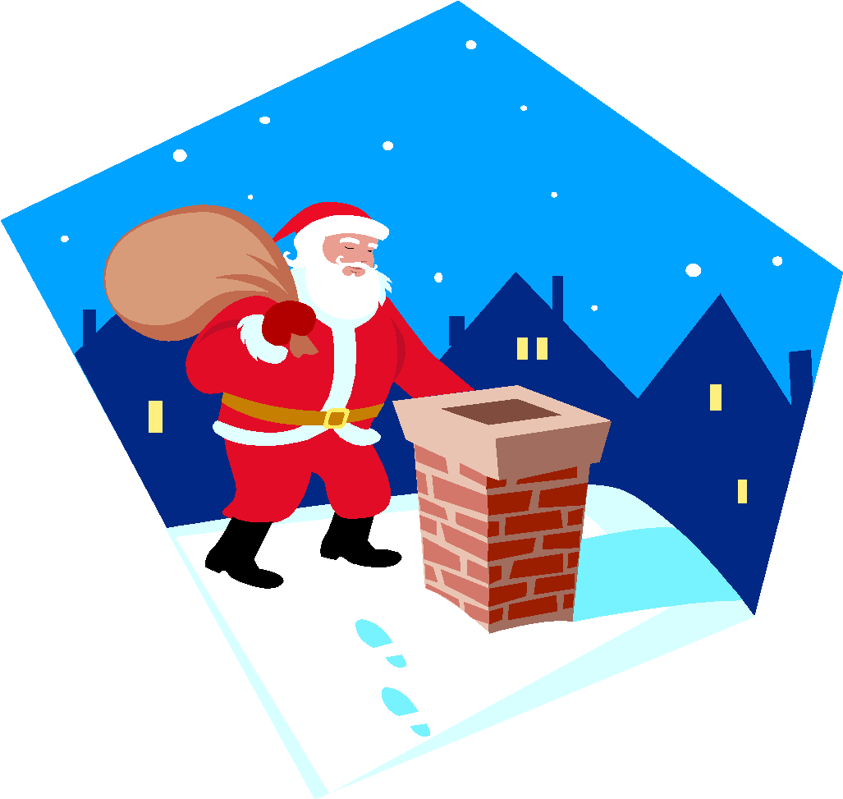
How does Santa enter a house?
9.
He comes down through the __________.
chimney
?
3

Slide 16
43
10.

Slide 17
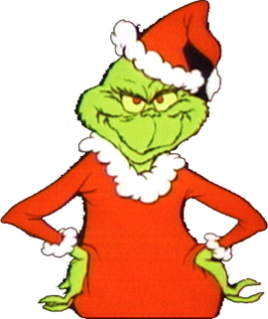
11.
Hint:
G
R
I
N
C
H
?
2

Slide 18
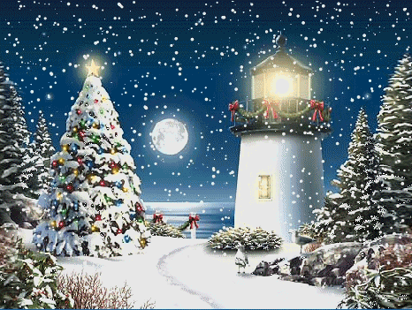
What is a “white Christmas”?
12.
When there is _______ on Christmas day.
snow
?
1

Slide 19
13.

Slide 20
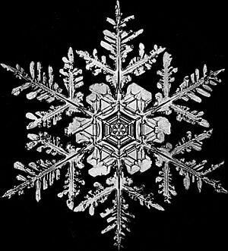
What is one piece of snow called?
14.
?
3
snowflake

Slide 21
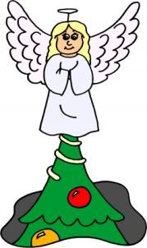
Some people put a star on top of their Christmas tree. Other people put _______
15
A. a bird
B. a santa
C. an angel
?
2

Slide 22
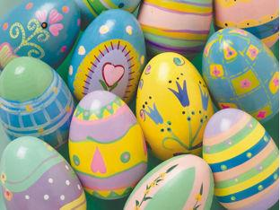
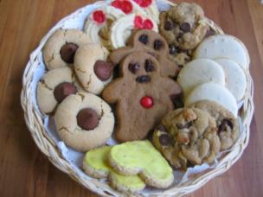
16.
Which is NOT a picture from Christmas?
A.
B.
C.
?
1

Slide 23
17.

Slide 24
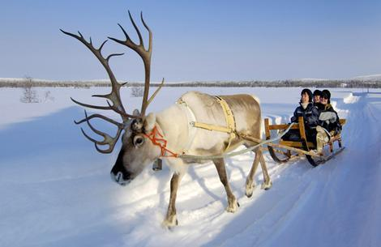
How many reindeer does Santa have?
18
A. 7
B. 9
C. 11
?
1

Slide 25
19.
What is December 24th called?
Christmas Eve
?
1

Slide 26
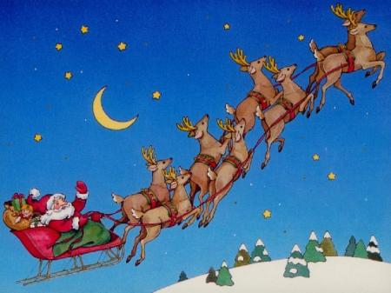
20.
What does Santa ride on?
sleigh
?
3

Slide 27
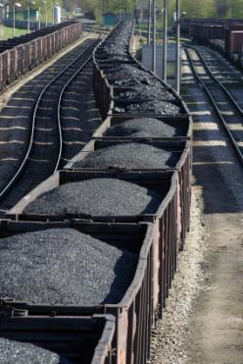
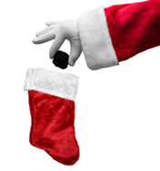
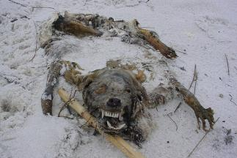
21.
If you are bad, Santa will put ___________ in your stocking.
A. coal
B. a dead
animal
C. a
textbook
?
1

Slide 28
22.
What color is Rudolph’s nose?
red
?
1

Slide 29
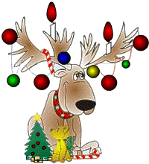
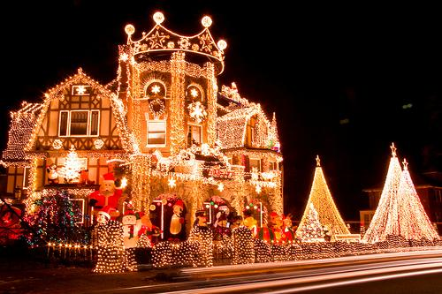
23.
When were electric Christmas lights first used?
A. 1895
B. 1906
C. 1923
?
1

Slide 30
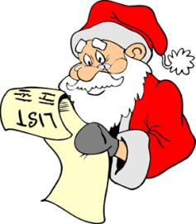
24
How many times does Santa check his list?
A. once
B. twice
C. three
times
?
1

Slide 31
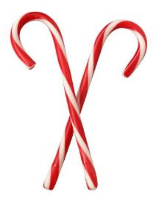
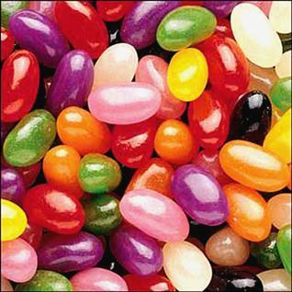
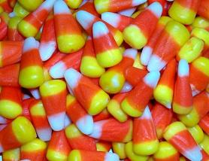
25.
Which is Christmas candy?
A. Candy canes
B. Jelly beans
C. Candy corn
?
1

Slide 32
26.

Slide 33
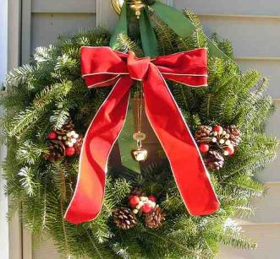
27
A ______ is a popular Christmas decoration.
A. leaf circle
B.
wreath
C. green ring
?
2

Slide 34
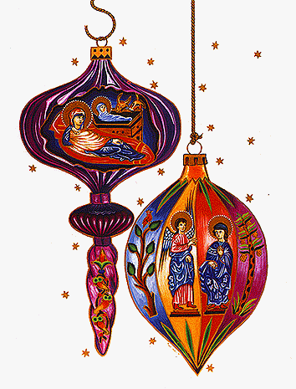
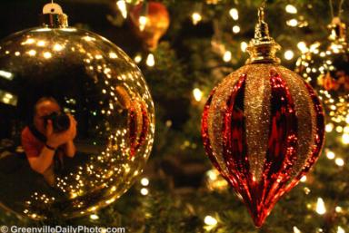
28.
What are these?
A. hooks and balls
?
B.
jingles
C. ornaments
1

Slide 35
29
Hint:
Santa’s “door”
?
2
C
H
I
M
N
E
Y

Slide 36
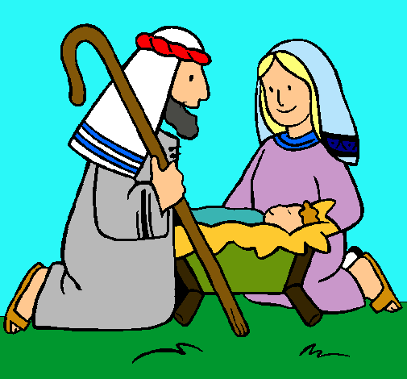
30
Why do Christians celebrate Christmas?
It was the day Jesus was born.
?
2

Slide 37
31

Slide 38
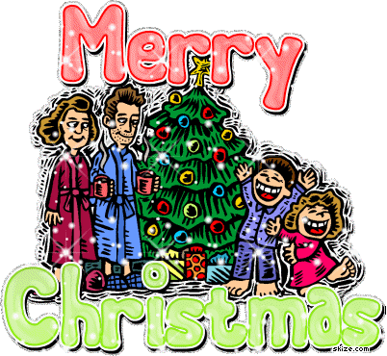
32.
When do children usually open their presents?
A. In the morning
B. In the afternoon
C. In the evening
?
1

Slide 39
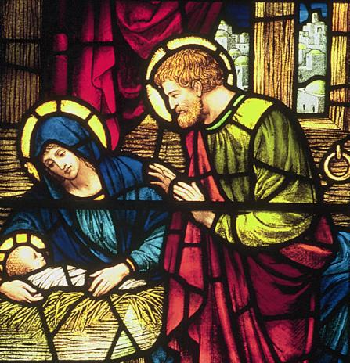
33
Who is the woman?
?
1
Mary/ Jesus’ mother

Slide 40
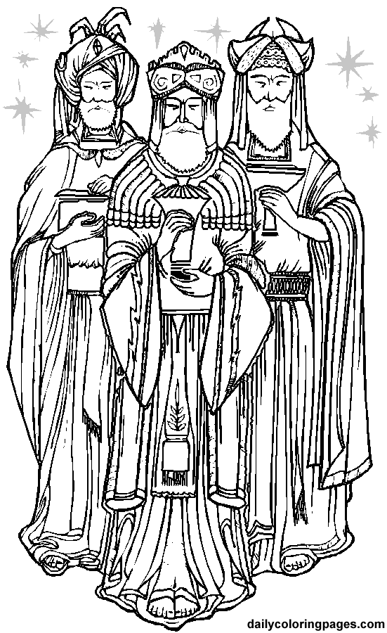
34
Who are these three men?
A. Three wise men
B. Three
rich men
C. Three musketeers
?
1

Slide 41
35.
Which is NOT true about Santa Claus?
A. He delivers presents on Christmas Eve.
B. He rides a flying sleigh.
C. He gives presents to bad children.
?
1

Slide 42
36
Hint:
Santa’s ____ is big and white
B
E
A
R
D
?
1

Slide 43
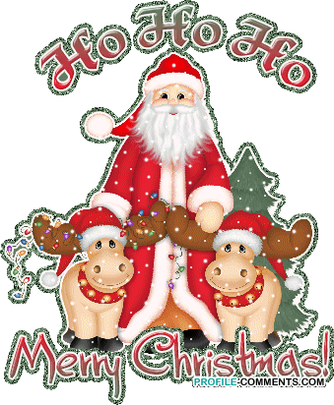
37.
Santa Claus is famous for saying “___ ___ ___, Merry Christmas!”
Ho, Ho, Ho
?
2

Slide 44
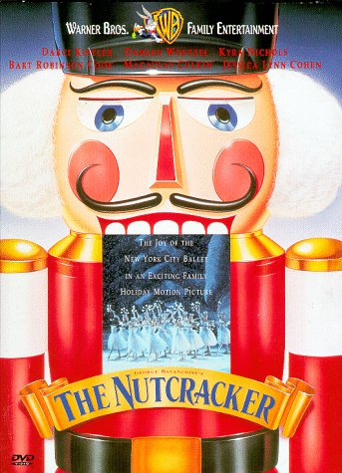
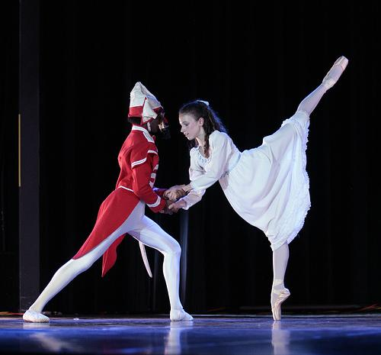
38
Which is a famous Christmas ballet?
A. The Nutcracker
B. Frosty the Snowman
C. Rudolph’s surprise
?
1

Slide 45
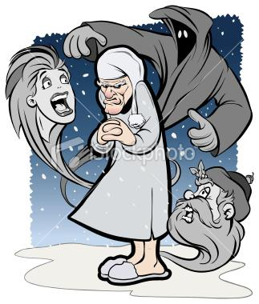
39.
In the famous story, “A Christmas Carol,” a greedy man is visited by ___ ghosts on Christmas Eve.
?
A. two
B. three
C. four
2

Slide 46
40
How do you say “Merry Christmas” in Spanish?
A. Joyeux Noel
B. Feliz
Navidad
C. Milad Majid
?
1

Slide 47
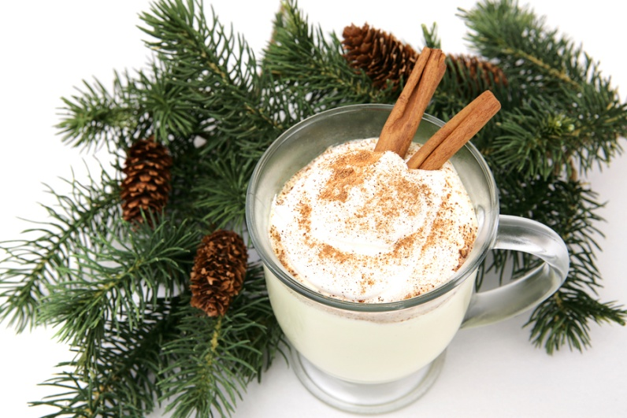
41
39
Which is a popular drink people only have around Christmas?
A. Vanilla milk
B. Butter milk
C. Egg nog
It’s made from eggs, sugar, cream, and cinnamon.
?
2

Slide 48
42.
What color is The Grinch?
Green
?
1

Slide 49
43

Slide 50
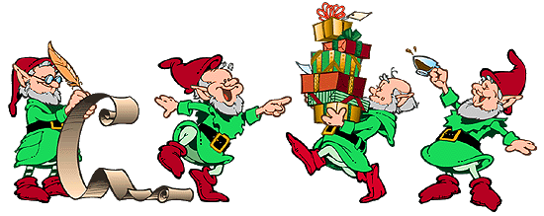
Who helps Santa to make toys?
44.
elves
?
3

Slide 51
45
Which is NOT a famous Christmas song?
A. Santa Claus is Coming to Town
B. Frosty the Snowman
C. I love Santa
?
2

Slide 52
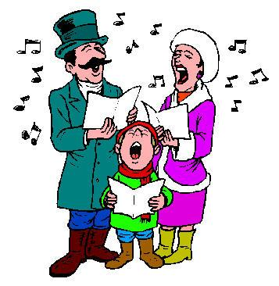
46.
What are Christmas songs called?
A. jingles
B. melodies
C. carols
?
2

Slide 53
47.

Slide 54
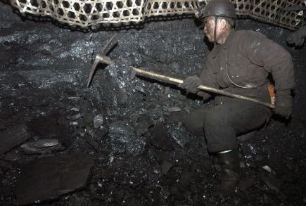
48
39
Hint:
Santa gives this to bad children
C
O
A
L

Slide 55
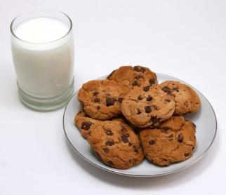
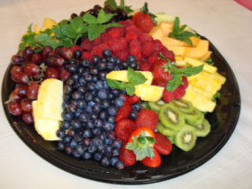
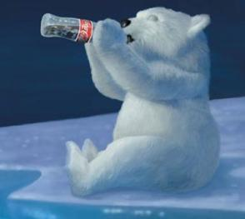
49
What snack do children in the USA leave out for Santa?
A. Juice and fruit
B. Milk and cookies
C. Coca-cola and potato chips
?
2

Slide 56
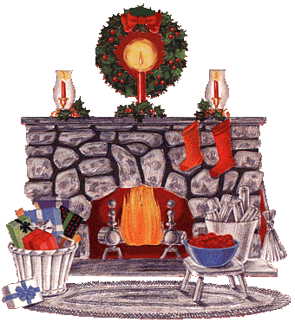
50.
Children hang _____ in front of the fireplace.
A. stockings
B. hats
C. shoes
?
1

Slide 57
51.

Slide 58
52
What meat do many Americans eat on Christmas?
?
1
turkey

Slide 59
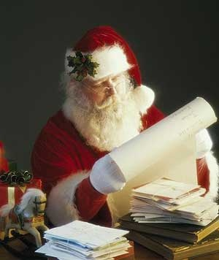
Children write ________ to Santa, asking for presents.
letters
?
1

Slide 60
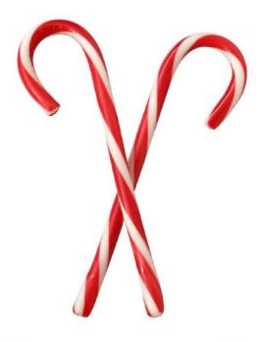
What do candy canes usually taste like?
54
A. strawberry
B.
cherry
C. peppermint
?
2

Slide 61
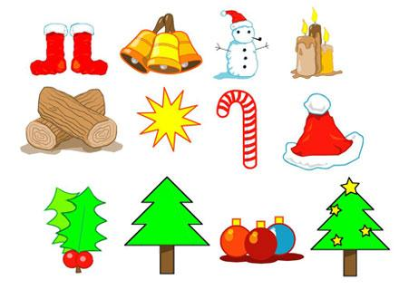
55.
?
-2

Slide 62
2
1
?
?
2
1
3
Steal 2
?
?
2
3

Slide 63
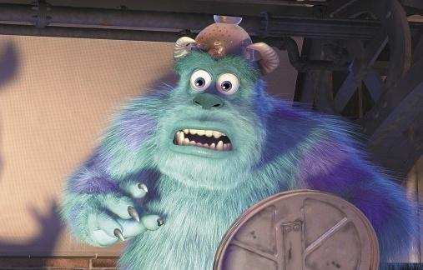
Question
Answer

Slide 64
How to Use the Hangman Slide
First delete all boxes in the desired slide, but don’t delete the slide itself.
Then copy everything from the hangman slide to that one by left clicking and selecting all the items then pressing Ctrl + C.
Go to the slide you want to add it to add press Ctrl + V.
Now just copy the letter and the little box below it at the same time as many times as you need to spell whatever word you want.
Just change the letter to the one you need.
To reveal the letter just click on the little box below it.
To add a part to the hangman for a wrong letter just click on the base of the hangman pole.
Keep going till the head appears or they spell the word.
There should also be sound effects for right and wrong answers.

Slide 65
Monster Created by Brian Castledine
Copy Monster on previous slide to desired number of slides.
I find it helps to remove question and answer box on slides with a monster.
Put questions in big squares and answers in the little ones.
Divide class into desired number of teams.
Each team takes turns picking questions from question board.
If a team answers a question correctly they get one point.
If a team finds a monster they get to steal two points from another team.
Click on the house button to go to the score card and the house button again to go to the question board again.
Click on a grey circle to add a point and click on a yellow circle to remove that point.
The team with the most points when all the questions are answered or you run out of time is the winner.

