Slide 1
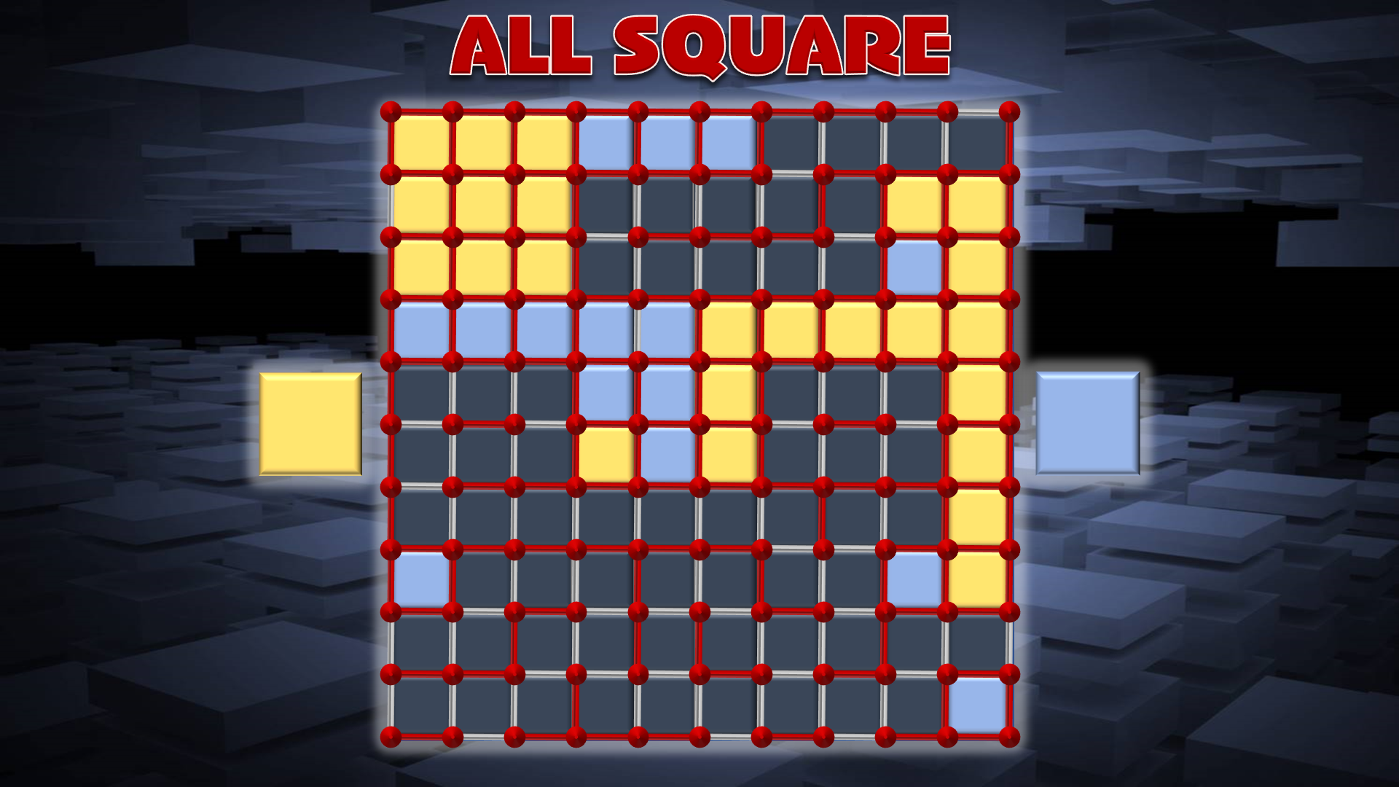
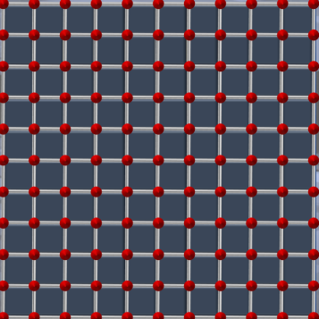
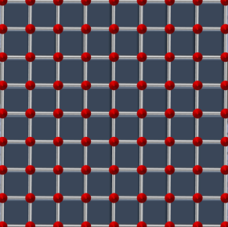
The object of this game is to make more small squares than your opponent.
To play, take alternate turns to connect two adjacent dots by clicking on the lines around them.
If you complete a square, click once if you are the yellow player, twice if you are blue.
(If you make a mistake, keep clicking until the right colour is revealed).
Once you have filled a square with your colour, you get another turn.
Click on this picture to play the 64 square game
Click on this picture to play the 100 square game

Slide 2
ALL SQUARE
Instructions
To 100 square game

Slide 3
ALL SQUARE
To 64 square game
Instructions

