Slide 1
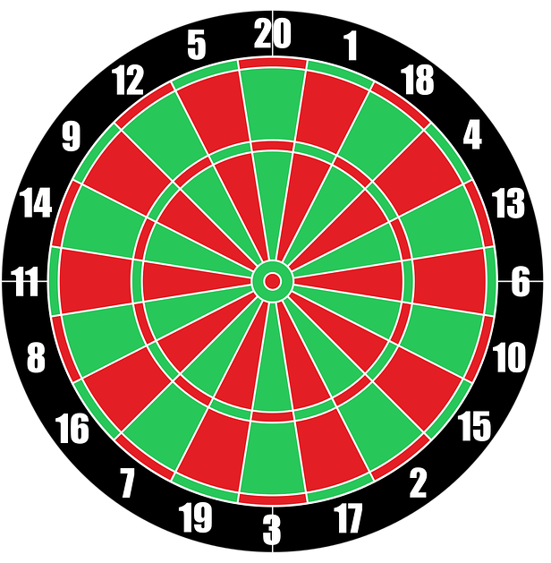
THE
AROUND
CLOCK
THE CLASSIC DART GAME
HOW TO PLAY
PLAY

Slide 2
HOW TO PLAY
A buzzer will let you know when you stray from the revolving
bright area
Try to get a dart in all segments before 10 revolutions of the
bright segment
A light will switch on after each revolution
To start, click on the upper segment of number 1 on the board
Move your cursor to stay within the revolving bright segment and click in the outer segment for the remaining numbers from 2 – 20 in the correct sequence
A dart will land in the segment if you click on it correctly
PLAY

Slide 3
THE
AROUND
CLOCK

