Slide 1
ASTEROID
ATTACK
Zap the asteroids
and save your
spaceship!
PLAY

Slide 2
Here they come!
YES
NO
16 / 20 HITS NEEDED TO SAVE THE SHIP – DID YOU DO IT?

Slide 3
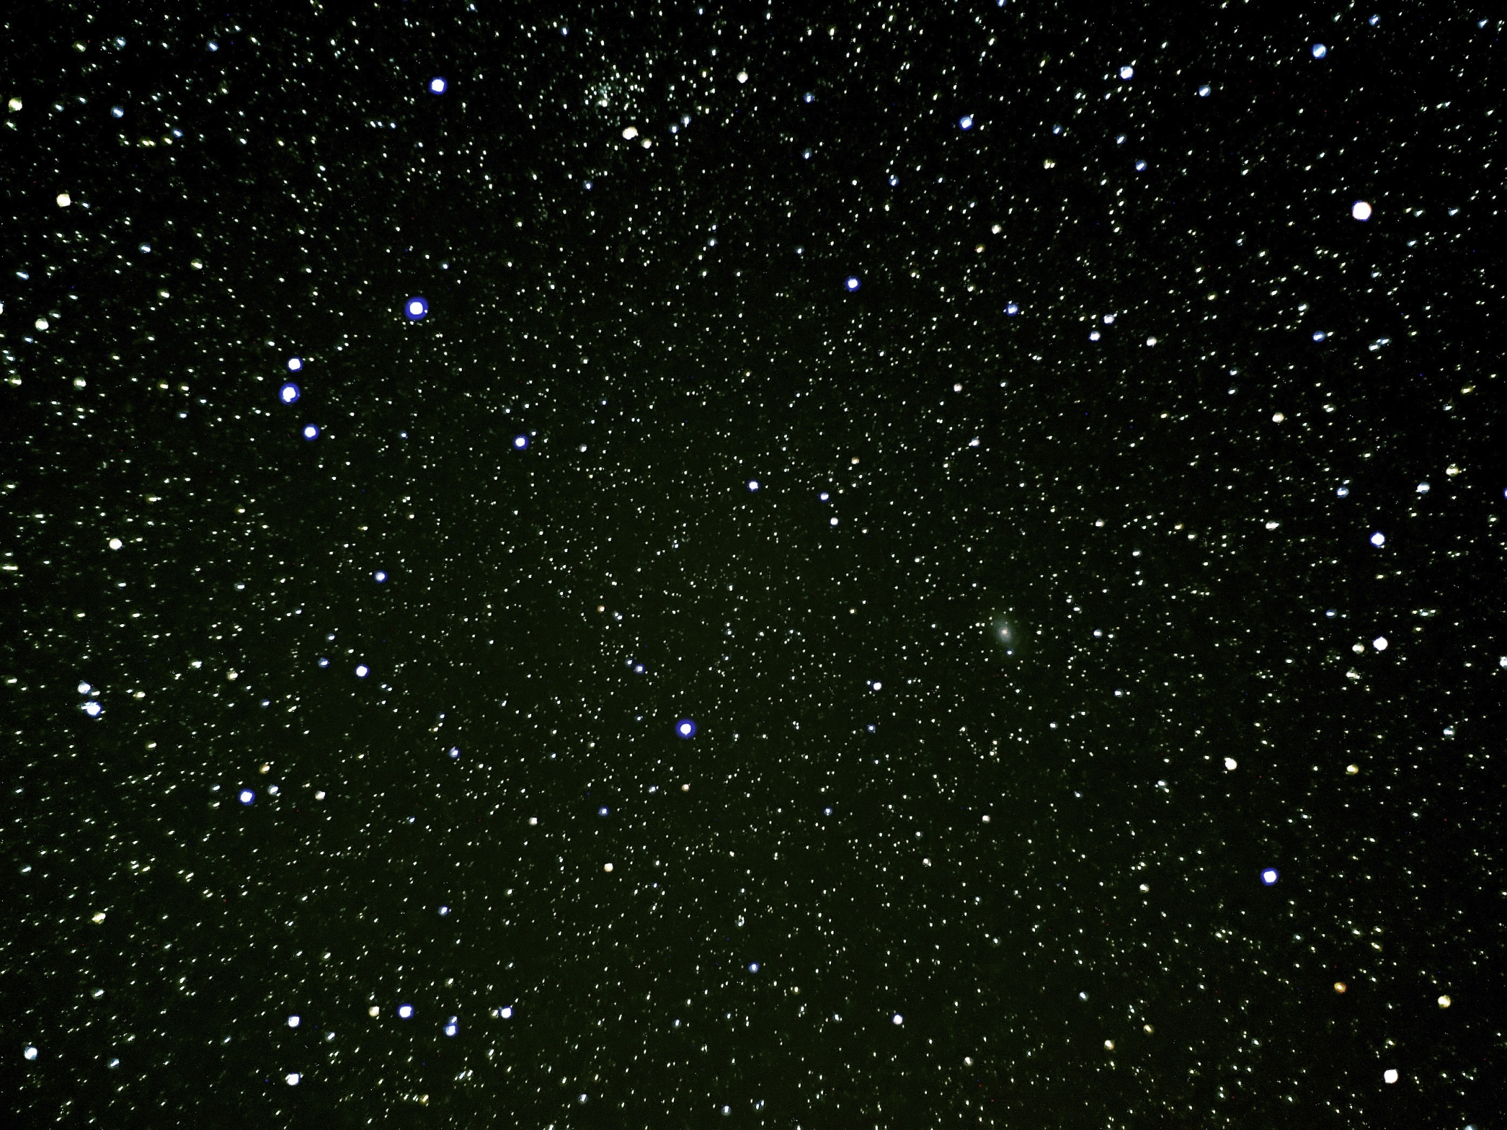
Then let’s go!
YES
NO

Slide 4
Oh no. Head for the shuttle!
YES
NO

Slide 5
Mother ship lost,
but you survived….Just

