Slide 1
tiger
SHOW

Slide 2
monkey
SHOW

Slide 3
lion
SHOW

Slide 4
cat
SHOW

Slide 5
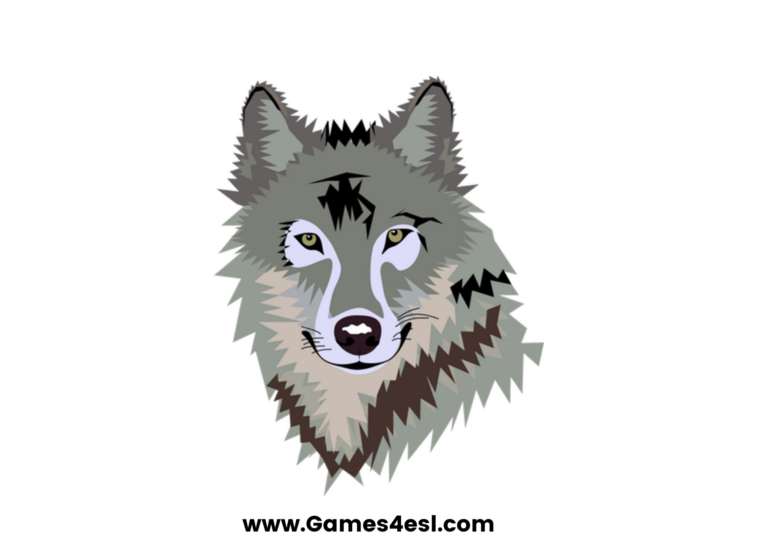
wolf
SHOW

Slide 6
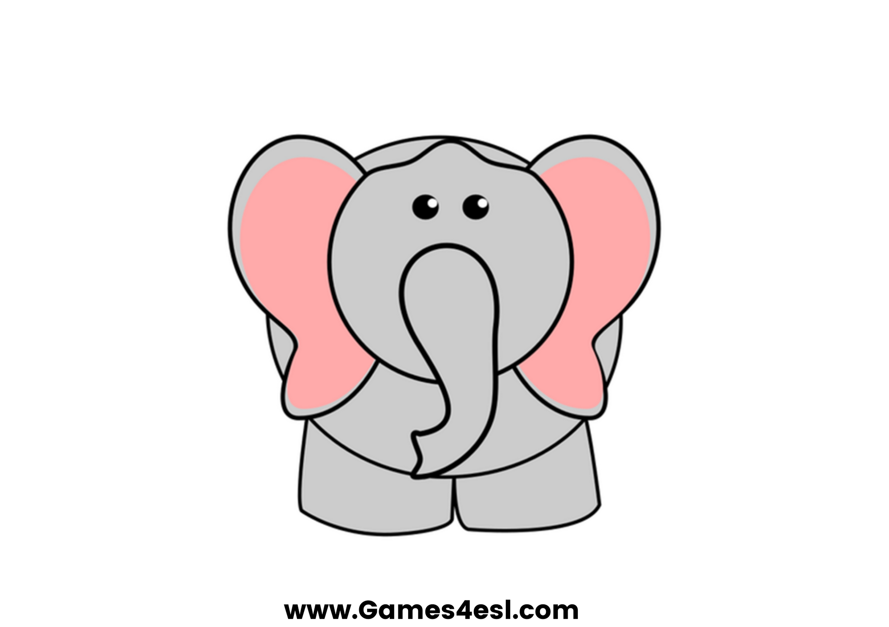
elephant
SHOW

Slide 7
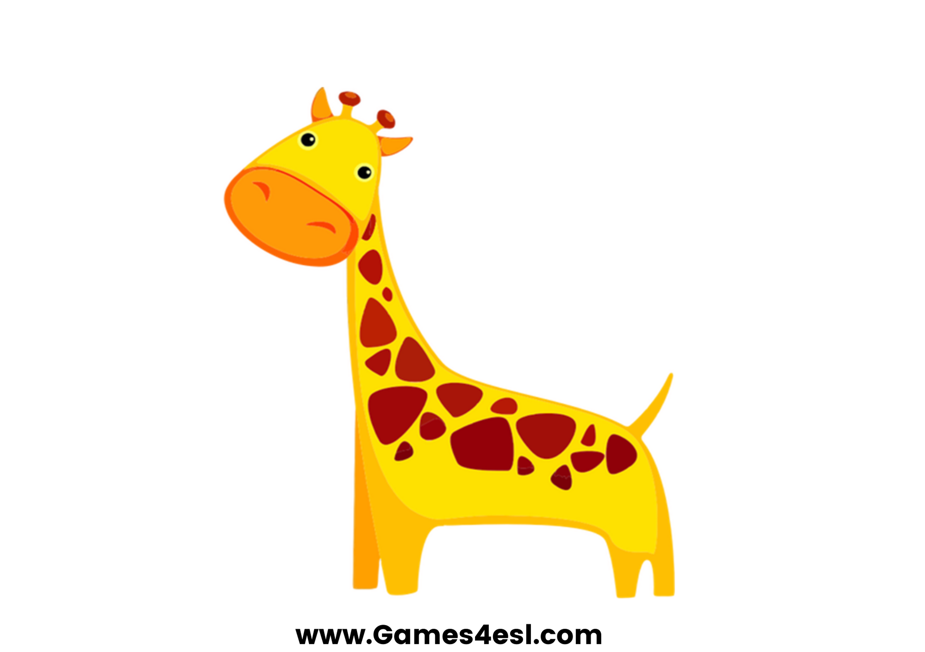
giraffe
SHOW

Slide 8
dog
SHOW

