Slide 1
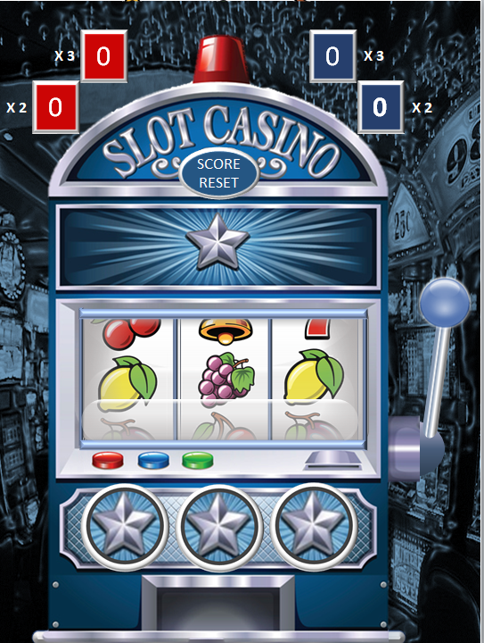
Click on the handle to start
Score 10 for
X3 matching
symbols
Score 2 for X2 matching symbols
FIRST TO 20
WINS!
Double -click on the circles to stop the spin
Click on ‘SCORE RESET’ to start a new game

Slide 2
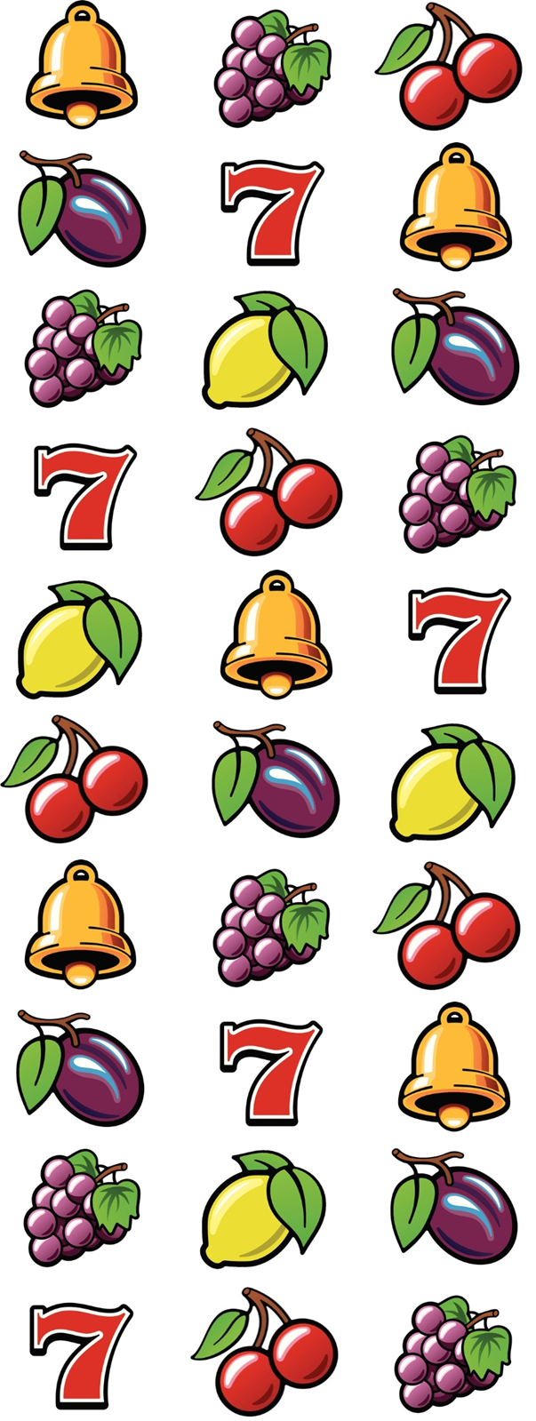
20
10
0
20
10
X 3
0
X 3
20
18
16
14
12
10
8
6
4
2
0
20
18
16
14
12
10
8
6
4
2
X 2
0
X 2
SCORE RESET
BACK

