Slide 1
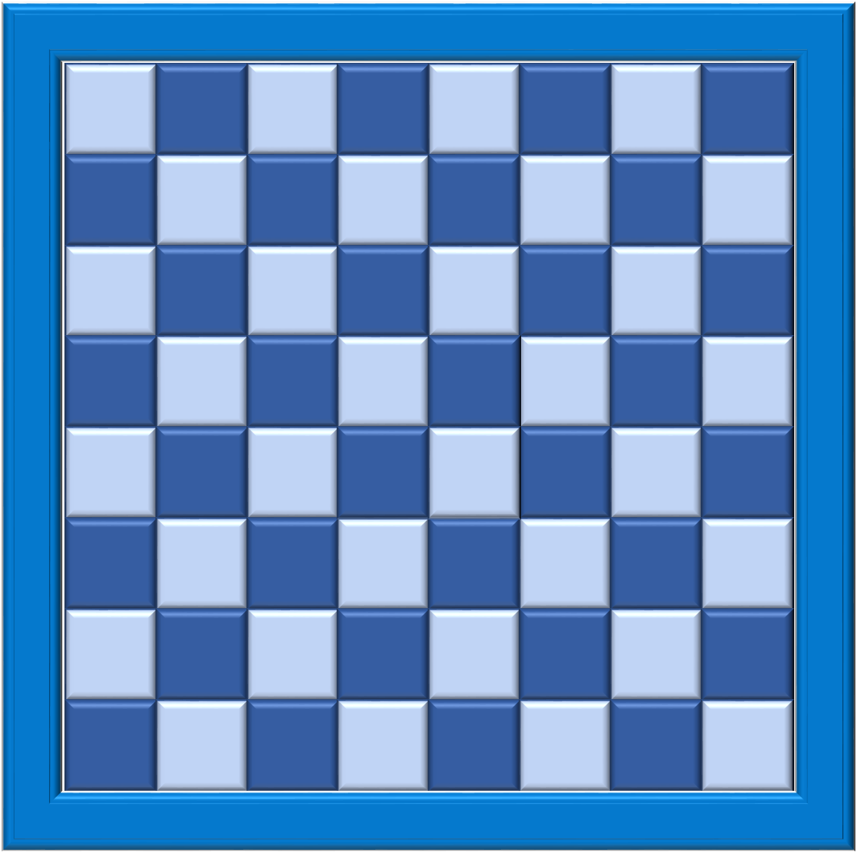
Players take turns to click on a block and connect their colours. They must connect squarely, not diagonally.
A game for two players.
Players choose either light or dark blue blocks to play.
Aim: to be first player to connect their coloured blocks from top to bottom or side to side across the board.
When the light blue player clicks on a dark blue block, it will change into a light blue block – and vice versa.
Click on the two blocks below to see.
A
B
C
D
E
F
G
H
1
1
2
2
3
3
4
4
Note: once a block’s colour has changed, it will not be reversed if clicked again.
5
5
6
6
7
7
8
8
Click to play the 64 or 100 square game.
A
B
C
D
E
F
G
H
64
100
Use your skill to make your connections and block your opponent from making theirs.
Play can start from any block on the board.
Visit: www.powerpointgames.uk

Slide 2
A
B
C
D
E
F
G
H
Esc
1
1
Click on the Esc button to exit and re-open for another game. or
click on the arrow for the 100 square game
2
2
3
3
100
4
4
Player
Player
5
5
6
6
Click on
Click on
7
7
8
8
To make
To make
A
B
C
D
E
F
G
H
Visit: www.powerpointgames.uk

Slide 3
A
B
C
D
E
F
G
H
I
J
Esc
1
1
Click on the Esc button to exit and re-open for another game
or
click on the arrow to go back to the 64 square game
2
2
3
3
64
4
4
Player
5
5
Player
6
6
7
7
Click on
8
8
Click on
9
9
10
10
To make
To make
A
B
C
D
E
F
G
H
I
J
Visit: www.powerpointgames.uk

