Slide 1
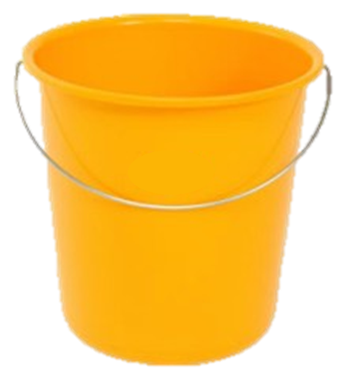
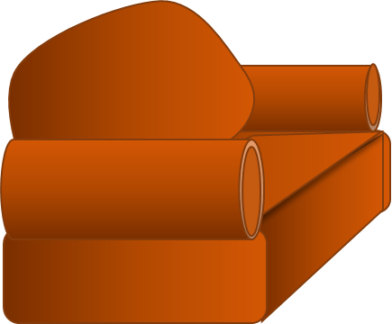
Oh No! the bath’s overflowing.
Quick – click here to grab the bucket and catch the drips while I go and turn off the water.

Slide 2
Turned off now.
Did you catch all the drips?

