Slide 1
Basic English conversation

Slide 2

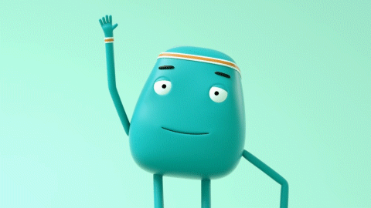
Hello!
Hi!

Slide 3
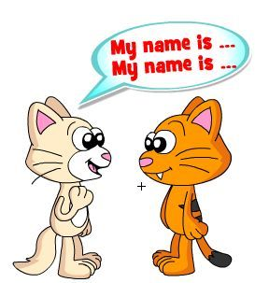
What's your name?
My name is...

Slide 4
https://www.youtube.com/watch?v=zMdq9jSaNLg

Slide 5
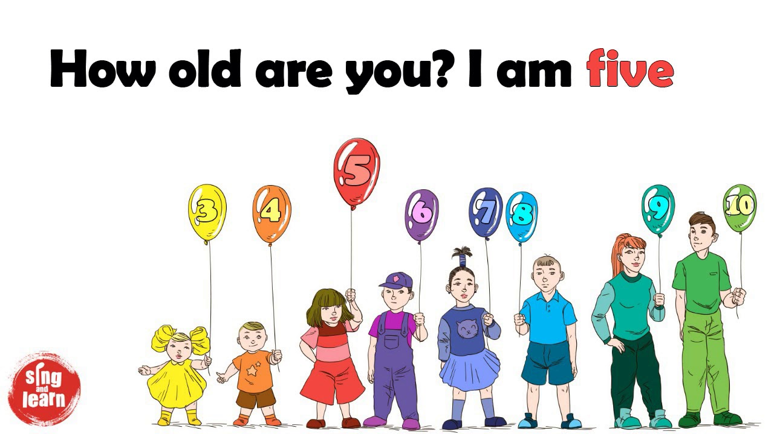
How old are you?
I am..... years old.

Slide 6

How are you?
I am......

Slide 7
https://www.youtube.com/watch?v=j1QBY35LdfA

Slide 8

Where are you from?
I am from ..............

Slide 9
https://www.youtube.com/watch?v=l6A2EFkjXq4

Slide 10
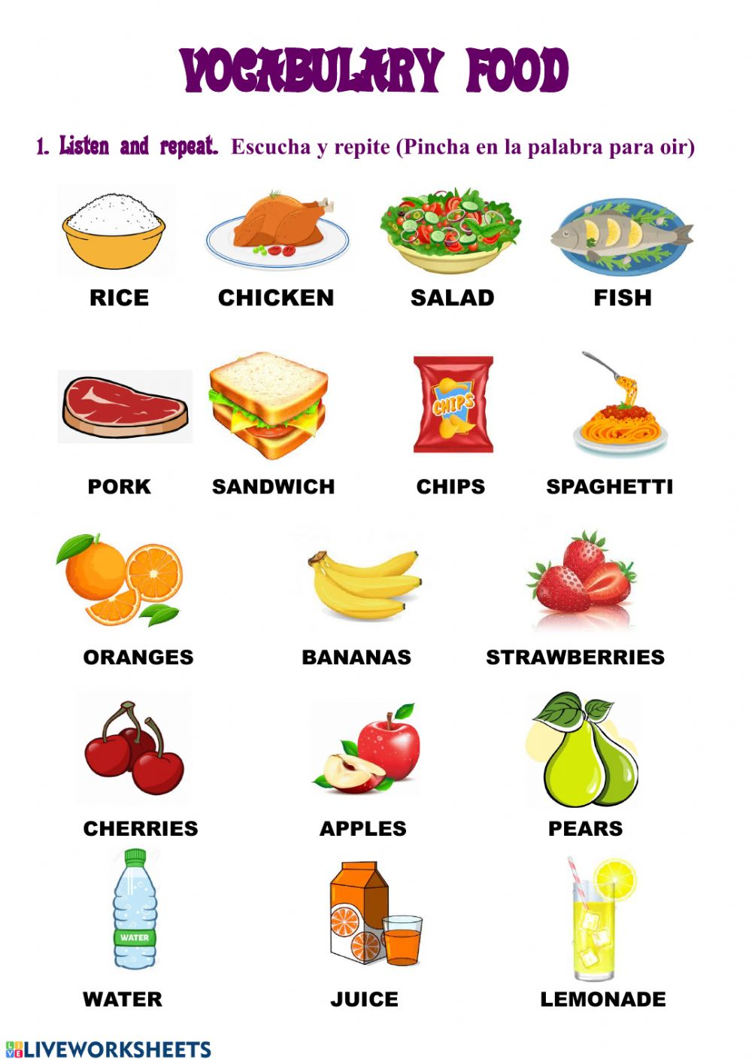
What do you like to eat?
I like to eat..............

Slide 11
https://www.youtube.com/watch?v=yUw3-im44qY

Slide 12
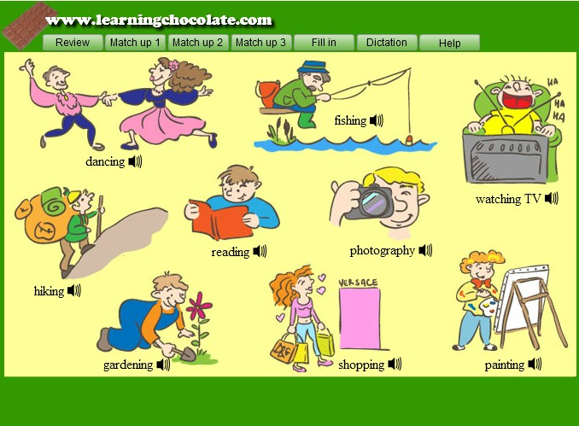
What do you like to do?
I like ..............

Slide 13
https://www.youtube.com/watch?v=nddRGDEKxA0

Slide 14
What do you like to do?
https://www.learningchocolate.com/content/hobbies-1
I like ..............

Slide 15

It was nice to meet you. Goodbye!
Nice to meet you too. Goodbye!

