Slide 1
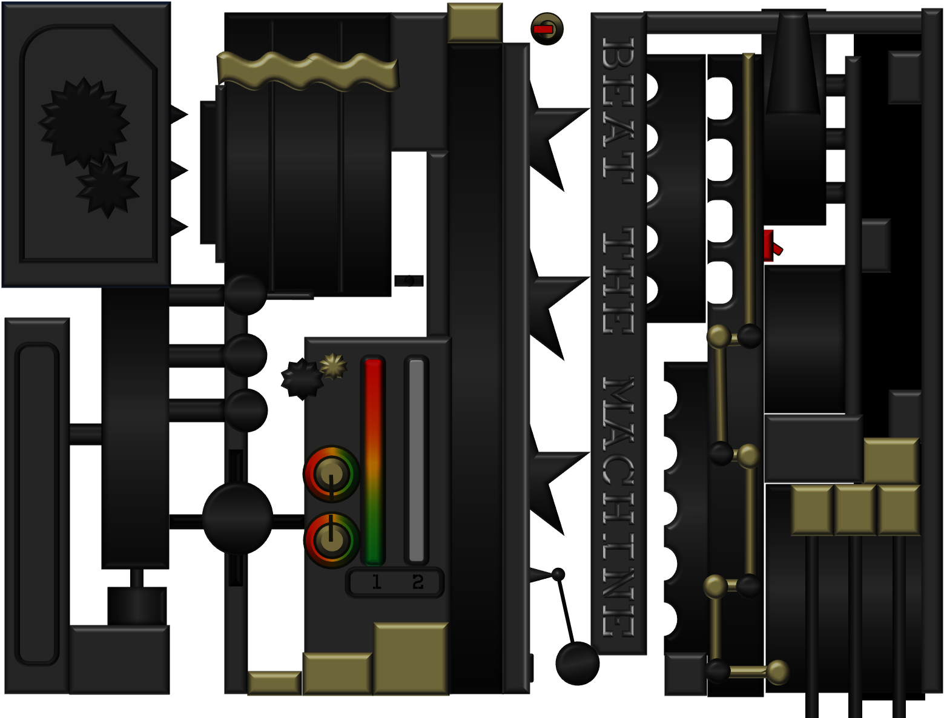

Slide 2
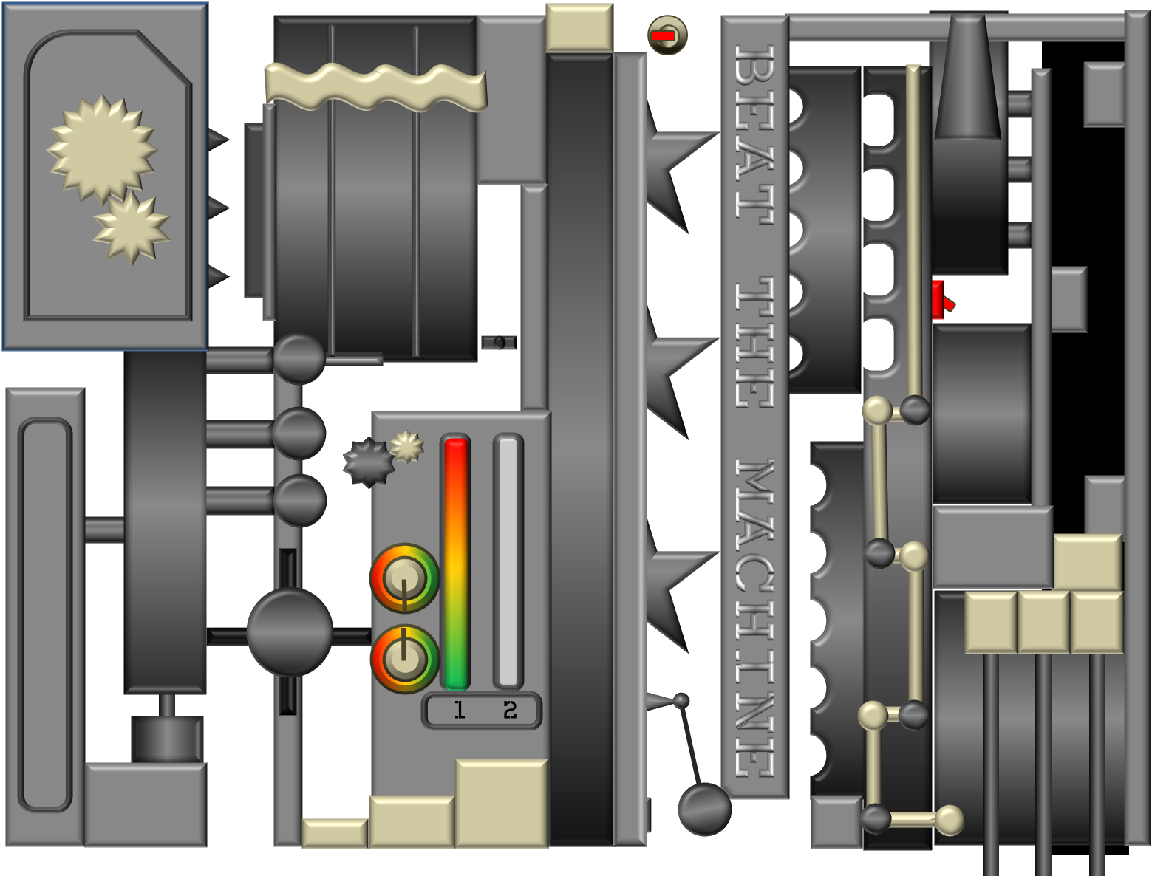
START

Slide 3
1
2

Slide 4
TRY AGAIN?

Slide 5
START 2

Slide 6
\\\\
1
2

Slide 7
TRY AGAIN?

Slide 8
Press ‘Esc’ to exit

