Slide 1
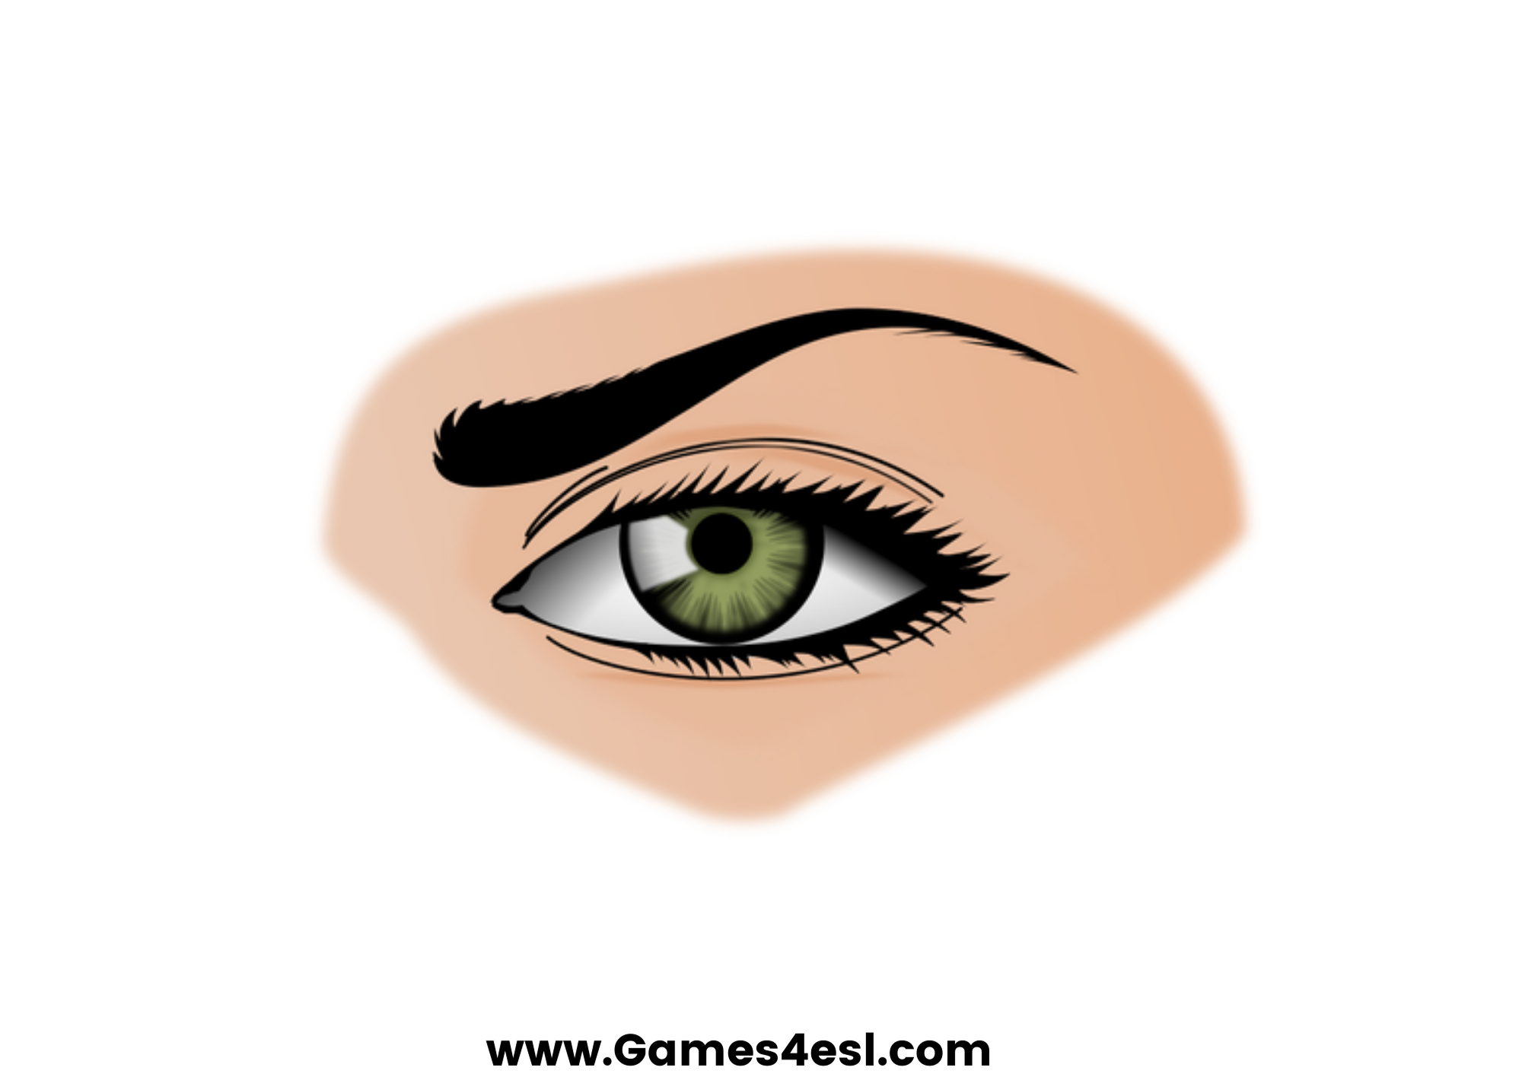
eye
SHOW

Slide 2
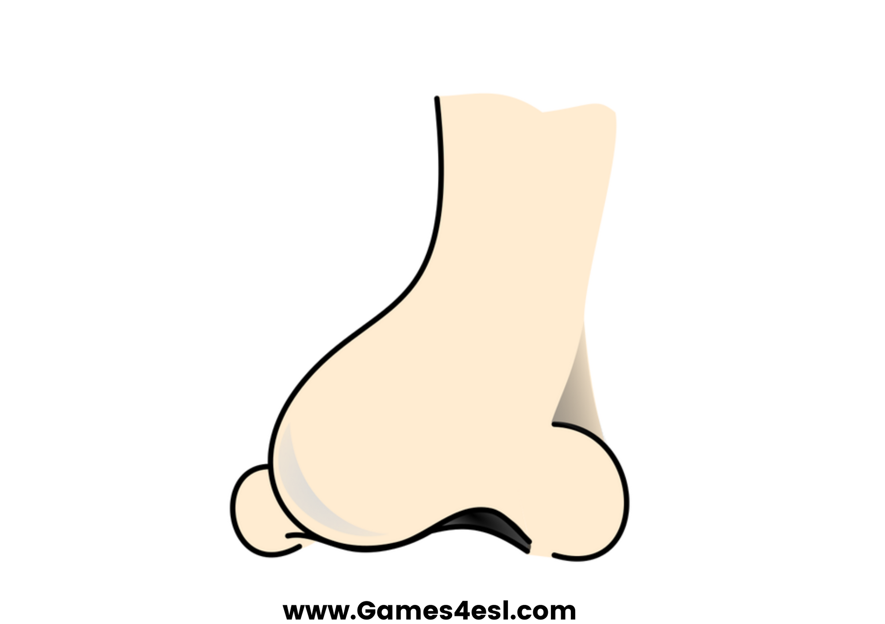
nose
SHOW

Slide 3
ear
SHOW

Slide 4
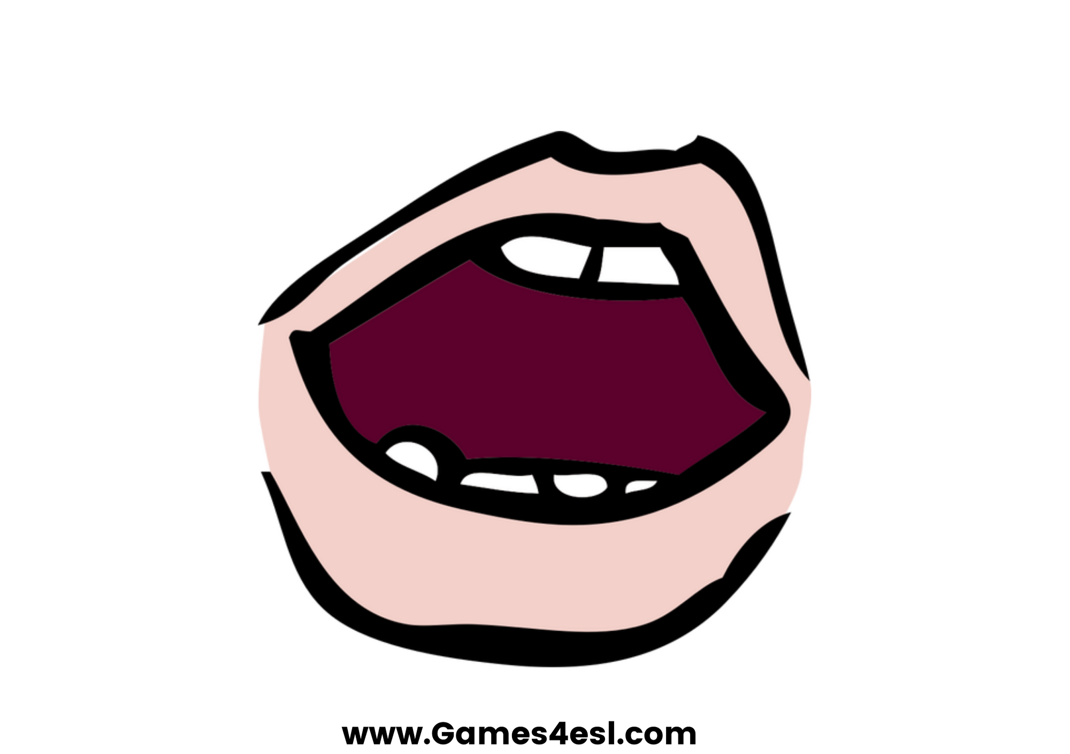
mouth
SHOW

Slide 5
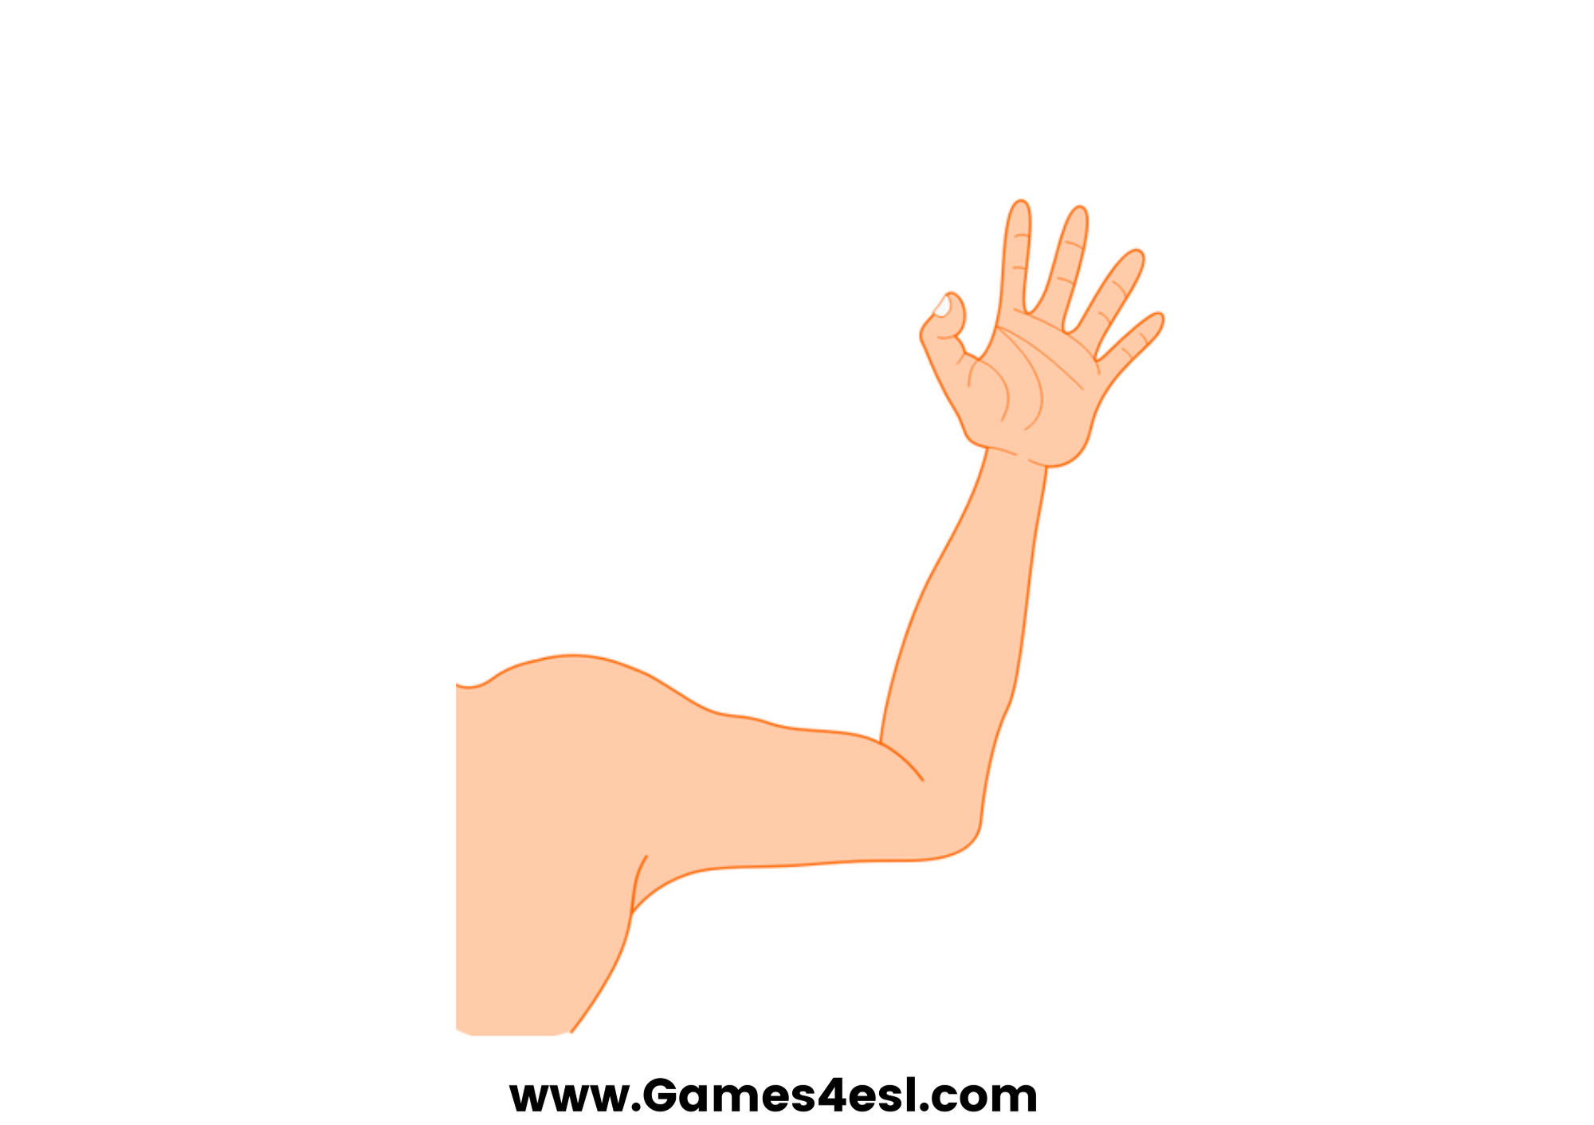
arm
SHOW

Slide 6
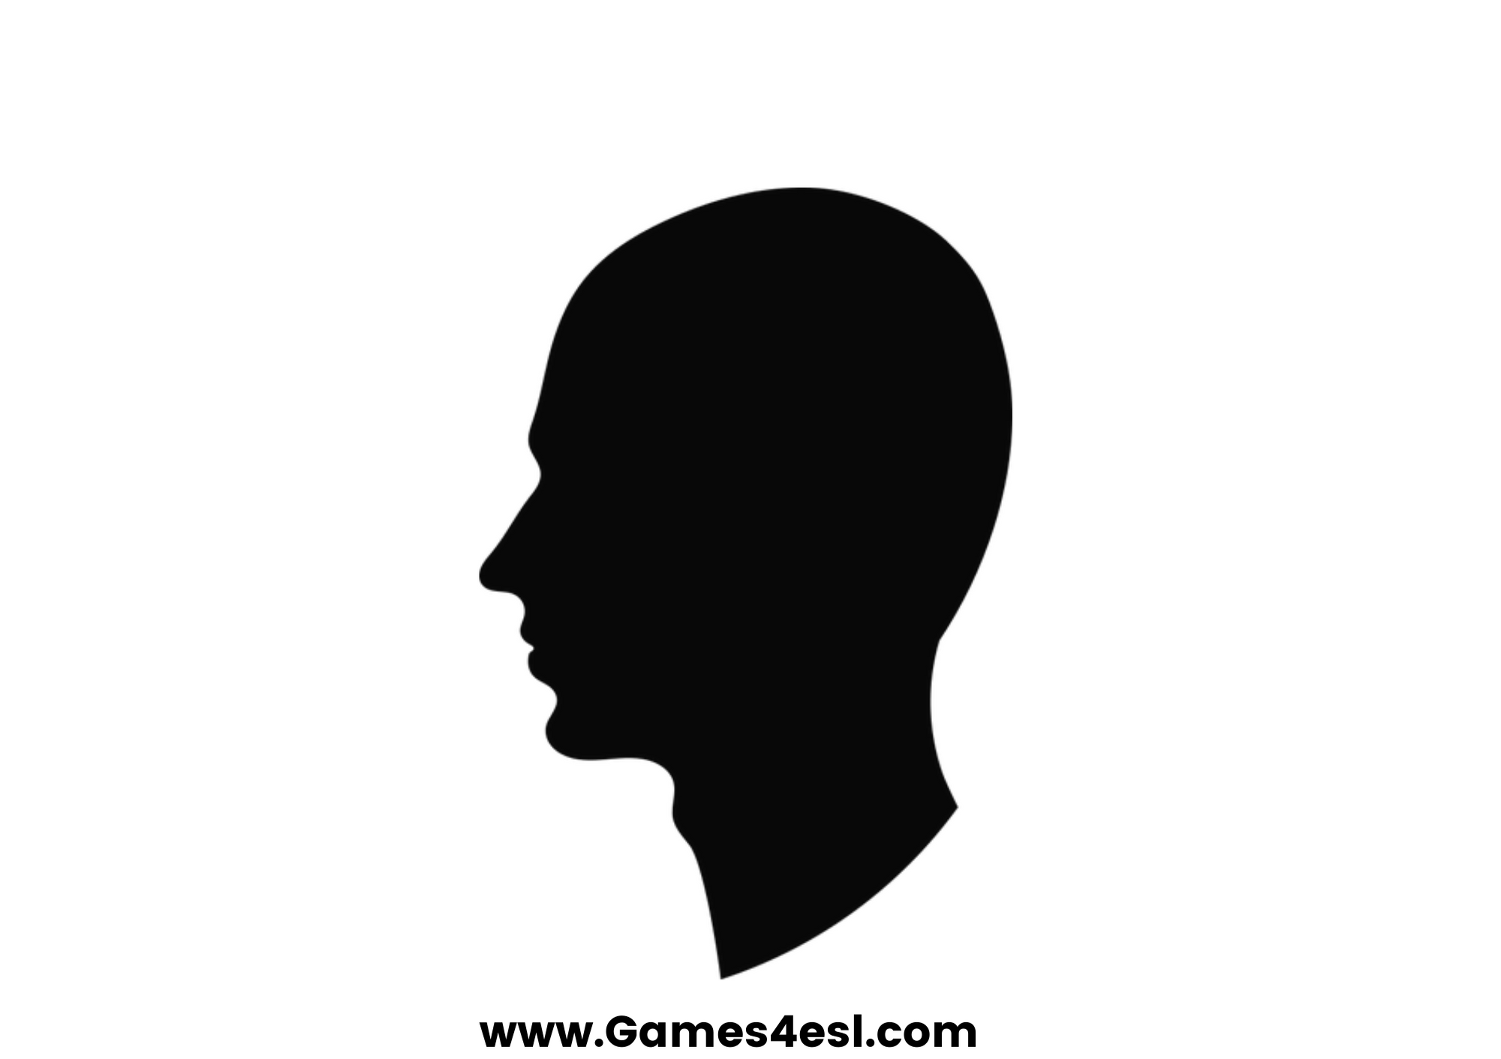
head
SHOW

Slide 7
leg
SHOW

Slide 8
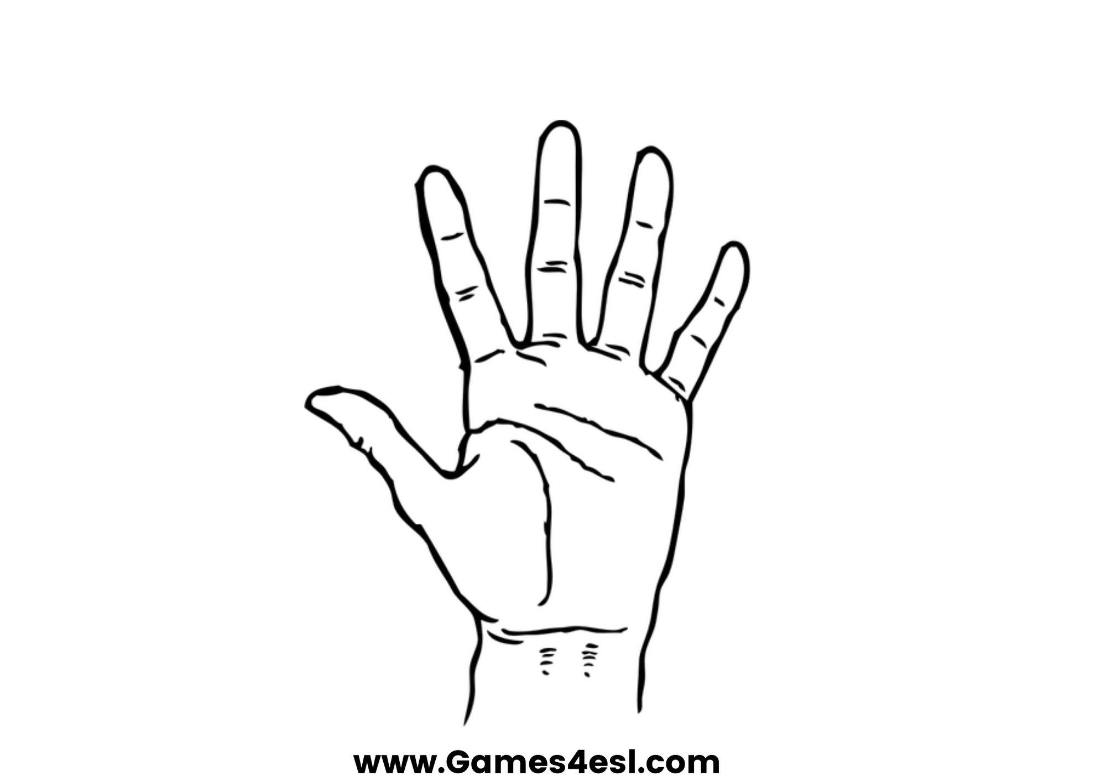
hand
SHOW

