Slide 1
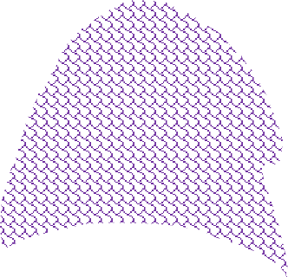
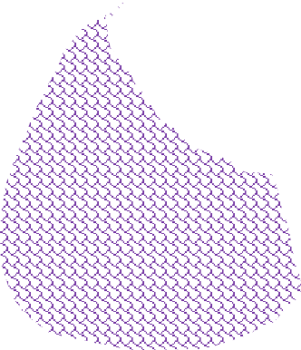
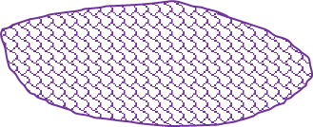
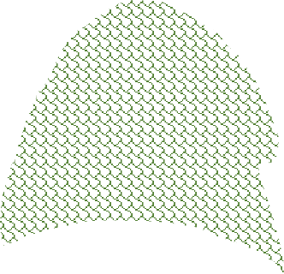
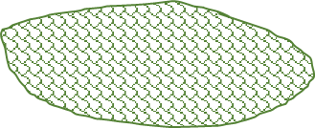
CATABALL
3
1
1
2
3
4
2
PLAY

Slide 2
SURVIVAL
CATABALL
5
3
1
1
4
2
3
4
5
0
2
0

Slide 3
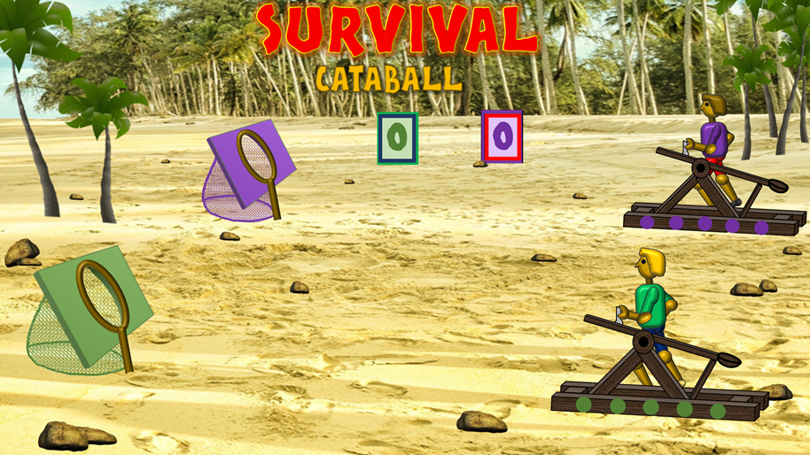
INSTRUCTIONS:
AIM: TO BE THE FIRST TEAM TO GET 5 BALLS INTO THEIR NET.
1. ESTABLISH GREEN / PURPLE TEAMS & WHO GOES FIRST
3. IF ANSWER CORRECT, CLICK ON A COLOURED BALL
2. ASK A QUESTION
4. IF ANSWER INCORRECT, CLICK ON THE AREA BELOW A COLOURED BALL
Click for Survival theme and cheering
5. USE SCOREBOARDS TO SHOW A POINT AFTER EACH CORRECTLY ANSWERED QUESTION
OR
WHEN A TEAM GETS 5 BALLS IN THE NET
(5 CORRECTLY ANSWERED QUESTIONS) THEN RESET FOR ANOTHER ROUND
Click to reset for a new round

