Slide 1
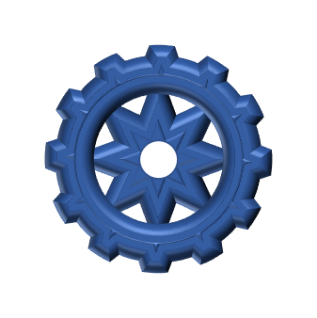
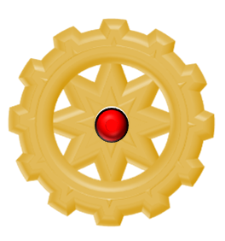
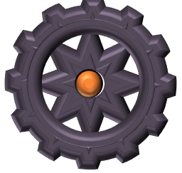
COGWORKS
START
THE GAME IS TO CONNECT THE MOTOR COG TO THE CONVEYOR BELT COGS BY LINKING ALL THE OTHER COGS. LINK THEM TO WHERE THE LIGHTS ARE PULSING.
IN ‘SLIDE SHOW’ MODE, CLICK ON ‘START’ ABOVE TO SEE THE FIRST PLAYING SLIDE AND THE SPIN OF THE COGS
CLICK ON THE ‘REPOSITION COGS’ BUTTON TO SELECT AND MOVE THE COGS
CLICK ON ‘SLIDE SHOW TAB > FROM CURRENT SLIDE’ TO SEE THE COGS IN MOTION AGAIN
(THERE IS A POSSIBLE SOLUTION TO VIEW IF REQUIRED)
MOTOR COG
ALL COGS MUST BE USED
EACH COG MUST TURN ONE OTHER COG ONLY
THE MOTOR COG CANNOT BE MOVED
COGS CANNOT BE RESIZED
COGS CAN BE ROTATED
STOP WHEN YOU ARE SATISFIED THAT THE COGS ARE ACCURATELY LINKED AND MOVE ON VIA THE ‘NEXT’ BUTTON

Slide 2
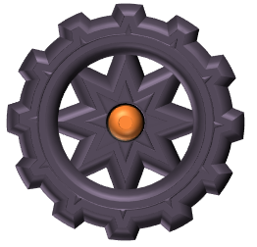
GAME 1
REPOSITION COGS
POSSIBLE SOLUTION
NEXT GAME

Slide 3
GAME 2
POSSIBLE SOLUTION
NEXT GAME
REPOSITION COGS

Slide 4
GAME 3
REPOSITION COGS
POSSIBLE SOLUTION
NEXT GAME

Slide 5
GAME 4
REPOSITION COGS
POSSIBLE SOLUTION
NEXT GAME

Slide 6
GAME 5
POSSIBLE SOLUTION
NEXT GAME
REPOSITION COGS

Slide 7
GAME 6
POSSIBLE SOLUTION
REPOSITION COGS
NEXT GAME

Slide 8
GAME 7
POSSIBLE SOLUTION
NEXT GAME
REPOSITION COGS

Slide 9
GAME 8
REPOSITION COGS
POSSIBLE SOLUTION
NEXT GAME

Slide 10
GAME 1
BACK

Slide 11
GAME 2
BACK

Slide 12
GAME 3
BACK

Slide 13
GAME 4
BACK

Slide 14
GAME 5
BACK

Slide 15
GAME 6
BACK

Slide 16
GAME 7
BACK

Slide 17
GAME 8
BACK

