Slide 1
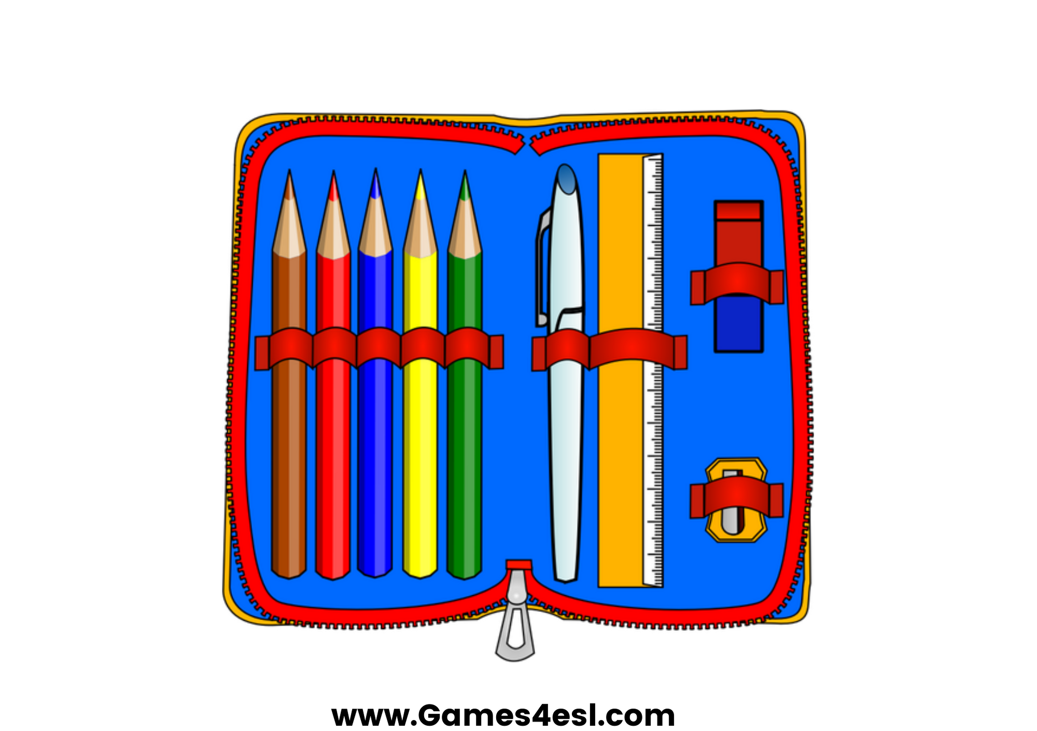
pencil case
SHOW

Slide 2
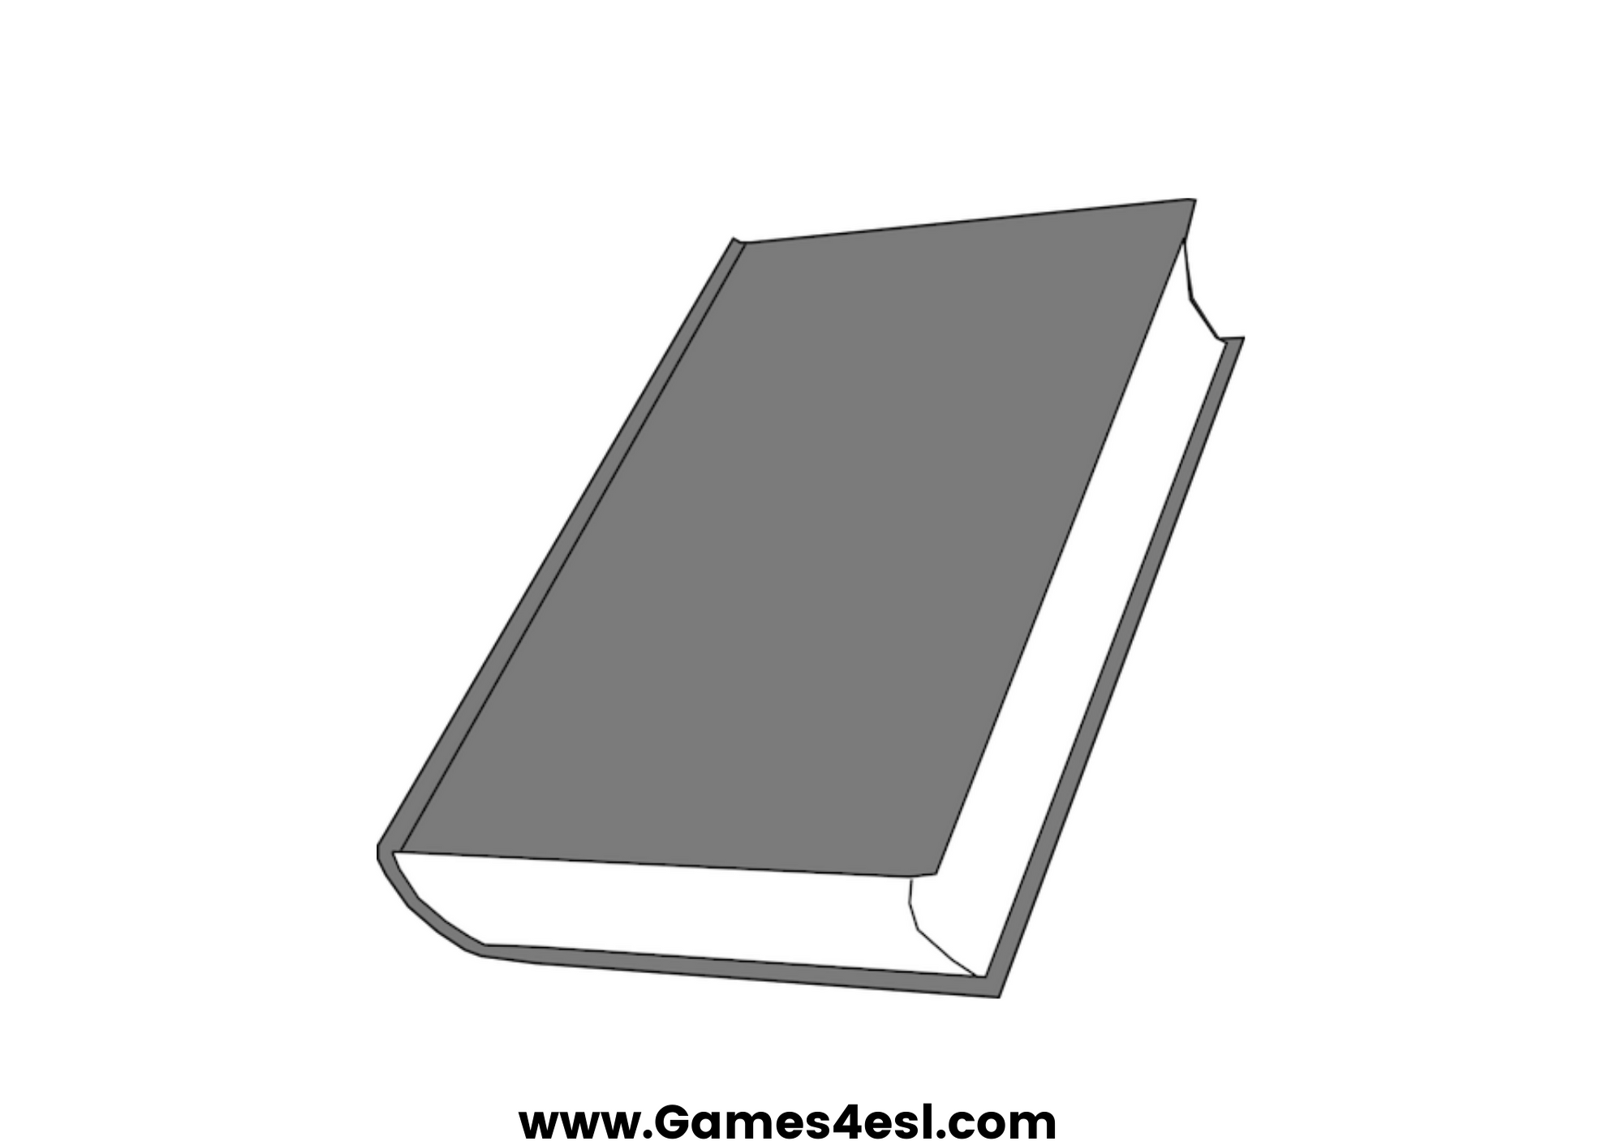
book
SHOW

Slide 3
glue
SHOW

Slide 4
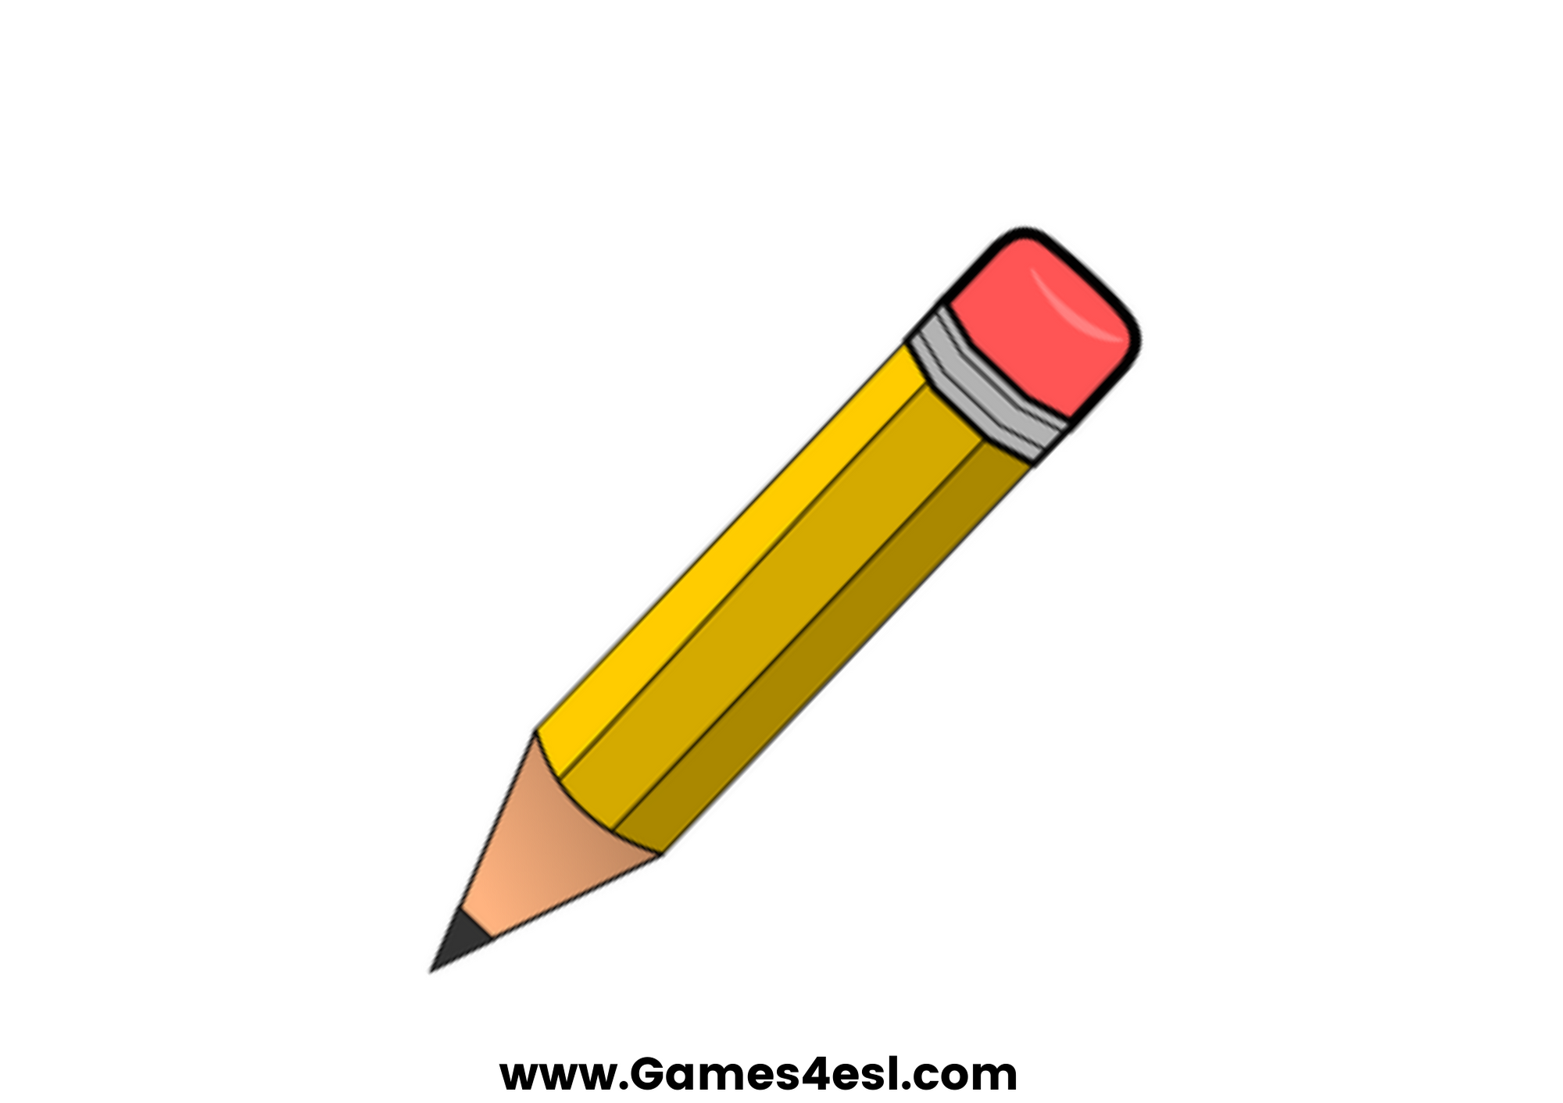
pencil
SHOW

Slide 5
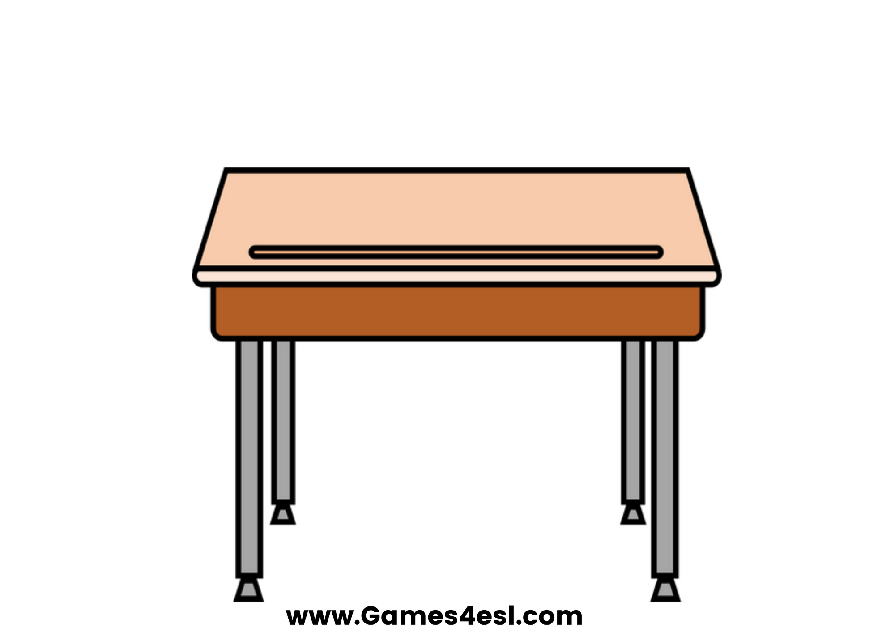
desk
SHOW

Slide 6
scissors
SHOW

Slide 7
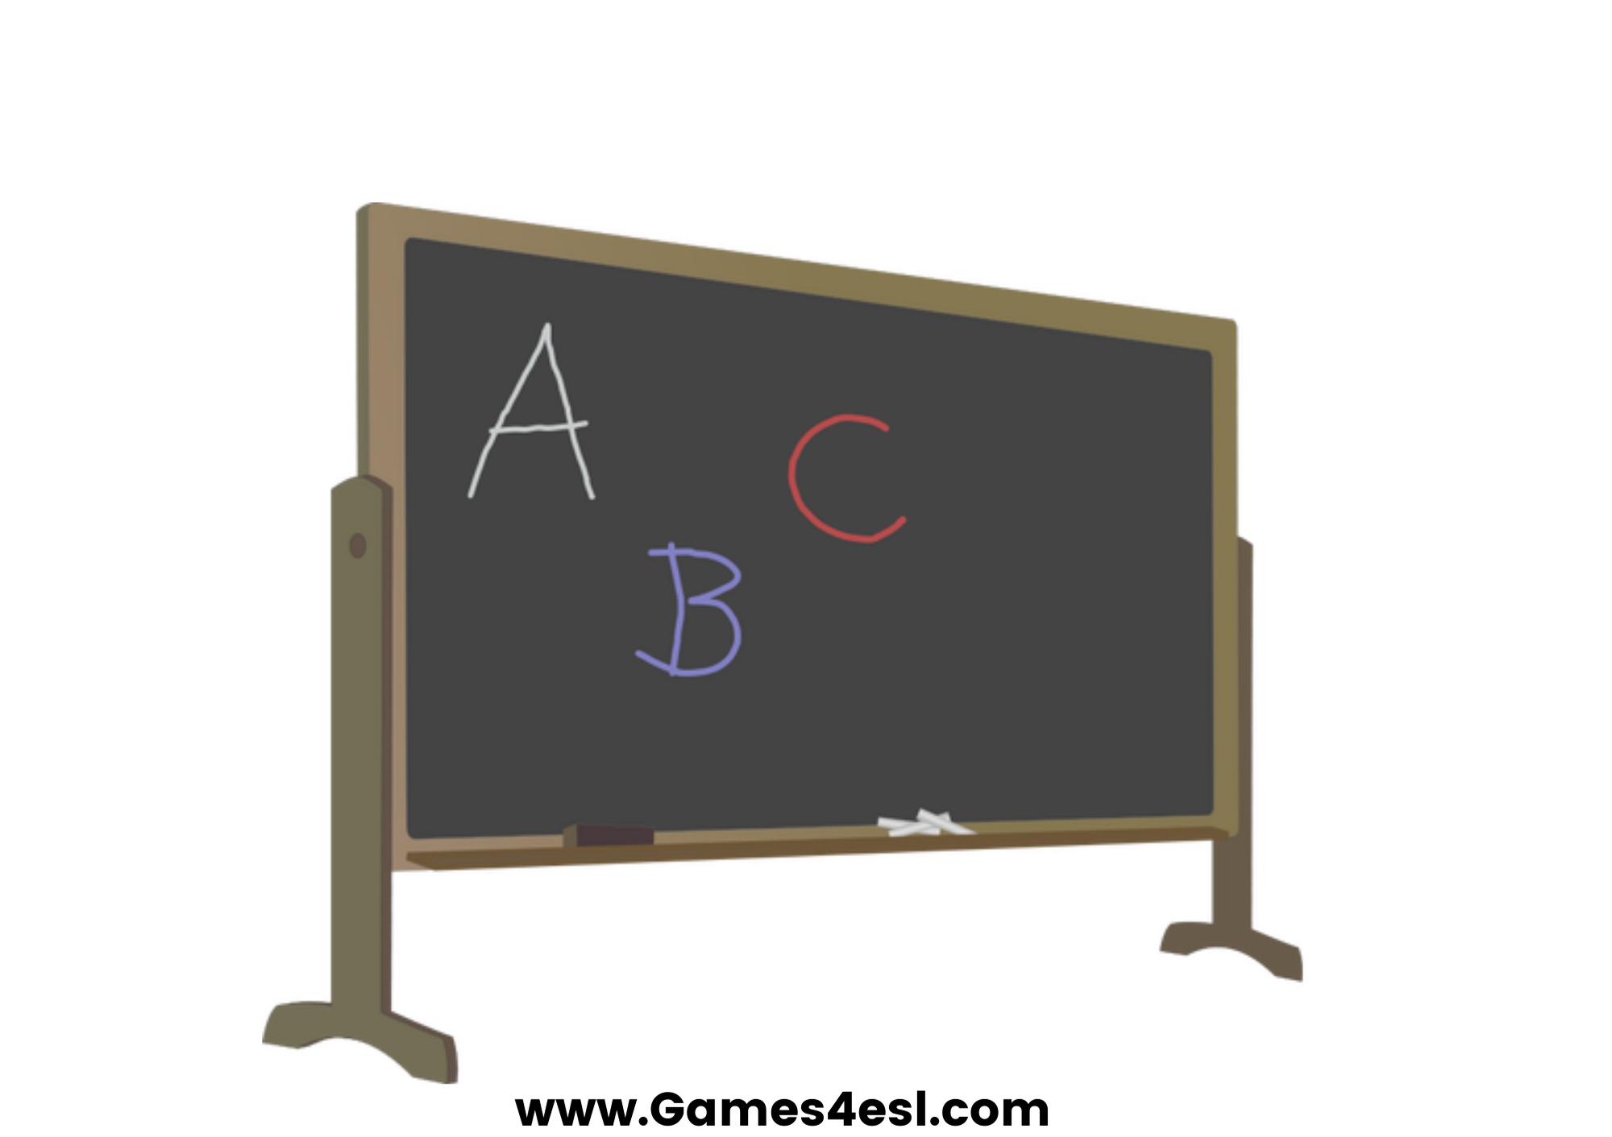
board
SHOW

Slide 8
chair
SHOW

