Slide 1
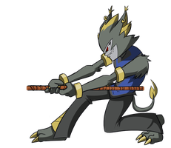
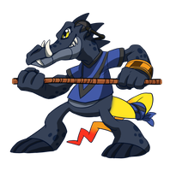
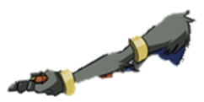
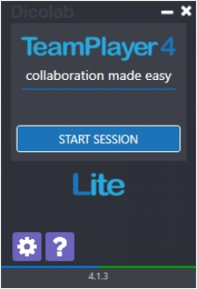
CLICK O’WAR
INTRODUCTION
TO PLAY THIS GAME YOU WILL NEED TWO MICE THAT WORK INDEPENDENTLY SO THAT EACH PLAYER HAS THEIR OWN CURSOR. YOU CAN DOWNLOAD FREE ‘TEAM PLAYER 4 LITE’ SOFTWARE FROM THE LINK ON THE RIGHT OR BELOW TO ENABLE THIS .
ONCE YOU GET TO THE COUNTDOWN SCREEN YOU WILL HAVE 5 SECONDS FOR EACH PLAYER TO POSITION THEIR CURSOR OVER THEIR CHOSEN CONTESTANT, THEN START CLICKING TO TRY AND PULL THEIR OPPONENT OVER THE EDGE OF THE CLIFF.
START SCREEN
http://download.cnet.com/TeamPlayer4-Lite/3000-2654_4-76476280.html

Slide 2
CLICK O’WAR
START COUNTDOWN

Slide 3
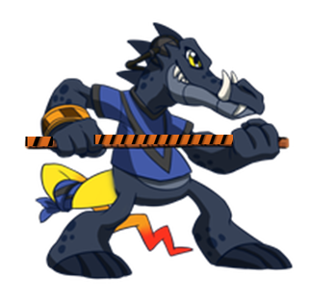
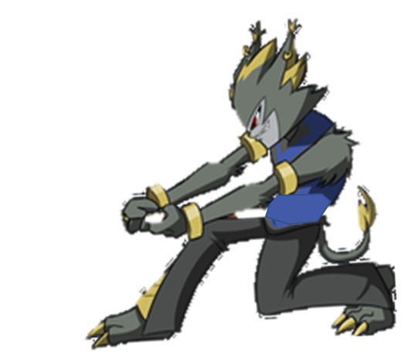
WINNER!
LOSER!

Slide 22
CURSORS ON FIGURES
5
4
2
3
1
CLICK!

Slide 41
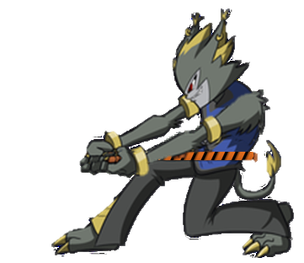
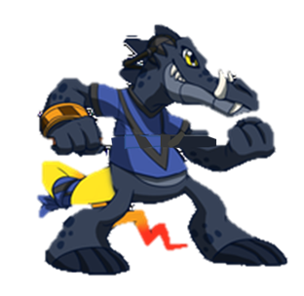
LOSER!
WINNER!

