Slide 1

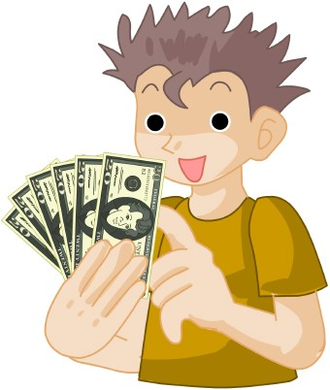
Who wants to win millions?
Hundred Dollar Questions

Slide 2
Clothes
Likes/Dislikes
Likes/Dislikes 2
Time
Time 2
$50
$100
$100
$100
$2 00
$100
$200
$200
$200
$400
$150
$300
$300
$300
$600
$200
$400
$400
$400
$800

Slide 3
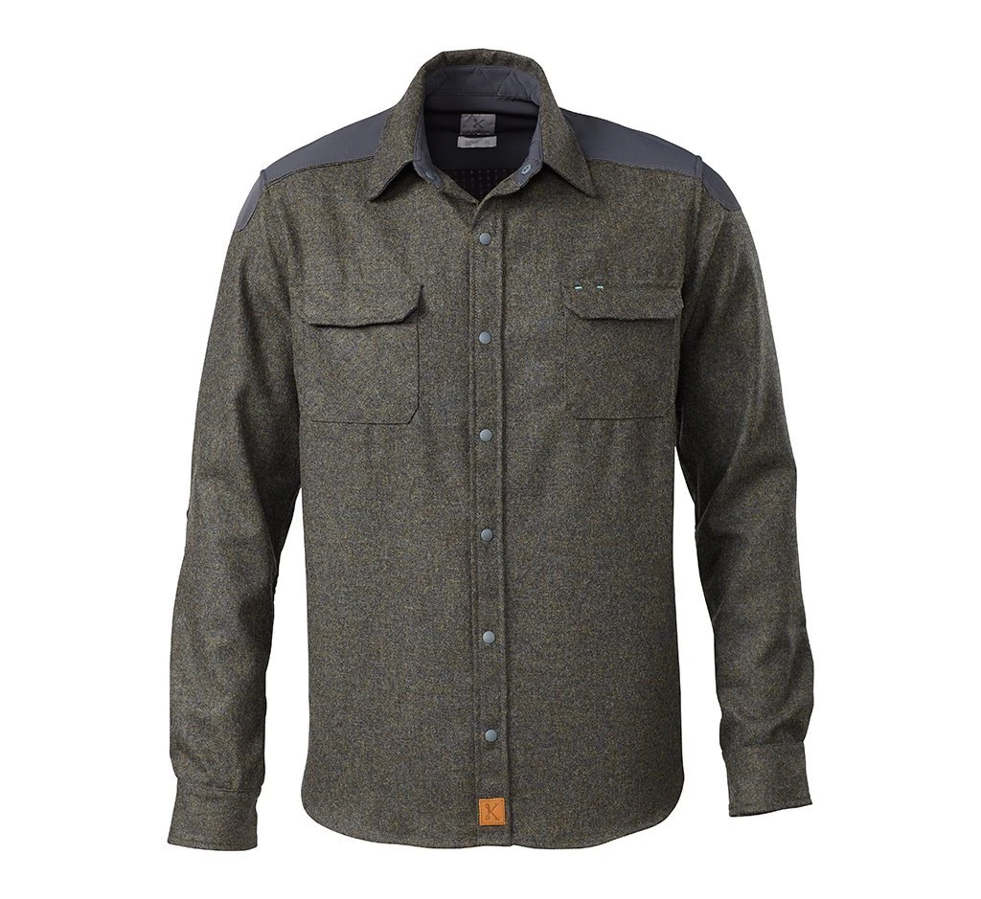
$50
What is it?

Slide 4
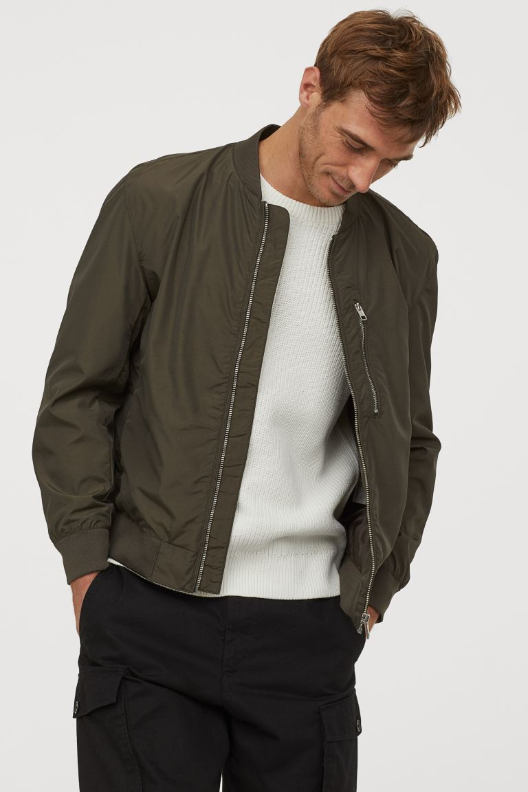
$100
What is he wearing?

Slide 5
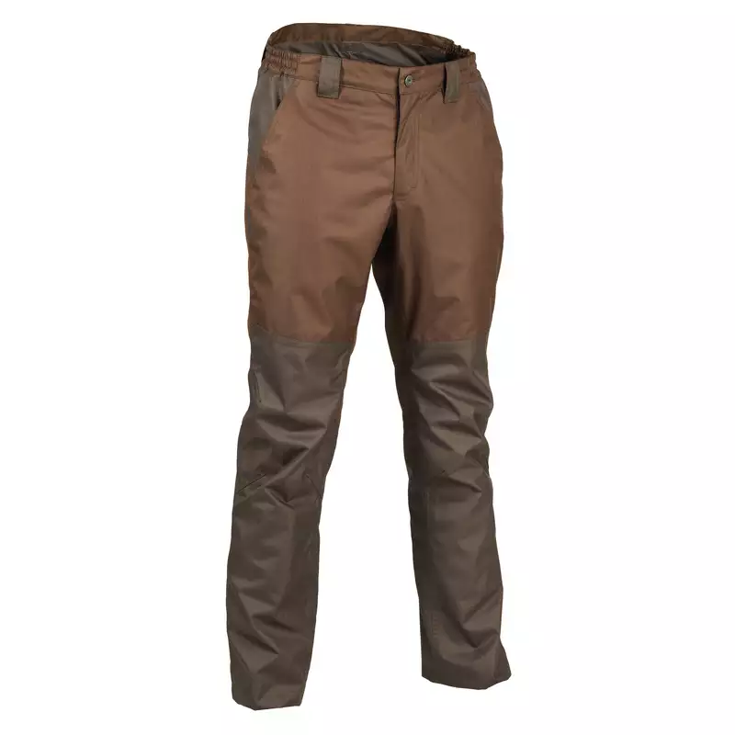
$150
What are they?

Slide 6
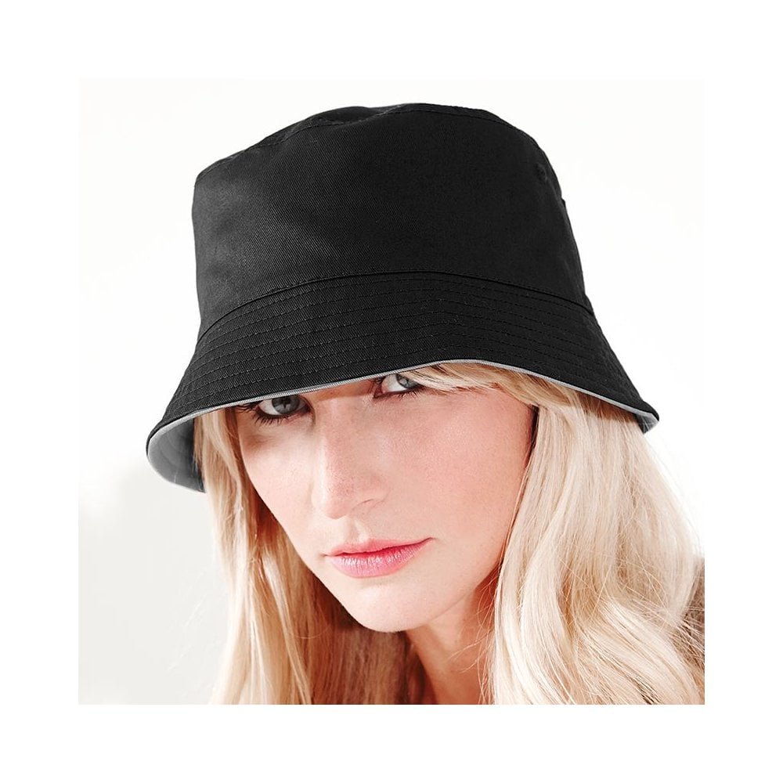
$200
What is she wearing?

Slide 7
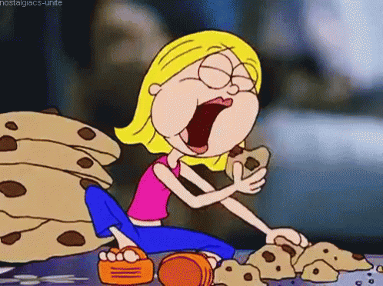
$100
Does she like cookies?

Slide 8
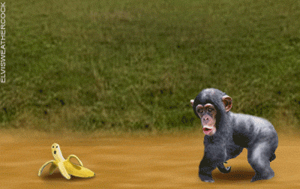
$200
Does the monkey like bananas?

Slide 9

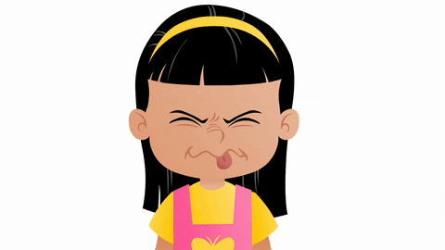
$300
Do the children like pickle yoghurt?

Slide 10
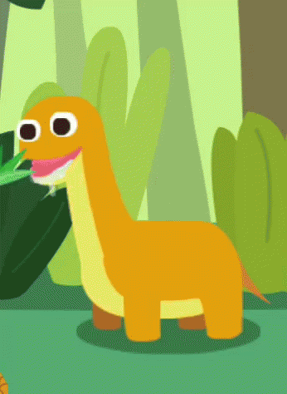
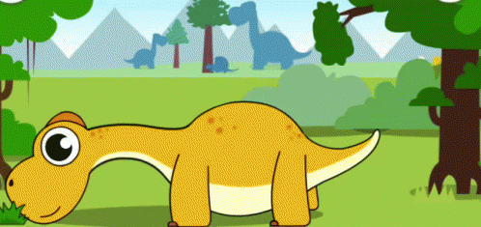
$400
Do dinosaurs like leaves and grass?

Slide 11
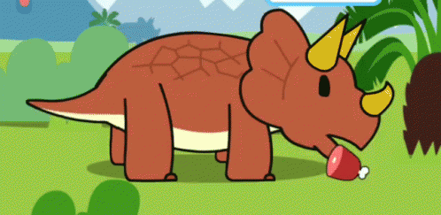
$100
Does the dinosaur like eating meat?

Slide 12
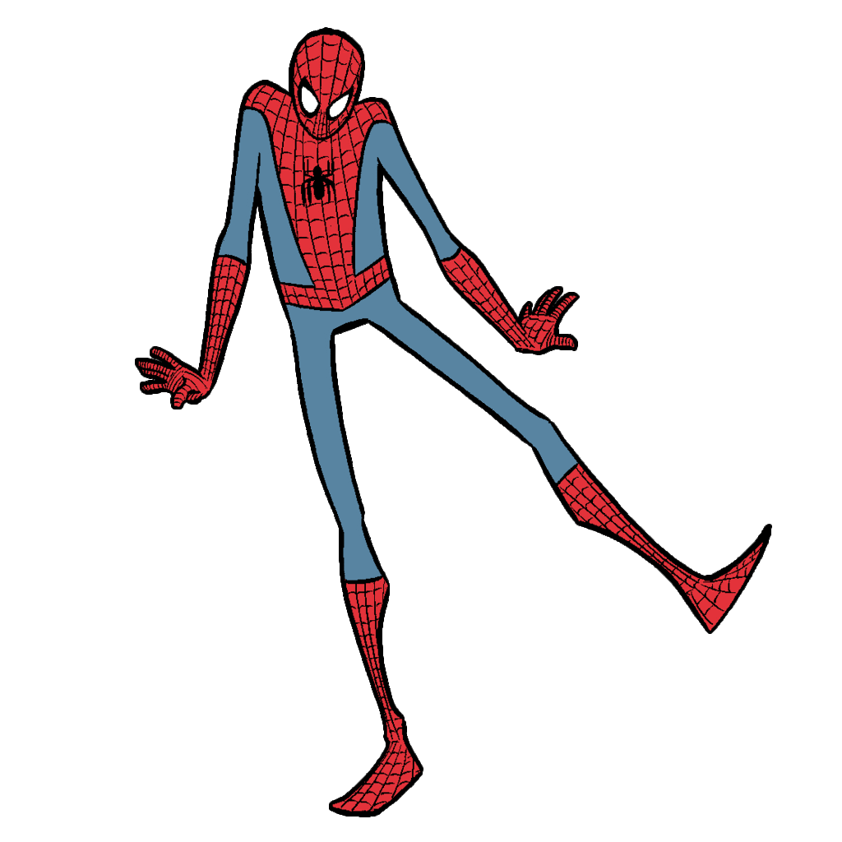
$200
Does Spiderman like dancing?

Slide 13
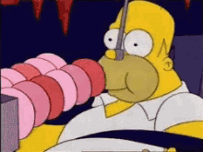
$300
Does he like eating doughnuts?

Slide 14
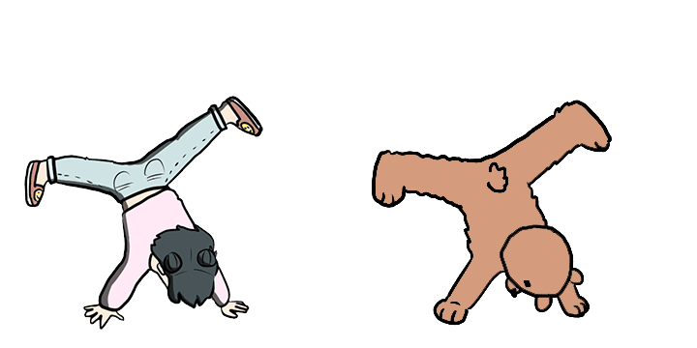
$400
Do they like dancing?

Slide 15

$100
What time is it?

Slide 16
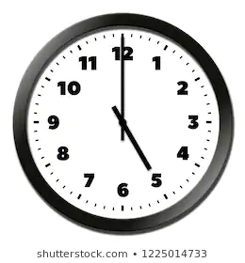
$200
What time is it?

Slide 17
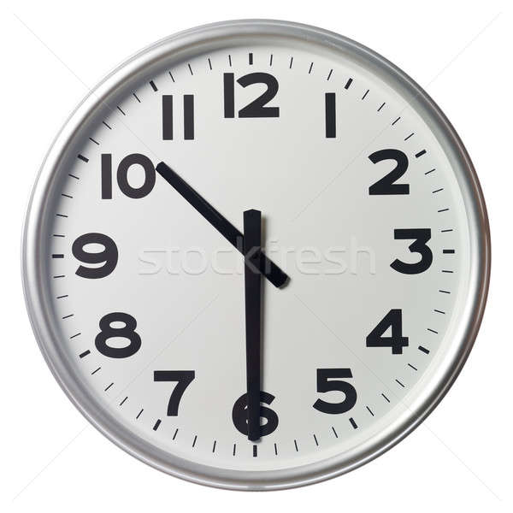
$300
What time is it?

Slide 18

$400
What time is it?

Slide 19

$200
What time is it?

Slide 20

$400
What time is it?

Slide 21

$600
What time is it?

Slide 22
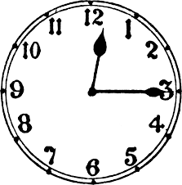
$800
What time is it?

