Slide 1
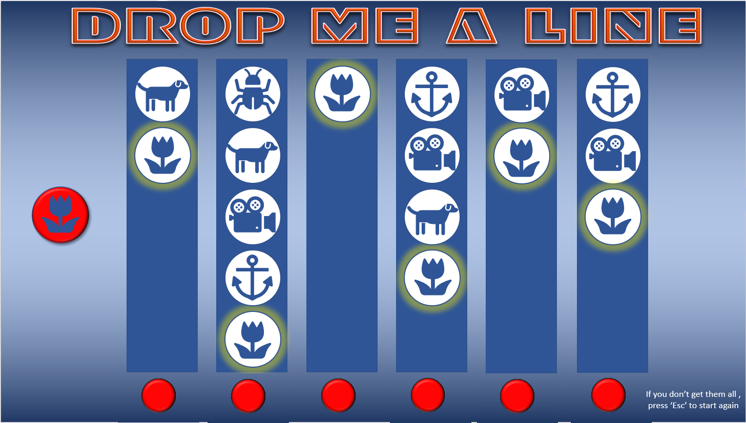
To play, all you have to do is click on a red button at the bottom of a column to start the descent of a ‘spotlight’.
When the spotlight shines on the icon that’s shown on the left, click on the red button at the bottom to stop it at that point.
Your aim is to end up with a line of matching icons across the page, with no other icons below them (like the flower icons highlighted here).
It starts off easy, but gradually……!!
START

Slide 2
START
START
START
START
START
START

Slide 3
START
START
START
START
START
START

Slide 4
START
START
START
START
START
START

Slide 5
START
START
START
START
START
START

